Slide 1
Arc Agent Installation

Slide 2
Prerequisites

Slide 3
On-prem Firewall configuration
https://management.azure.com
https://<region>.dp.kubernetesconfiguration.azure.com
https://login.microsoftonline.com
https://<region>.login.microsoft.com
login.windows.net
https://mcr.microsoft.com
https://*.data.mcr.microsoft.com
https://gbl.his.arc.azure.com
https://*.his.arc.azure.com
*.servicebus.windows.net
*.arc.azure.net
Notes:
https://management.azure.com
https://<region>.dp.kubernetesconfiguration.azure.com
https://login.microsoftonline.com
https://<region>.login.microsoft.com
login.windows.net
https://mcr.microsoft.com
https://*.data.mcr.microsoft.com
https://gbl.his.arc.azure.com
https://*.his.arc.azure.com
*.servicebus.windows.net
*.arc.azure.net

Slide 4
Add Single Server

Slide 5
Add Multiple Servers
Unattended installation on multiple servers

Slide 6
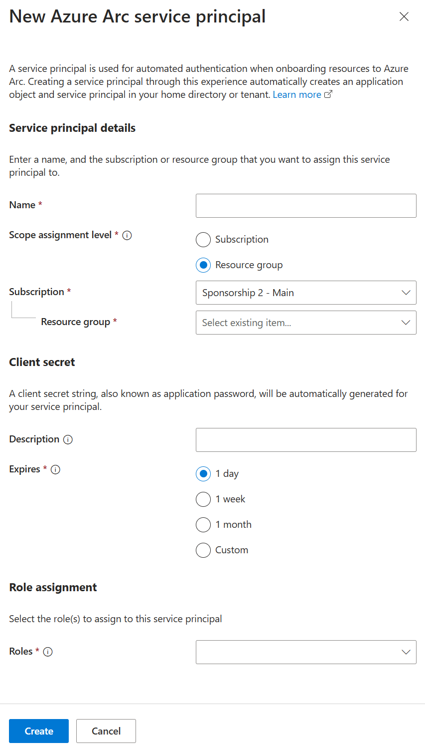
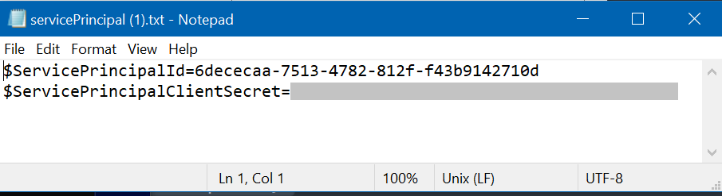
Add Multiple Servers
Arc -> Create -> Add Multiple Servers
Select Resource Group / Region
Create Service Principal
After Service Principal is created
Download Script

Slide 7
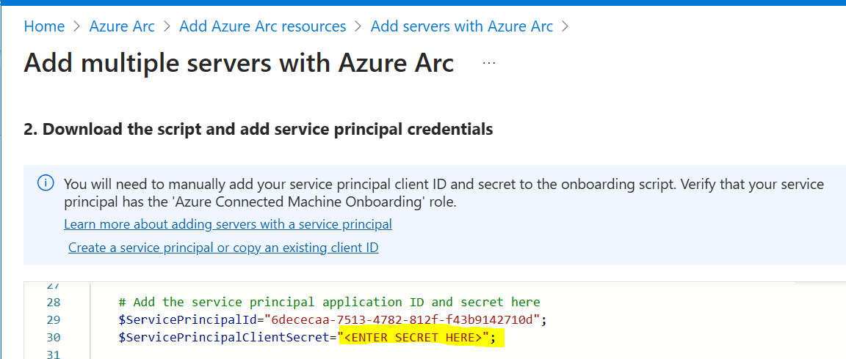
Add Multiple Servers #2
Edit Service Principal Secret in the script
Push script to multiple machines

