Slide 1
Citrix 2019 Migration Application Map
Peter Petersen

Slide 2
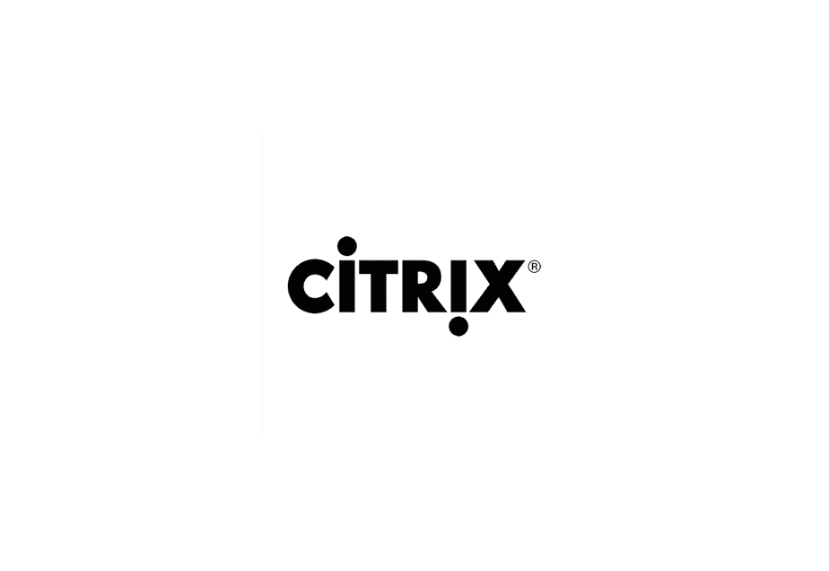
Context
What is Citrix?
Citrix at Fisher is a collection of 538 servers, that 4000 employee’s login into daily.
It is a virtual desktop that employees use to remotely access Fisher’s working environment.
Employee’s access Citrix through Citrix storefront via an application
or through Fishers website.

Slide 3
Context
Why Do We Need This App Map?
End of life for Citrix version 2016 executes in October, so our team must do a year's worth of server work in a couple of months.
Constructing blueprints on how we are going to migrate is critical, and has little room for error given our timeframe.
For network engineers making these connections between infrastructure and firewalls can be abstract, so visualization is invaluable.

Slide 4
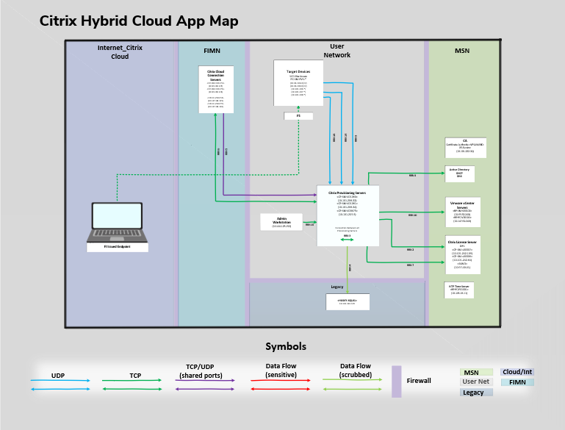
Protocols
UDP
Simpler and faster
Not the most reliable
TCP
Slower and less advanced
Very reliable
Firewall
Network security device

Slide 5
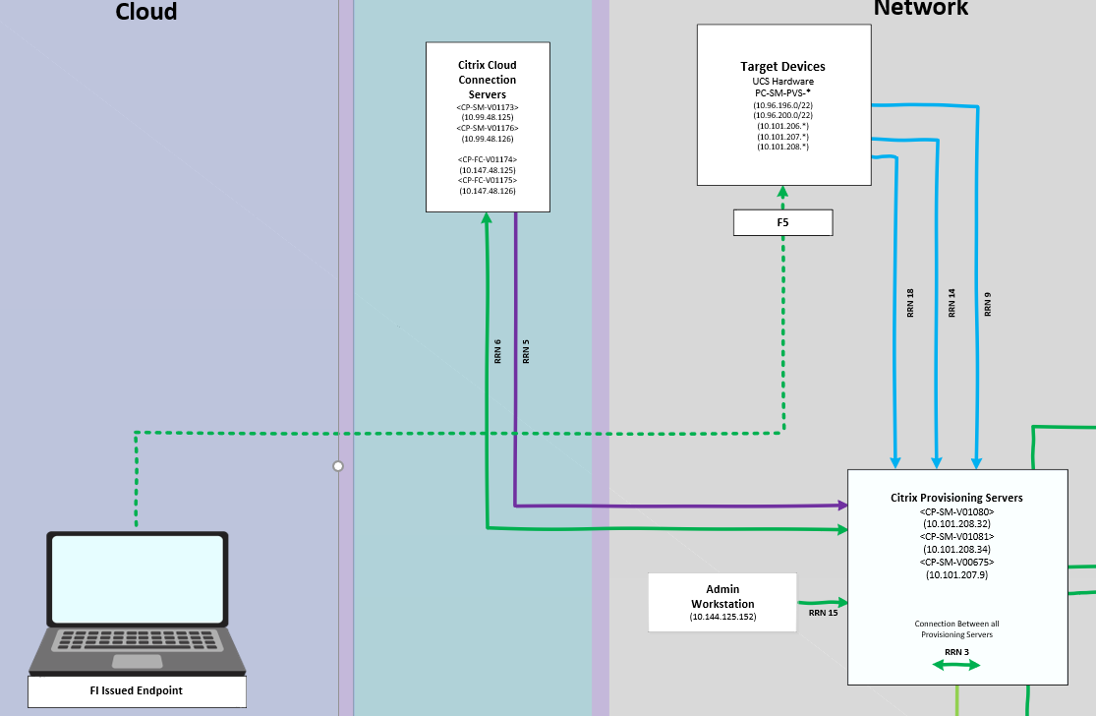
1st Stage
End User to Target Devices
The end user connects to Fisher’s F5 network either locally with WIFI or through a VPN.
Once connected to the F5, users can access the target devices (Citrix’s 538 Servers).
These target devices are not the virtual desktop’s themselves.

Slide 6
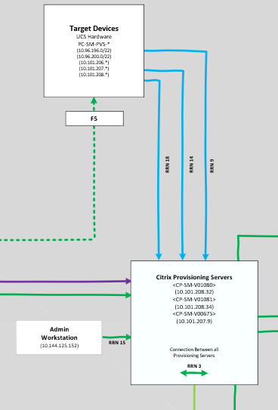
2nd Stage
Provisioning Servers
Each one of the 538 target devices house 1-8
virtual desktop servers.
These provisioning servers hold a virtual disk
that contains the C: Drive and OS.
That virtual disk is then streamed across our
network to a blank target device server
which is what the end user view’s when
logging in.

Slide 7
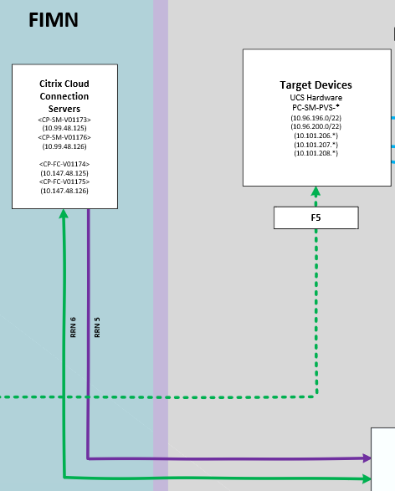
3rd Stage
Cloud Connectors
Controls who gets what desktop on Citrix storefront by connecting to a delivery controller.
This delivery controller is currently in our own network but we are moving it to the cloud.

Slide 8
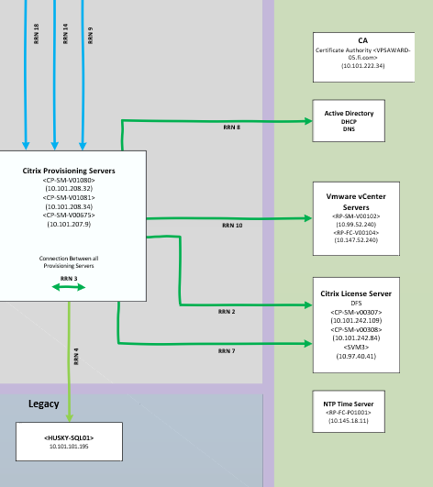
4th Stage
The Microsoft Network and Legacy
Controls authentication, IP addressing, and Licensing.
Legacy holds all of the configuration data that makes Fisher’s Citrix hypervisor unique.
All of these components work in tandem to present the end user a seamless virtual desktop experience

Slide 9
Challenges
It was a struggle to navigate Fisher’s current unorganized Citrix environment, let alone organize and design a migration with new infrastructure components.
Finding individual mac id’s and IP addresses for infrastructure took longer than expected because I had to develop PowerShell scripts and get read access.
This was the first 2019 Citrix Migration application map, so designing a map that could be digestible at all levels was delicate.

Slide 10
Outcomes & Findings
This application map has given the I/O group a migration timeframe estimate, and at our current rate we can finish this project around October.
This map helped identify the teams needed to migrate such as Network Security, Info Sec, Server Lifecycle, Group Policy Admin’s, Citrix Team, and Digital Workplace.
I was able to pioneer the way Visio application map’s are constructed and how they visualize information within my team.

Slide 11
Improvements
Moving to cloud servers would allow us dynamically scale servers as needed so we can turn off servers not being used, saving large sums of electricity.
Migration to the cloud would reduce latency for Citrix users outside of the United States.
Refining the collaboration process between different teams and departments would reduce downtime.

