Slide 1
CSS & HTML RECAP
Matt Prichard

Slide 2
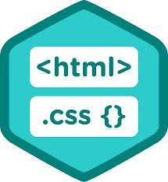
Overview
Html recap
Inline vs block elements
CSS
Cascading order
Examples and demos
Meta data

Slide 3


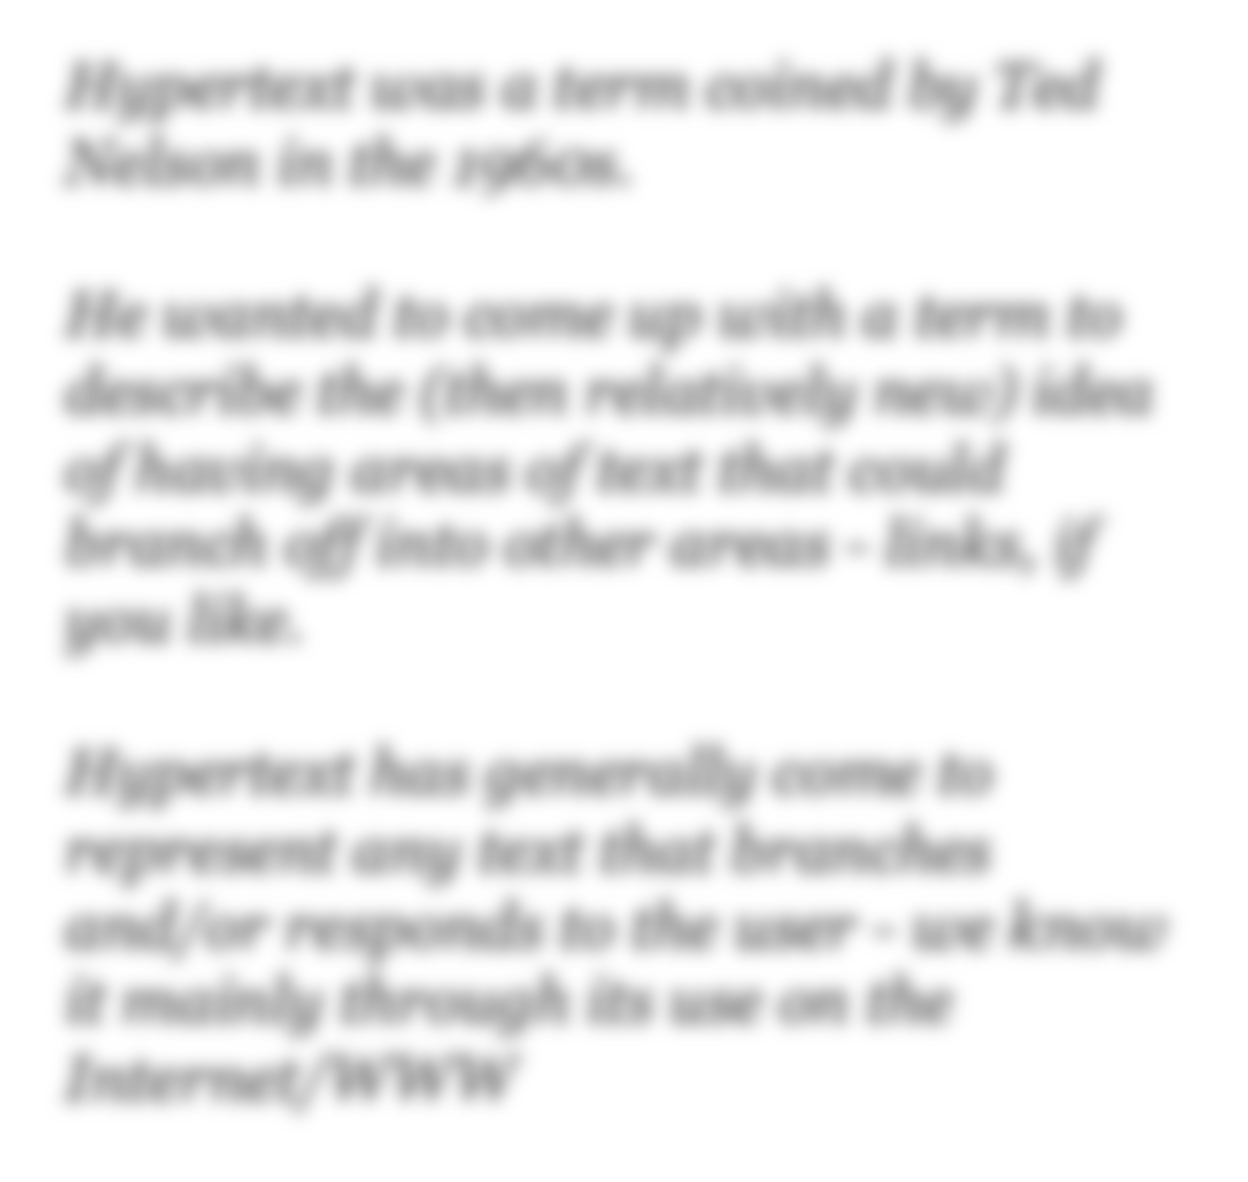

Hypertext was a term coined by Ted Nelson in the 1960s.
He wanted to come up with a term to describe the (then relatively new) idea of having areas of text that could branch off into other areas - links, if you like.
Hypertext has generally come to represent any text that branches and/or responds to the user - we know it mainly through its use on the Internet/WWW

Slide 4

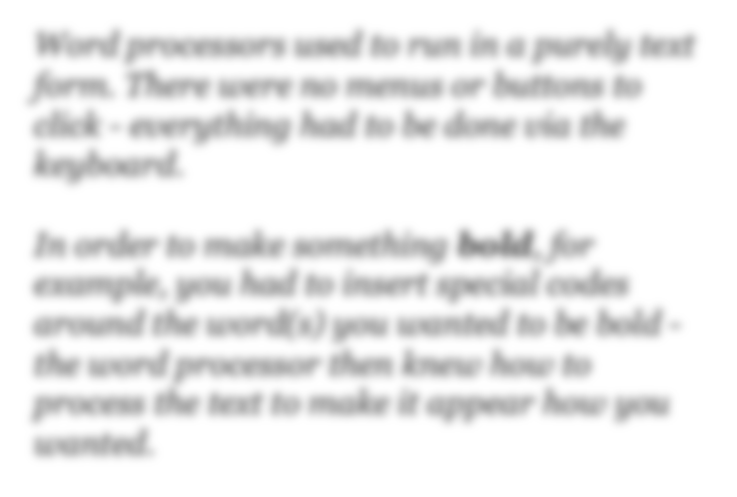

Word processors used to run in a purely text form. There were no menus or buttons to click - everything had to be done via the keyboard.
In order to make something bold, for example, you had to insert special codes around the word(s) you wanted to be bold - the word processor then knew how to process the text to make it appear how you wanted.

Slide 5
HTML
So, HTML is a combination of approaches that gives us the ability to:
Describe the structure of pages/text.
Link to and from other documents using the text of the page itself.

Slide 6
Why use HTML for screen design?
Designing content for the screen can become very technical - for instance...

Slide 7

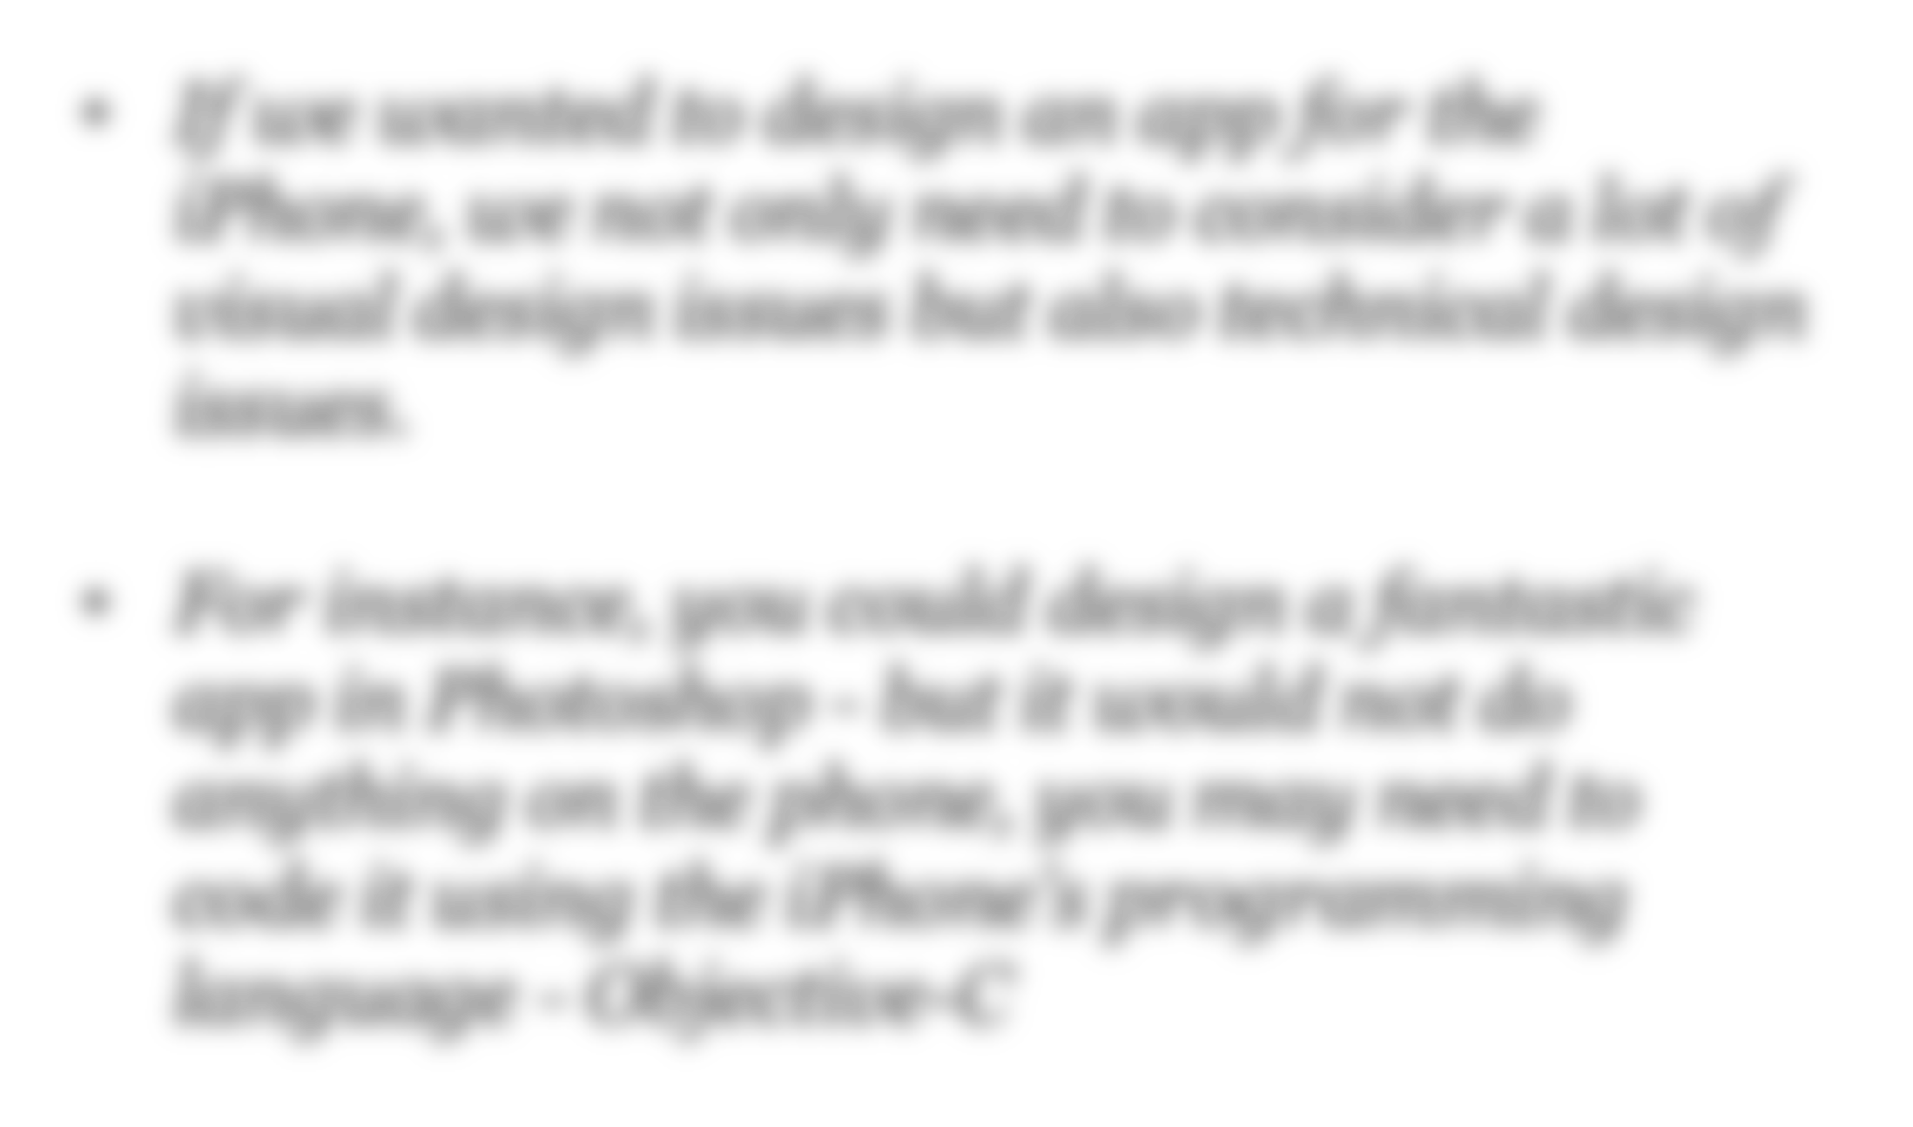

If we wanted to design an app for the iPhone, we not only need to consider a lot of visual design issues but also technical design issues.
For instance, you could design a fantastic app in Photoshop - but it would not do anything on the phone, you may need to code it using the iPhone’s programming language - Objective-C

Slide 8

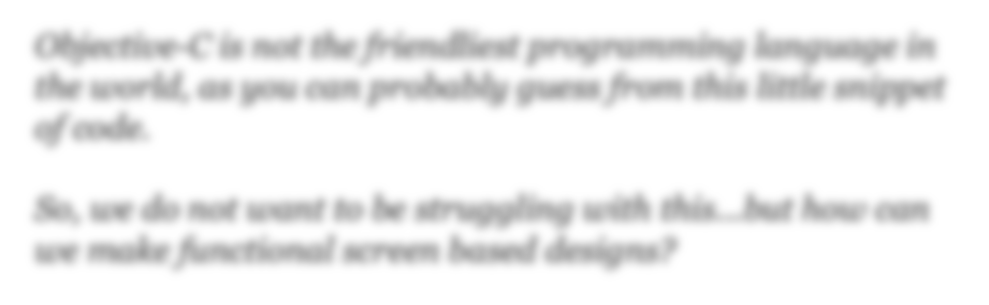

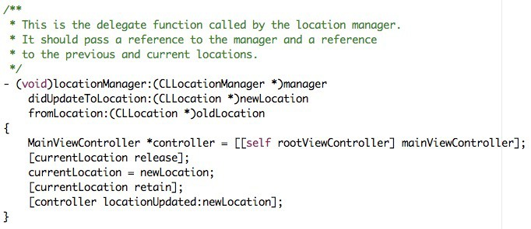
Objective-C is not the friendliest programming language in the world, as you can probably guess from this little snippet of code.
So, we do not want to be struggling with this...but how can we make functional screen based designs?

Slide 9



HTML allows us to quickly and easily produce layouts that
we can make interactive/functional.

Slide 10

The DIV tag
Inline vs block elements
https://www.w3schools.com/html/html_blocks.asp

Slide 11
Separation of code

Slide 12

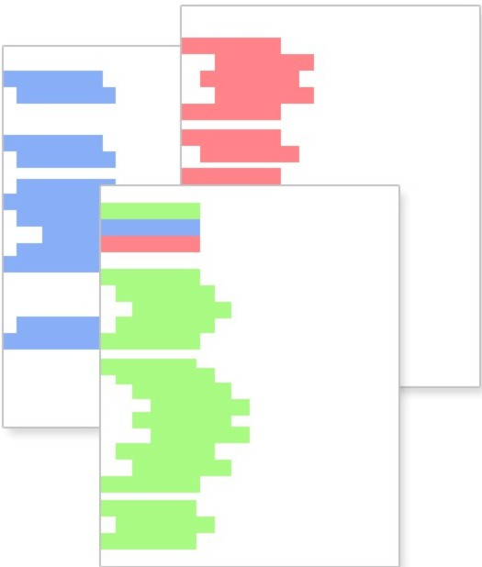
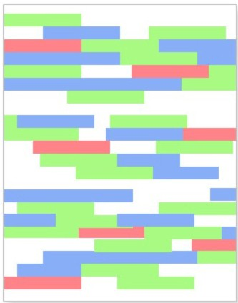
HTML
css
SCRIPTS
MARKUP PRESENTATION BEHAVIOR
< BECOMES THIS >
by Naalie Jost ,,..,.,..,w.nct-oliejosl.com March 7, 2086
Permi ion lo reprin1ror educdional purposes, bul ool le el for commercial one::;

Slide 13


Slide 14

CSS stands for Cascading Style Sheets

Slide 15
Each elements has a default style
http://www.w3.org/TR/CSS2/sample.html
https://www.w3schools.com/cssref/css_default_values.asp

Slide 16
We can override those styles and create new ones
e.g. http://www.w3schools.com/css/demo_default.htm

Slide 17
What does cascading mean?

Slide 18


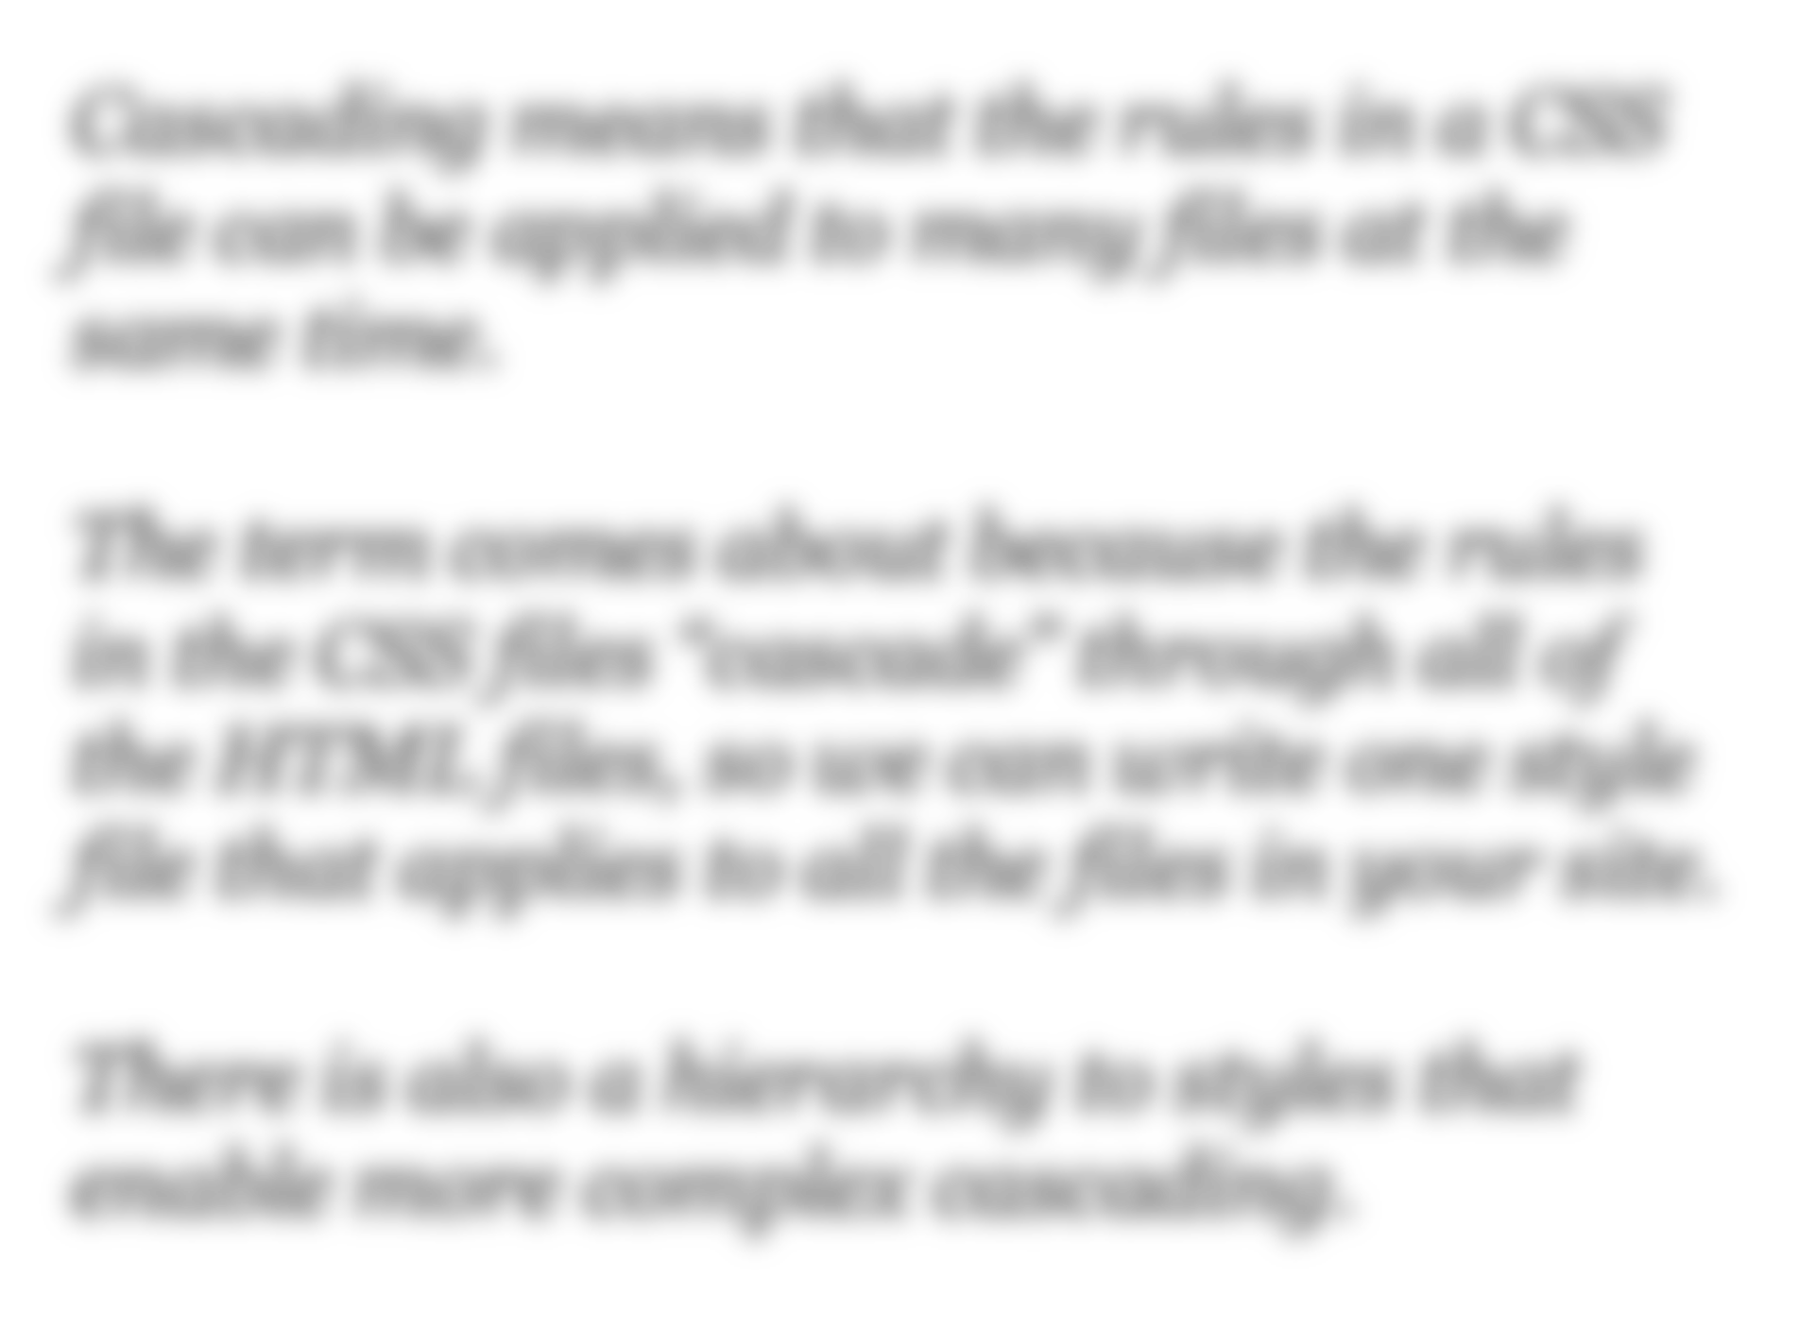
Cascading means that the rules in a CSS file can be applied to many files at the same time.
The term comes about because the rules in the CSS files “cascade” through all of the HTML files, so we can write one style file that applies to all the files in your site.
There is also a hierarchy to styles that enable more complex cascading.

Slide 19

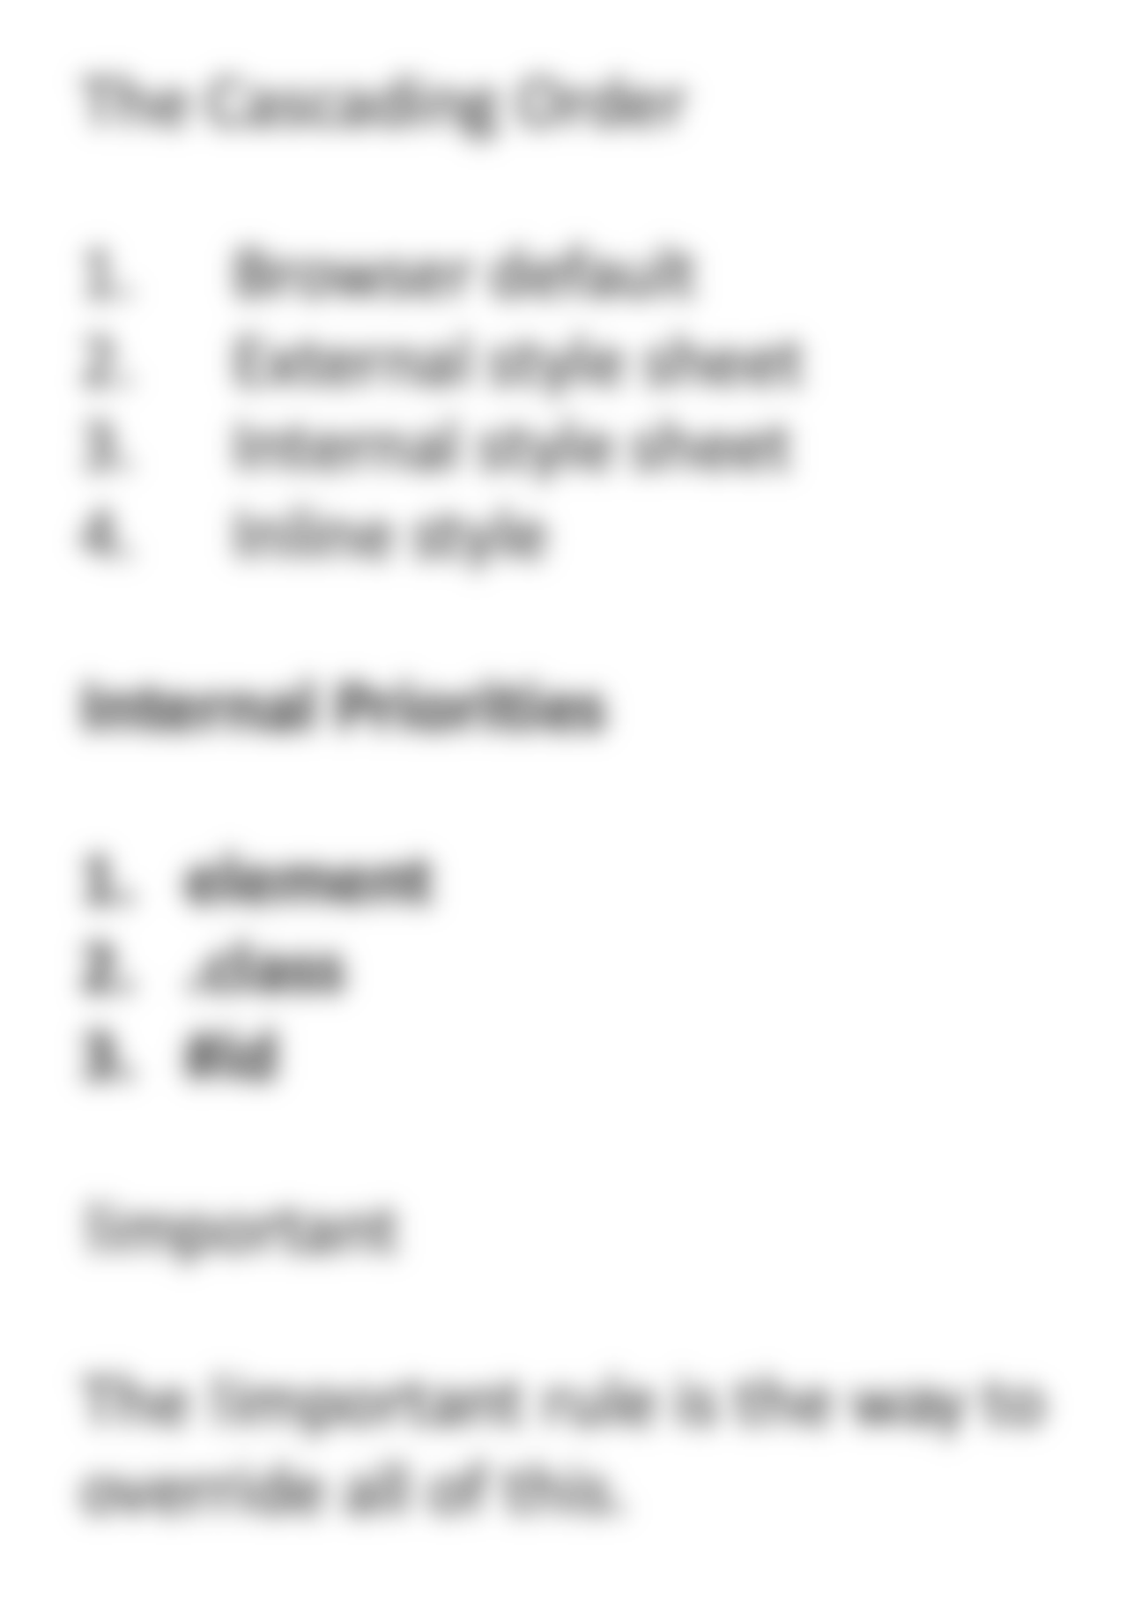
The Cascading Order
Browser default
External style sheet
Internal style sheet
Inline style
Internal Priorities
element
.class
#id
!important
The !important rule is the way to override all of this.

Slide 20
3 ways to insert CSS
External Internal Inline
http://www.w3schools.com/css/css_howto.asp

Slide 21
Why use CSS for screen design?
Flexibility - as CSS cascades through all the files in your work, you can make variants quickly and easily, which then gets applied to all the files automatically
Imagine if you were creating screen pages using Photoshop - if you wanted to change something that features on all the pages (e.g. a logo colour, the font) you would have to do it on every single page individually.
With CSS you change one file and everything updates.

Slide 22
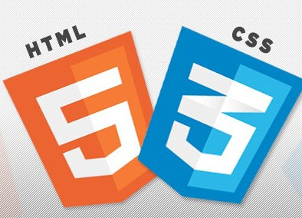

CSS works great with HTML.
And you can do some awesome stuff with it...
https://tutorialzine.com/2014/07/20-impressive-css3-techniques-libraries-and-examples

Slide 23
View source
Chrome Developer tools

Slide 24
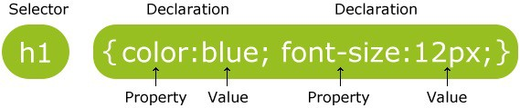
syntax

Slide 25
CSS declarations always end with a semicolon, and declaration groups are surrounded by curly brackets
p {color:red;text-align:center;}

Slide 26
CSS Demonstration
Styling elements
Id and class selectors
Backgrounds
Text
Margins and Padding (see box model)

Slide 27
CSS Id and Class
In addition to setting a style for a HTML element, CSS allows you to specify your own selectors called "id" and "class".
The id selector is used to specify a style for a single, unique
element.
The id selector uses the id attribute of the HTML element, and is defined with a "#”.
The style rule below will be applied to the element with id=”menu”
#nav{
width:950px; padding:10px; text-align:center;
}
<ol id="nav">

Slide 28
CSS Id and Class
The class selector is used to specify a style for a group of elements.
Unlike the id selector, the class selector is most often used on several elements.
This allows you to set a particular style for many HTML elements with the same class.
The class selector uses the HTML class attribute, and is defined with a ".”
In the example below, all HTML elements with class="center" will be center-aligned:
.center {text-align:center;}
<p class=“center”>text … </p>

Slide 29
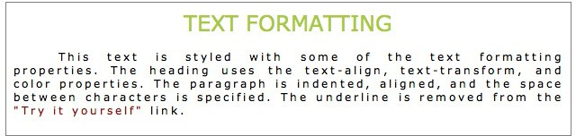
CSS Text
p{
color:blue;
text-align:center;
text-decoration:underline;
font-family:"Times New Roman”; font-size:30px;
}
http://www.w3schools.com/css/css_text.asp

Slide 30
Understanding CSS
The key to understanding how CSS works is to imagine that there is an invisible box around every HTML element.
CSS rules can control the way each individual box (and the contents of that box) is presented, for example:
Boxes - you can change width and height; borders (colour, thickness, style); background colour and images; position in the browser window
Text - you can change typeface; size; colour; italics, bold, uppercase, lowercase, small-caps...
Specific - you can change specific elements of HTML like lists, tables etc.

Slide 31
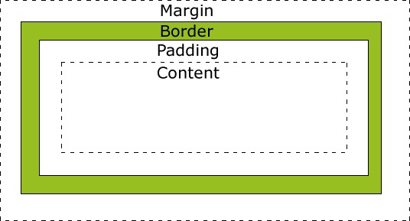
CSS Box Model
p{
width:250px; padding:10px; border:5px solid gray; margin:10px;
}
total width of the element is 300px
250px (width)
+ | 20px | (left | and | right | padding)
+ | 10px | (left | and | right | border)
+ | 20px | (left | and | right | margin)
= | 300px
http://www.w3schools.com/css/css_boxmodel.asp

Slide 32
Lab Task

Slide 33
Questions
?

