Slide 1
Computer Systems and Internet Technologies
CSS – Float and Flexbox
Matt Prichard

Slide 2
Pre CSS
Years ago, it was common for people to design work for print and web completely separately. This was because print designers had huge control over the layout of objects on the page, whereas web designers (by contrast) had very little control.
To control how pages looked, web designers used a complex combination of images (usually created and “sliced” in Photoshop) and tables (which were never designed to act as a layout tool - in HTML, tables are there to show data and that’s it, at least in theory).
This led to overly complicated designs and huge amounts of redundant “layout” code in the HTML, which made sites hard to update and difficult to create. It was, however, precise.

Slide 3

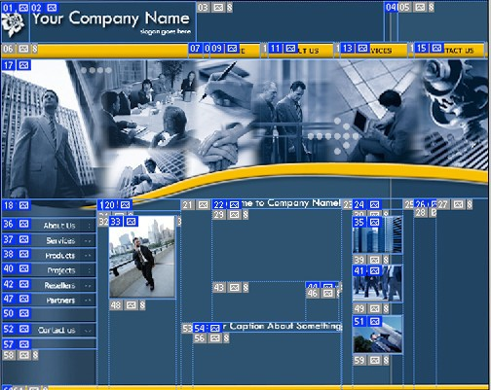
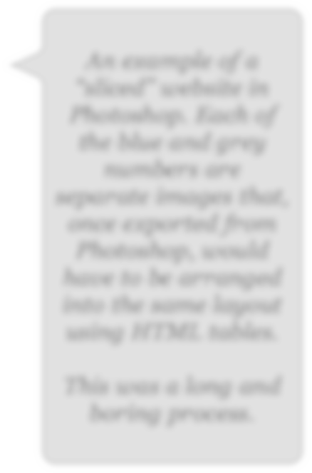
An example of a “sliced” website in Photoshop. Each of the blue and grey numbers are separate images that, once exported from Photoshop, would have to be arranged into the same layout using HTML tables.
This was a long and boring process.

Slide 4
CSS for Layout.
CSS proposed a number of (at the time) radical changes.
Firstly, formatting of text would be removed from the HTML and placed in it’s own area.
Secondly, there was to be a new way of laying out objects on the page - a combination of creating a new “box” model to hold page content and encouraging developers to move away from the table model they had been using for years.

Slide 5
CSS for Layout.
Whilst a difficult transition for some, it was widely embraced by web developers.
This became especially true with the rise of “standards compliant” web browsers such as Opera, Firefox, Safari and Chrome but also because it started to offer features that developers would not have been able to do previously (using the table method of layout).
One especially important area was that of grid systems.

Slide 6
CSS Box Model.
As you probably know, the CSS box model has a number of parameters that we need to be able to change to give us the look and feel we want for our site.
The main ones are padding, border and margin. It’s easier to explain this with a diagram

Slide 7
Top
Margin
Border Padding
Content
Left
Right
Bottom

Slide 8
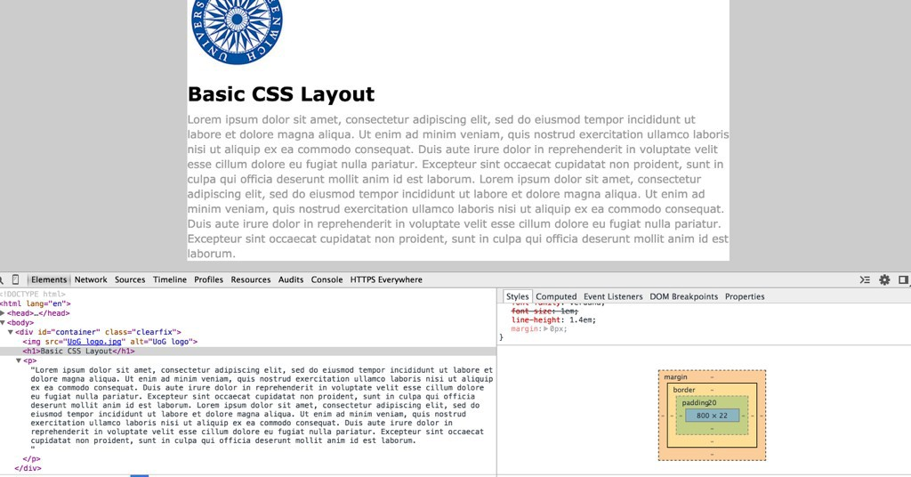
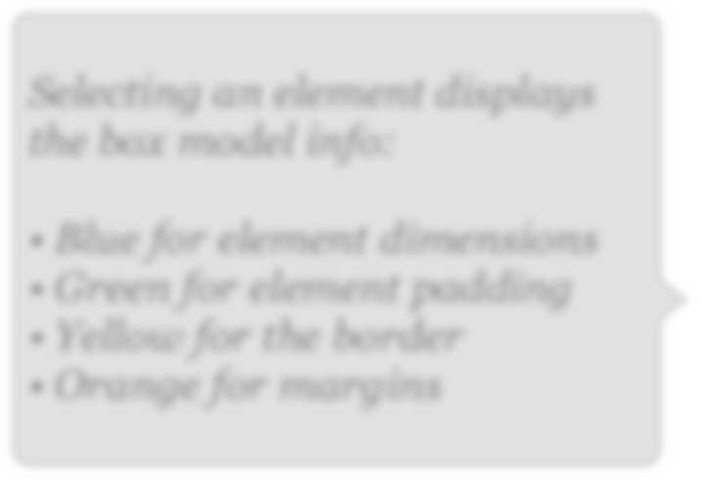
Chrome dev tools box model helper
Selecting an element displays the box model info:
Blue for element dimensions
Green for element padding
Yellow for the border
Orange for margins

Slide 9
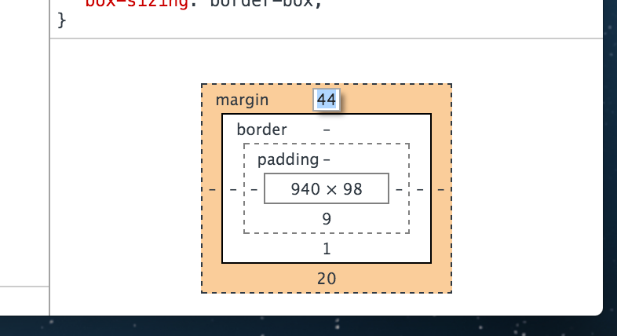
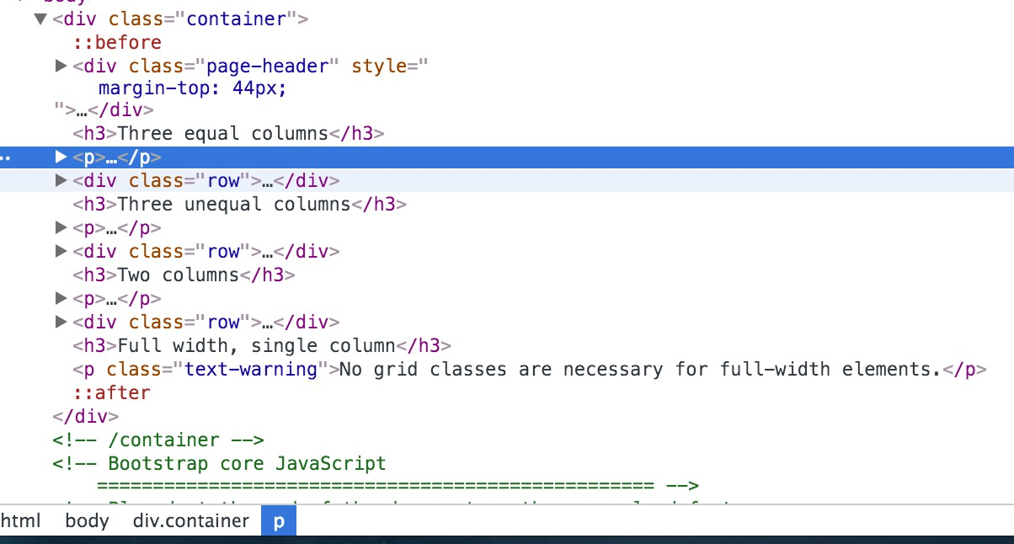
Change values and drag and drop demo
Highlight a value and change it in the browser
Elements can be dragged and dropped to rearrange them too.

Slide 10
Document Flow and using Float.
One of the related areas that makes CSS layout work is the concept of how browsers render the document flow.
This tells the browser how to arrange the elements on the page - for instance, where text goes in relation to images and so on.
The usual document flow works like a word processor - elements are simply displayed one “under” the other, from the top of the page to the bottom.
For instance, let’s say I have an image followed by some text. The default flow would render the content something like this:

Slide 11
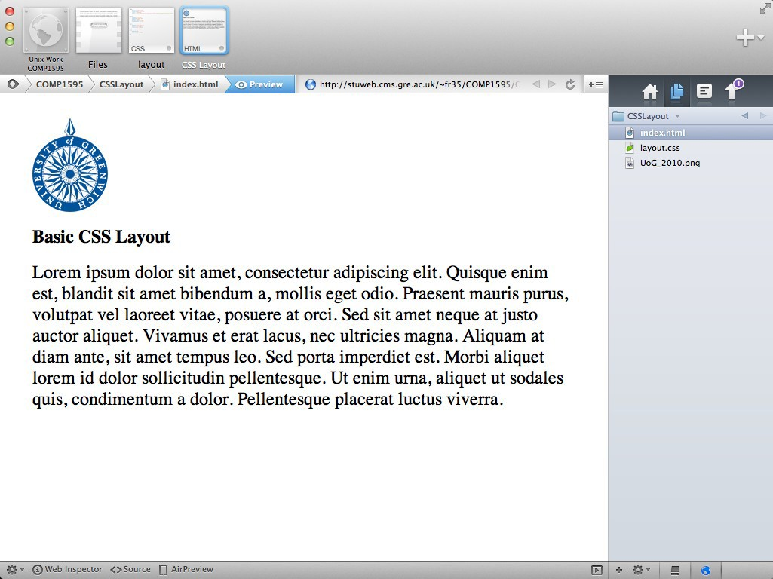

Image, followed by heading, followed by text. Each new item on a new line.

Slide 12
Changing Document Flow.
Of course, we would not want all webpages to look like this - a better approach would be to tell the browser how to display the image alongside the text.
To do this, we need to use some CSS - float, to be precise.
Float tells the browser to allow content to flow down its side - content can flow down the right side of a left-floated box and down the left side of a right- floated box. (I realise this sounds confusing, it’ll make sense when you see it).
Floating an element removes it from the default document flow.
I’ve added some CSS to our example make the text and background a little more aesthetically pleasing. I’ll also add a float to the image.

Slide 13
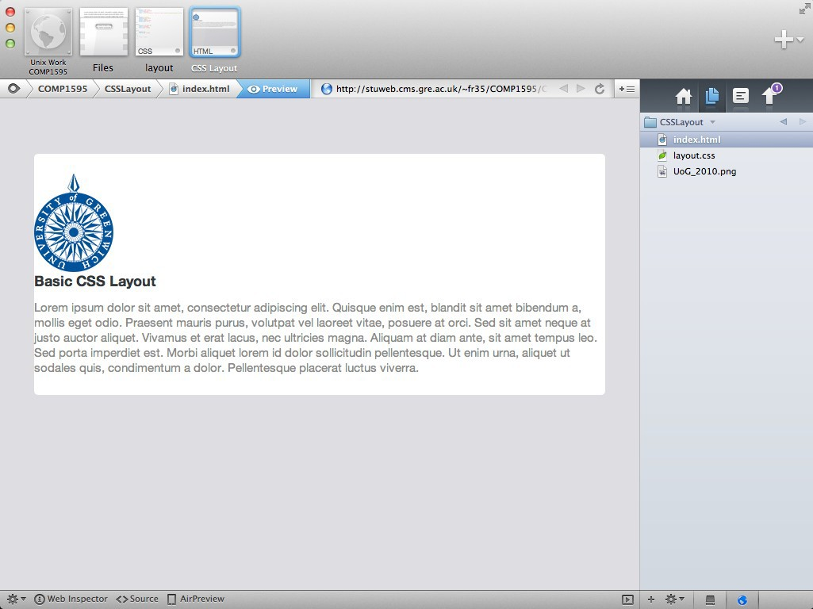
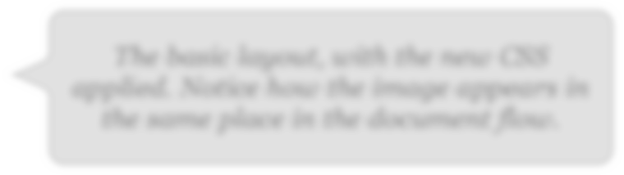
The basic layout, with the new CSS applied. Notice how the image appears in the same place in the document flow.

Slide 14
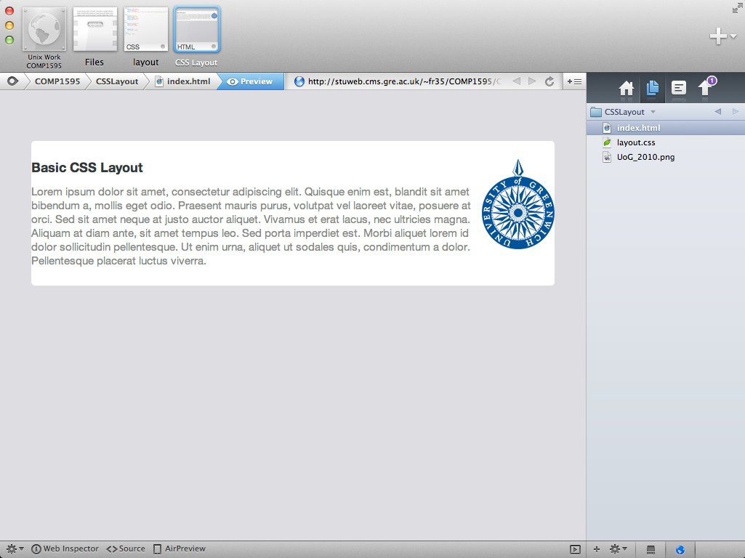
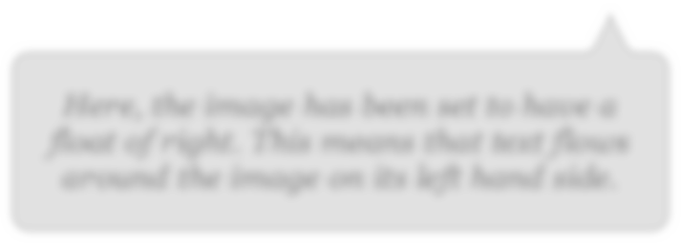
Here, the image has been set to have a float of right. This means that text flows around the image on its left hand side.

Slide 15
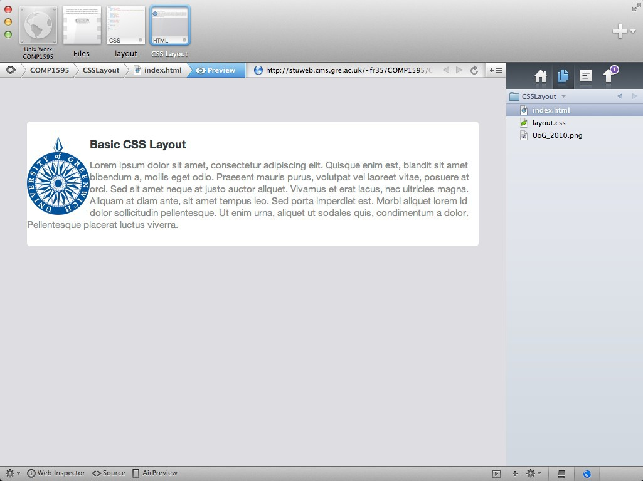
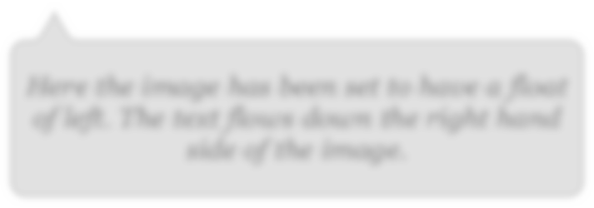
Here the image has been set to have a float of left. The text flows down the right hand side of the image.

Slide 16
Other Changes.
The text looks a bit cramped up against the image, so it would be nice to give it some breathing space. To do this, we need to add a margin to the image, which pushes the text content away from the image.
Remember, the box model applies to each element - so even though the image is not part of the normal document flow any more, it still has the same properties as any other element.
We can also set the text to have a width of slightly less than the containing area.
If we do this, we have a slight issue:

Slide 17
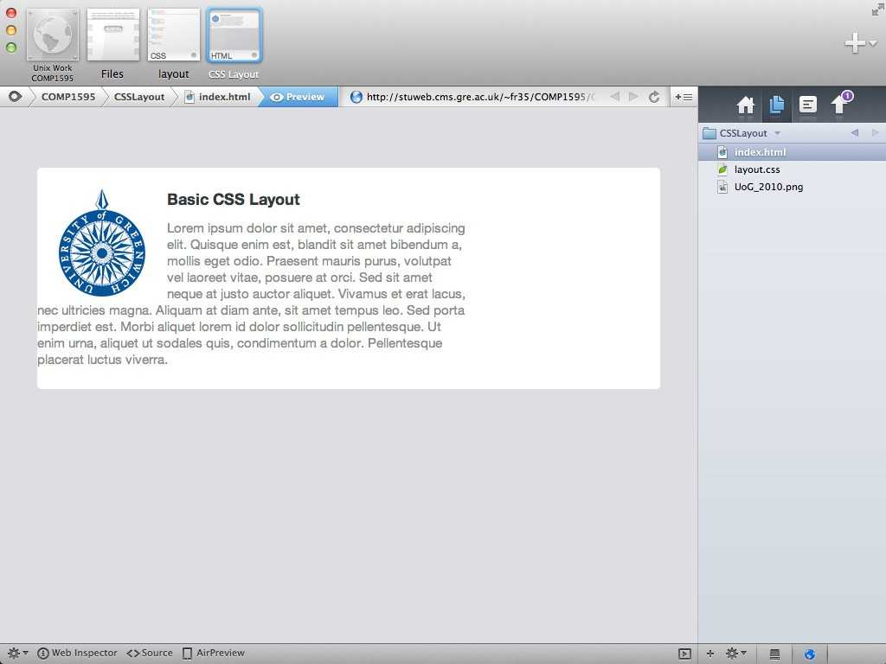
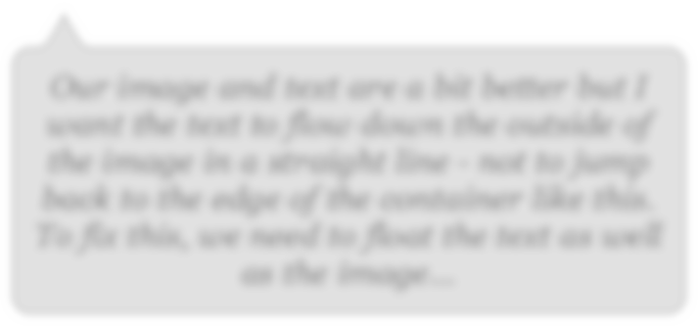
Our image and text are a bit better but I want the text to flow down the outside of the image in a straight line - not to jump back to the edge of the container like this. To fix this, we need to float the text as well as the image...

Slide 18
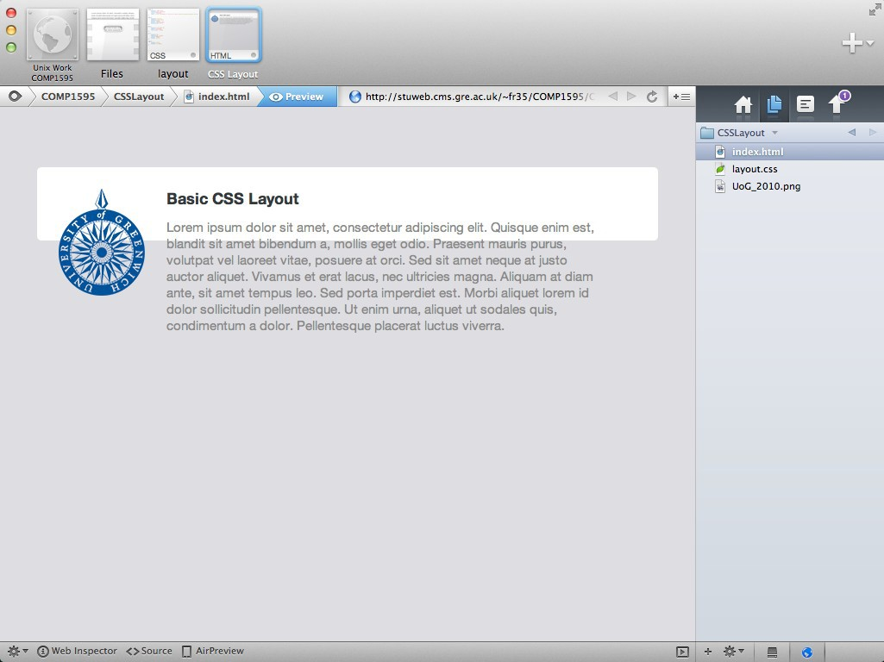
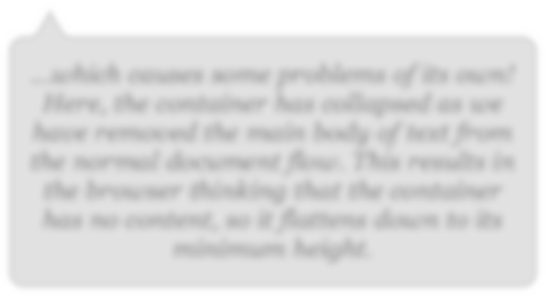
...which causes some problems of its own!
Here, the container has collapsed as we have removed the main body of text from the normal document flow. This results in the browser thinking that the container has no content, so it flattens down to its minimum height.

Slide 19
Fixes.
This is annoying, but fixable. There are a number of techniques we could use to fix this, Here is one
https://css-tricks.com/almanac/properties/o/overflow/
.

Slide 20
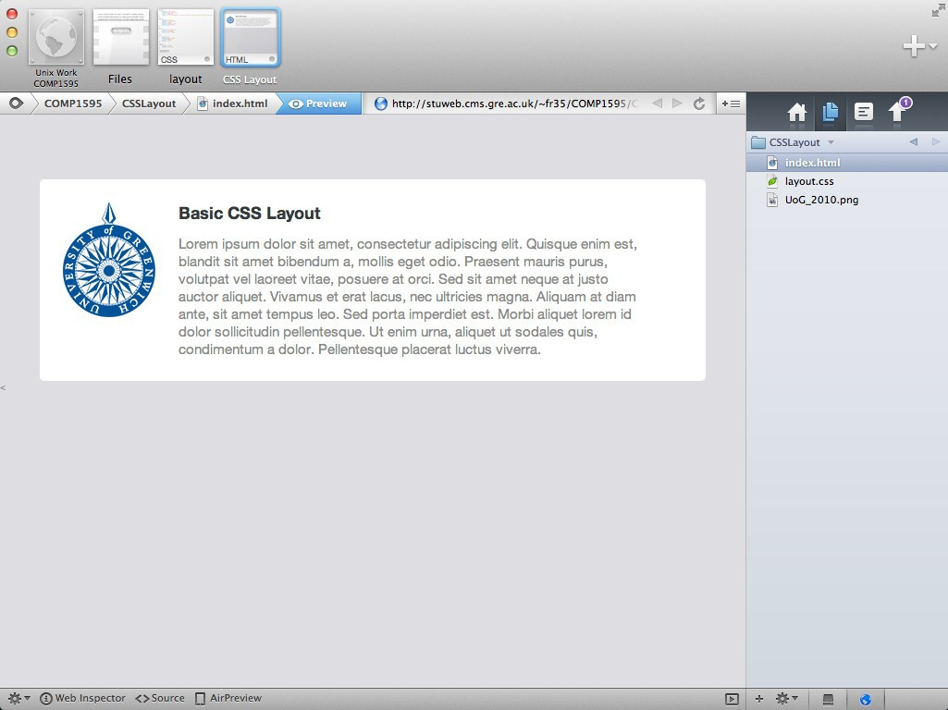
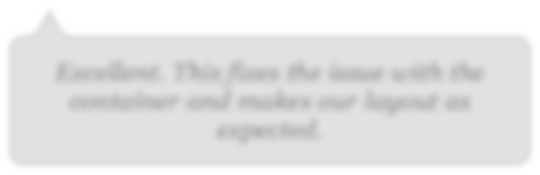
Excellent. This fixes the issue with the container and makes our layout as expected.

Slide 21
Flexbox
.

Slide 22
Flexbox
.
Flexbox, also called Flexible Box Module, is one of the two modern layouts systems, along with CSS Grid.
Compared to CSS Grid (which is bi-dimensional), flexbox is a one-dimensional layout model.
It will control the layout based on a row or on a column, but not together at the same time.
The Flexible Box Layout Module, makes it easier to design flexible responsive layout structure without using float or positioning.

Slide 23
Enable Flexbox
.
A flexbox layout is applied to a container, by setting
display: flex;
the content inside the container will be aligned using flexbox.

Slide 24
Flex Direction
.
flex-direction: row
places items as a row, in the text direction (left-to-right for western countries)
flex-direction: row-reverse
places items just like row but in the opposite direction
flex-direction: column
places items in a column, ordering top to bottom
flex-direction: column-reverse
places items in a column, just like column but in the opposite direction

Slide 25
Change the horizontal alignment
.
justify-content has 5 possible values:
flex-start : align to the side of the container.
flex-end : align to the right side of the container.
center : align at the center of the container.
space-between : display with equal spacing between them.
space-around : display with equal spacing around them

Slide 26
Change the vertical alignment
.
align-items has 5 possible values:
flex-start : align to the top of the container.
flex-end : align to the bottom of the container.
center : align at the vertical centre of the container.
baseline : display at the baseline of the container.
stretch : items are stretched to fit the container
https://www.w3schools.com/cssref/playdemo.php?filename=playcss_align-items&preval=stretch

Slide 27
Wrap
.
By default items in a flexbox container are kept on a single line, shrinking them to fit in the container.
To force the items to spread across multiple lines, use
flex-wrap: wrap
This will distribute the items according to the order set in
flex-direction
Use flex-wrap: wrap-reverse to reverse this order.

Slide 28

Perfect centring
.
.flex-container { display: flex; height: 300px; justify-content: center; align-items: center;
}

Slide 29
Child Elements (Items) The direct child elements of a flex container automatically becomes flexible (flex) items.
The flex item properties are:
order
flex-grow
flex-shrink
flex-basis
flex
align-self
.
Investigate these in your own time
https://css-tricks.com/snippets/css/a-guide-to-flexbox/

Slide 30
Summary
CSS Grid to make the main grid layout for your site (next week)
Flexbox to help position or centre items within in a single row or area.
Float to wrap text around images.
.

Slide 31
?

