Slide 1
Layout.
201
₅20
1
7

Slide 2
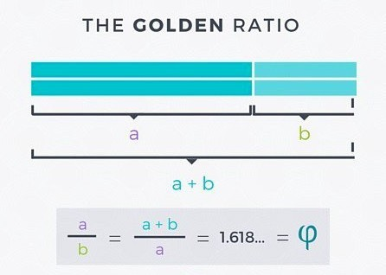

https://designschool.canva.com/blog/what-is-the-golden-ratio/

Slide 3
The Golden ratio cont…
The Golden Ratio (also known as the Golden Section, Golden Mean, Divine Proportion or Greek letter Phi - pronounced fie as in fly).
This harmony and proportion has been recognised for centuries: from the Pyramids in Giza to the Parthenon in Athens; from Michelangelo’s The Creation of Adam on the ceiling of the Sistine Chapel to Da Vinci’s Mona Lisa; and from the Pepsi logo to the Twitter logo.

Slide 4
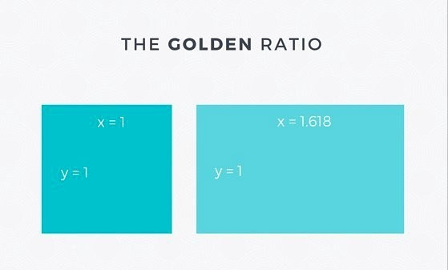
Take a square and multiply one side of by 1.618 and you get a rectangle of harmonious proportions:
https://designschool.canva.com/blog/what-is-the-golden-ratio/

Slide 5
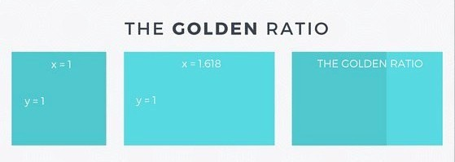
Now, if you lay the square over the rectangle the two shapes will give you the Golden Ratio:
https://designschool.canva.com/blog/what-is-the-golden-ratio/

Slide 6
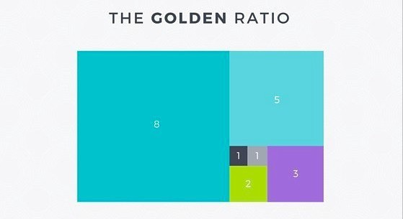
If you keep applying the Golden Ratio formula to the new rectangle on the far right of the image, you will eventually get this diagram with progressively smaller squares:
https://designschool.canva.com/blog/what-is-the-golden-ratio/

Slide 7
If you take our Golden Ratio diagram, and draw an arch in each square, from one corner to the opposite corner, you will draw the first curve of the Golden Spiral (or Fibonacci Sequence)
A series in which the pattern of each number is the sum of the previous two numbers. Starting at zero, the sequence is: 0, 1, 1, 2, 3, 5, 8, 13, 21, 34, 55, 89, 144… and so on.

Slide 8
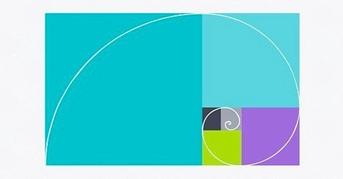
The Golden Spiral
https://designschool.canva.com/blog/what-is-the-golden-ratio/

Slide 9
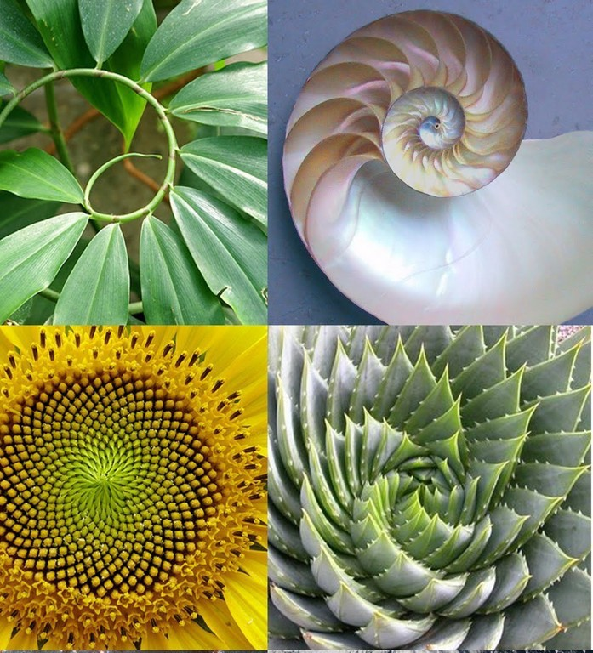
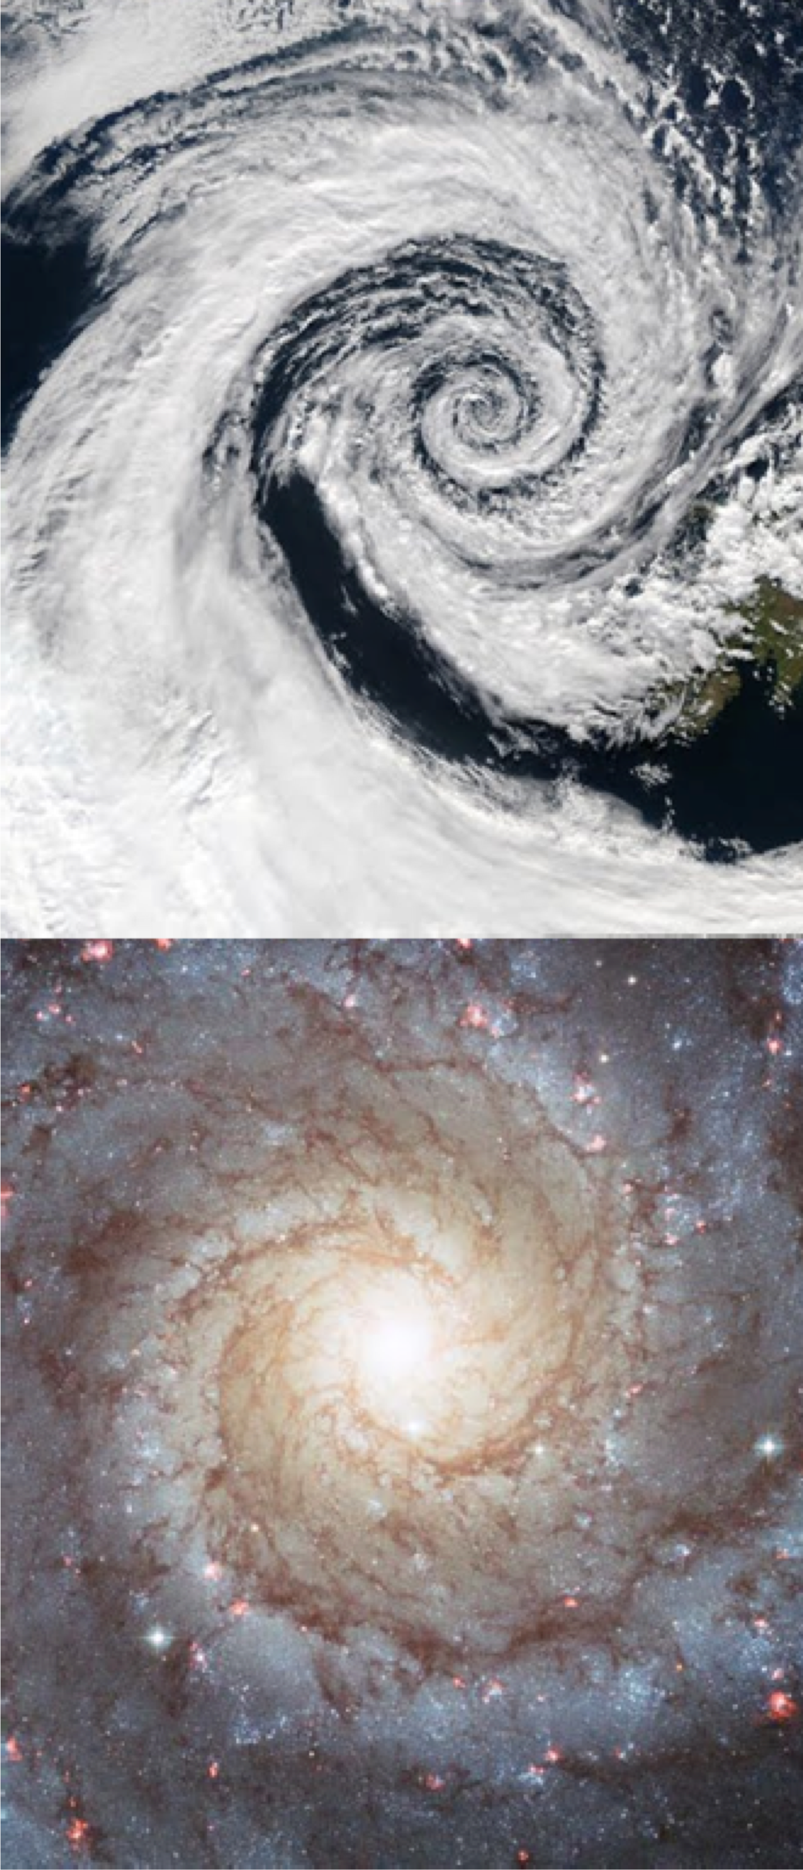

Slide 10
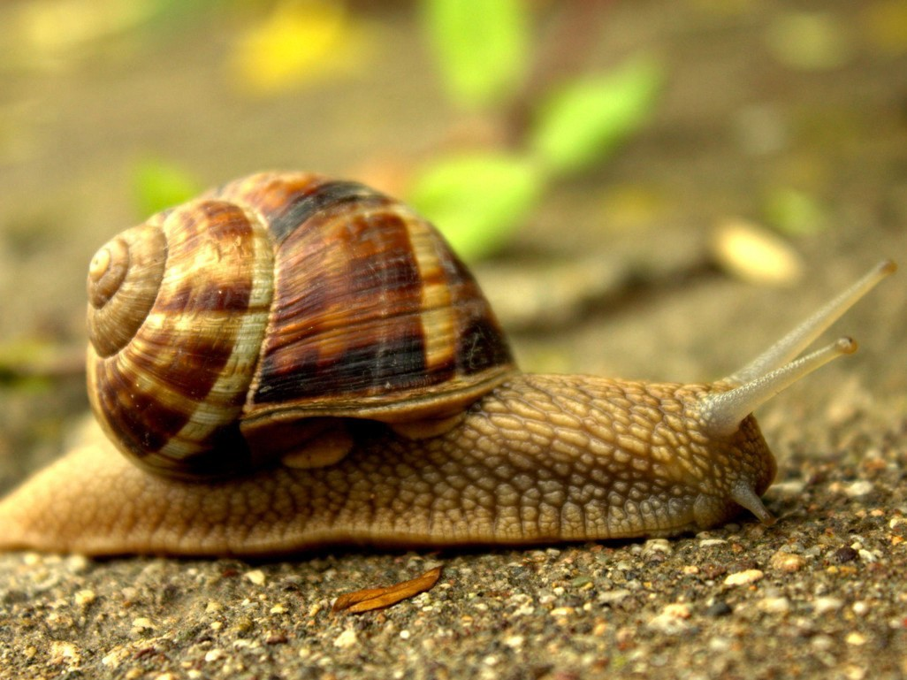

Slide 11
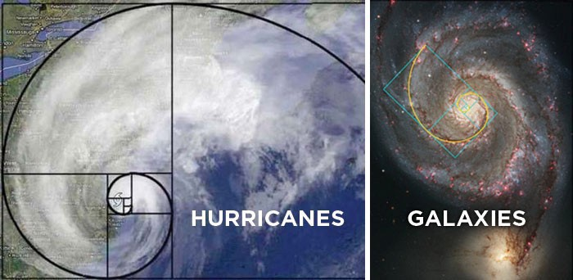

Slide 12
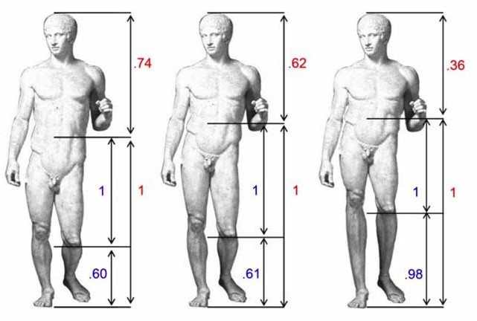
Volunteers with no background in art theory were shown an original image of a sculpture, Doryphoros by Polykleitos (center) as well as distorted versions (left and right). The original obeys the golden ratio, the original activated certain sets of brain cells more than the distorted versions, suggesting the brain judges beauty by at least partly hard- wired standards.
http://www.livescience.com/7389-sense-beauty-partly-innate-study-suggests.html

Slide 13
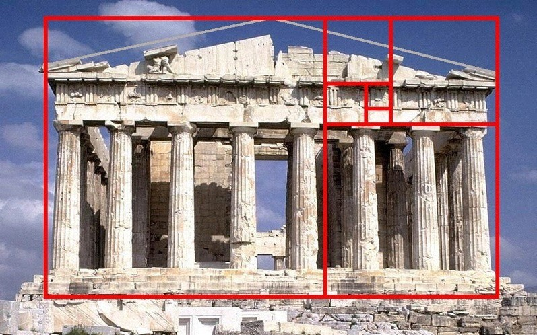

Slide 14

Break a layout into two columns using the Golden Ratio. Working within these two shapes your layout will abide by the harmonious proportions of the Golden Ratio.
https://designschool.canva.com/blog/what-is-the-golden-ratio/

Slide 15
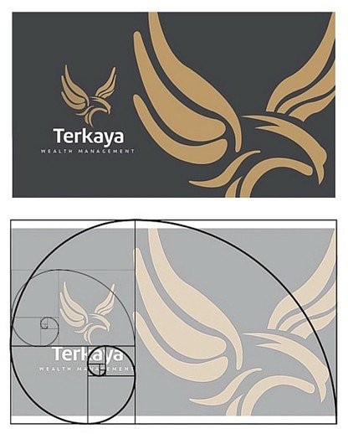
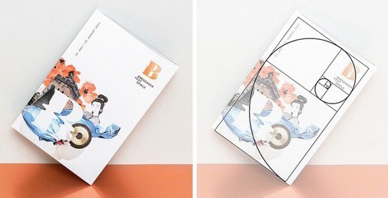
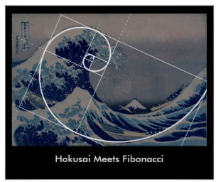
More layout examples
https://designschool.canva.com/blog/what-is-the-golden-ratio/

Slide 16
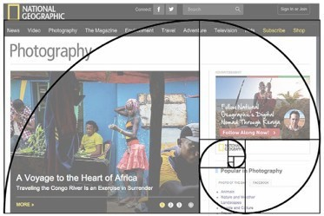
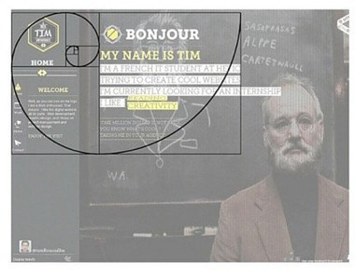
Content with the golden spiral
The Golden Spiral can be used as a guide to determine the placement of content.
Our eye is naturally drawn to the center of the spiral, which is where it will look for details, so focus your design on the center of the spiral and place areas of visual interest within the spiral.
https://designschool.canva.com/blog/what-is-the-golden-ratio/

Slide 17
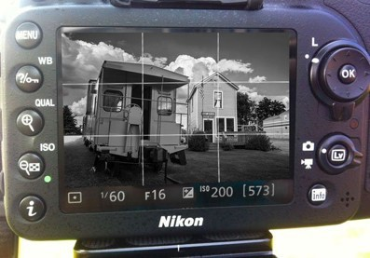
Rule of Thirds - Dynamism
Using the rule of thirds can help create dynamic and interesting images.
Try to consider this when taking or cropping images.
Images, pages etc. can usually be divided up into “thirds”.
This can lend the image/page a sense of balance.
Many cameras have a thirds overlay grid.

Slide 18
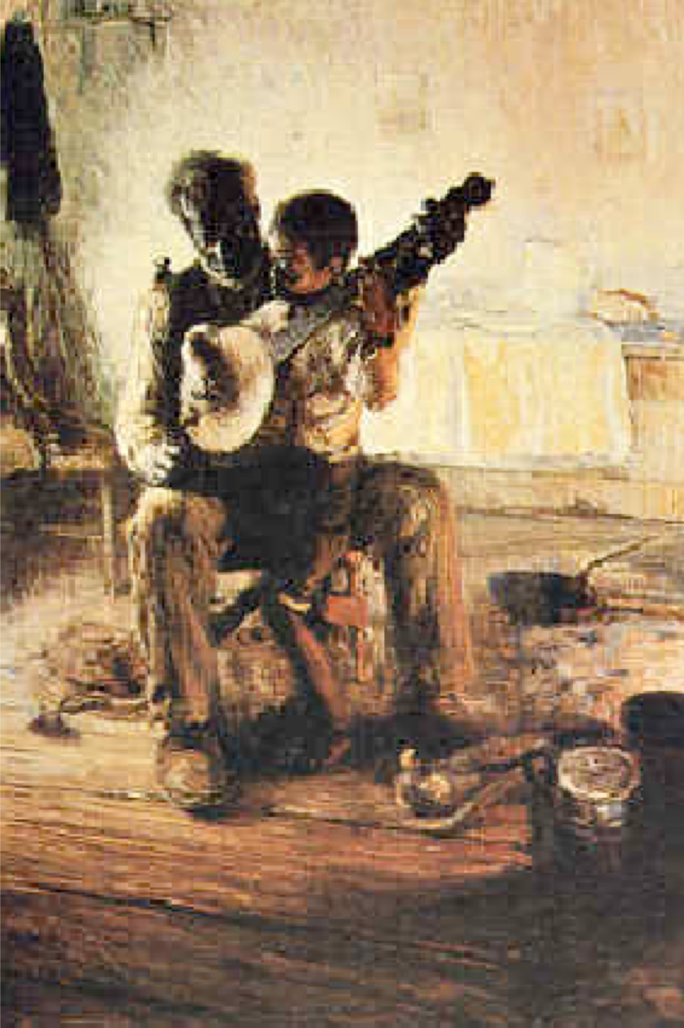
Rule of Thirds
This image combines two ideas - the rule of thirds and the rule of fifths.
Artists use these ideas to partition their canvas, avoiding equal spatial divisions where possible, to give their images dynamic qualities

Slide 19




This picture is split into thirds, making it more dynamic.
This picture is split into half/ quarters.
It lacks interest and appears dull and lifeless.
Note the new position of the boat.
1
2
1
3
1
3
1
2
1
3

Slide 20
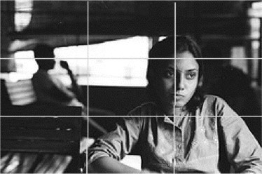

Slide 21
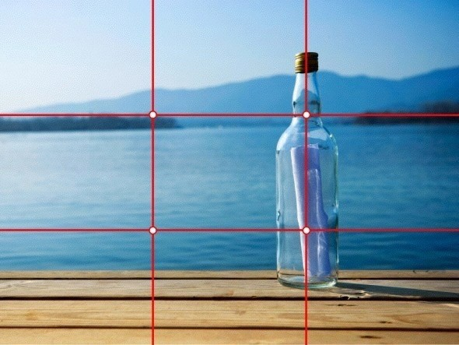

Slide 22
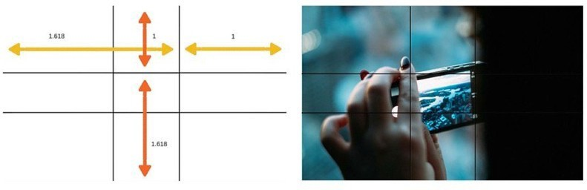
The ‘Golden’ rule of thirds
A slightly di"erent version of the rule of 3rds
Using the Golden Ratio, you split the picture into three unequal sections then use the lines and intersections to compose the picture.
The ratio is 1: 0.618: 1 – so the width of the first and third vertical columns will be 1, and the width of the center vertical column will be 0.618.
https://designschool.canva.com/blog/what-is-the-golden-ratio/

Slide 23
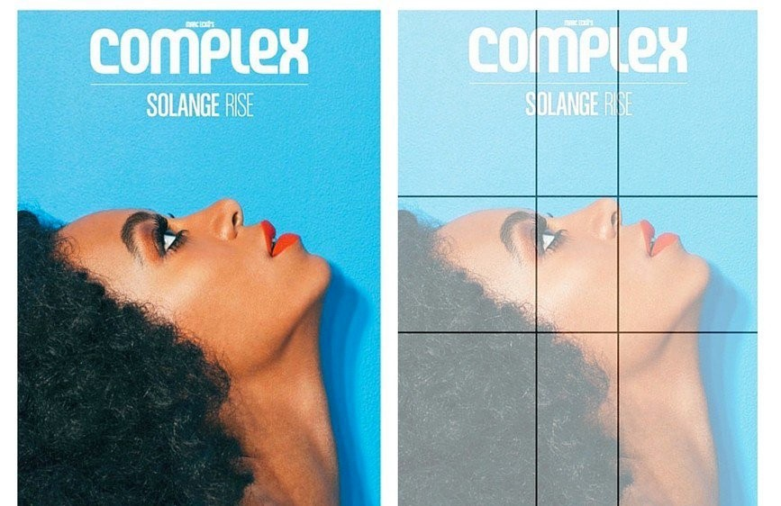
This cover for Complex magazine uses the Golden Ratio to determine the proportion of positive and negative space. The top of Solange’s nose and (almost) her forehead reach the top horizontal line; while her nose and eye fall on the two vertical lines around the center
https://designschool.canva.com/blog/what-is-the-golden-ratio/

Slide 24
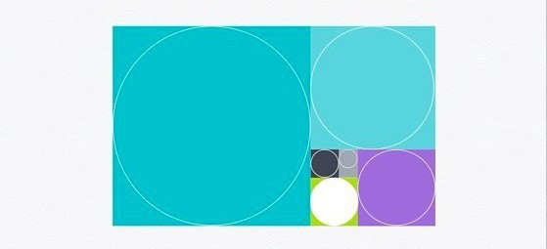
Golden circles
Just like the Golden Ratio can be harnessed to create squares and rectangles that are in harmonious proportion to each other, it can also be applied to create circles. A perfect circle in each square of the diagram will follow the 1:1.618 ratio with the circle in the adjacent square.
https://designschool.canva.com/blog/what-is-the-golden-ratio/

Slide 25
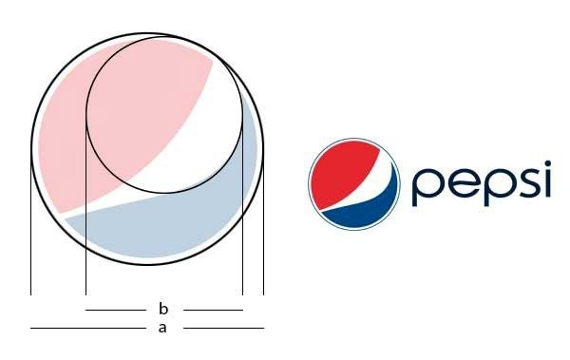
https://designschool.canva.com/blog/what-is-the-golden-ratio/

Slide 26
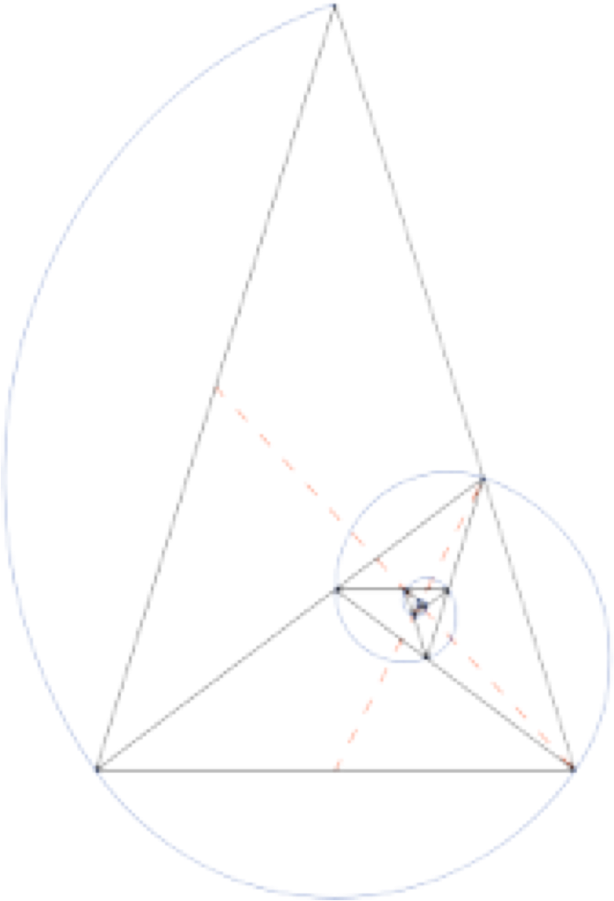
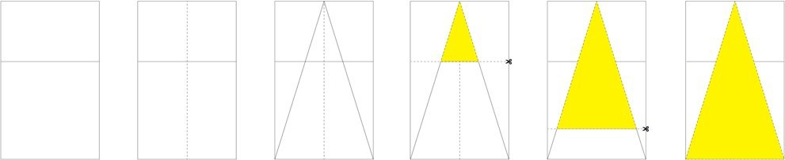
Lastly - The Golden Triangle
Placing an isosceles triangle (two sides the same length) within the golden rectangle is another way of using TGR within design. Named, you guessed it… the golden triangle. This shape holds its proportions regardless of how you divide it.
http://www.totemlearning.com/totemspoll/2015/4/22/the-golden-ratio-a-brief-introduction

Slide 27
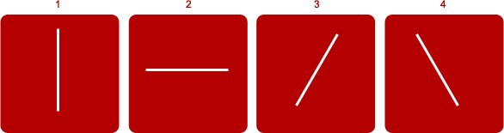
Balance - symmetry or asymmetry
In design we try to achieve a balance between elements because it is pleasing on the eye. But balance isn’t always achieved through symmetry.
The white line in box 1 and 2 is symmetrically balanced while in boxes 3 and 4 the line is asymmetrically balanced.
http://www.sitepoint.com/principles-of-good-design-balance/

Slide 28

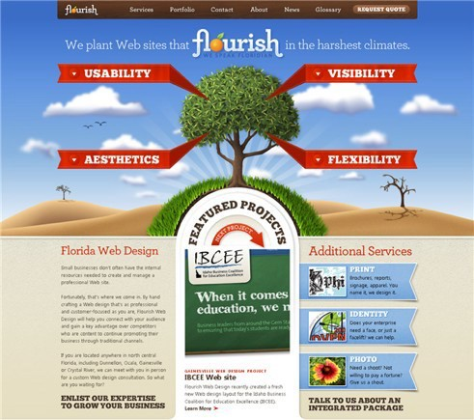
Symmetry
Symmetrical balance is mirror image balance. If you draw a line through the centre of the page, the elements on one side of the line are mirrored on the other side. We can achieve it by placing elements fairly evenly in the design
http://www.sitepoint.com/principles-of-good-design-balance/

Slide 29
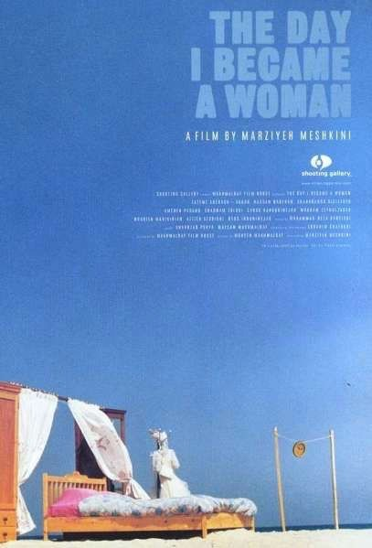
Diagonal symmetry
http://www.sitepoint.com/principles-of-good-design-balance/

Slide 30

Asymmetry
Asymmetrically balanced layouts have elements that don’t mirror each other across a centreline. These layouts can be more difficult to design but can be appealing to viewers. We can create an asymmetrically balanced layout by placing several small items on one side, and one large item on the other side. If you have one dark item on one side, you may place several light coloured items on the other side. An asymmetrical balanced design can create tension, drawing the viewer in.
http://www.sitepoint.com/principles-of-good-design-balance/

Slide 31

Off-balance
If you know the rules, then you can break them of course, and lack of balance can convey action and motion. It can make people feel a little uneasy or even disturbed. An off-balance design can make people think. Just don’t let it happen by accident.
http://www.sitepoint.com/principles-of-good-design-balance/

Slide 32
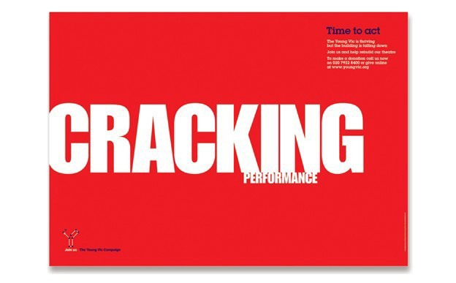
Size - This one is simple enough: people readbiggerthings first.
https://99designs.com/designer-blog/2014/06/09/6-principles-of-visual-hierarchy/

Slide 33
Questions
?

