Slide 1
COMP 1589
Introduction to HTML forms
Matt Prichard

Slide 2
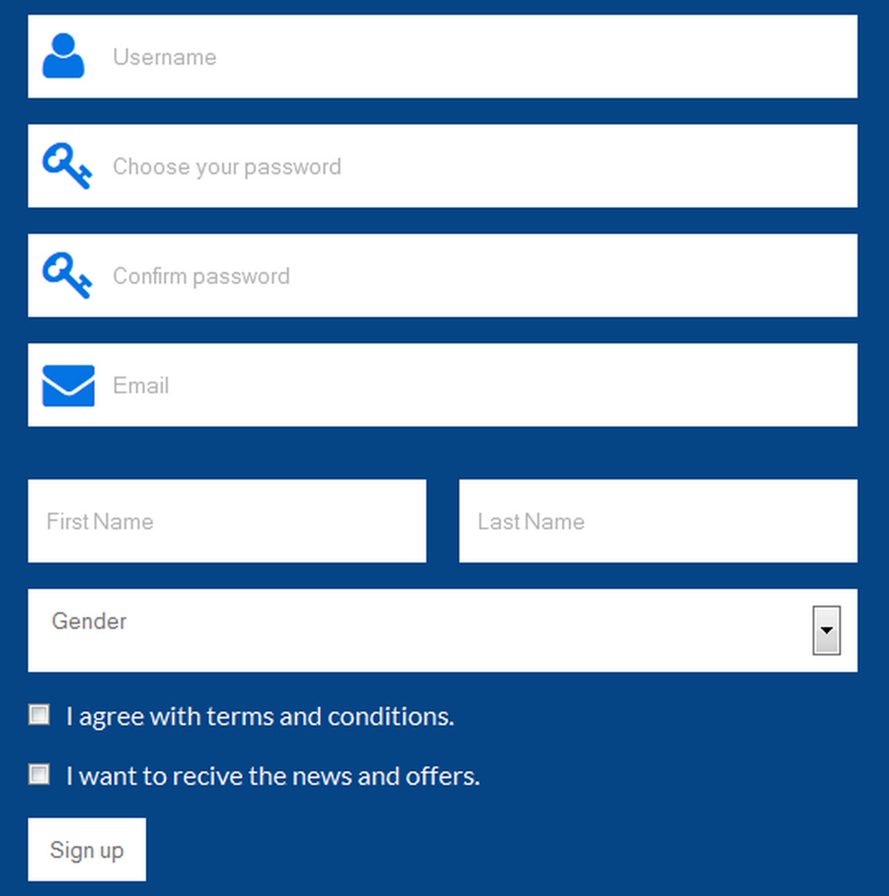

Slide 3
HTML Forms
Forms are a way of collecting information or data from our site visitors.
How do they work?
We place data-entry fields or controls on the Web page such as text boxes, check boxes and submit buttons.
The site visitor fills in the fields and clicks a submit button.
The data the user enters is sent over the Internet to our server.
The server, through a server-side scripting language, takes action on and processes the data.

Slide 4
Creating the form
A form is an invisible element that contains the form controls.
Form controls are the fields or elements that allow the user to enter information (like text fields, drop-down menus, radio buttons, checkboxes, etc.)
A form is defined with the <form> </form> tags.
All other controls must be nested within these tags.

Slide 5
Input element
The most general type of control is the INPUT element.
The type of INPUT is specified with the typeattribute.
<input type="text"/>
Notice this is a self-closing html tag. This creates an empty text box on the screen.
<input type="text" name="firstname" size="30"/>
This creates an empty text box 30 characters wide and its name is “firstname” for processing purposes later.

Slide 6
Text Area
<textarea name="message" rows="5" cols="30">
</textarea>
This creates a text area with scrollbars which allow the user to enter large amounts of text.
Again, we have named it something sensible and set its size to 5 rows high and 30 characters wide. If the user enters more than 5 lines of text, the scrollbars become active.
Notice this element requires a closing tag.

Slide 7
Buttons
There are two types of pre-defined button; a submit button that sends the form to the server for processing and a reset button that clears or empties the form.
<input type="submit" value="submit"/>
This creates a submit button, the value is what is written on the button.
<input type="reset" value="clear"/>
This creates a reset button, the value is what is written on the button.

Slide 8
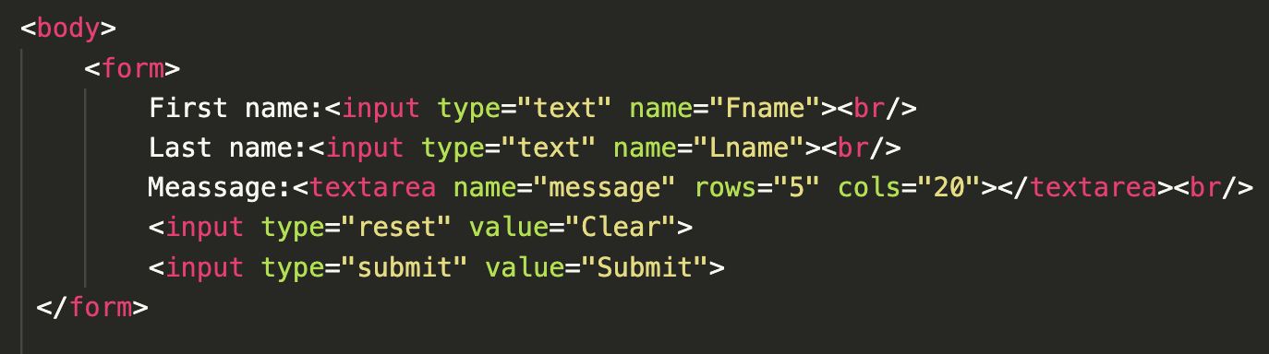
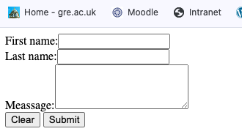
Basic form code
The result in a browser – ugly but functional

Slide 9
Quick list of most common controls
 | What will be displayed | Control to use
Text | Text entry ﬁeld, size deﬁned with size attribute. | <input type=“text” name=“text1” size=“25”/>
Text area | A large text area ﬁeld, size deﬁned by rows and cols attributes. | <textarea name=“” rows=“8” cols=“25”></textarea>
Password | Text entry ﬁeld, characters appear as dots or asterisks. | <inputtype=“password” name=“pass1”/>
Check box | Unchecked check box, unless checked attribute is present | <input type=“checkbox” name=“box1” value=“yes”/>
Radio button | Unchecked radio button, unless checked attribute is present | <input type=“radio” name=“set1” value=“ﬁrst”/>
DropMdown list | DropMdown list of choices | <select name=“drop1” option value=“ﬁrst”/>
Button | Submit form or resetform | <inputtype=“submit”/> <inputtype=“reset”/>

Slide 10
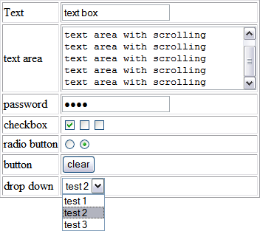
Common controls as they appear

Slide 11
Other controls
Other attributes that form elements can have;
Maxlength=“11” this restricts the amount of characters that can be entered into a text box.
Id=“someid” id, again can be accessed by JavaScript and CSS for styling individual form elements.
Tabindex=“1” for selecting form elements when the tab button is pressed.
checked=“checked” for preselecting radio and check boxes.

Slide 12
Other controls
Other attributes that form elements can have;
Maxlength=“11” this restricts the amount of characters that can be entered into a text box.
Id=“someid” id, again can be accessed by JavaScript and CSS for styling individual form elements.
Tabindex=“1” for selecting form elements when the tab button is pressed.
checked=“checked” for preselecting radio and check boxes.

Slide 13
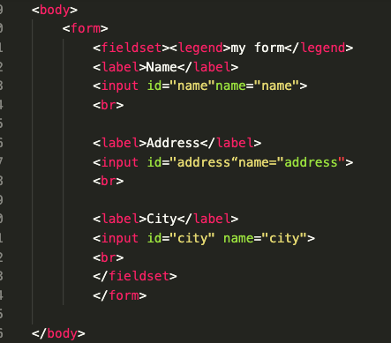
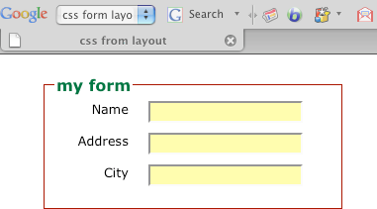
Forms with CSS

Slide 14
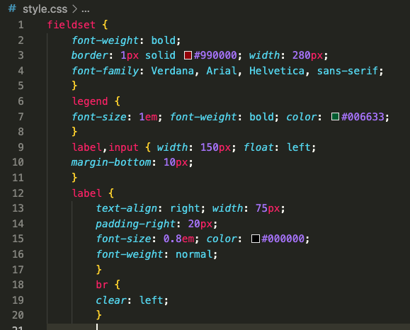
The CSS

Slide 15
Look at these tutorials
https://www.w3schools.com/html/html_forms.asp
https://www.w3schools.com/css/css_form.asp

Slide 16
?

