Slide 1
responsive design CSS Frameworks
Matt Prichard

Slide 2
Mobile/Responsive Design
Print design allows us very tight control over the final output and what the viewer sees.
Design for screen is not so straight forward - why?
Screen size / resolution
Browser issues
Device capabilities
Colour representation
Interaction methods – to name a few

Slide 3
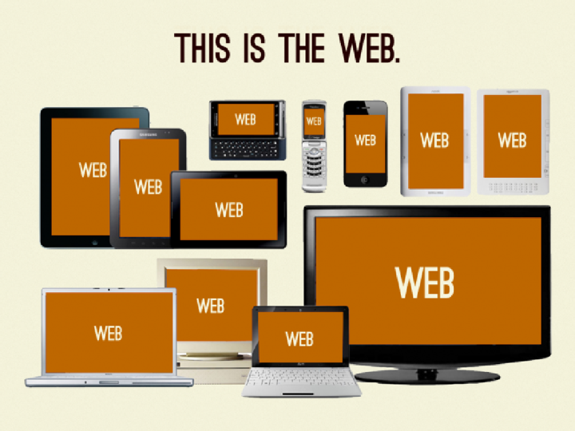

Slide 4








11'[9
'
; •?.?• •
.??,?•
• ?•
■

Slide 5
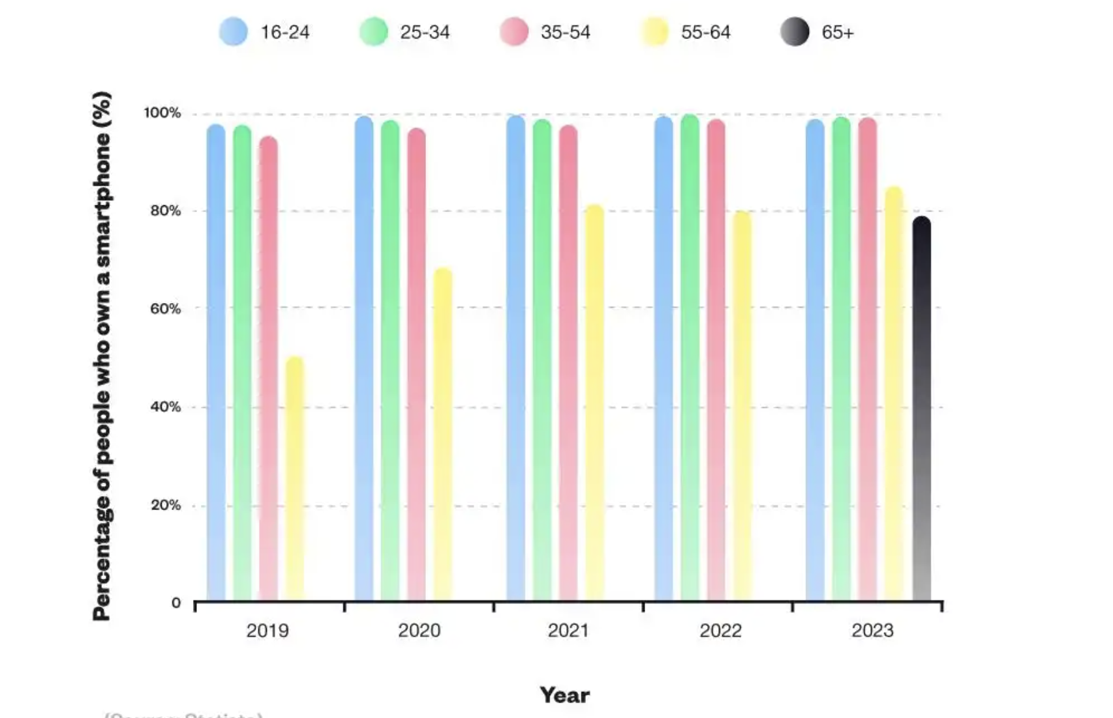
Smartphone ownership UK
https://www.uswitch.com/mobiles/studies/mobile-statistics/

Slide 6
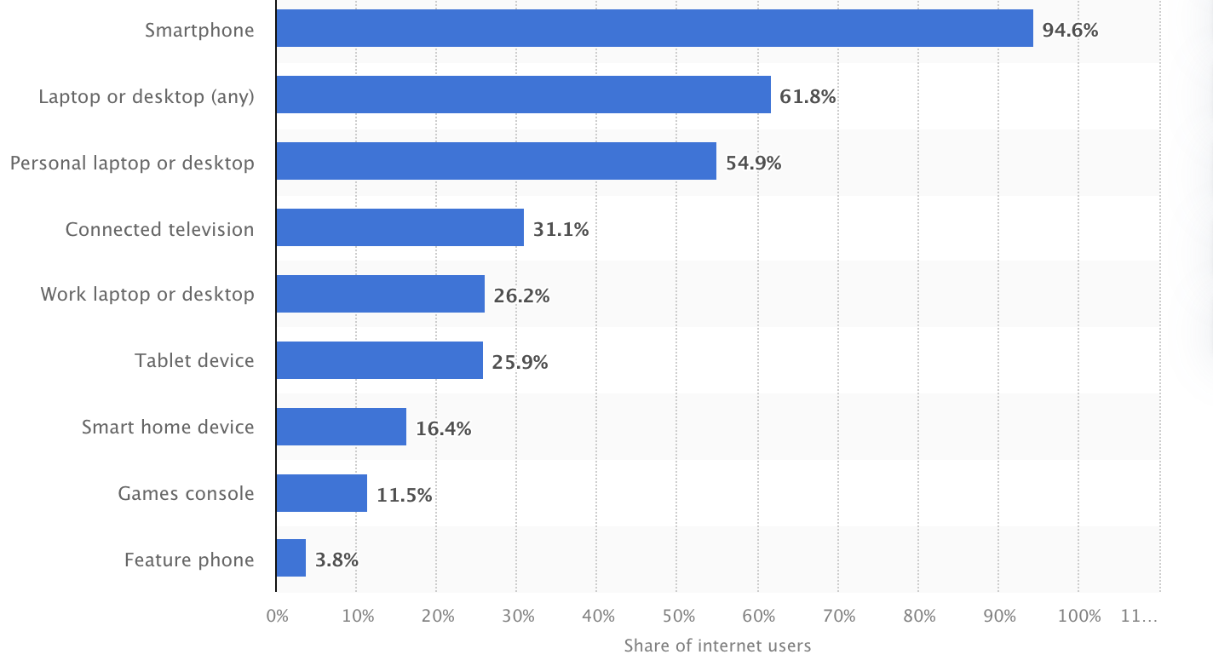
Which is the most important device you use to connect to the internet, at home or elsewhere?
https://www.statista.com/statistics/1289755/internet-access-by-device-worldwide/

Slide 7
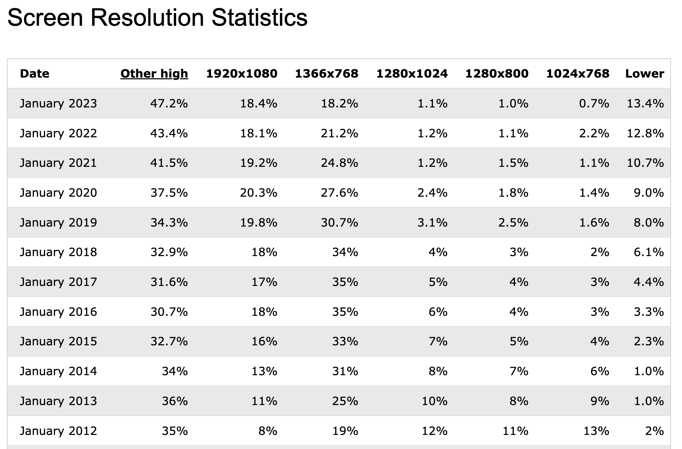

Slide 8

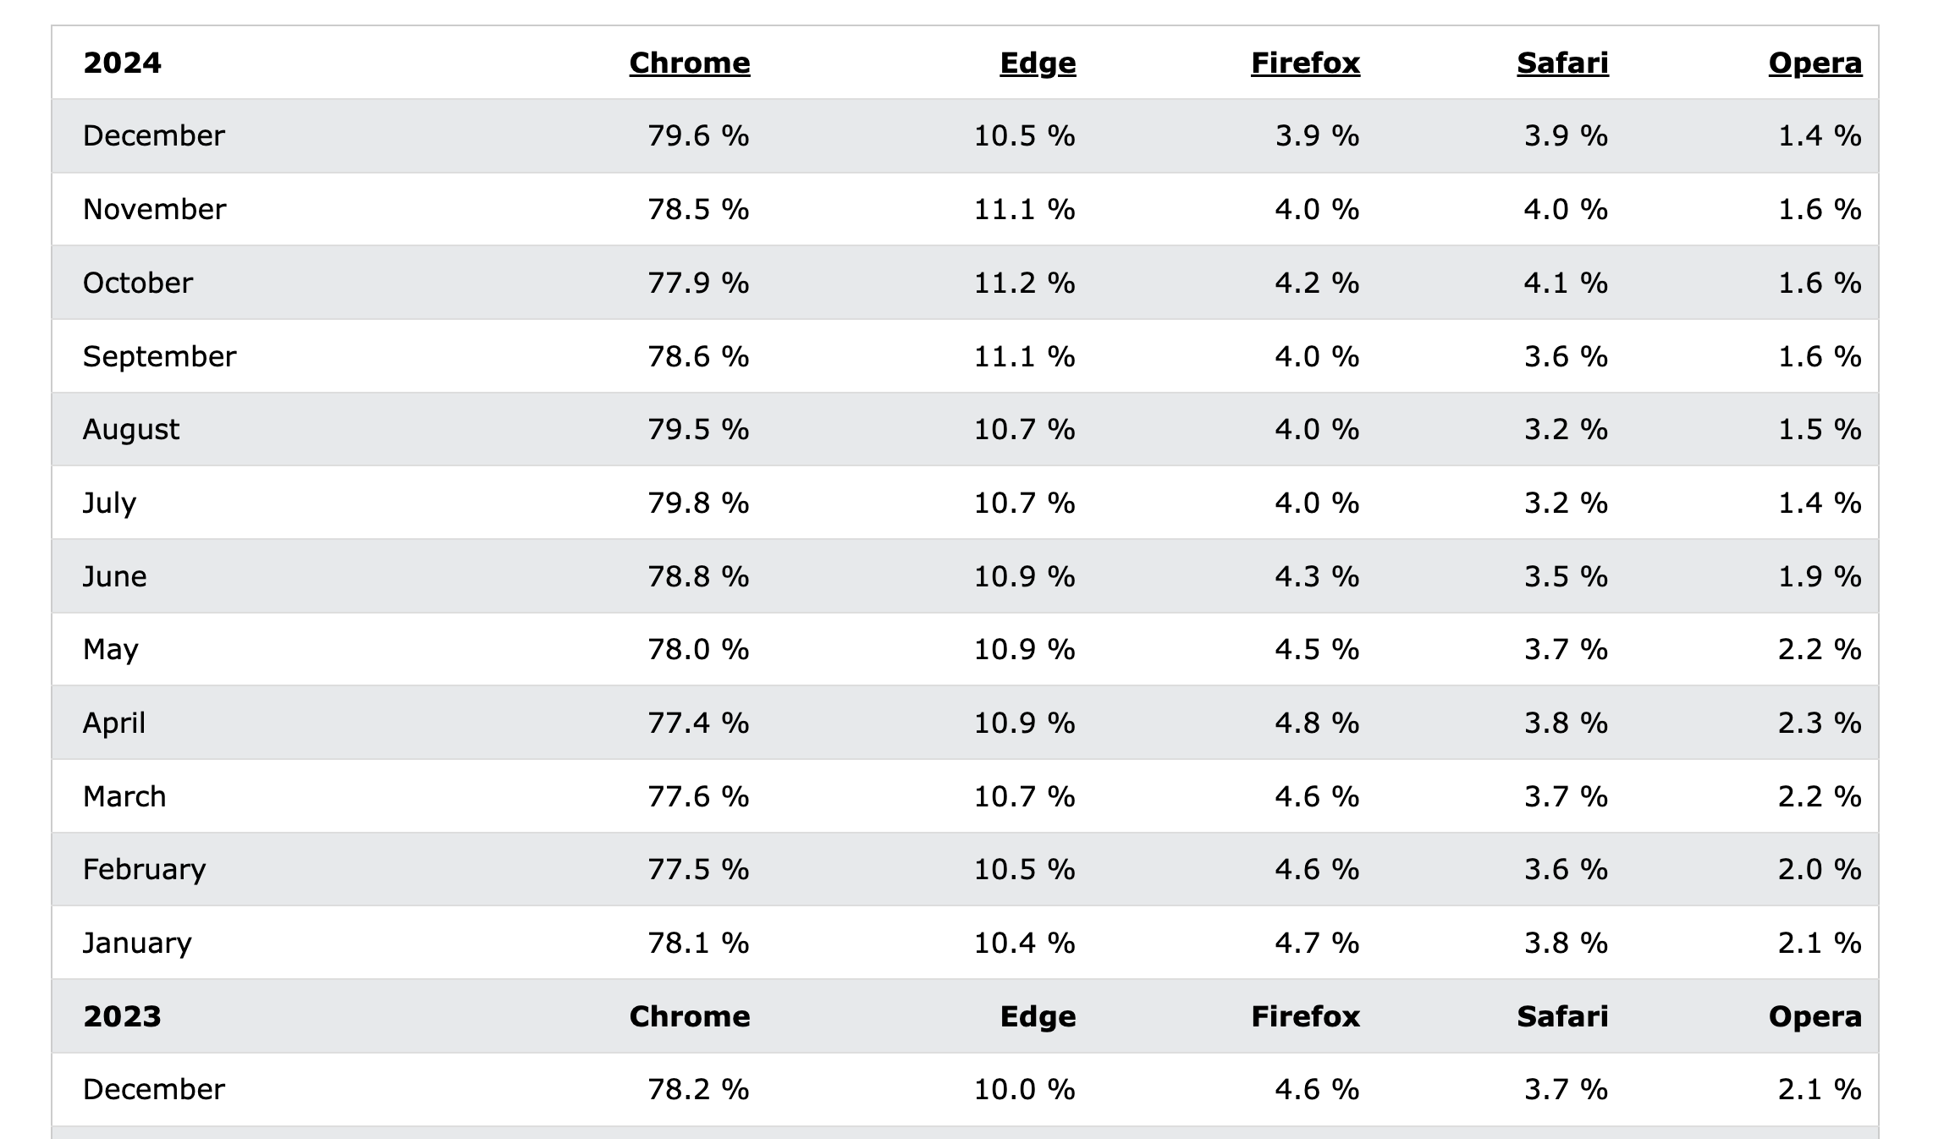

Slide 9
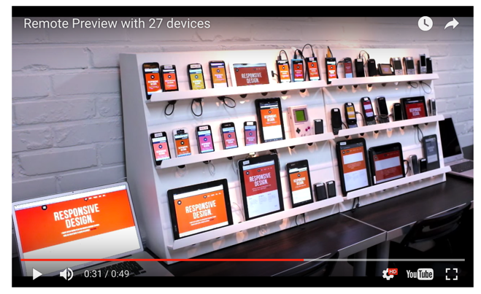
https://www.youtube.com/watch?v=7NvzRfyhd5Q

Slide 10
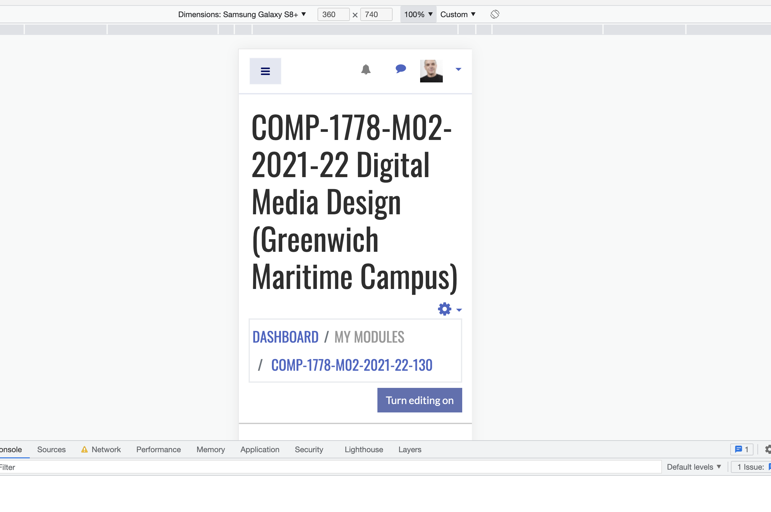
Chrome Dev Tools

Slide 11
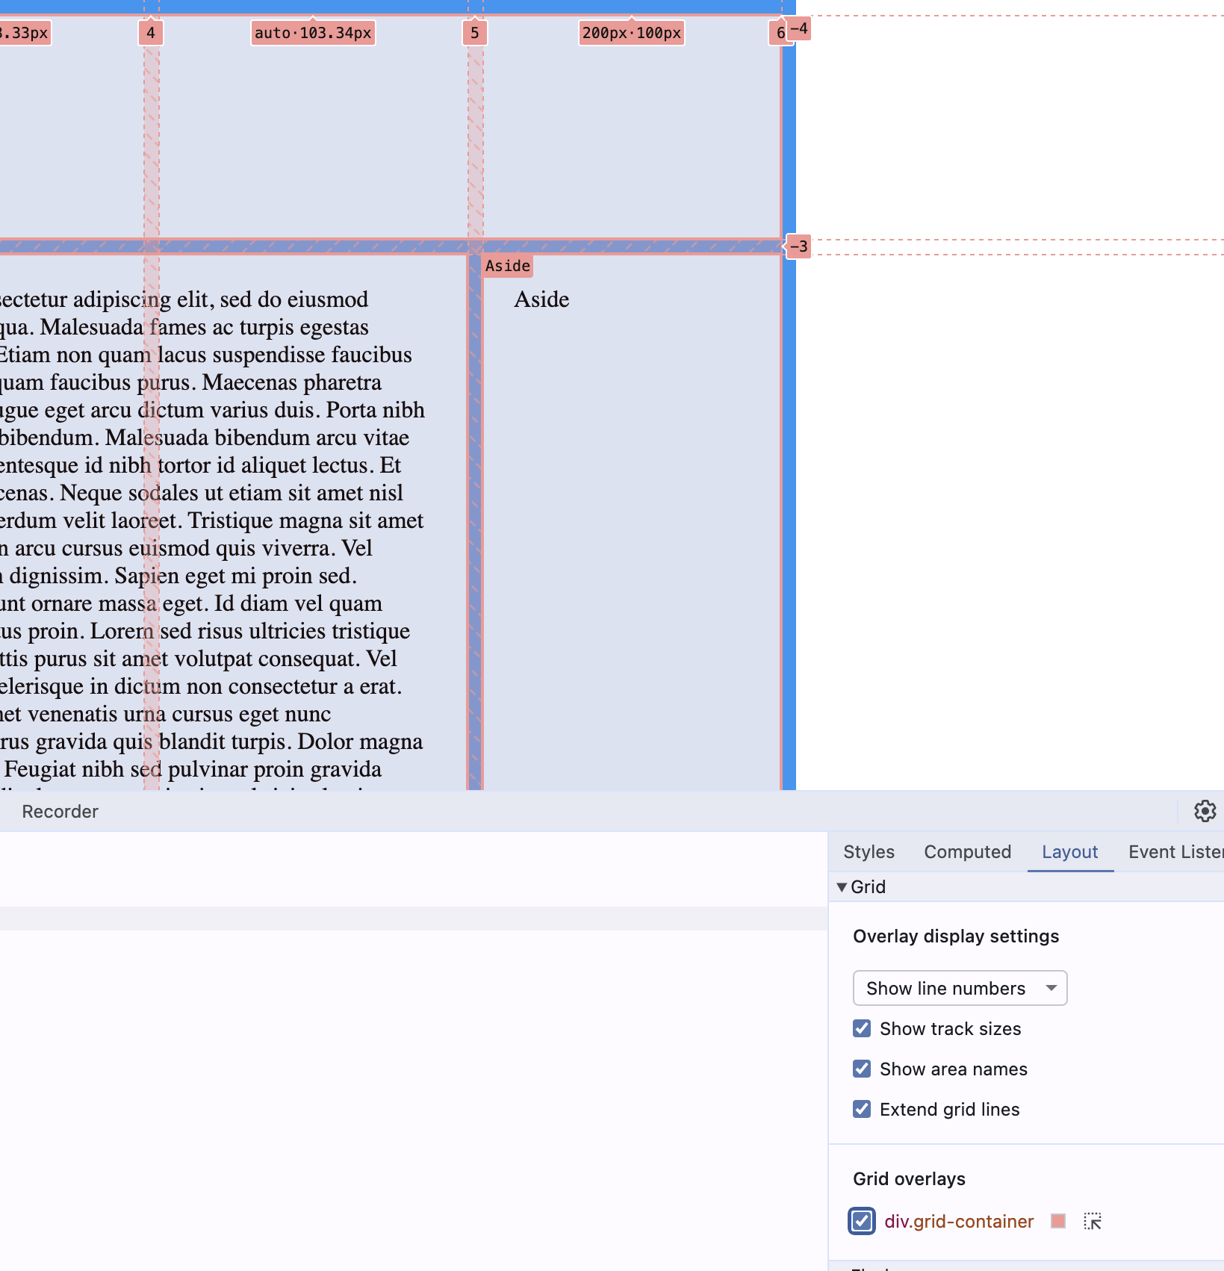
https://developer.chrome.com/docs/devtools/css/grid

Slide 12
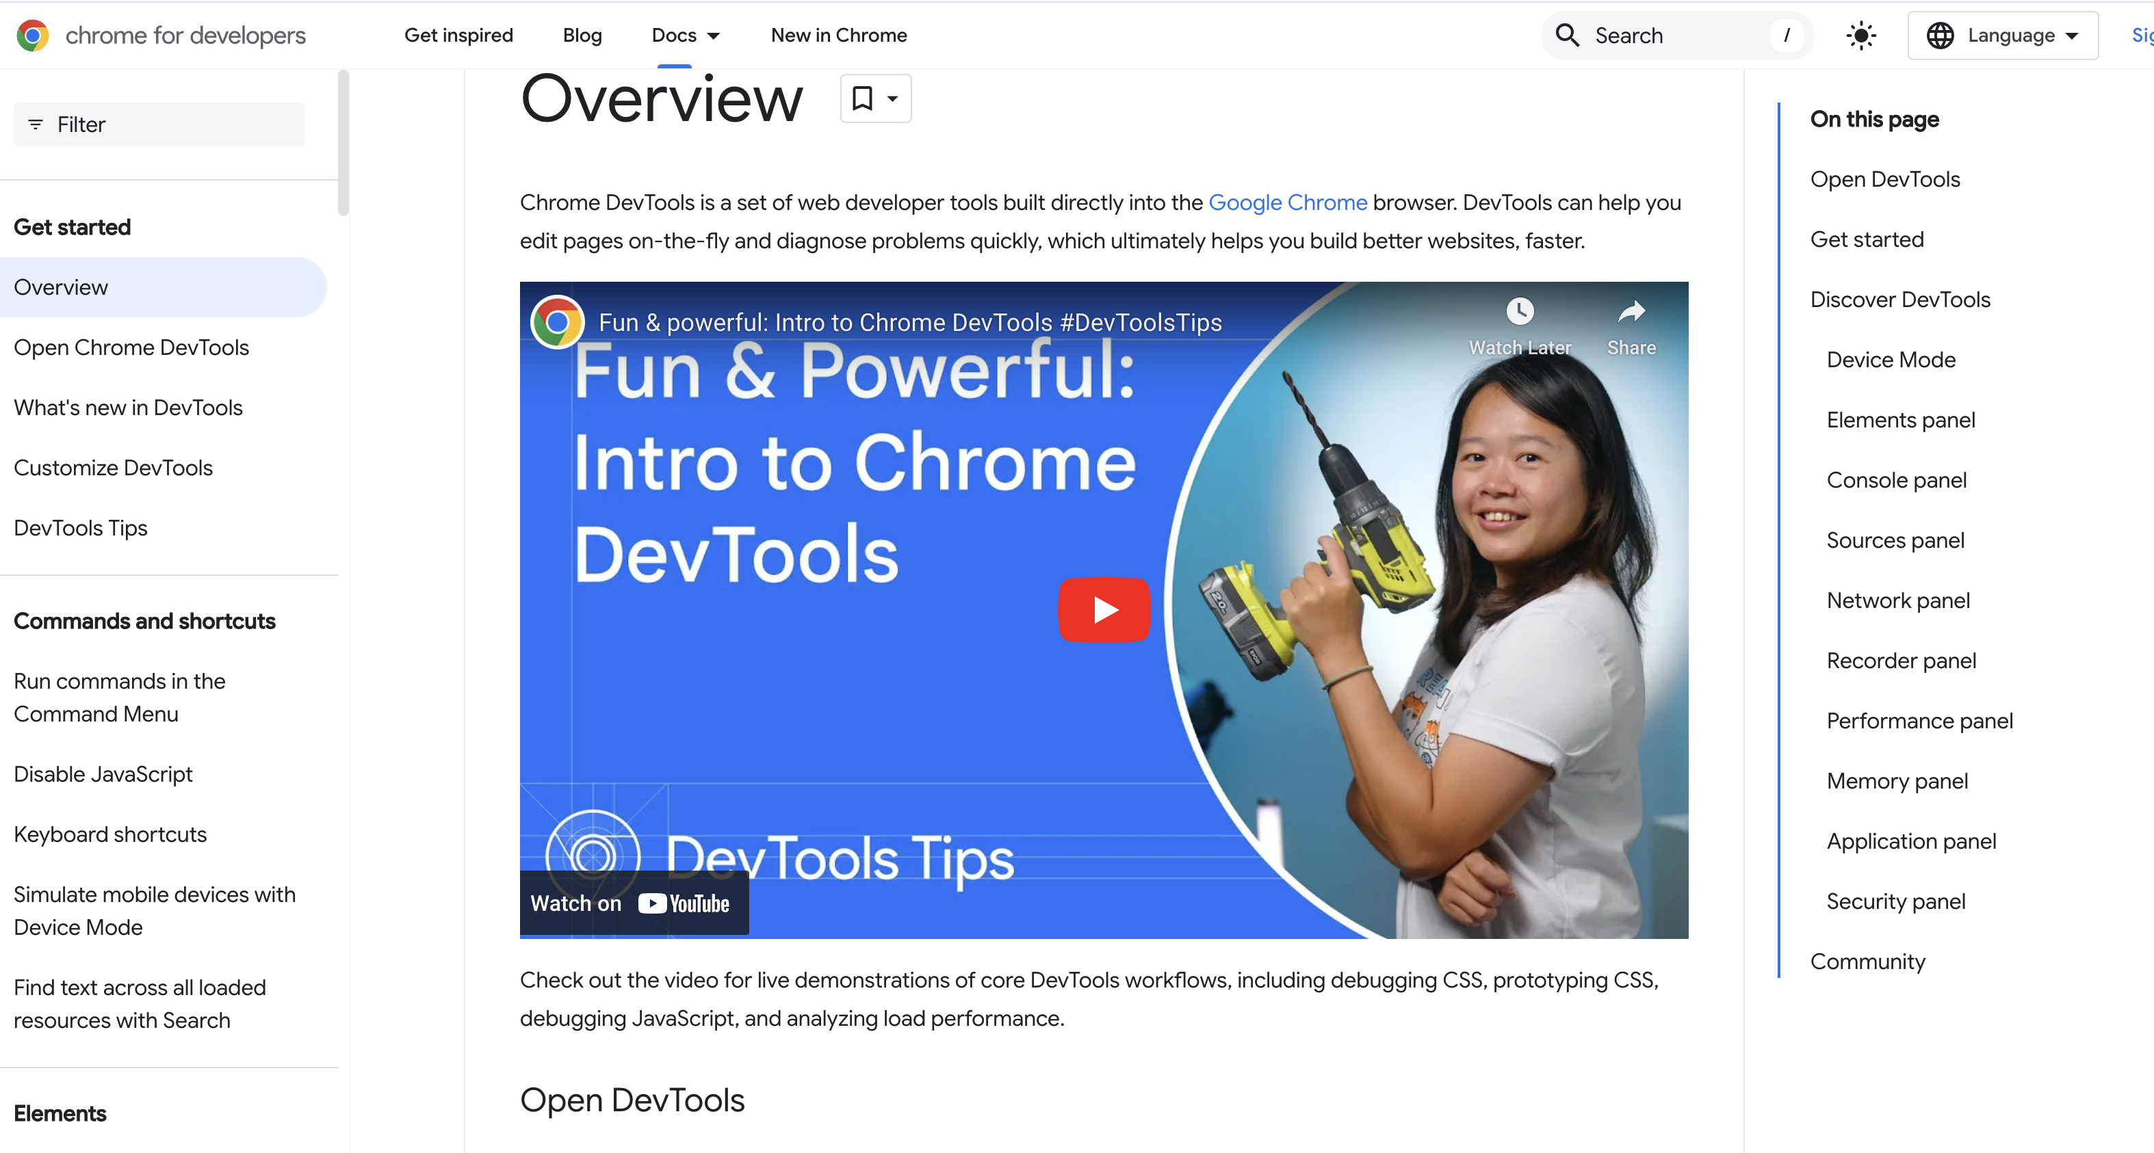
https://developer.chrome.com/docs/devtools/overview

Slide 13

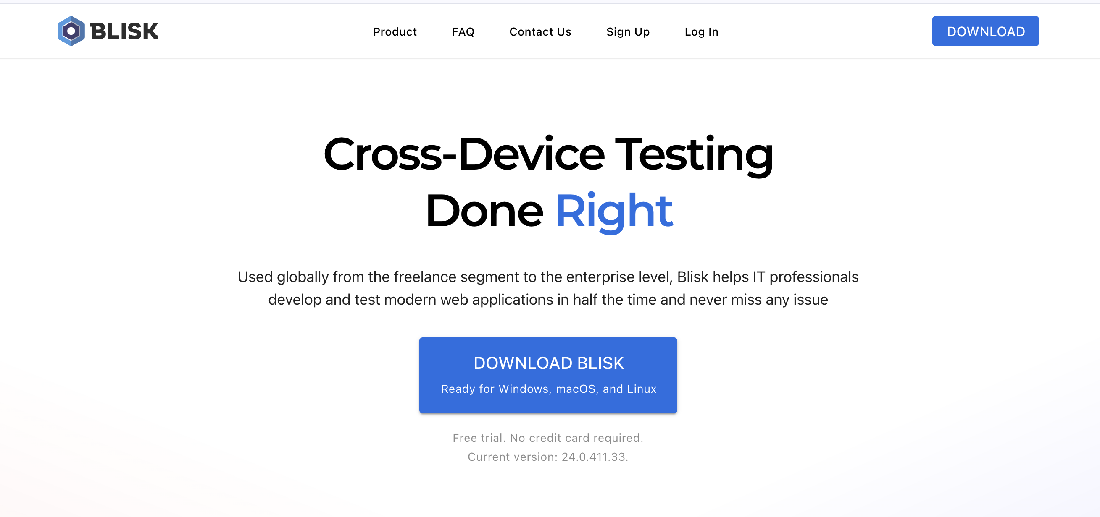
https://blisk.io/

Slide 14
The rise of mobile internet use means screen design must now encompass mobile design.
3 main options for mobile design / delivery.
Responsive web design
Native app / web app
Mobile specific site

Slide 15
RWD responsive web design

Slide 16
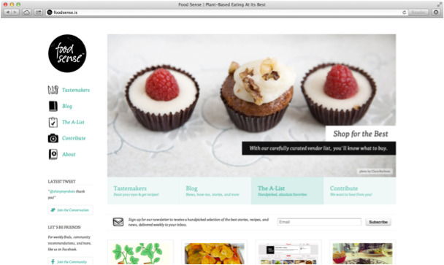
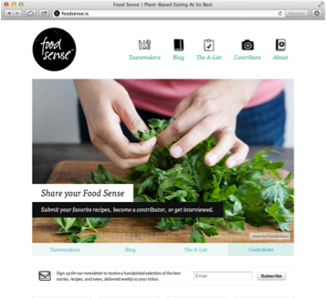

47 Responsive Web Design Examples
https://www.youtube.com/watch?v=5M5A8PHta38
COMP1678 – User Centred Web Engineering

Slide 17
What Is Responsive Web Design?
Responsive Web design is the approach that suggests that design and development should respond to the user’s behaviour and
environment based on screen size, platform and orientation.
The practice consists of a mix of flexible grids and layouts, images and an intelligent use of CSS media queries. As the user switches
from their laptop to iPad, the website should automatically switch to accommodate for resolution, image size and scripting abilities.

Slide 18
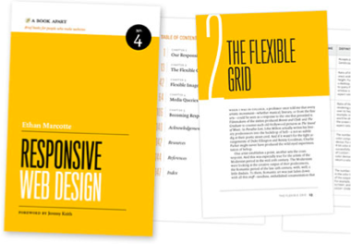
Ethan Marcotte
Ethan Marcotte coined the term responsive web design (RWD)—and defined it to mean fluid grid/ flexible images/ media queries—in a May 2010 article in A List Apart.
He described the theory and practice of responsive web design in his
brief 2011 book titled Responsive Web Design.

Slide 19
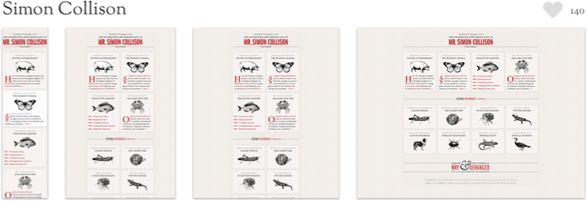
Media Queries
“The W3C created media queries as part of the CSS3 specification, improving upon the promise of media types. A media query allows us to target not only certain device classes, but to actually inspect the physical characteristics of the device rendering our work.”
- Ethan Marcotte

Slide 20


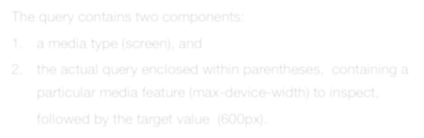
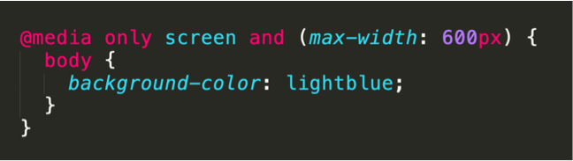
The query contains two components:
a media type (screen), and
the actual query enclosed within parentheses, containing a particular media feature (max-device-width) to inspect, followed by the target value (600px).

Slide 21


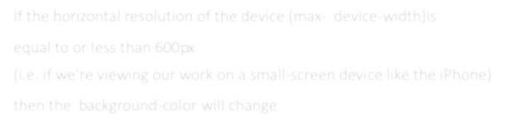
If the horizontal resolution of the device (max- device-width) is equal to or less than 600px
(i.e. if we’re viewing our work on a small-screen device like the iPhone) then the background-color will change
https://www.w3schools.com/css/tryit.asp?filename=tryresponsive_mediaquery

Slide 22



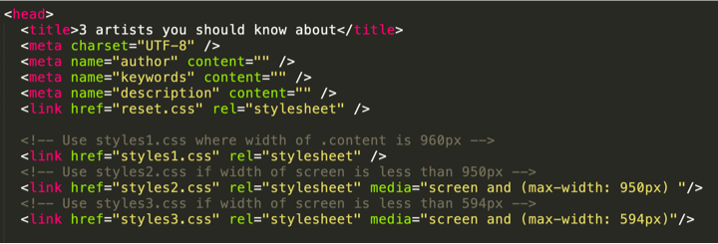
We can also load in an entirely different CSS page depending on screen width too, this can be used to create “adaptive” designs

Slide 23
Demo responsive design folder and adaptive design folder

Slide 24
Fluid vs Static layout
What is the difference ?

Slide 25
Responsive vs Adaptive
What is the difference

Slide 26
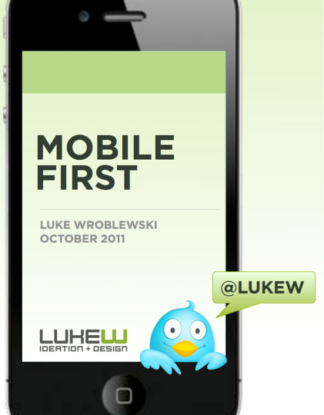
Luke Wroblewski
COMP1678 – User Centred Web Engineering
https://www.lukew.com/resources/mobile_first.asp

Slide 27
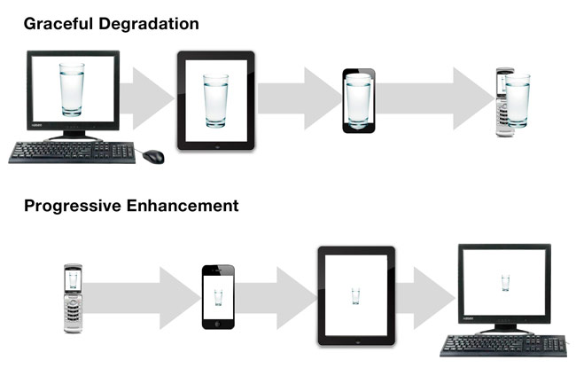
Mobile first

Slide 28
CSS Frameworks

Slide 29
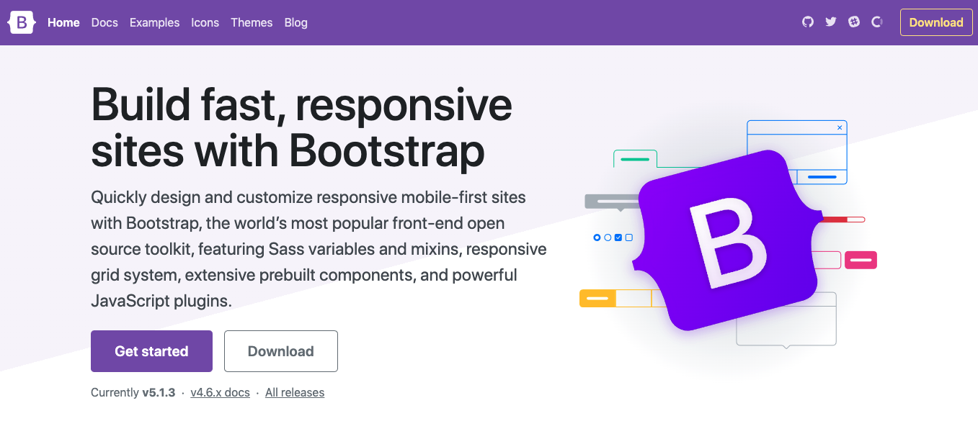

Slide 30
What is Bootstrap
Bootstrap is a front-end framework that helps developers to jump start the web development process.
Bootstrap is not only useful for novice web developers, but for expert coders too.
The idea is that with Bootstrap you only have to concentrate on writing proper HTML, leaving the tricky CSS and JavaScript to Bootstrap.

Slide 31
Why Bootstrap
Imagine you have to design a website with an attractive navigation bar, stylish buttons, nice typography etc—yet you aren't a front end development expert.
But what if these features were already coded for you, and you just had to write a little HTML to use them? This is Bootstrap.
Bootstrap is more than just decorating links, images and typography. One of its most important features is the grid system. You cannot create a mobile-friendly and responsive website without the grid system.

Slide 32

Why Bootstrap cont…
All the CSS classes and JavaScript code needed are already included in the Bootstrap package. For example, using the class btn with link (<a></a>) elements will make them appear like a button below.
Also using the btn-primary class with a link will make it a dark blue button:
<a href="http://www.google.com" class="btn btn-primary”>Visit Google</a>
https://getbootstrap.com/docs/5.3/components/buttons/

Slide 33
The origins of Bootstrap
Bootstrap was developed in 2011 by Mark Otto and Jacob Thornton, a pair of web developers at Twitter. Their main focus was to bring consistency and maintainability in their code.
Bootstrap 1.0.0 was launched in 2011 with only CSS and HTML components. There were no JavaScript plugins included in it until Bootstrap 1.3.0, a version that was also compatible with IE7 and IE8.
After 15 major updates, Bootstrap 3 in 2013 was another significant release, becoming a “Mobile First and always responsive” framework.
The current and very new version is 5.3

Slide 34
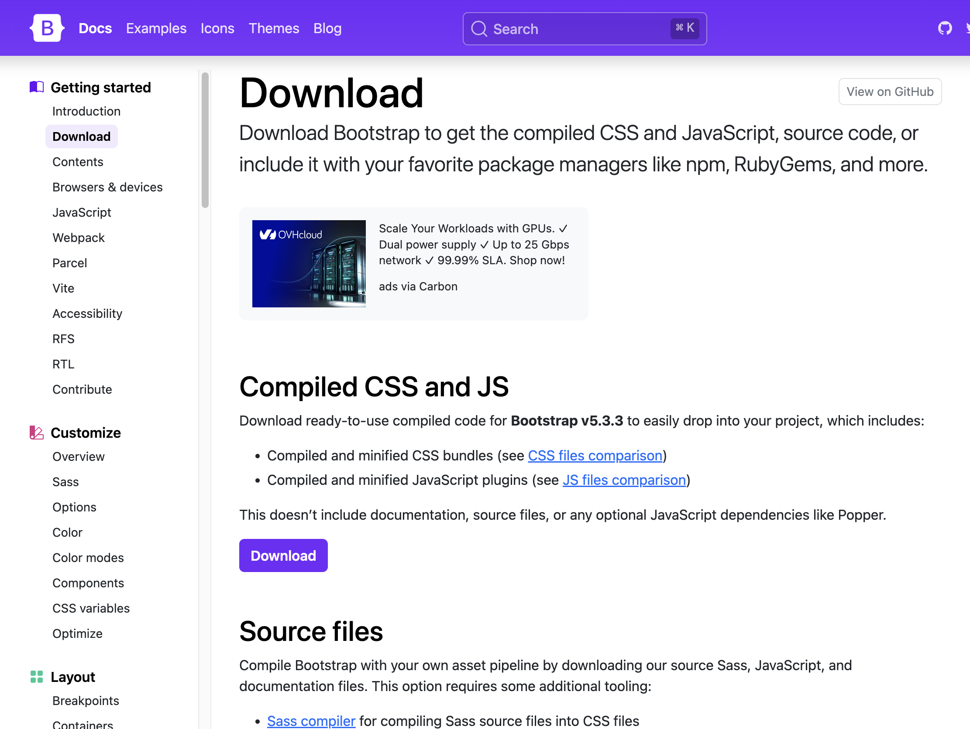
https://getbootstrap.com/docs/5.3/getting-started/download/

Slide 35
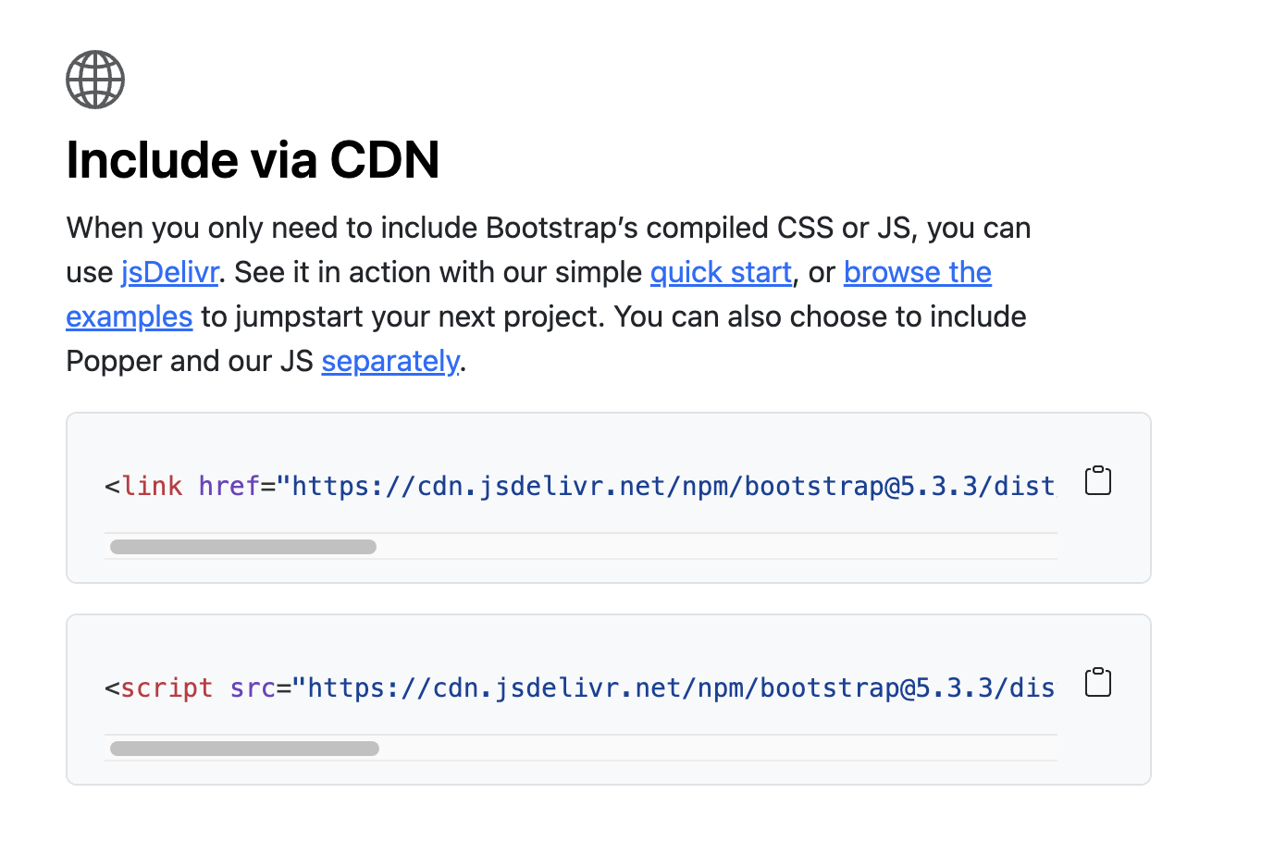
Even easier - use the CDN (content delivery network)
https://getbootstrap.com/
https://getbootstrap.com/docs/5.3/getting-started/introduction/#quick-start

Slide 36
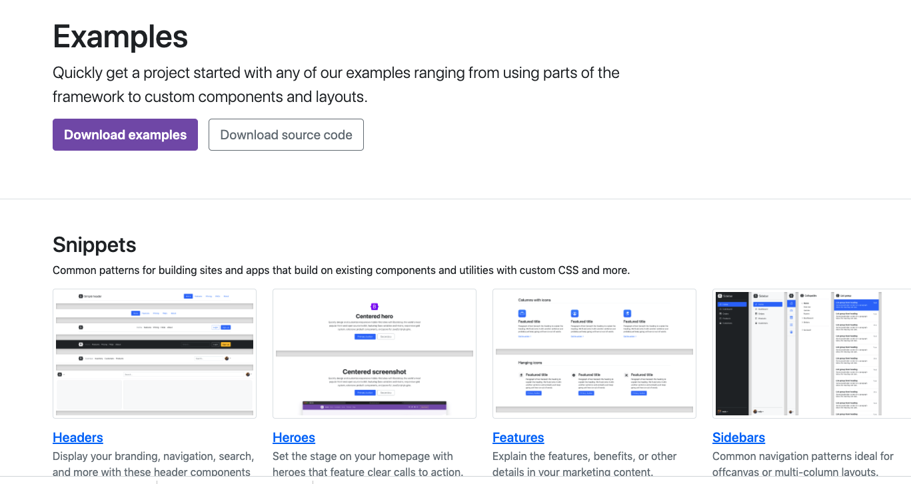
Example templates
https://getbootstrap.com/docs/5.3/examples/

Slide 37
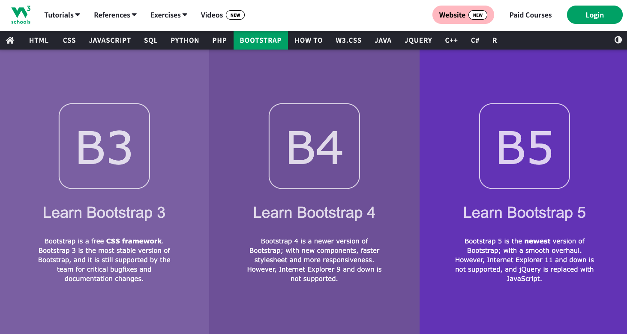
Try the excellent tutorials at W3schools
https://www.w3schools.com/bootstrap/bootstrap_ver.asp

Slide 38
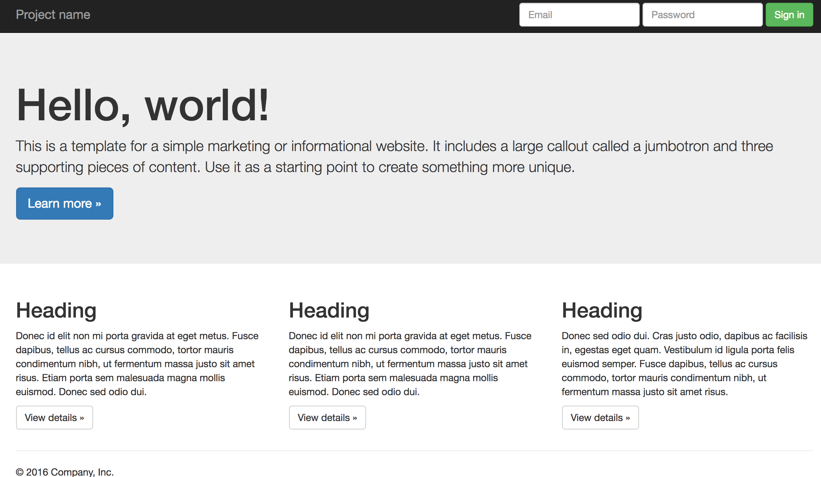
Bootstrap is responsive by default

Slide 39
CSS Frameworks (cont...)
There are many other CSS frameworks out there, some very specialised and others very general.
Let’s have a look at a couple to see how they diﬀer from Bootstrap and what they could oﬀer your work.

Slide 40
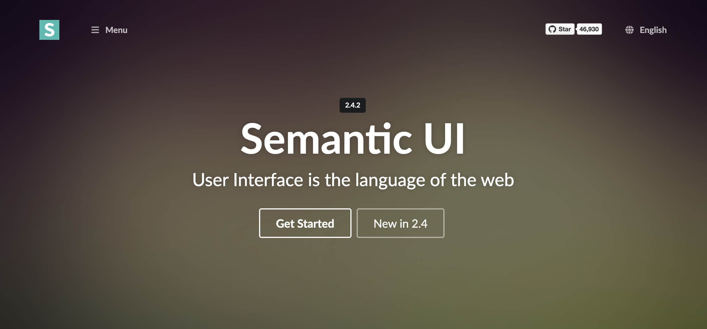
A fluid version of 960.gs - it supports columns resizing as the window size changes, as they are all based on percentages rather than fixed widths as in 960.gs.
https://semantic-ui.com/

Slide 41
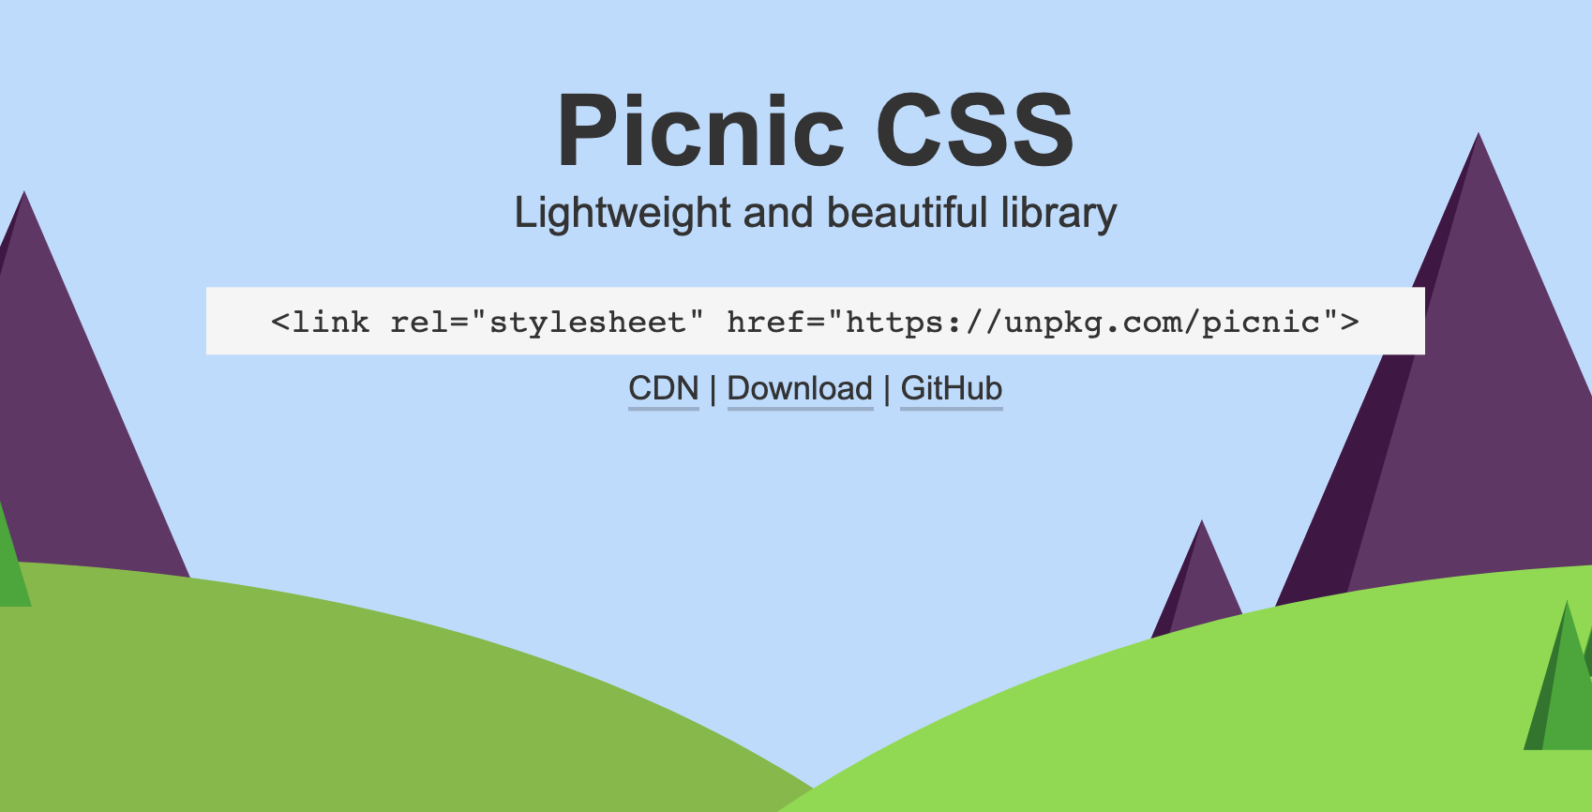
https://picnicss.com/

Slide 42
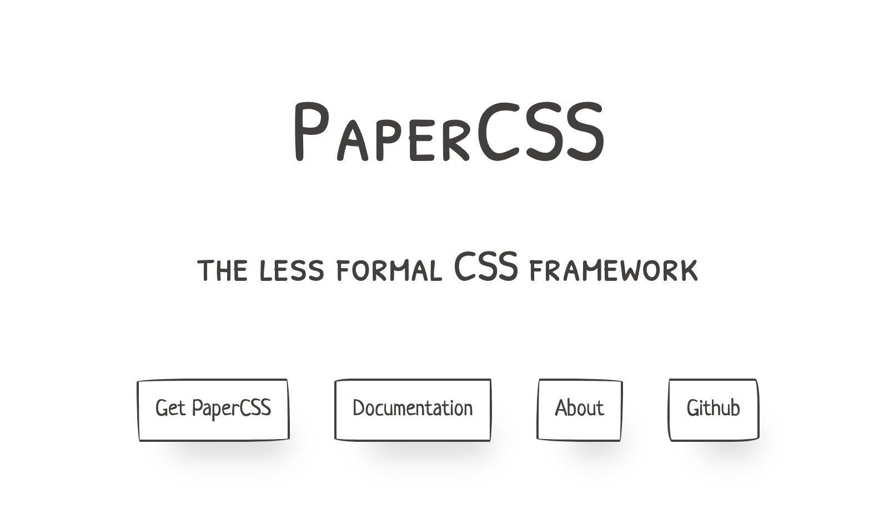
https://www.getpapercss.com/

Slide 43
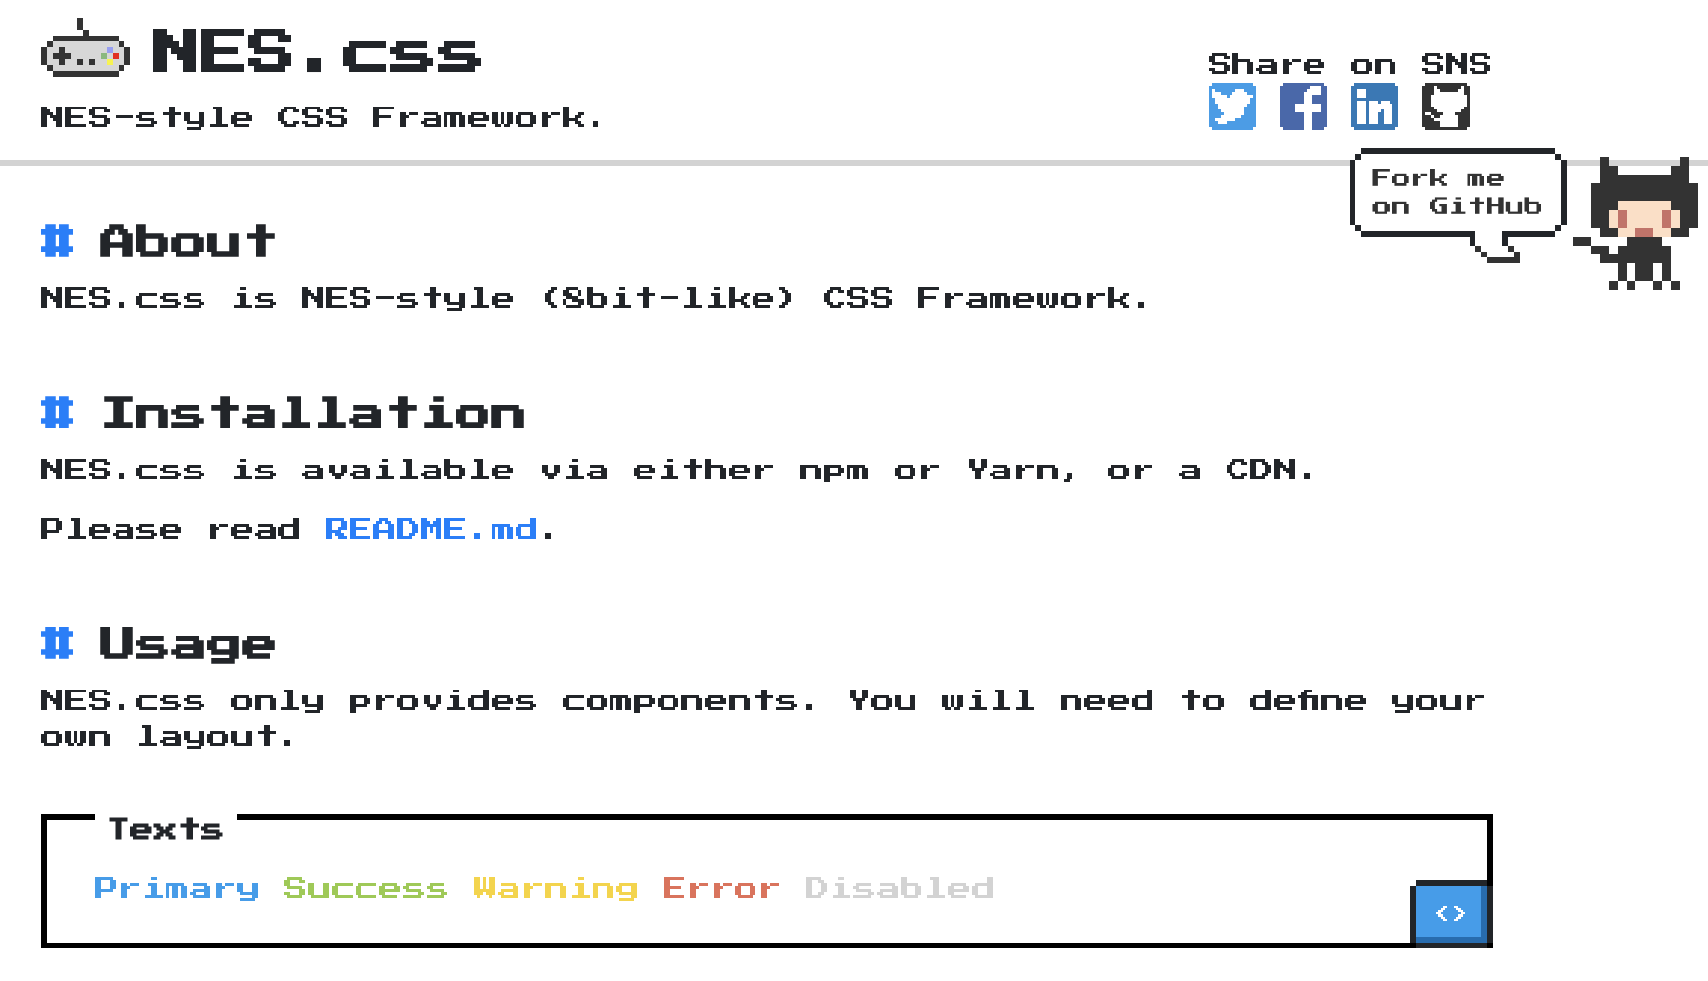
https://nostalgic-css.github.io/NES.css/

Slide 44
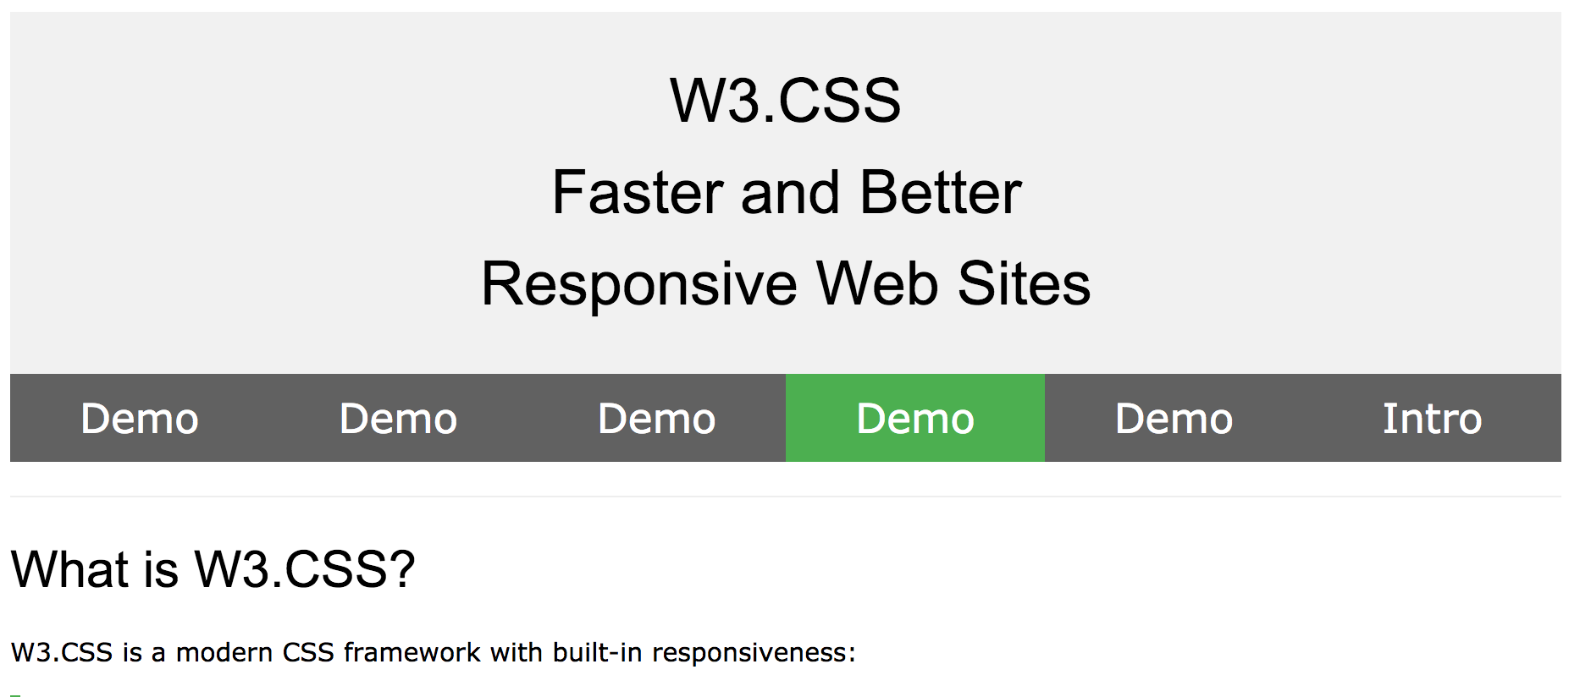
W3 schools have one too
https://www.w3schools.com/w3css/default.asp

Slide 45
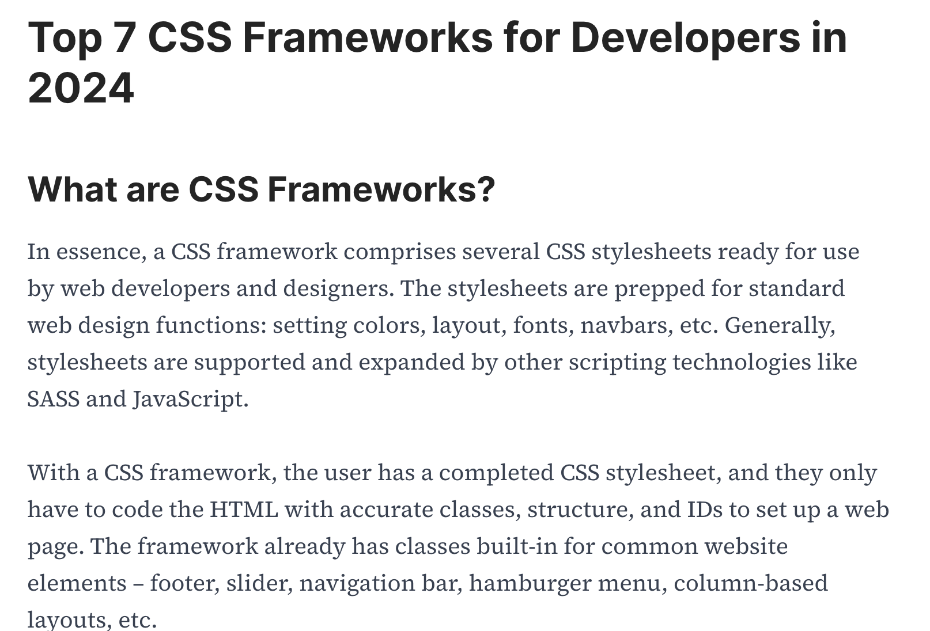
https://www.browserstack.com/guide/top-css-frameworks

Slide 46
For your coursework I would like you to at least try and hand code the CSS.
In later modules in the 2nd Also, you are free to use frameworks. But it is worth the experience of trying to hand code CSS at least once.
Also, an understanding of vanilla CSS will be essential for debugging and tweaking code from frameworks.
But you are absolutely allowed to use online resources to help with your CSS and use components from W3 schools for example, just make sure your reference it in your code comments
See below for a list:
https://www.w3schools.com/howto/default.asp

Slide 47
Questions
?

