Slide 1

Introduction to JavaScript
COMP 1589
Matt Prichard
COMP1314 - Digital Media, Computing and Programming

Slide 2
Why JavaScript?

Slide 3
What is JavaScript
JavaScript is a platform-independent, event-driven, interpreted programming language.
JavaScript's official name is "ECMAScript". The standard is developed and maintained by the ECMA organisation.
ECMA-262 is the official JavaScript standard. The standard is based on JavaScript (Netscape) and JScript (Microsoft).
The language was invented by Brendan Eich at Netscape (with Navigator 2.0), and has appeared in all Netscape (defunct since Mar 2008) and Microsoft browsers since 1996.

Slide 4
What is JavaScript Cont...
JavaScript was designed to add interactivity and to provide client-side programming to HTML pages
JavaScript is a scripting language or a lightweight programming language .
Executable JavaScript may be included into an HTML page as either...
External - a separate file containing JavaScript
Embedded - as the content of a <script> element
Inline - as the value of an HTML event attribute
Everyone can use JavaScript without purchasing a license

Slide 5

“JavaScript is THE scripting language of the Web. JavaScript is used in billions of Web pages to add functionality, validate forms, communicate with the server, and much more.”

Slide 6


JavaScript is not Java

Slide 7
Introduction to
JavaScript
demonstrations

Slide 8
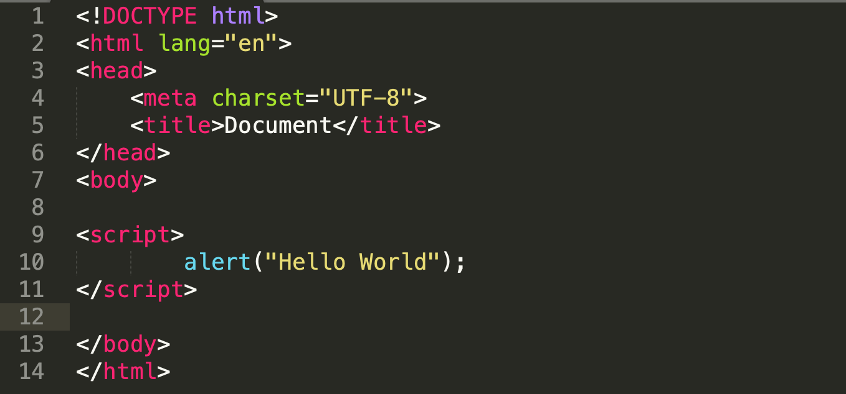
To insert a JavaScript into an HTML page, use the <script> tag. The <script> and </script> tells where the JavaScript starts and ends. The lines between the <script> and </script> contain the JavaScript.

Slide 9



alert(expression);
evaluates the expression and displays the result in an alert box

Slide 10
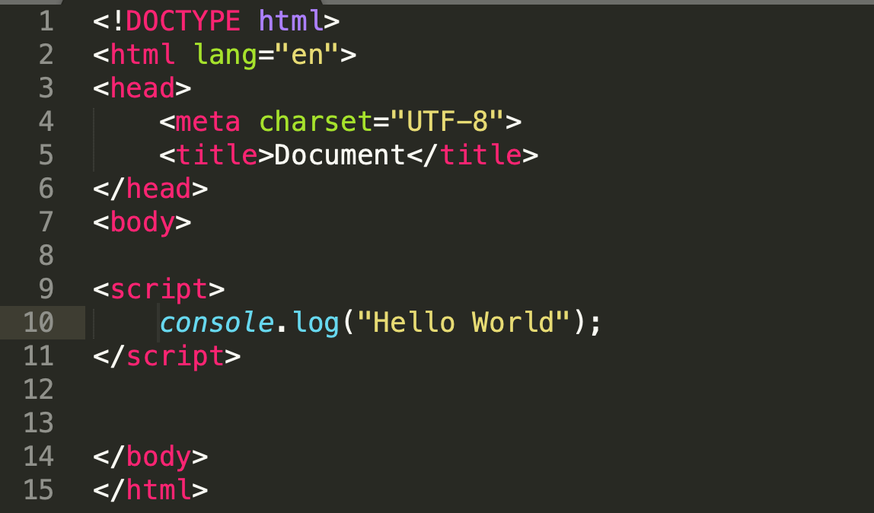

Slide 11



console.log(expression);
evaluates the expression and displays the result in the JavaScript Console

Slide 12
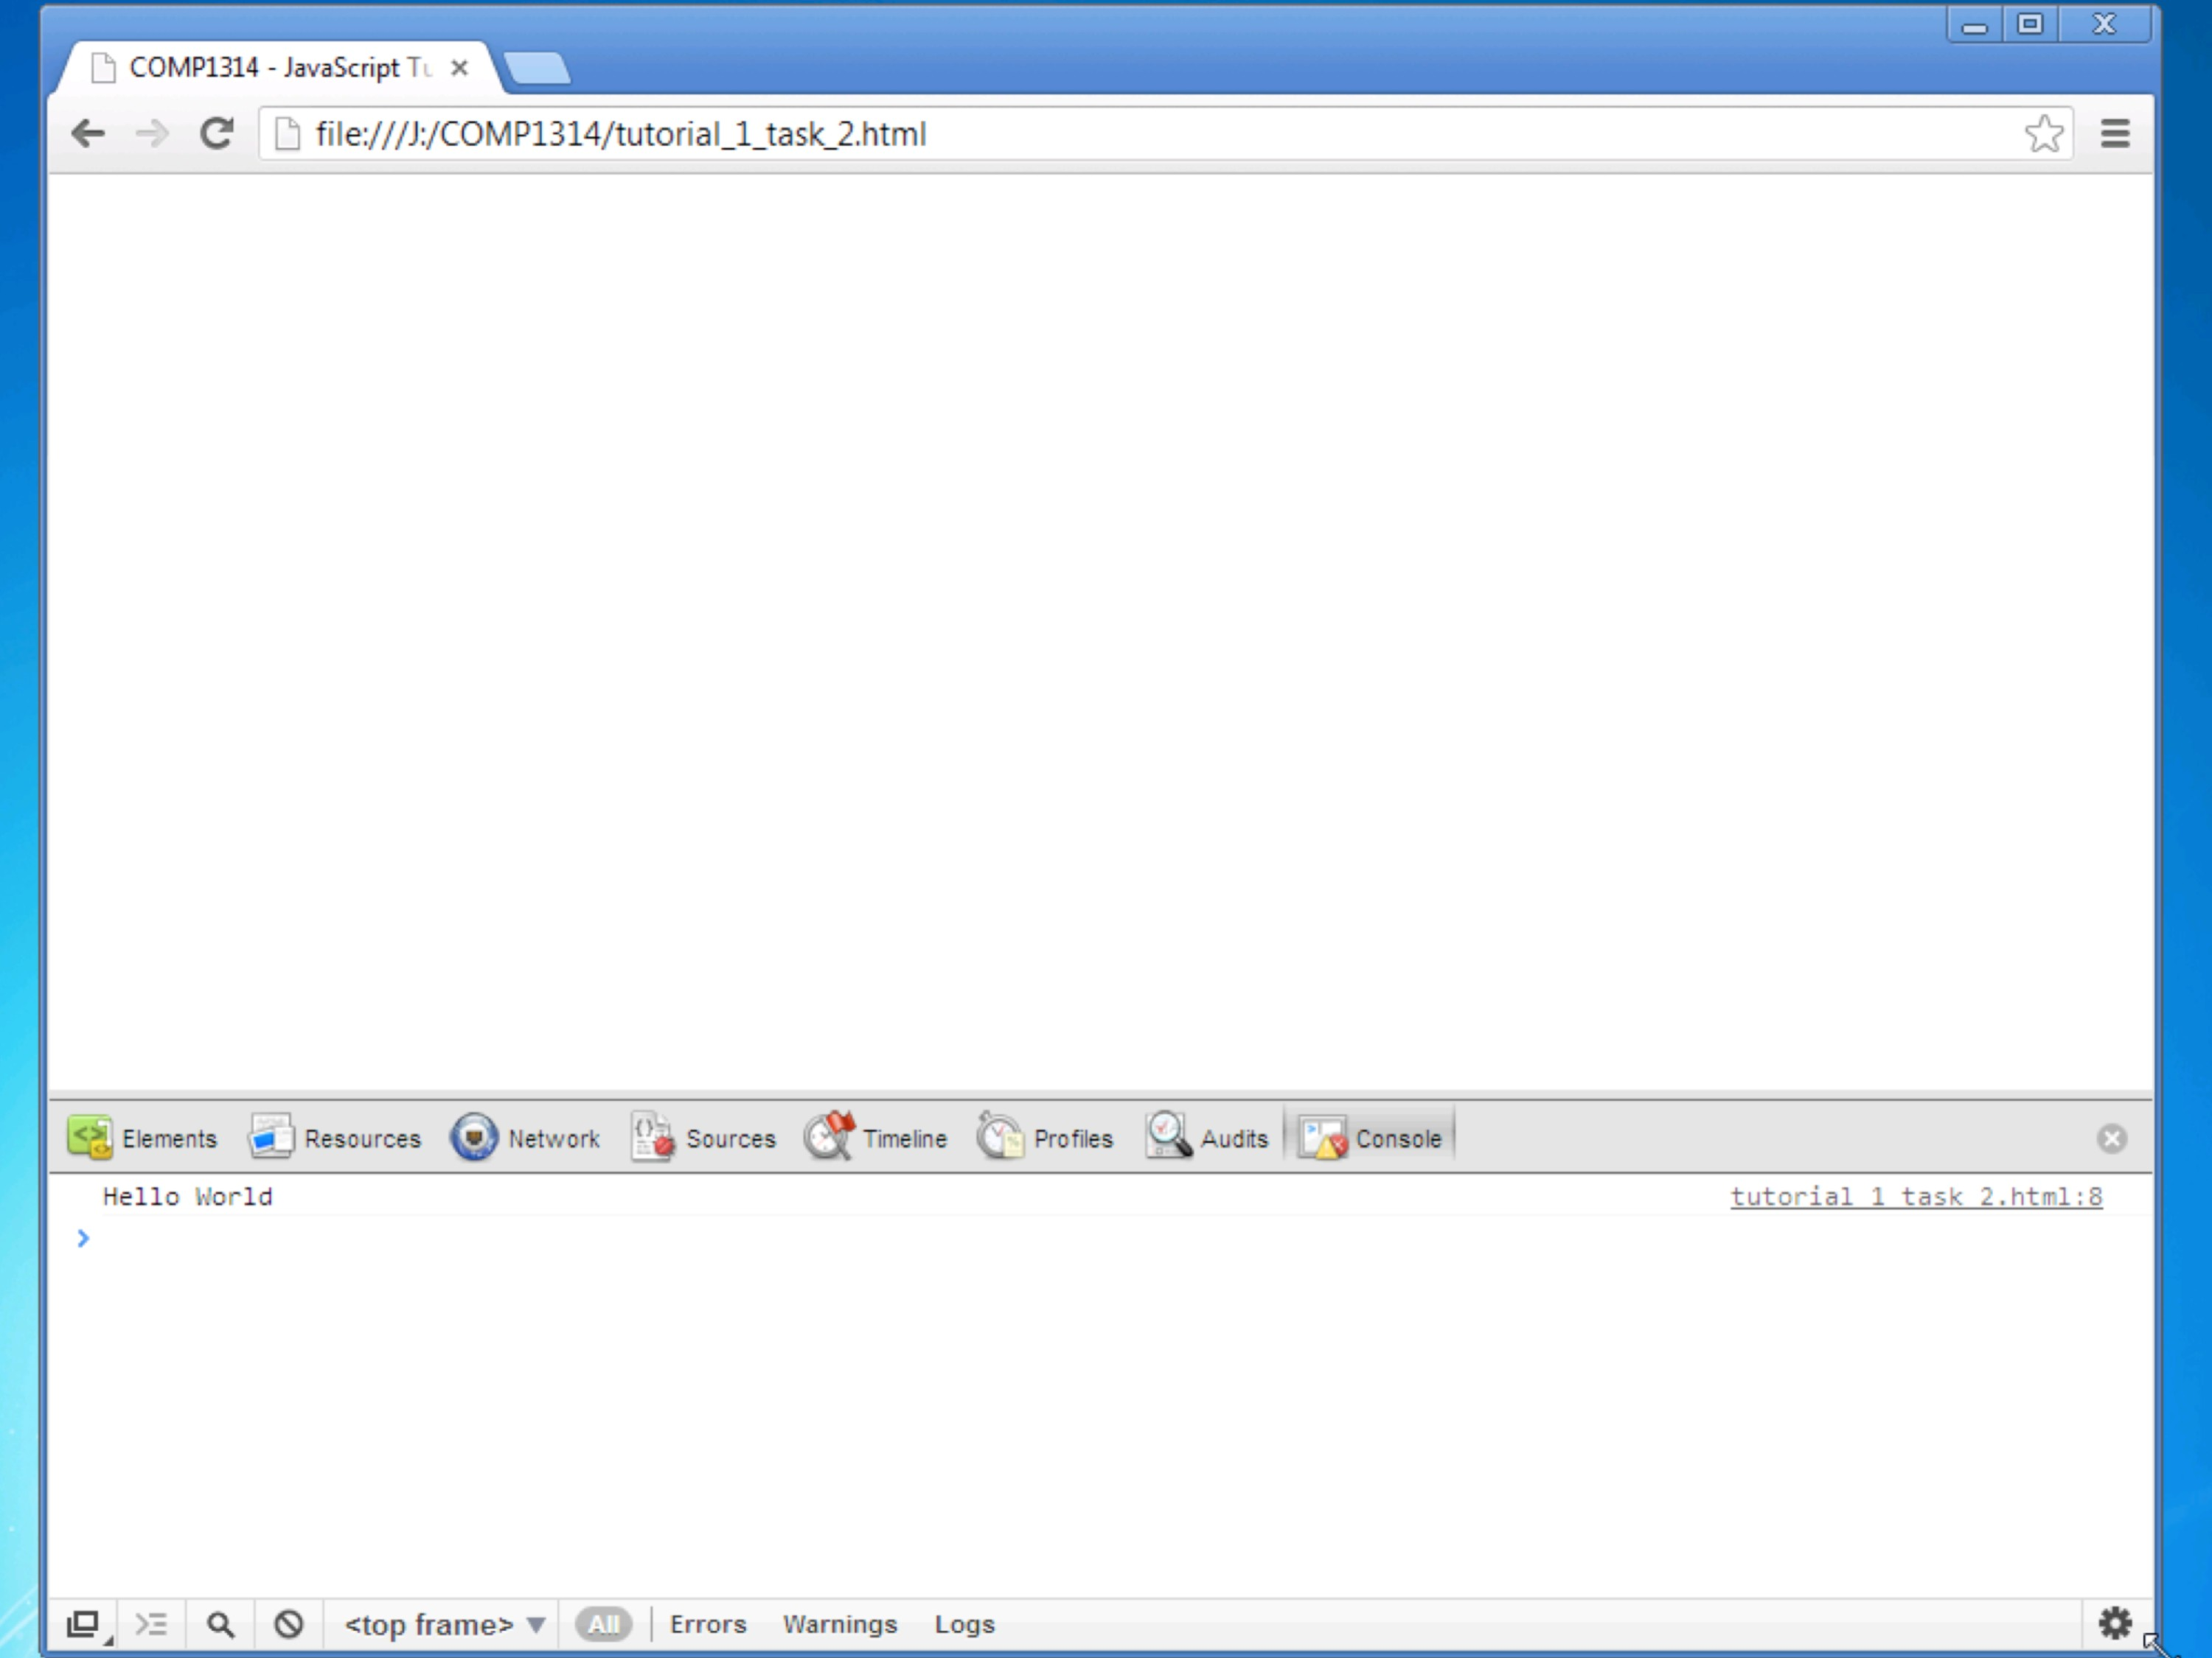
COMP1314 - Digital Media, Computing and Programming

Slide 13

innerHTML
Another way to get output to the screen is using innerHTML
This allows us to output to any HTML element we know the ‘id’ of.
We create an HTML element and give it an ID.

Slide 14
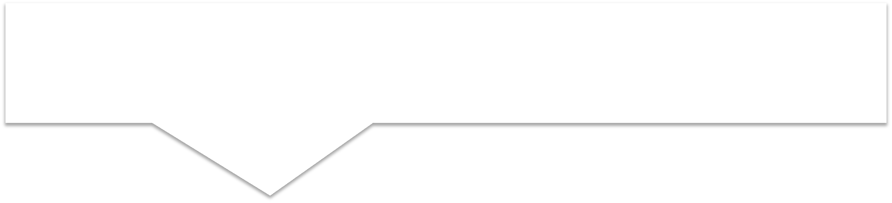



innerHTML cont.
The getElementById() method accesses the first element with the specified id.
Then access the inner HTML property of that element and assign it a value

Slide 15
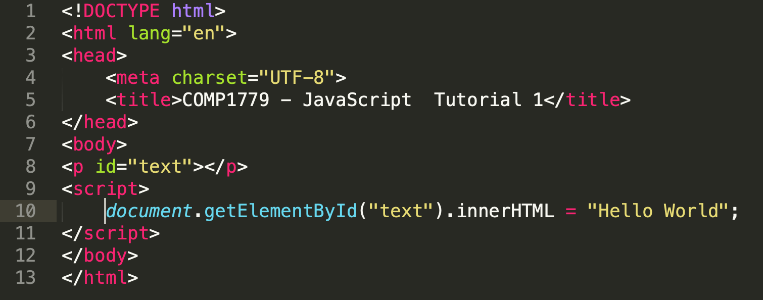

Slide 16
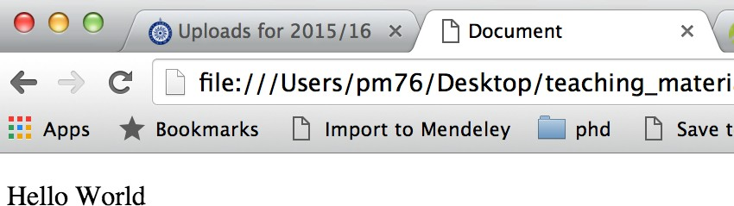
Inner html in a browser

Slide 17
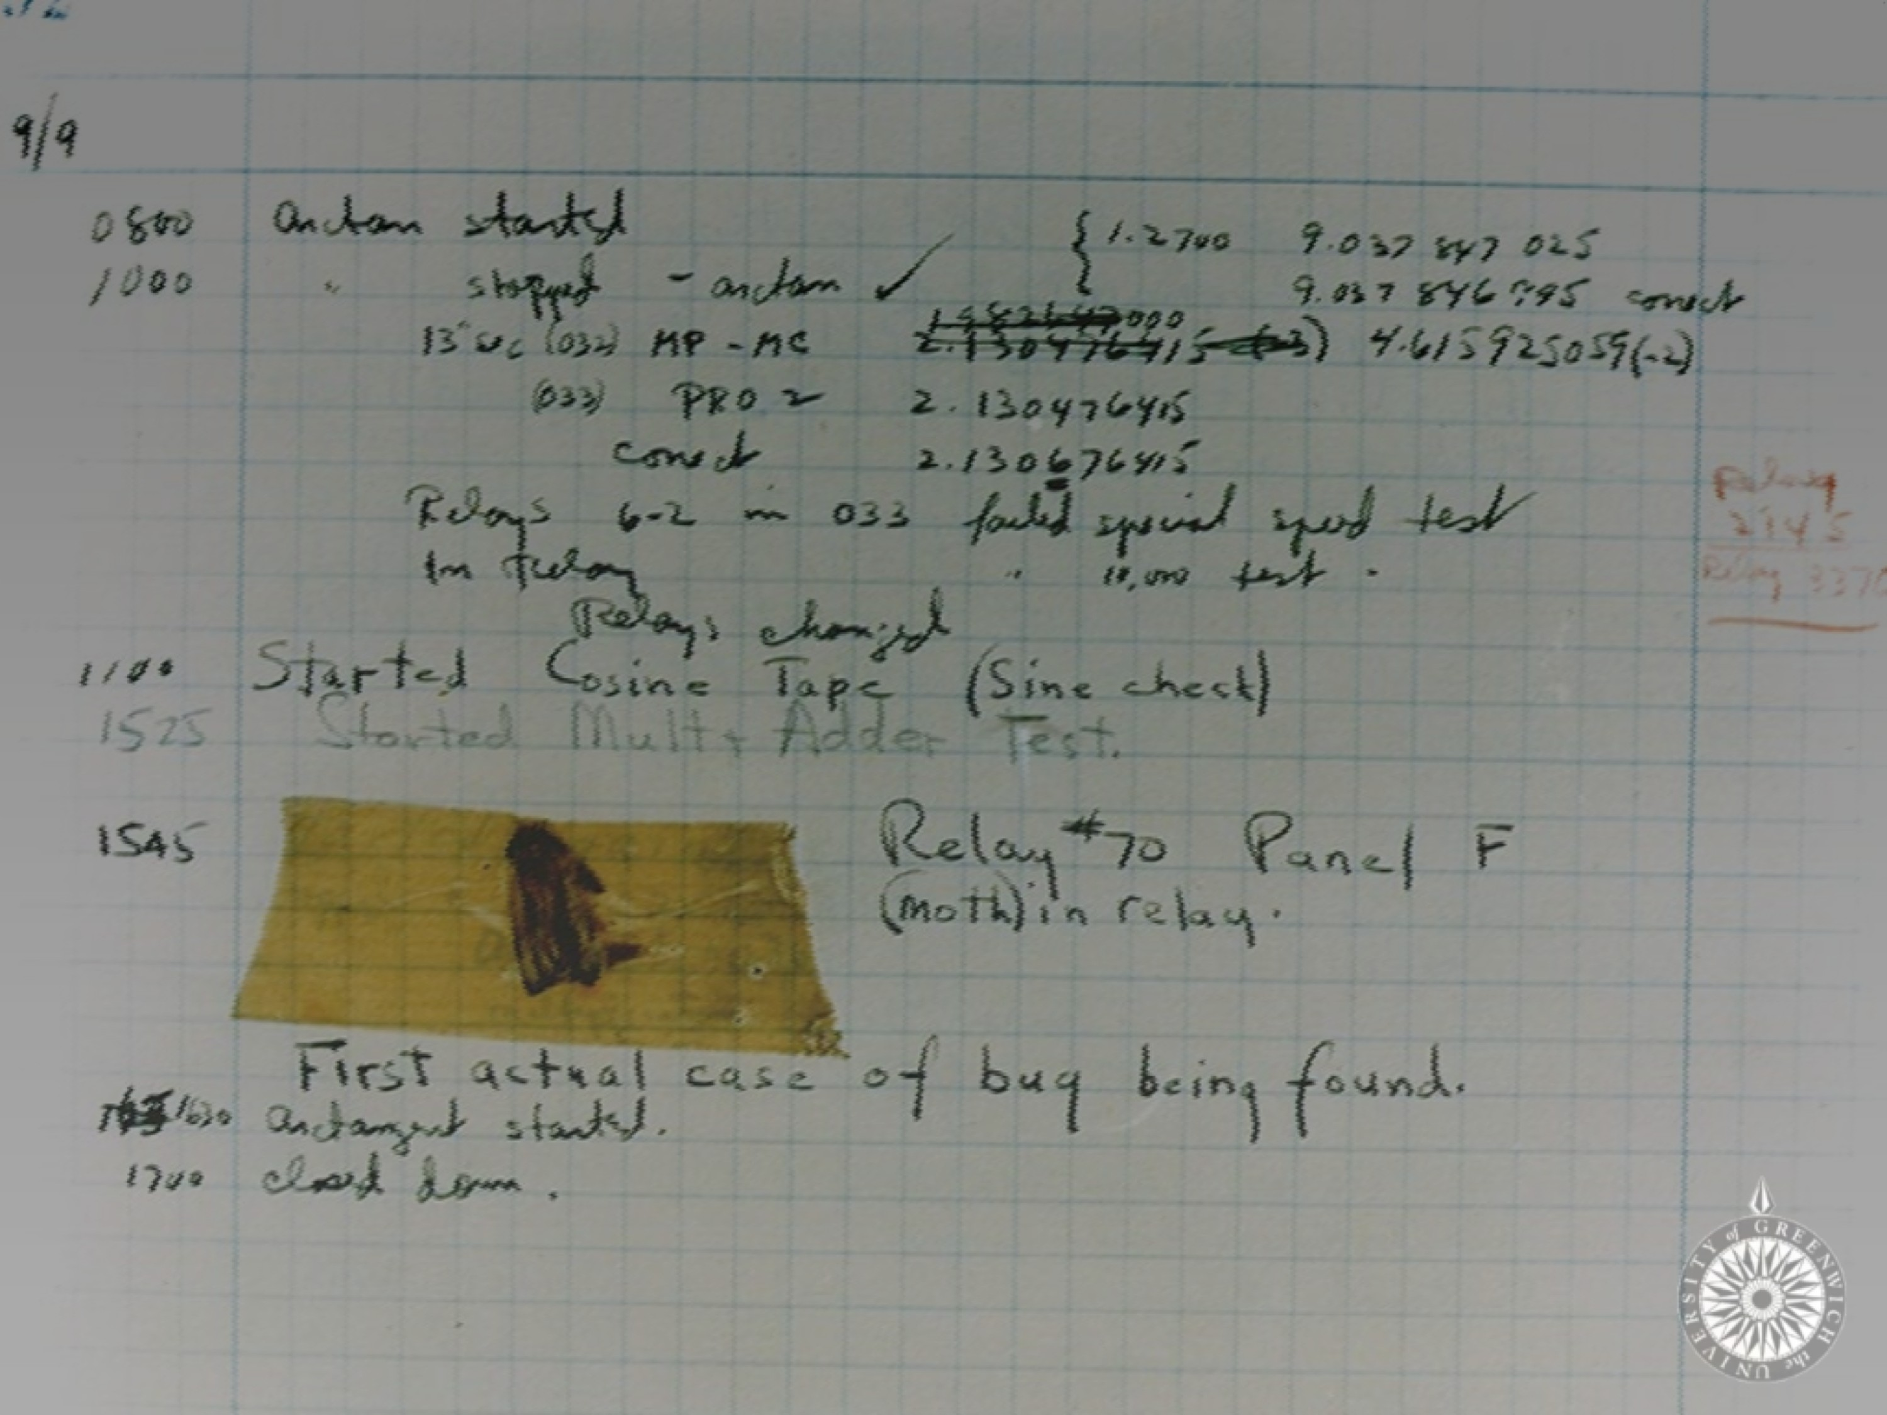
Errors
(debugging)

Slide 18

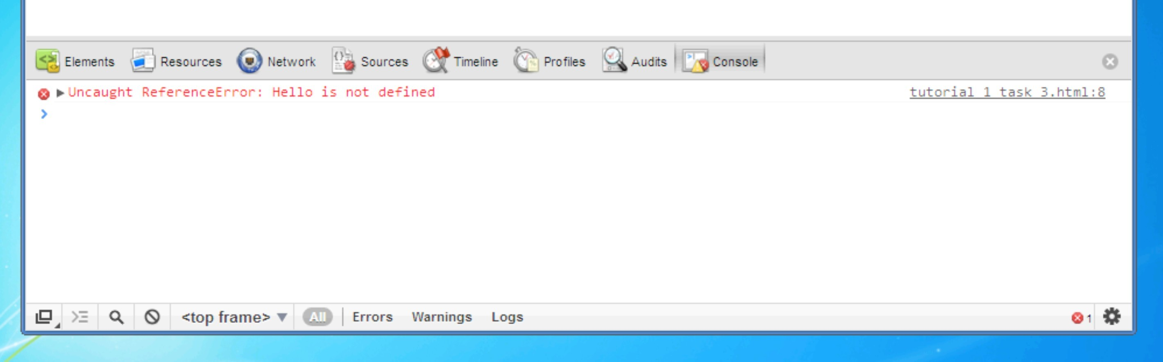
Access the Console in Chrome or Firefox

Slide 19
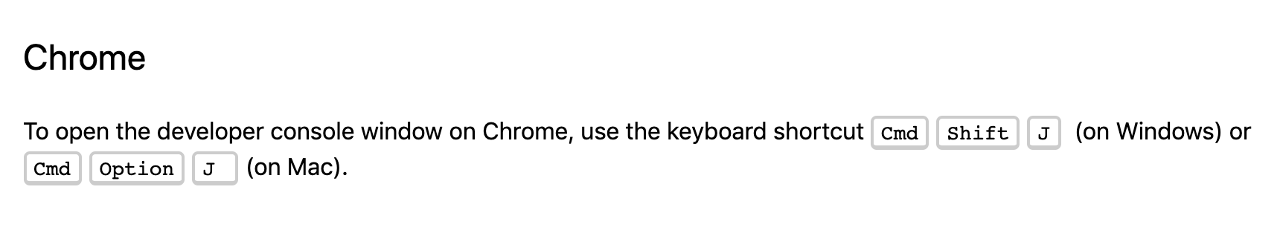
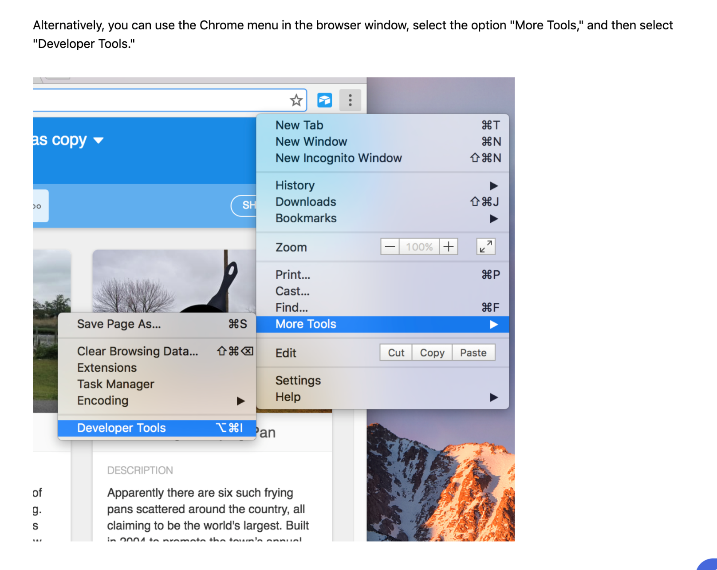
https://support.airtable.com/hc/en-us/articles/232313848-How-to-open-the-developer-console

Slide 20
Comments
// ………

Slide 21
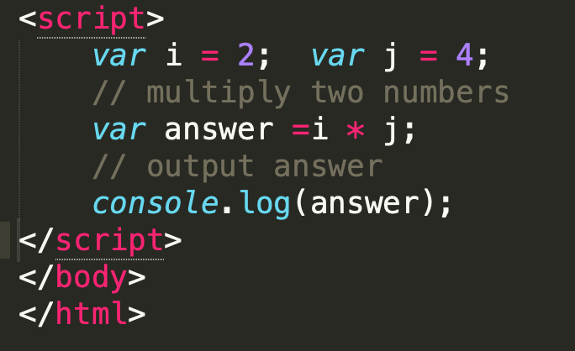

Slide 22
?

