Slide 1

Variables, Functions and Methods
Matt Prichard

Slide 2
I am assuming you understand the very basics of programming from term 1 Python. We will be re-covering some of the same concepts but in a different language, JavaScript. I will be making some assumptions about your knowledge but stop me if something is unclear. The main difference between the languages at entry level are to do with syntax, the broad concepts are very similar though.

Slide 3
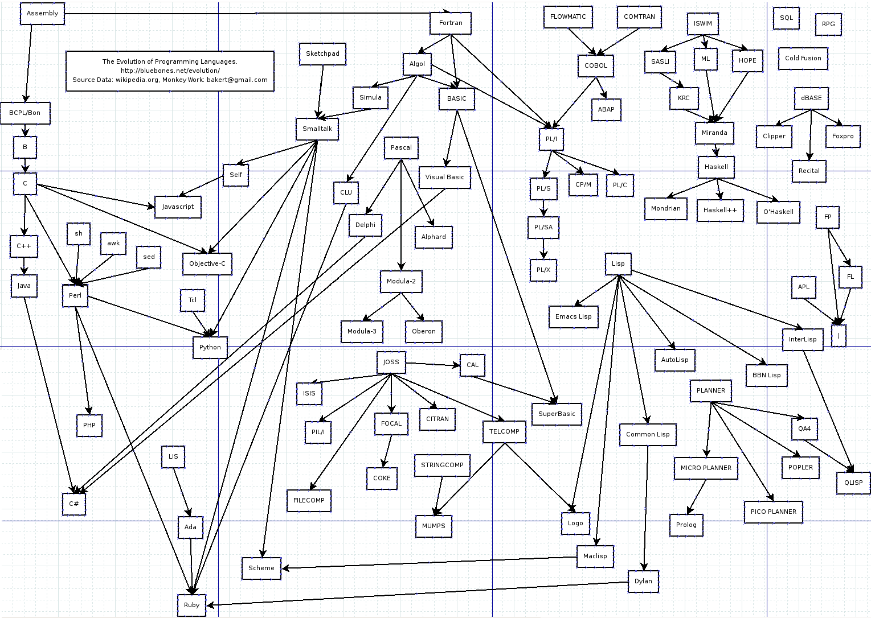
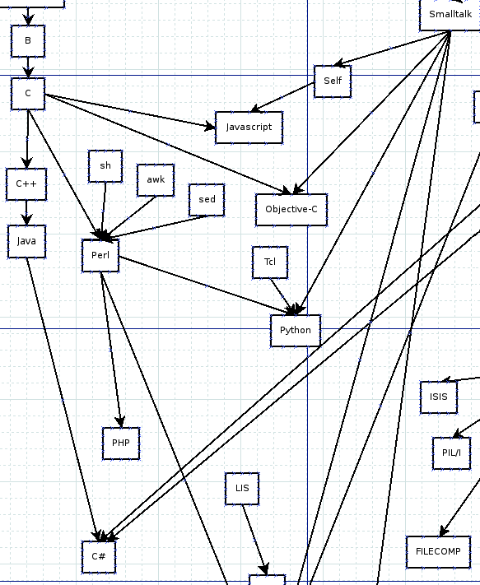

Slide 4
Variables

Slide 5
var message = “Hello”; console.log(message);
Tells JavaScript this is a variable
Variable name (Some are reserved).
Variable names in lowercase
Outputs the contents of the variable message
Puts the word Hello into the variable message

Slide 6
Puts the number 29 into the variable age
Numbers don’t have quotes
var age = 29;
console.log(age);

Slide 7
let vs const vs var
I highly recommend you read this section
https://www.w3schools.com/js/js_variables.asp
Always declare JavaScript variables with var, let, or const.
The var keyword is used in all JavaScript code from 1995 to 2015.
The let and const keywords were added to JavaScript in 2015.
If you want your code to run in an older browser, you must use var.

Slide 8
const
The const keyword was introduced in ES6 (2015).
Variables defined with const cannot be Redeclared.
Variables defined with const cannot be Reassigned.
Variables defined with const have Block Scope.
As a general rule, always declare a variable with const unless you know that the value will change. Use const when you declare:
A new Array, a new Object or a new Function

Slide 9
let
The let keyword was introduced in ES6 (2015).
Variables defined with let cannot be Redeclared.
Variables defined with let must be Declared before use.
Variables defined with let have Block Scope.
https://www.freecodecamp.org/news/understanding-let-const-and-var-keywords/

Slide 10
var
We will use ‘var’ throughout this term as it keeps everything simple to understand.
But if looking online for help you will most likely now see ‘const’ used the most and ‘let’ when appropriate.
Don’t worry too much about this at the moment.

Slide 11
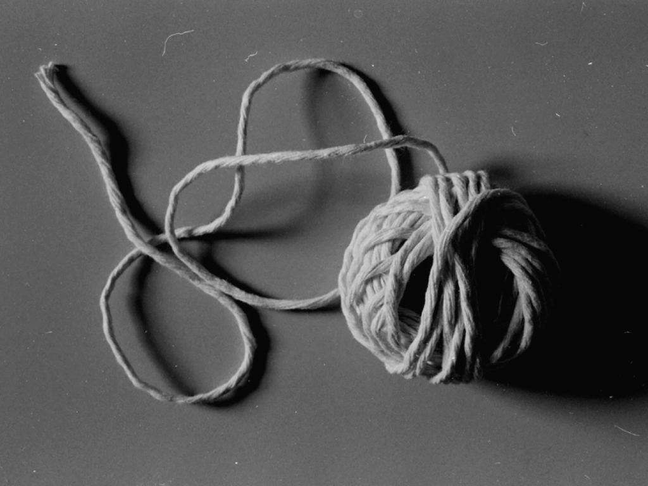
String

Slide 12
One of the most widely used data types is a string.
A string consists of one or more characters, which can include letters, numbers, or other types of characters. You can think of a string as plain text.
A string represents alphanumeric data. This means that a string can contain many different characters, but they are all considered as if they were text, even if the characters are numbers. A string can also contain spaces.
http://study.com/academy/lesson/data-types-in-programming-numbers-strings-and-others.html

Slide 13
var message = “Hello”; var tag = '<br />';
To tell JavaScript the data is of type “string” the data must be enclosed in a pair of quotes.
They can be single or double quotes but the pair must match

Slide 14

var message = ‘Mary’s house’;
What if we what to use quotes in our string?
var message = ‘Mary\’s house’;
We need to ‘escape’ the quote with a backslash. This says the quote is part of the string not the end of it.
Examples/string.html

Slide 15
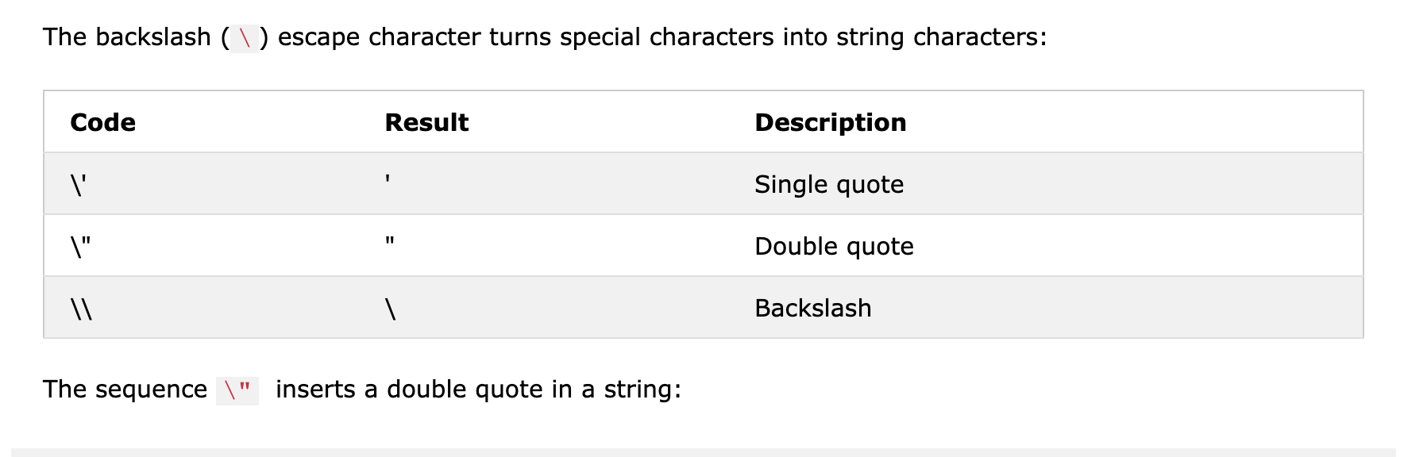

https://www.w3schools.com/js/js_strings.asp

Slide 16
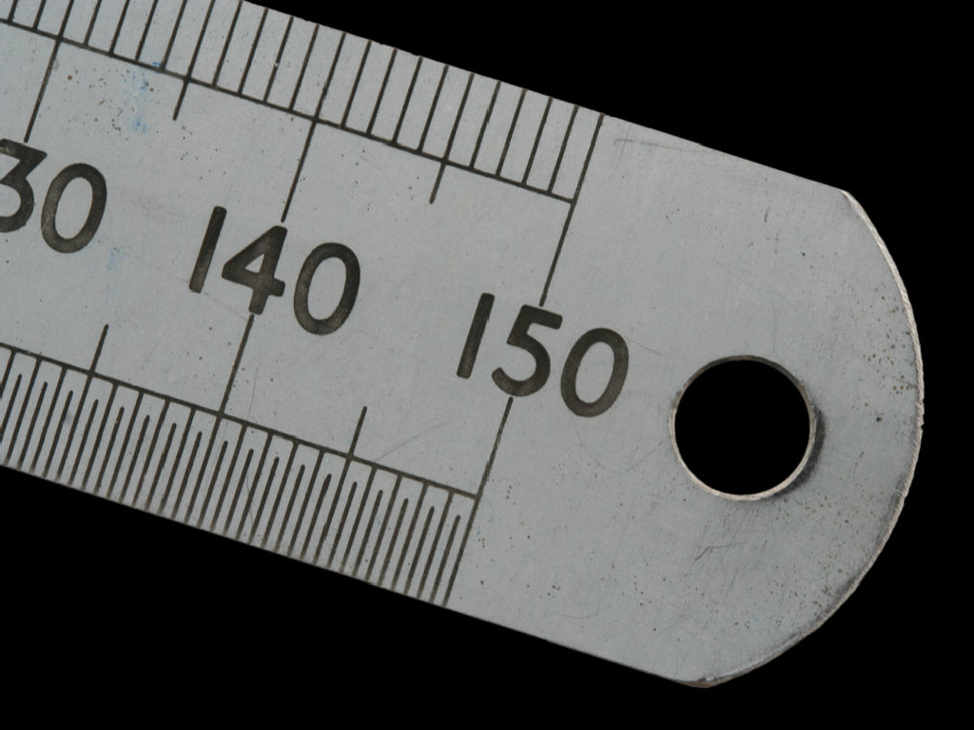
Numbers

Slide 17
JavaScript has one number type
It can hold integers
var age = 29;
It can hold floats or decimals
var awidth = 21.65;
var cash = 15e5;
It can hold large number with scientific notation

Slide 18
“different types are used to describe different data, and different types have different operations.”

Slide 19






var numberOne = 1; var numberTwo = 2.00; var numberThree = “3”; var numberFour = “4”; console.log(numberOne + console.log(numberThree
var | numberOne | = | 1;
var | numberTwo | = | 2.00;
3
numberTwo);
+ numberFour);
34
Examples/slide13.html

Slide 20
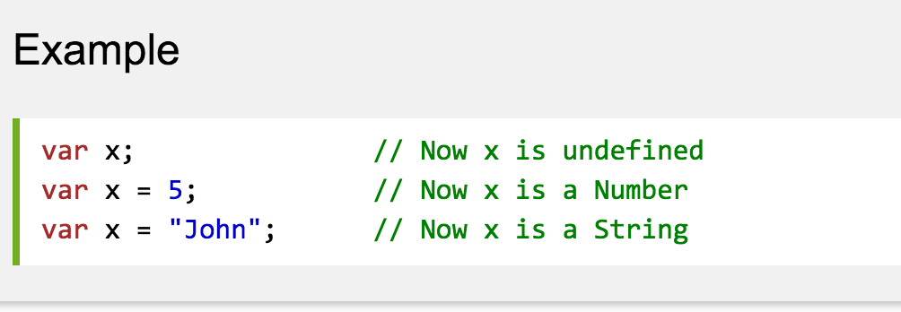
“JavaScript has dynamic data types, This means the same variable can be used as different types.”
http://www.w3schools.com/js/js_datatypes.asp

Slide 21
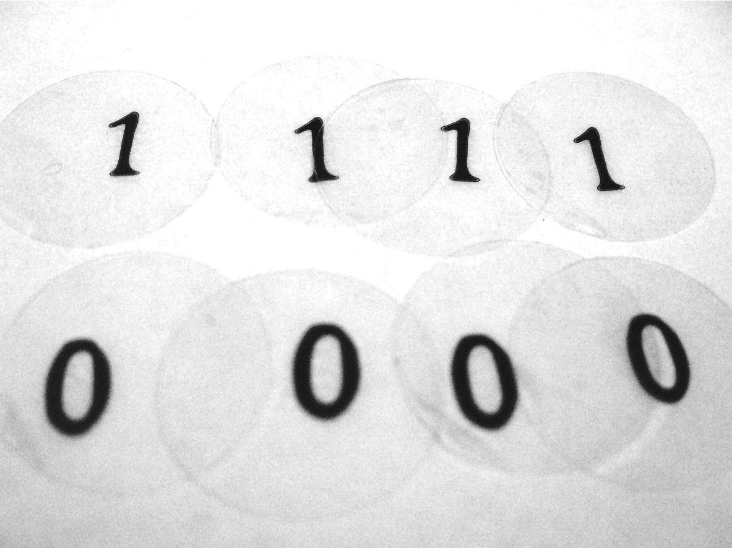
Boolean

Slide 22
The Boolean data type can only represent two values: true or false.
var correct = true; var wrong = false;
http://www.w3schools.com/jsref/jsref_obj_boolean.asp

Slide 23
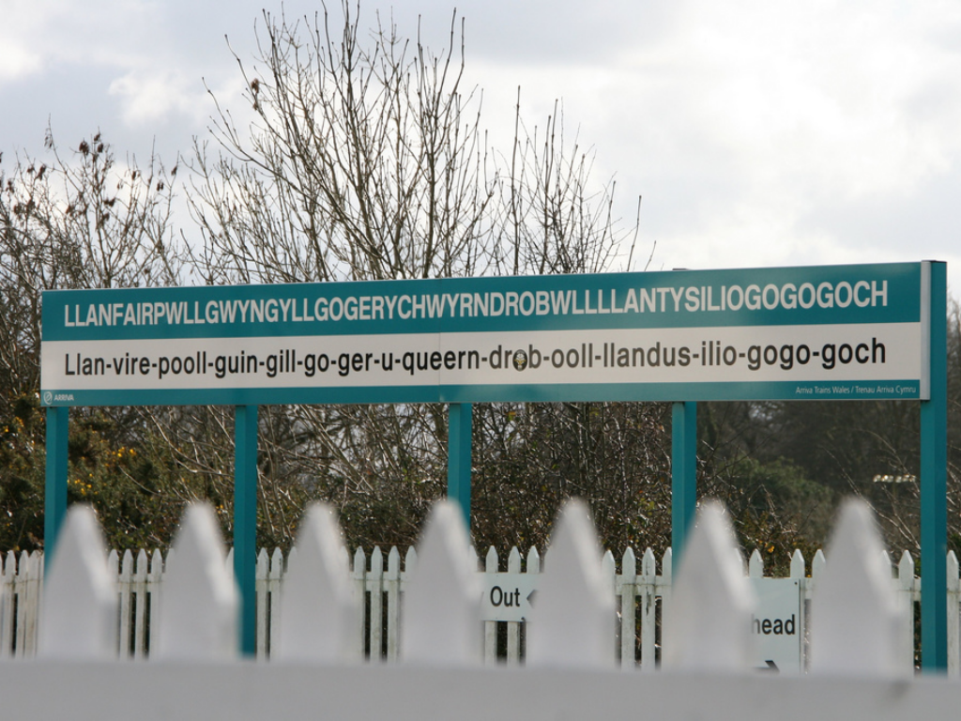

Naming Variables

Slide 24
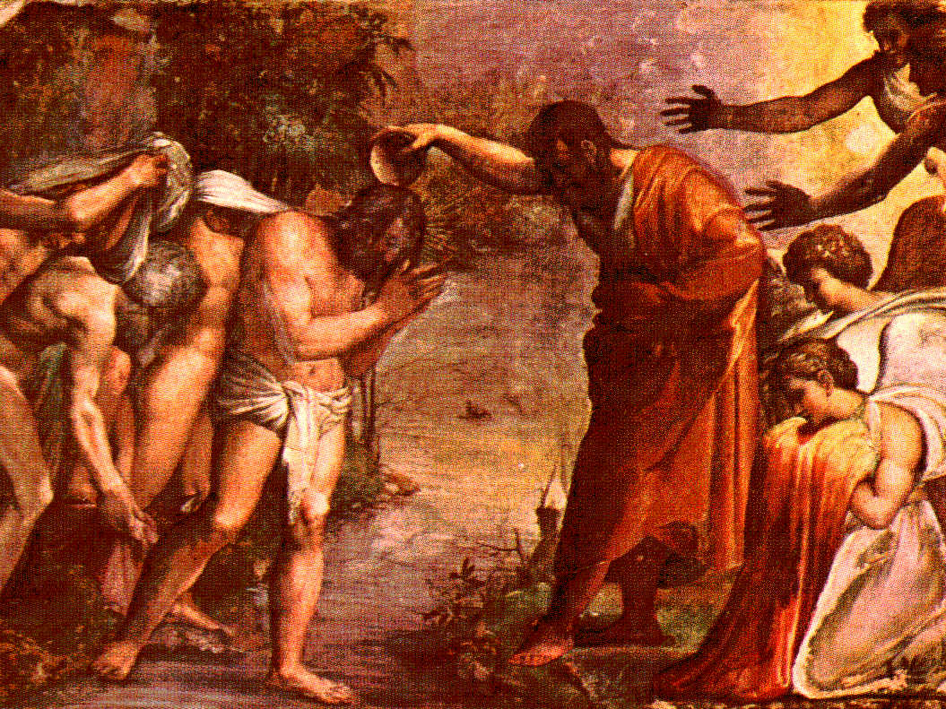
“a variable’s name is called its identifier.”

Slide 25

letters and numbers only but cannot start with a number

Slide 26
Also allowed
$ (dollar)
_ (underscore)
)

Slide 27




var employee var employee001 var _employee var $employee
✔✖
var 1employee var employee 01 var #employee
var employee.name
var employee-name

Slide 28
Pick variable names that mean something in the context of your program !

Slide 29
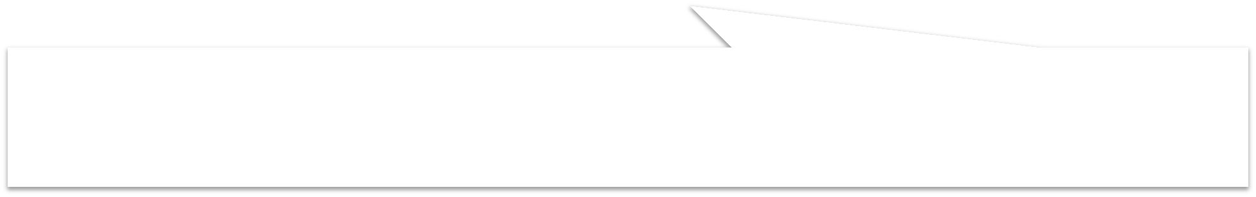


var employeeID var employeeName var employee_id var employee_name
✔
lowercase first letter then following words uppercase letter or use an underscore to separate words
✖
var avariable var rover
var gfhdsfgj

Slide 30
Variable names - summary
Must begin with a letter, $ or _ Can’t start with a number.
Can contain letters, numbers, $ and _ Can’t contain a hyphen (-) or full stop (.) or space.
Cannot use reserved words as they ‘do something’ in the language – full list:
http://www.w3schools.com/js/js_reserved.asp
Variable names are case sensitive ‘dog’ and Dog’ are different.
Use names that describe the information the variable stores.
If using more than one word use a Capital letter for each word after the first ( camelCase – camelCaps ) or use underscores (not hyphens) to join words.

Slide 31
Concatenation
“Concatenation (from Latin concatenare, to link together) is taking two or more separately located things and placing them side-by-side next to each other so that they can now be treated as one thing.
In computer programming two or more character strings can be concatenated for the purpose of saving space or so that they can be addressed as a single item.”
In JavaScript you use the + symbol (same as Python)
http://whatis.techtarget.com/definition/concatenation-concatenate-concatenating

Slide 32
Methods / Functions

Slide 33
Functions consist of a series of statements that have been grouped together because they perform a specific task. A method is a set of instructions that are associated with an object

Slide 34
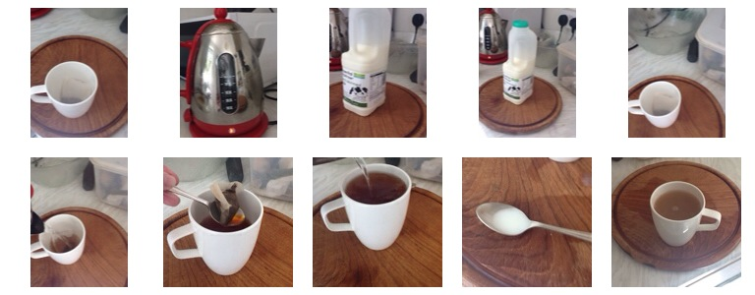
Make a cup of tea

Slide 35
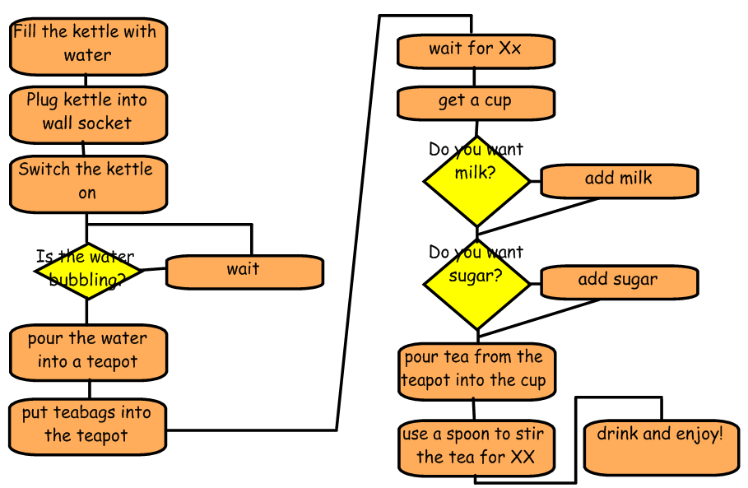
Possible list of steps
http://www.porchester.notts.sch.uk/.a/6a00d83513e5a153ef01676405194f970b-pi

Slide 36
Create a function
If we group all those steps together and call them “make a cup of tea” it would be a lot easier to just say “make a cup of tea” rather than have to list all of the steps each time.
Also, once we have grouped all the steps together into our “make a cup of tea” function, we can reuse it when ever we want by just saying “make a cup of tea”.

Slide 37
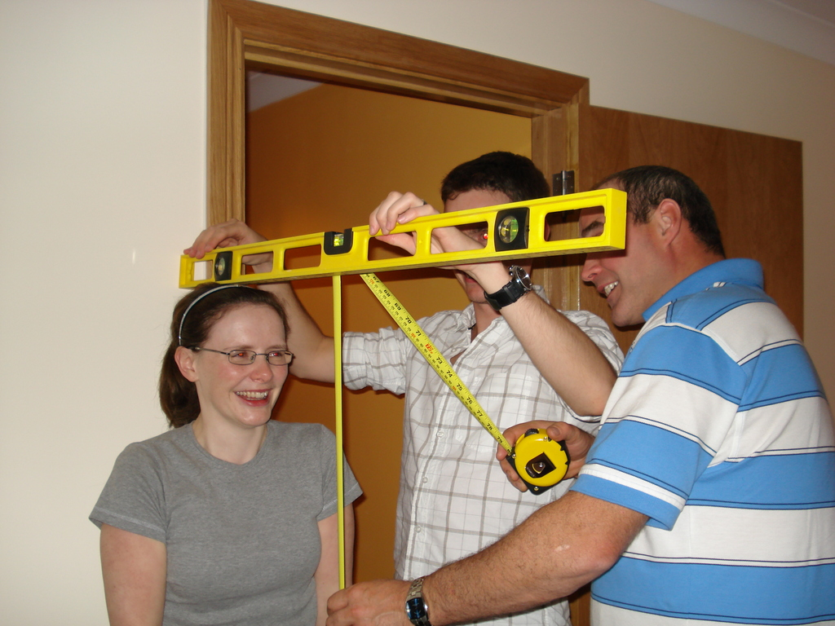
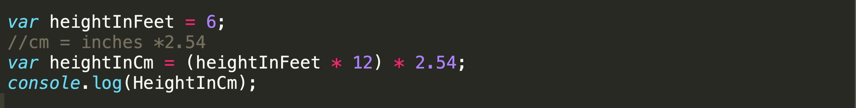
Examples/convertBot.html

Slide 38


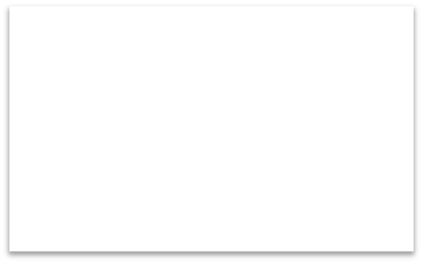
Simple Function Types
Function called Parameters sent
Function called Parameters sent
Function called
function
function
function
Returned value
e.g. Date function that returns a date to be used
later in program
e.g. Formatting and writing out text
e.g. Formatting and writing out inputted text

Slide 39
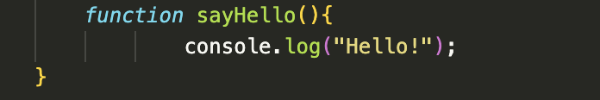
Declaring a simple function
Use the ’function’ keyword to declare a function
Give the function a name (use variable naming conventions)
The statements that perform the task sit in the code block in curly braces.
All functions must have a pair of brackets after the name

Slide 40
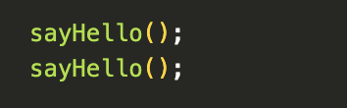
Calling a simple function
To run or call the function simply use the function name followed by parentheses (brackets)
You can call or reuse the function as many times as you like.
Examples/sayHello_function.html

Slide 41
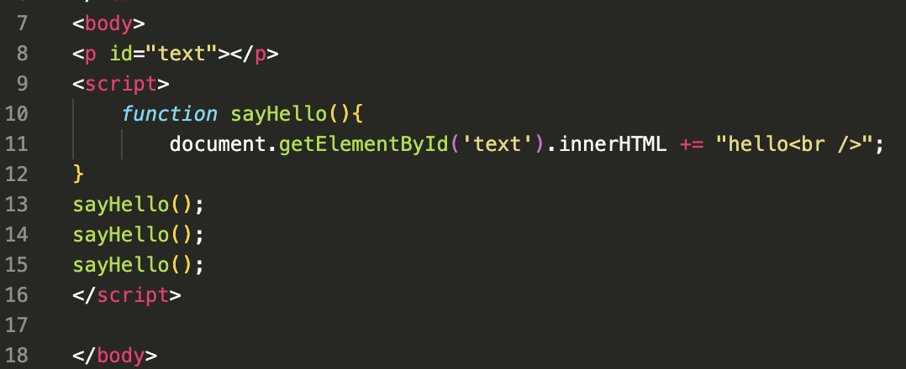
Same function into a <p>
Notice the +=
Examples/sayHello_function2.html

Slide 42
Simple Function Types
Function called Parameters sent
Function called Parameters sent
Function called
function
function
function
Returned value
e.g. Date function that returns a date to be used
later in program
e.g. Formatting and writing out text
e.g. Formatting and writing out inputted text

Slide 43
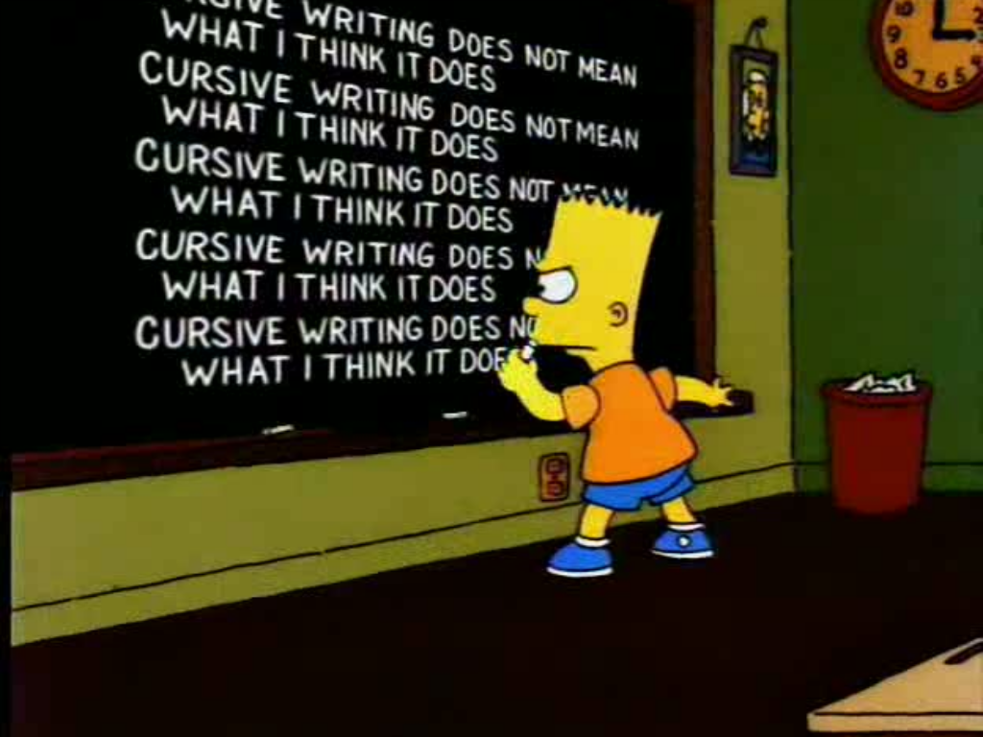
var message = “Cursive writing does not mean what I think it does”; message = message.toUpperCase();
console.log(message);
message = “Cursive writing does not message = message.toUpperCase(); | mean | what | I | think | it | does”;
console.log(message); message = “Cursive writing does not message = message.toUpperCase(); console.log(message); message = “Cursive writing does not message = message.toUpperCase(); | mean mean | what what | I I | think think | it it | does”; does”;
console.log(message); message = “Cursive writing does not message = message.toUpperCase(); console.log(message); | mean | what | I | think | it | does”;
message = “Cursive writing does not message = message.toUpperCase(); console.log(message); message = “Cursive writing does not message = message.toUpperCase(); | mean mean | what what | I I | think think | it it | does”; does”;
console.log(message);

Slide 44
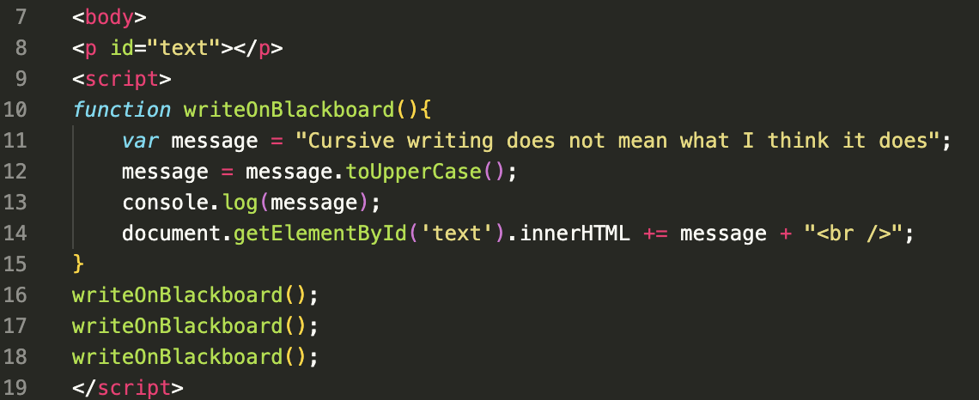
eeee
Examples/cursive.html

Slide 45
Simple Function Types
Function called Parameters sent
Function called Parameters sent
Function called
function
function
function
Returned value
e.g. Date function that returns a date to be used
later in program
e.g. Formatting and writing out text
e.g. Formatting and writing out inputted text

Slide 46
Make a cup of tea, parameters
What if we want to control milk and number of sugars?
These would be parameters of our function.
We could pass values:
Milk - yes or no?
Sugar - how many ?

Slide 47
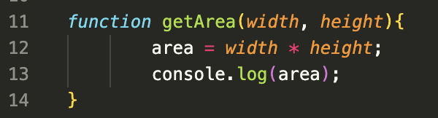
Functions can have parameters
These name act like variables within the function. They can accept words or numbers depending on what the function is doing.
Items in the brackets after the name are called parameters.

Slide 48

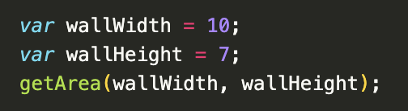
Calling functions that have parameters
Call the function and pass ‘arguments’ to the parameters. 3 to the width and 5 to the height.
You can use variables as arguments too, this will do the same thing.
Examples/getArea.html

Slide 49
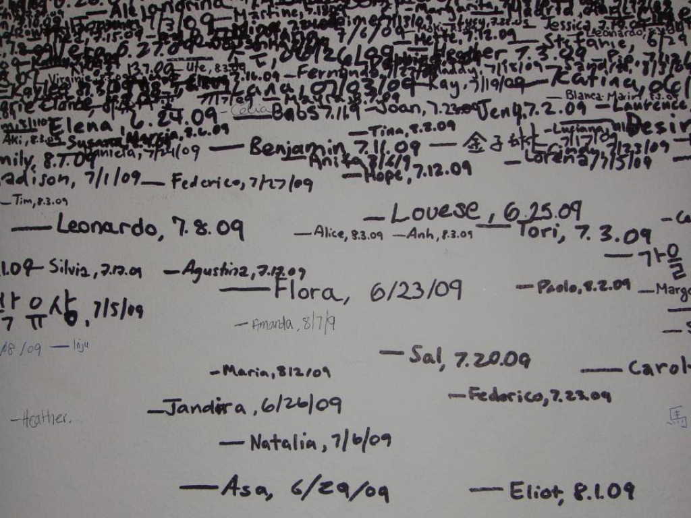
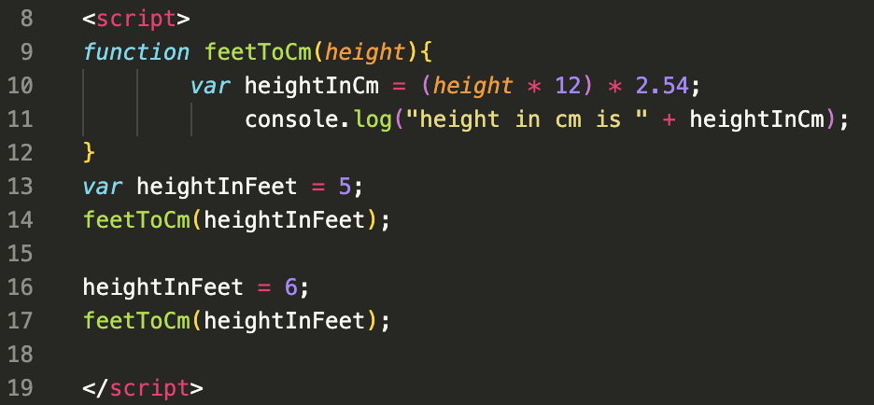
Examples/feetToCm.html

Slide 50
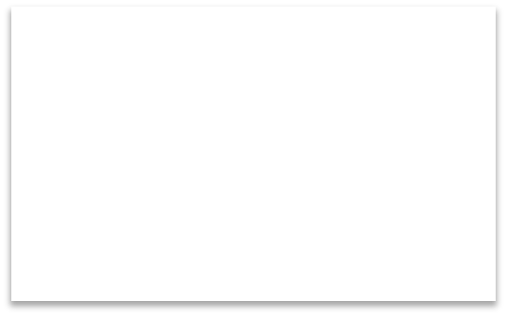

Simple Function Types
Function called Parameters sent
Function called Parameters sent
Function called
function
function
function
Returned value
e.g. Date function that returns a date to be used
later in program
e.g. Formatting and writing out text
e.g. Formatting and writing out inputted text

Slide 51
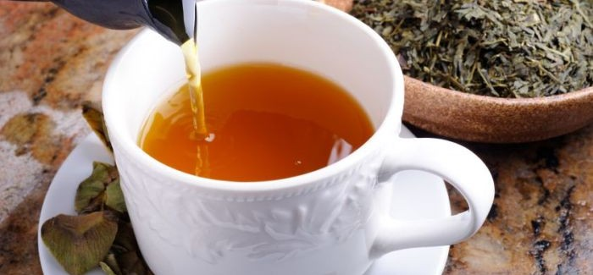
Make a cup of tea - return
We now want to call for our cup of tea to be made and ‘returned’ to us to where we ordered it from.
Functions can return their result to the code that called them.

Slide 52
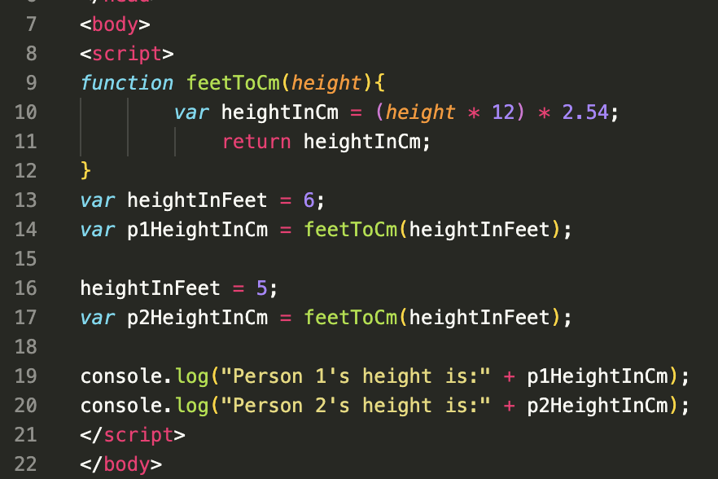
Examples/feetToCm_return.html

Slide 53
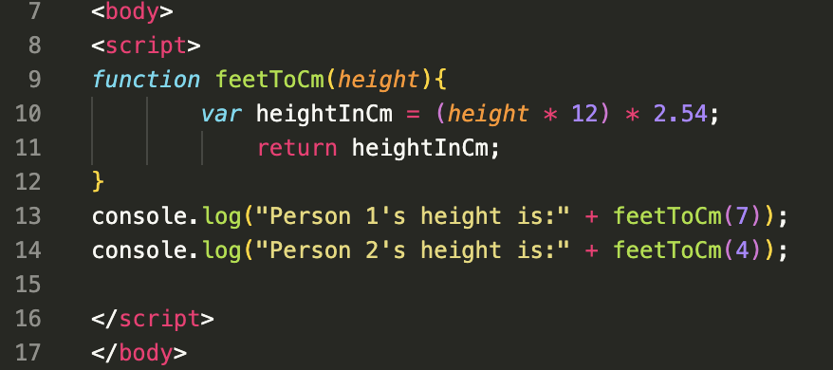
Examples/feetToCm_return2.html

Slide 54

More than one way …

Slide 55
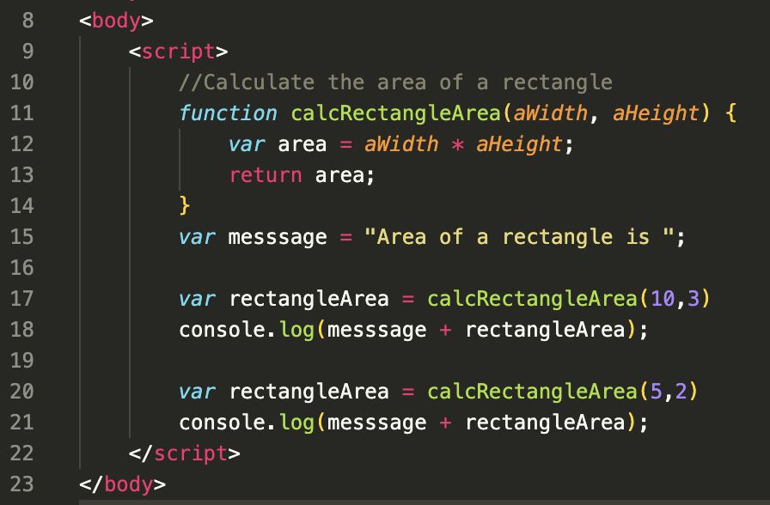
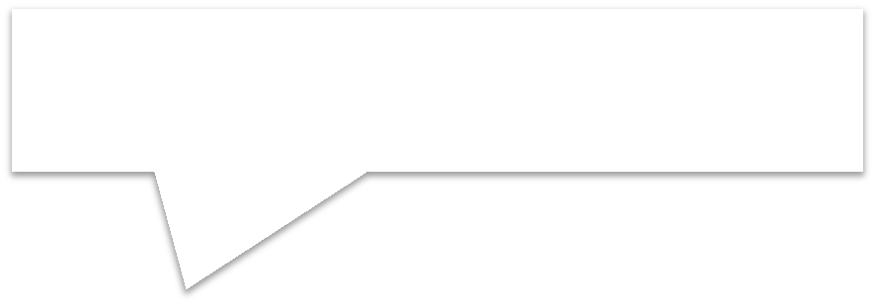

Note the 2 parameters comma separated.
aHeight
Examples/areacalculator-basic.html

Slide 56
Interactive area calc
The code is on Moodle.
Use it in the labs for reference
Go through lab task
Examples/areacalculatorCommented.html

Slide 57
Questions
?

