Slide 1
Agent-Based Modelling
TECHNIQUES IN GEOGRAPHIC DATA SCIENCE

Slide 2
What is Agent-Based Modelling? (1)
"An agent-based model (ABM) is a class of computational models for simulating the actions and interactions of autonomous agents with a view to assessing their effects on the system as a whole.“
Combines elements of:
- game theory,
- complex systems,
- emergence,
- computational sociology,
- multi-agent systems,
- evolutionary programming.

Slide 3
What is Agent-Based Modelling? (2)
Most agent-based models are composed of:
(1) numerous agents
(2) decision-making heuristics;
(3) learning rules or adaptive processes;
(4) an interaction topology; and
(5) an environment.
ABMs are typically implemented as computer simulations, either as custom software, or via ABM toolkits, and this software can be then used to test how changes in individual behaviors will affect the system's emerging overall behavior.

Slide 4
Early Developments: John Conway’s ‘Game of Life’
Rules
1. Any live cell with fewer than two live neighbours dies, as if by underpopulation.
2. Any live cell with two or three live neighbours lives on to the next generation.
3. Any live cell with more than three live neighbours dies, as if by overpopulation.
4. Any dead cell with exactly three live neighbours becomes a live cell, as if by reproduction.

Slide 5
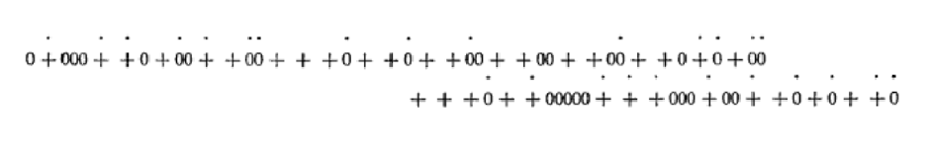
Thomas Schelling (1969). Models of Segregation.
"Imagine a line along which blacks and whites have been distributed in equal numbers and random order...
Define everybody's 'neighbourhood' as extending four neighbours on either side, and suppose that everyone is content if half his 'neighbours' are the same color as he.
If fewer than half are his color, he moves in either direction to the nearest point at which half his eight nearest neighbors are the same color as he."

Slide 6
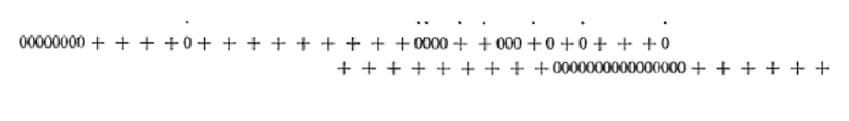
Thomas Schelling (1969). Models of Segregation.
"I have put a dot over the individuals that are dissatisfied...
Suppose that the dotted individuals move in turn, starting from the left, if they are still discontent when their turns come: rearrange the plusses and zeroes by moving each dotted one to the nearest point where, inserting itself between two others, at least four of its eight neighbors are of its own color.”

Slide 7
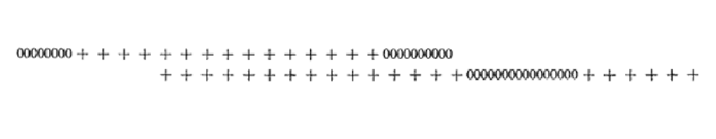
Thomas Schelling (1969). Models of Segregation.
"Eight have become newly discontent. We give them their turn and... we end up with six groups of alternating color.
All of this is too abstract to be a motion picture of whites and blacks or boys and girls choosing houses on a road... but it is suggestive of some of the dynamics that could be present in individually motivated segregation"

Slide 8
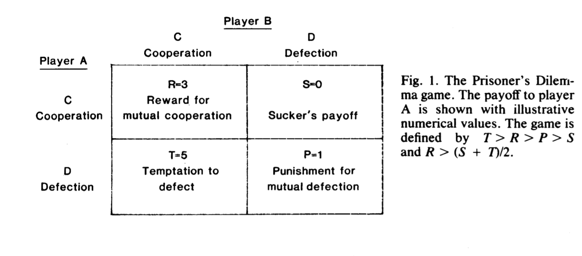
Axelrod & Hamilton (1981). The Evolution of Cooperation.

Slide 9
Axelrod & Hamilton (1981). The Evolution of Cooperation.
"With two individuals destined never to meet again, the only strategy that can be called a solution to the game is to defect always...
[But] If an individual can recognize a previous interactant and remember some aspects of the prior outcomes, then the strategic situation becomes an integrated Prisoner's Dilemma with a much richer set of possibilities."
"[Axelrod] conducted a computer tournament for the Prisoner's Dilemma... [There was] a game length of 200 moves. The 14 entries and a totally random strategy were paired with each other in a round robin tournament... the result of the tournament was that the highest average score was attained by the simplest of all strategies submitted: TIT FOR TAT. This strategy is simply one of cooperating on the first move and then doing whatever the other player did on the preceding move. Thus TIT FOR TAT is a strategy of cooperation based on reciprocity."

Slide 10
ABM became widespread in the 1990s
- Disease Dynamics in a Refugee Camp
- Modelling the Emergence of Riots
- Exploring the Growth of Slums
- The Spread of Agriculture during the Neolithic Period
Crooks, Malleson et al. (2018). Agent-Based Modelling and Geographical Information Systems.

Slide 11
Critique
- Ontology
Livet, Phan & Sanders (2008). Why do we need Ontology for Agent-Based Models.
'the question of the ontological compatibility between the “model world” and the “real world.’
- Causal Explanation
Grune-Yanoff (2008). The explanatory potential of artificial societies.
'... models do not provide potential causal explanations. Instead... they provide potential functional explanations.'

Slide 12
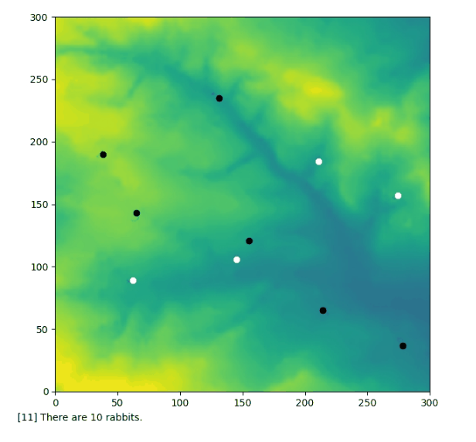
Simple Example: Rabbit Population Growth
https://github.com/peterprescott/agent-based-modelling

Slide 13
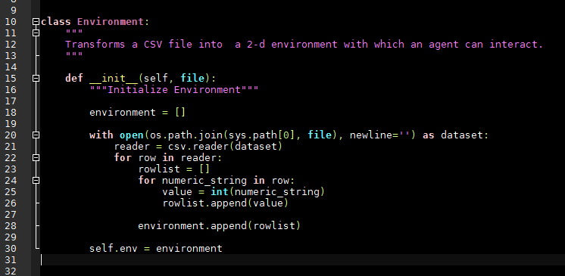
Simple ABM: Create Environment

Slide 14
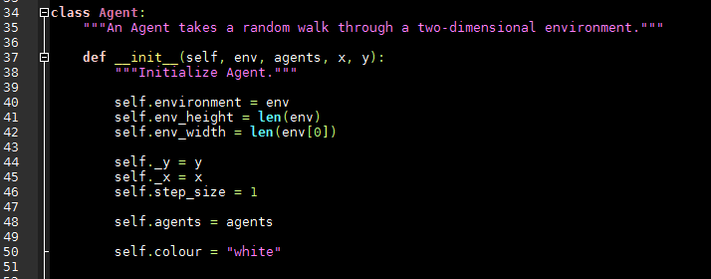
Simple ABM: Define Agent

Slide 15
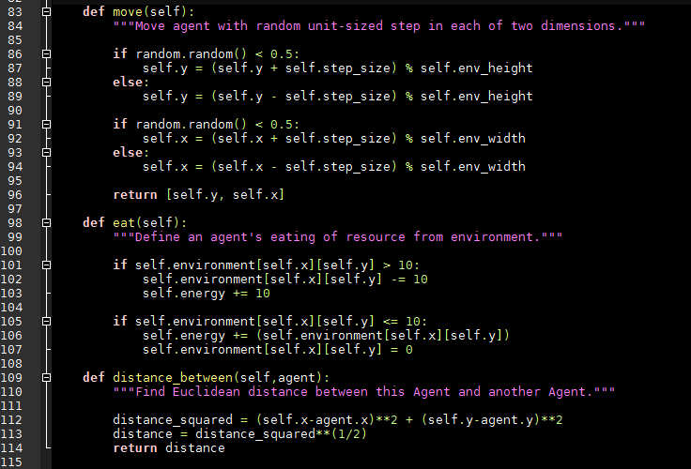
Simple ABM: Define Agent Behaviour

Slide 16
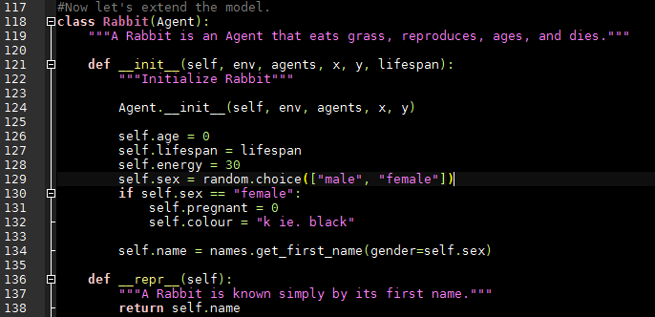
Simple ABM: Define a Rabbit

Slide 17
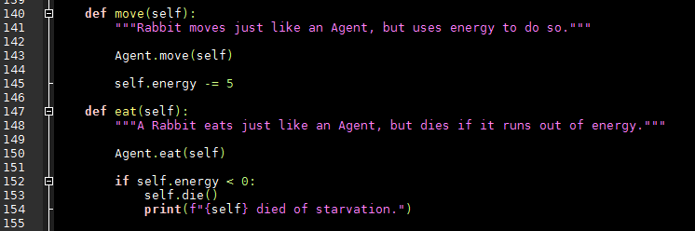
Simple ABM: Define Rabbit Behaviour (1)

Slide 18
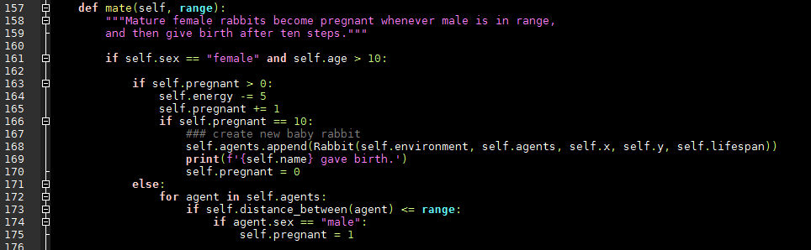
Simple ABM: Define Rabbit Behaviour (2)

Slide 19
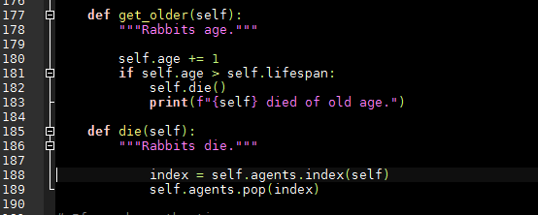
Simple ABM: Define Rabbit Behaviour (3)

Slide 20
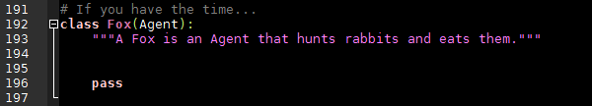
Simple ABM: Extend Model…

