Slide 1
Coursera Capstone Project
IBM for data science

Slide 2
Introduction
For many investors, Toronto is a paradise. It’s the biggest city in Canda. It’s also one of largest economy, traffic center in the city. So, opening a shopping center may be a good way to make money. Shopping mall is very popular nowadays. It can attract many customers spending money in it, like taking food in restaurant, or buying clothes. Of course, many investors have come out of this idea and many shopping mall has been built. So the location of shopping center is much more important because a bad location may bring overlap between two shopping malls’ influence radius.

Slide 3
Business Problems
This capstone project is aim to choose a proper location for shopping mall in Toronto to maximize stakeholders’ benefits. Through using data science methodology and machine learning, we try to solve this problem that where is the best place to create a new shopping center.

Slide 4
Data
Toronto Neighborhoods data
Coordinates of Neighborhoods, including longitude and latitude of Neighborhoods
Venue data, especially related data to shopping mall.
LINK：
https://en.wikipedia.org/wiki/List_of_postal_codes_of_Canada:_M
http://cocl.us/Geospatial_data

Slide 5
Methodology
beautifulsoup package to scrape html data
Geocoder package to get the location of the neighborhoods
Foursquare API to reach the venues and their coordinates
Calculate the mean of the frequency of the occurrence of each venue category and filter them by keyword “Shopping Mall”
Using elbow rule to choose the best number of clusters
K-means cluster

Slide 6
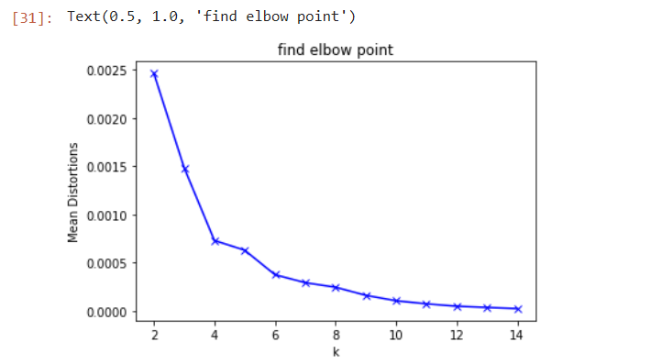
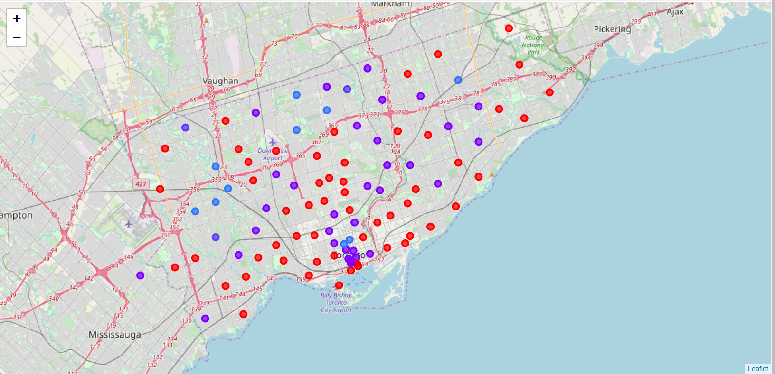
Results
cluster 0 which has very low shopping mall
cluster 1 points have low number of shopping malls
cluster 2 have a strong concentration of shopping mall
cluster 3 have a moderate number of shopping mall

Slide 7
Discussion
Cluster 0 which has very low shopping mall is distributed and surround the Toronto center.
Some cluster 1 points locate in the Toronto.
The number of cluster 2 is very rare.
cluster 3 is also distributed

Slide 8
Recommendations
Stakeholders have a strong chance to invest the shopping mall in places around Toronto.
Stakeholders can consider investing places in Toronto which are marked cluster 1 since cluster 1 points have low number of shopping malls
Stakeholders should avoid choose places marked cluster 2
Stakeholders can also take cluster 3 into consideration, since a bit concentration of shopping mall means many people may live there.

Slide 9
Thank you!

