Slide 1
DO
CO2
TDN/TN
DOC/TC
Salinity
Wetter
Drier
Our dataset provides a number of potential drivers, as indicated in the literature. We wanted to understand which drivers explain the most variance (MLR?)

Slide 2
tasks
Find an analysis of variance that will parse into individual drivers (is this not Random Forest??)
What about MLR?
If we use categories, can we do logistic regression?

Slide 3
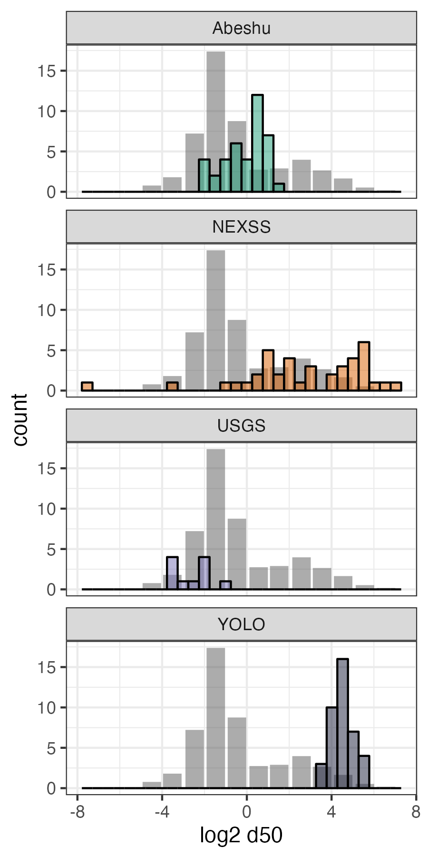
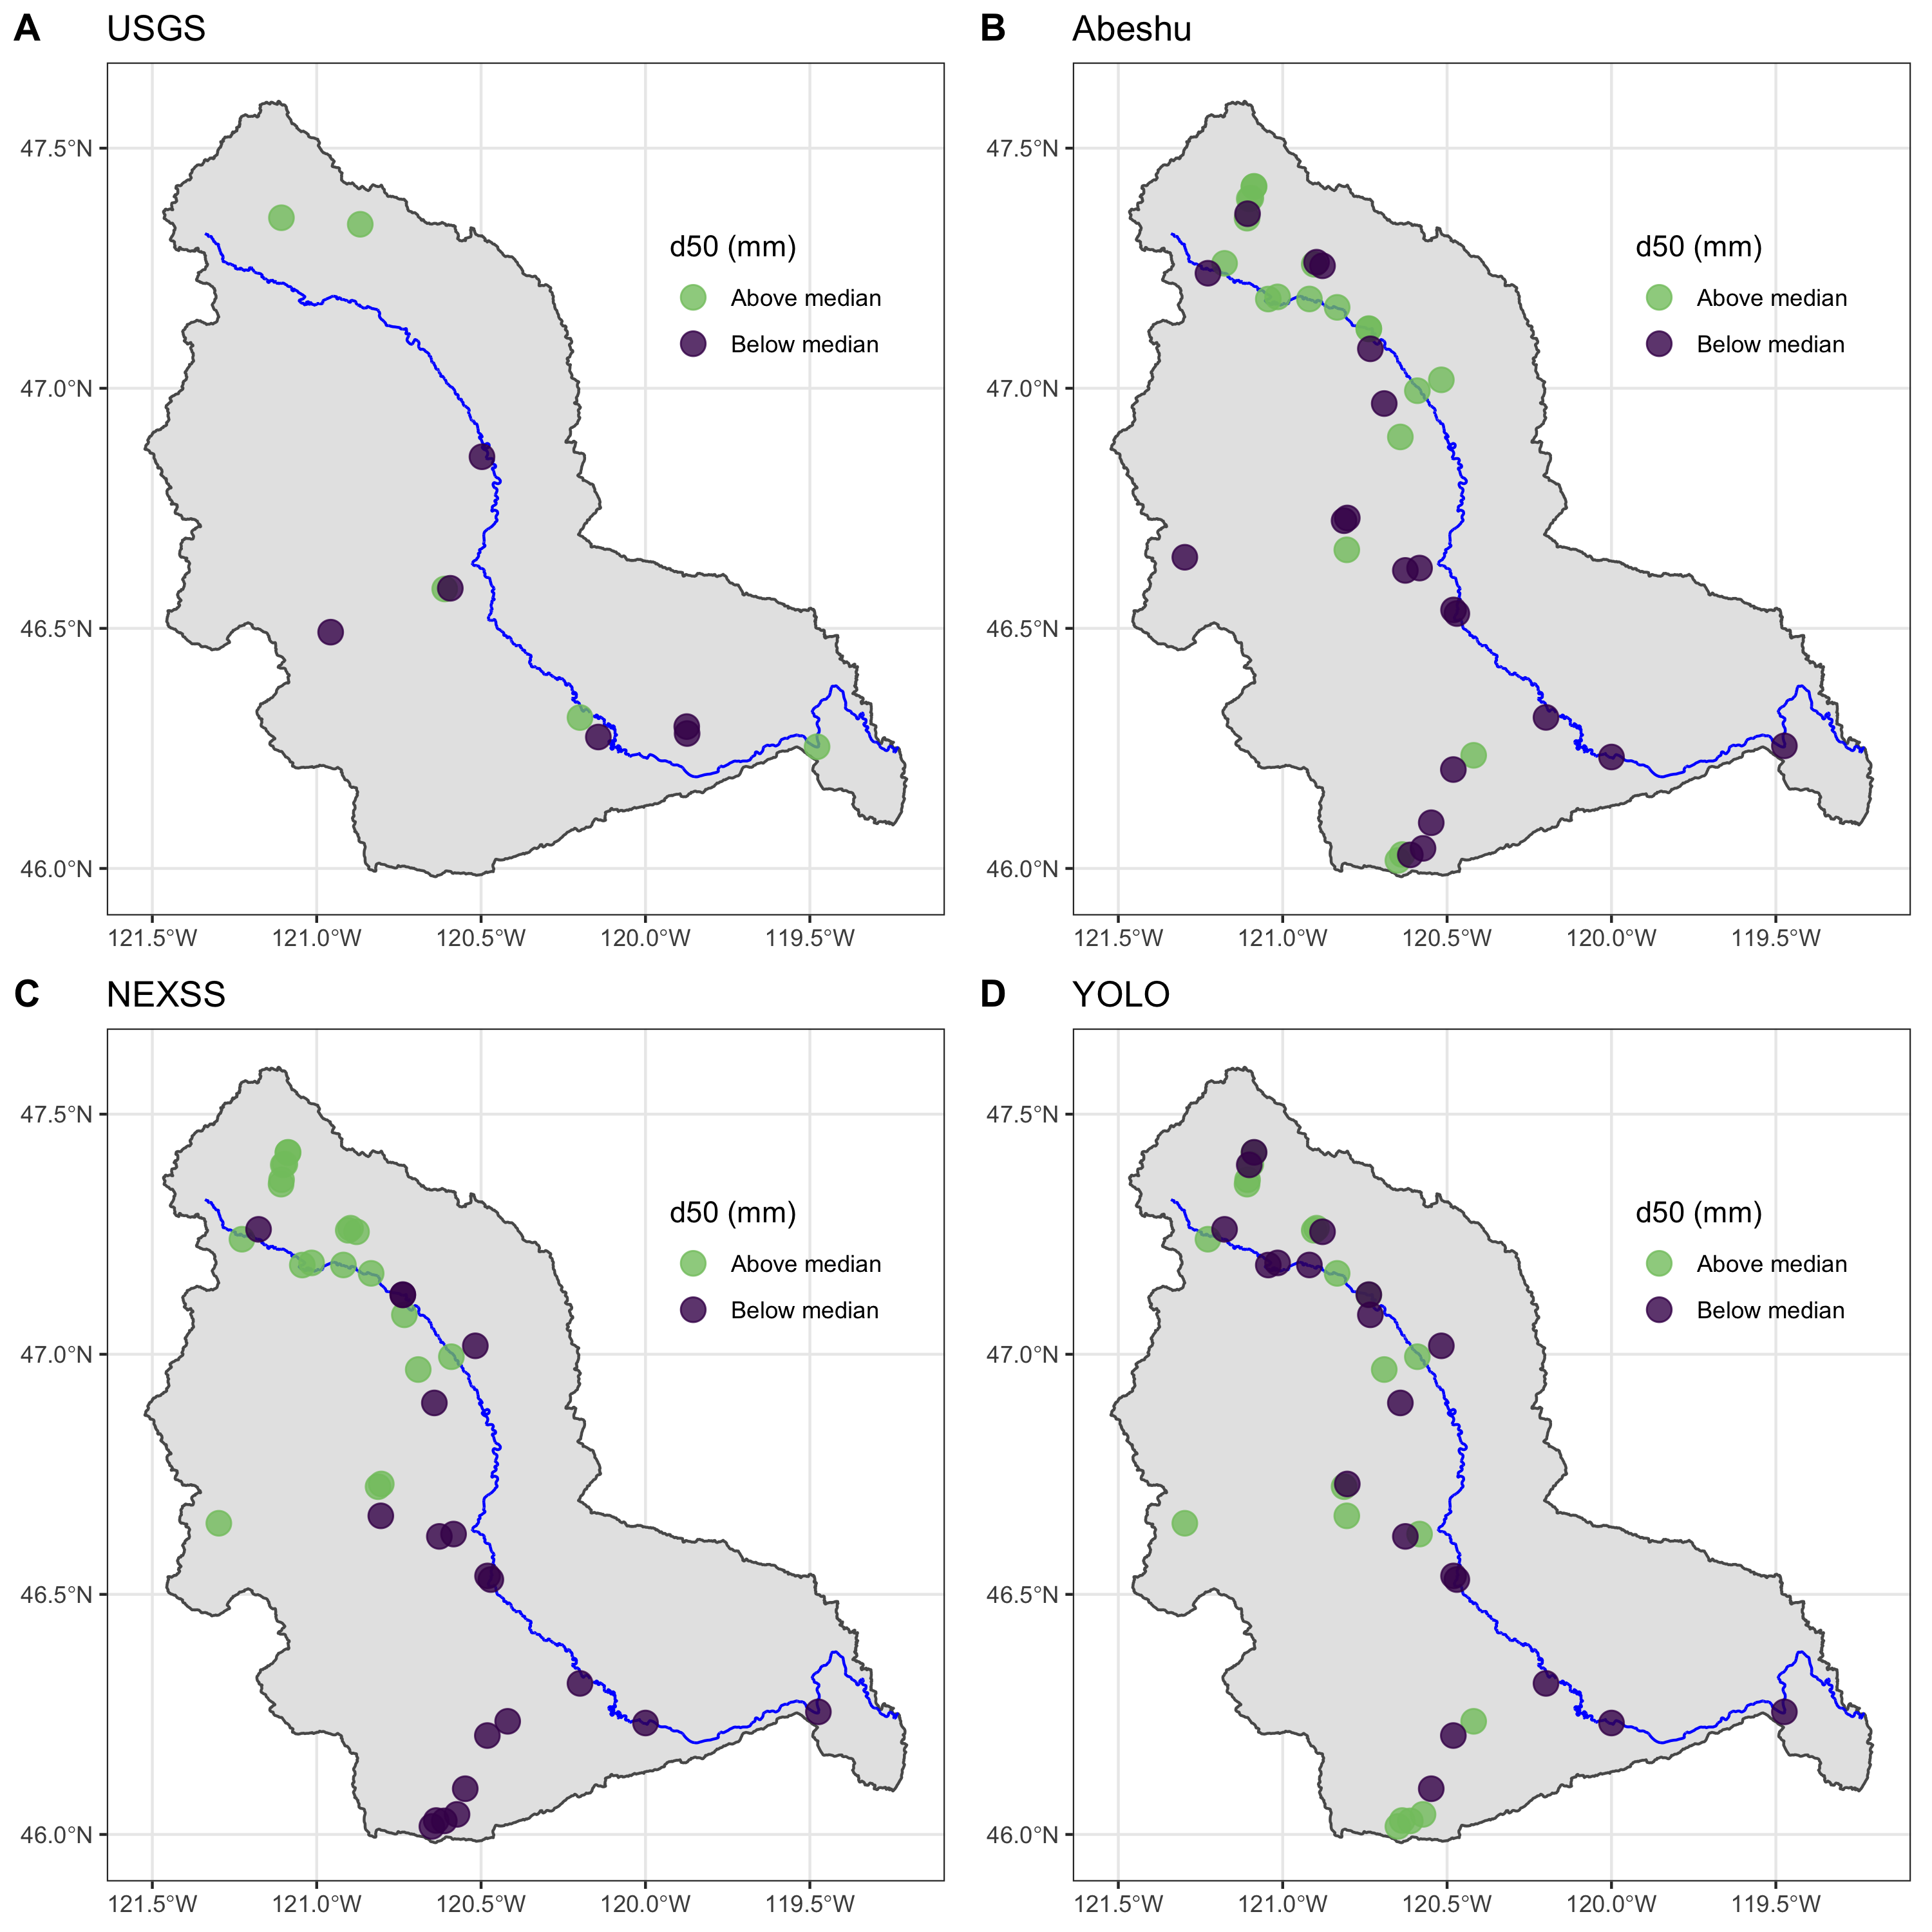
ML model
Spatial distributions vary between methods
CONUS: n=2577
Physics model
Measurements
Photogrammetry
Regier & Chen, et al., in prep for WRR

