Slide 1
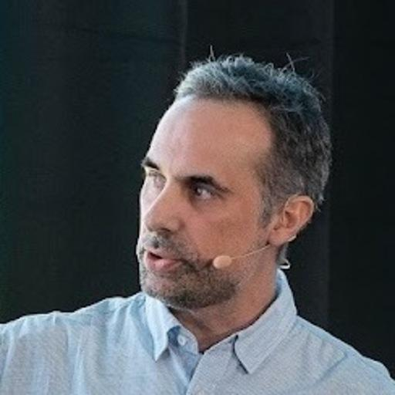

Masterclass, Revisited:
Vibe Coding Two Paths onto Liferay's Headless CMS
Devcon 2026
Rafael Lluis
Director Sales Engineer
Peter Richards
Senior Inside Sales Engineer

Slide 2


Insert your
QR Code here!
Scan to get session resources and join the discussion.
Notes:
Rafa: Before we start: we won’t take questions in the room. Scan this code to join our session on Discuss where you’ll find the associated resources. You can post questions any time during the talk and we’ll try answer everyone after the talk.

Slide 3

Agenda
40 minutes
Why revisit Masterclass
Approach 1: site initializer to site initializer
Approach 2: a live site, migrated in place
What to take home
Notes:
Peter: Here’s where we’re going today. First, why we came back to Masterclass at all, two years after Rafa’s original talk.
Then two approaches, each with its own demo. I’ll take the first: our site initializer, rewritten by AI to build the site on the Headless CMS.
Rafa: And I’ll take the second, which is where most of you probably are: a live site with no initializer, migrated in place.
Peter: We’ll finish with what to take home: the repo with everything we built, including the site initializer and the skills. But more importantly, what we learnt, and the habits that changed how we work with AI.

Slide 4

The CMS changed.
Can AI help move a real site onto it?
2024 → 2026
Notes:
Rafa: In 2024 I stood here and we converted Masterclass from web content to objects.
Peter: Since then, Liferay has shipped the Headless CMS. So the question for 2026: can AI do the migration, and what does it get wrong when it tries?
Rafa: And to be clear, we’re not saying 2024 was the wrong choice. One of the best things about Liferay DXP is that you can solve the same requirement in many different ways. Can you build e-Learning site with objects? Of course. With the Headless CMS? Yes. It depends on your use case: where the information lives, and which part of the LMS Liferay DXP is covering. We’re not judging that today. We’re adding options, so you have them to hand if you’re ever in the same situation.

Slide 5
Masterclass Site Initializer
Where we started
2024
2026
Converted from OSGi Site Initializer CMS to a Client Extension Site Initializer based on Liferay Objects
Objects enhanced with relationships
Enrolment added with new specific objects, actions, notifications, validations.
AI Conversion from OSGi Site Initializer CMS to an OSGi Site Initializer in new Headless CMS
Headless CMS Structured Content enhanced with relationships
Enrolment added with new Custom Objects related to Headless CMS Structured Content
Second approach: AI Conversion from a live CMS site to a Headless CMS Site
Notes:
Peter: Masterclass is an e-learning site for demonstrating content management in Liferay DXP. It has courses, their modules and the teachers behind them, and a set of blogs. It started life as an OSGi site initializer built on web content.
In the 2024 talk, Rafa converted it to a client extension site initializer based on Liferay Objects: he related the objects to each other and added enrolment, with its own objects, actions, notifications and validations.
This time we went back to the same web-content initializer and had AI convert it into an OSGi site initializer on the new Headless CMS instead: the structured content lives in a Space, with its relationships, and enrolment still uses custom objects, now connected to the CMS content.
Rafa: And there’s a second path, starting from a live site rather than the initializer. More on that in a moment.

Slide 6
Two starting points
Two approaches
Approach 1
Convert an OSGi Site Initializer CMS to be based on Headless CMS.
AI rewrites the initializer; the site is recreated from it
Approach 2
From a live site on the CMS/DAM to a site consuming the Headless CMS
AI changes the running site through the Headless APIs and MCP
Both
Masterclass on the new Headless CMS, all its content in a Space
Every lesson is in the repo, split by approach
Notes:
Peter: The same destination, two starting points.
Approach 1 is for teams who build sites from code: AI converted our OSGi site initializer from web content to the Headless CMS, and the site is recreated from it.
Approach 2 is for everyone else: a live site on web content and Documents and Media, migrated where it stands, with AI working through the headless APIs and MCP server, and no initializer in the middle.
Either way, you end up with Masterclass on the Headless CMS, all its content in a Space, and every lesson is in the repo, split by approach.
Rafa: Yes. And to be fair to Peter, he could have done his part by hand. I couldn’t: I haven’t been an engineer for years, so for me the AI isn’t a shortcut, it’s the only way in.

Slide 7
Approach 1
Convert an OSGi Site Initializer to be based on Headless CMS.
Notes:
Peter: OK, the first path: converting an OSGi site initializer so the site is based on the Headless CMS. Or rather, having AI convert it.

Slide 8





Five CMS objects in a Space
Target architecture
Course
Module
Teacher
Session
Blog
What students browse
The lessons in a course
Who runs it
A dated run of a course
Editorial posts
Notes:
Peter: The editorial content moved into a Space as five Headless CMS objects: courses, modules, teachers, sessions and blogs. Editors get drafts, versioning and the new Headless CMS experience, and the site reads them through collections and display pages.
Most of these types aren’t standalone. A course is made up of modules, it’s taught by teachers, and it runs as scheduled sessions.
In 2024 those were relationships between Liferay Objects; now they’re relationships between structured content inside the Space. I’ll show them in DXP at the end of the demo.
The blog is the exception. On a real e-learning site, it would be the editorial content that brings people in before they sign up. Here it’s standalone: the only type with no relationships.

Slide 9

Two additional objects to manage enrolment
Connected objects
A relationship can't cross a Space boundary
MyCourseSession acts as a bridge storing the SessionID
LPD-109530: Liferay is working on this specific use case so the Bridge won’t be needed
MyCourseEnrollment
MyCourseSession
Bridge to Custom Objects
Who is enrolled to a course
Notes:
Peter: Enrolment is different. It’s personal data, who signed up for what, so it stays in our own custom objects, outside the Space.
In fact, there are two: MyCourseEnrollment records who is enrolled on which course, and MyCourseSession. Today, a relationship can’t cross the Space boundary. That’s a current trade-off of the Headless CMS, not a bug.
To implement this today we introduced a bridging object, MyCourseSession. It holds just the session ID and reads everything else, like dates, course and teacher, from the Headless CMS.
It’s temporary and Liferay is already working on relating Headless CMS content to custom objects directly. That’s the LPD ticket on the slide, and when it lands, the bridge goes away.
You’ll see the bridge at the end of the demo, and Rafa will tell you why it ended up holding only the ID.

Slide 10
Four steps, in this order
How it runs
01
02
03
04
Platform fixes
Site initializer
Create the site
Batch
Workarounds module, JS and CSS client extensions
Pages, fragments, display pages, permissions
The initializer builds it and its Space
Populate Courses, Modules, Sessions, Teachers and Blogs
Notes:
Peter: Converting Masterclass took more than a new site initializer. There are JavaScript and CSS client extensions, a batch client extension to populate the content, and a workarounds module that fills a few gaps the platform doesn’t cover yet, including the rule that stops a student registering twice. We’ll share the repo at the end, with full instructions.
What matters is the order: the platform fixes first, then the site initializer, then create the site, and only then the batch.
The batch loads the content into the Space, and the Space only exists once the site does.
Deploy the batch too early and it fails loudly. Miss the workarounds module and it fails quietly, under a banner of success: the site looks fine, but the collections are empty, and students can register twice.
So once you’re home, read the README.

Slide 11

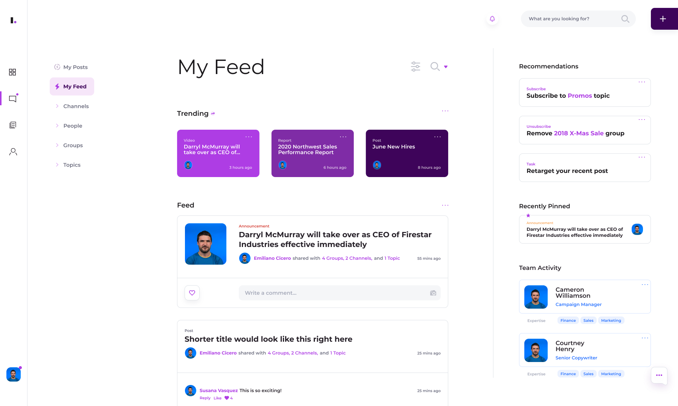
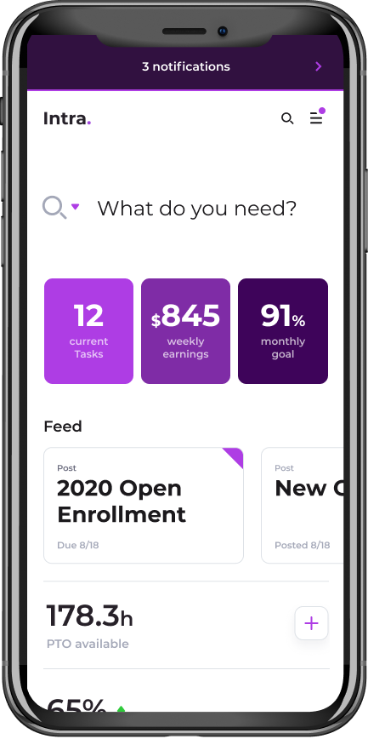
Build the site
Demo 1
Provision on a clean instance
Browse a course as a visitor
Enrol in a session
Notes:
Peter: Time for the first demo, in three parts: provision the site on a clean instance, browse a course as a visitor, and enrol in a session as a student.
Provisioning takes a few minutes, so we’ll start with the short version.

Slide 12
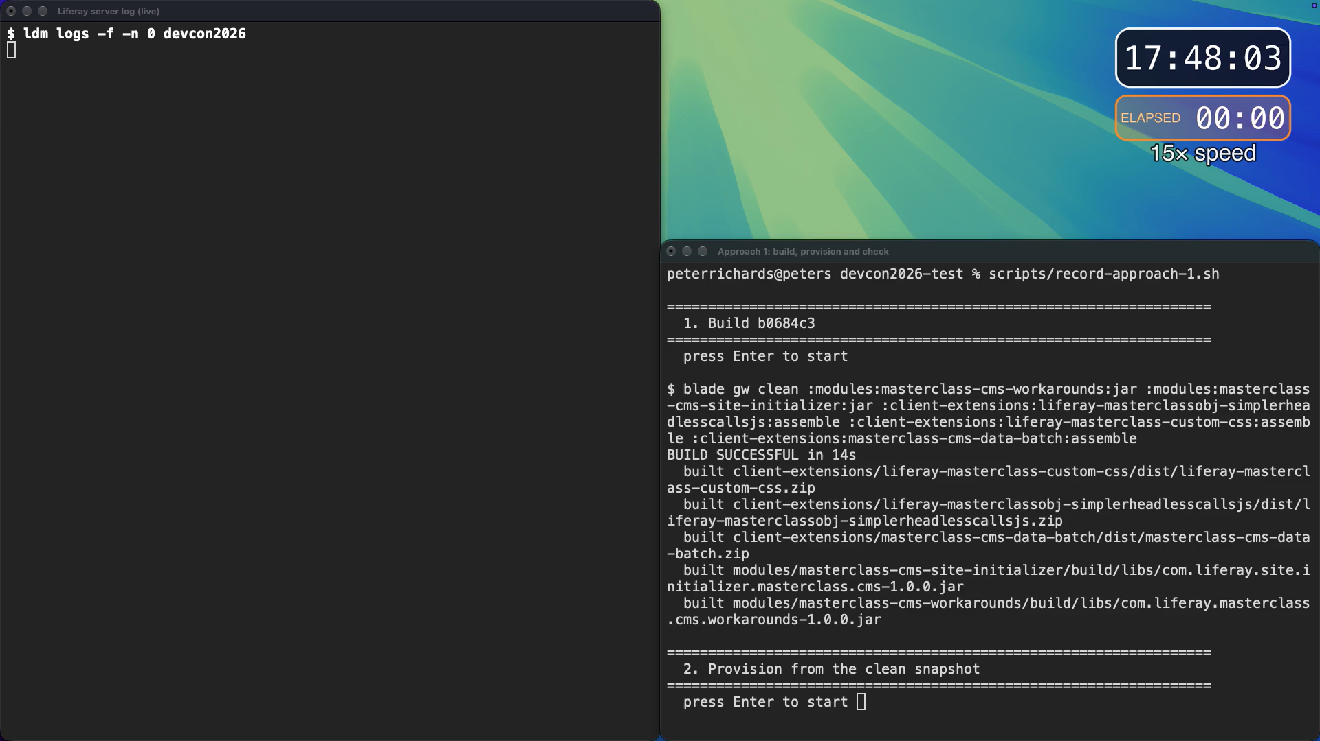
Notes:
Peter: This is the site initializer running on a clean instance, at fifteen times speed. In real time it takes just over six minutes, which is why you’re seeing the short version.
The log is on the left, the run on the right, and the clock in the corner keeps real time. [Play the time-lapse.]
It starts by restoring a clean snapshot. That’s how we worked throughout: snapshots let us test each change and go back to a known clean state between iterations.
The red in the log is the restore and the platform warming up, not our code. Watch what the checks say, not the colour.
Everything after this is live. [Switch to the laptop.]
[As a visitor: home page, courses, a course page, the blog.] All of this comes from the content structures in the Space.
[Sign in: student.one@liferay.com / test.] My Learning already has Building Enterprise Websites with Liferay. It went through the real enrol, approve and confirm flow before the snapshot.
[Open Mastering Data Modeling with Liferay Objects → Register to a Session → pick a session → confirm.]
[Course Registrations.] It shows Pending. That’s the real behaviour; an admin would approve it next. [Don’t approve it.]
[Register for the same session again.] “You are already registered for this session.” That’s the rule from the workarounds module I mentioned earlier.
[Switch to the second browser window (admin): model builder.]
Peter: One more thing before we go back. This is what’s behind what I have just clicked through. [Show the course related to its modules, teachers and sessions.]
And this is the bridge from earlier: MyCourseSession, holding just the session ID and reading the rest from the Headless CMS.
Rafa: By the way, this is a small evolution from the original Masterclass. In the original, teachers are not related to courses, a course has at most three modules, and sessions don’t exist at all. So, we didn’t just migrate it, we extended it a bit. Why not? Once you’re here with AI on your side…
Peter: …you might as well use it. Right, back to the slides.
[Before the talk: restore masterclass-02-3c9a590, then re-run demo-prep.sh.]

Slide 13
“Works on my machine” now has a second clause: as me.
Notes:
Peter: That visitor view you just saw didn’t always work. Course images, PDFs and video worked when we were signed in on the machine that built the site and vanished on a second machine or for a visitor.
An AI diagnosis called it an unfixable race condition in the site initializer. It was three separate problems, none of them a race: the Service Access Policy blocking guest REST calls; a missing download permission on each file field, which shows up as a 404 rather than 403; and attachment mappings the importer silently drops.
One clean run as a visitor settled what an hour of reasoning couldn’t. So “works on my machine” now has a second clause: as me.
And one more thing: our first fix produced an image that returned 200 with zero bytes. An automated check passed it; a person looking at the page caught it.
A 200 is not an image.
Rafa, you hit something similar from the editor’s side.

Slide 14
Reproduce before you theorise. REST working proves nothing about the UI.
Notes:
Rafa: Yes, true. Once everything was set up and ready to test, we hit something unexpected. Publishing any blog entry in the UI, even without changes, failed with a generic error. Only in the UI, and nothing in the logs unless you turn on DEBUG. We found it by replaying the exact click path in a headless browser. The editor form matches request parameters to fields by name prefix, so our “image” field also claimed “imageAuthor”, another field in the blog structure. We renamed it to photoCredit: workaround, done.
But here’s the lesson: REST was saving the same entries without any error the whole time. So test end to end, the way your editors actually work.

Slide 15
The least-code answer was a smaller data model, not a script.
Notes:
Rafa: Peter promised you the story of the bridge. Originally, an onAfterAdd action copied the session ID into our bridge object, plus the dates, to make later calls simpler, at the cost of a little duplicated data. But our Headless CMS objects have drafts and versioning turned on, so onAfterAdd fires on the empty draft, before the author has typed anything. Only the ID ever arrived. The fix was easy: the bridge stores only the session ID, and the page reads the dates straight from the session itself. No copy, so nothing to keep in sync. On a clean run, 12 sessions gave 12 bridge entries with matching IDs. And we’ve raised it with the product team, LPD-110575: an action that copies values needs to fire on publish, not on the empty draft.

Slide 16
The instructions needed a code review too.
Notes:
Peter: The agents learn from skills, written instructions about how Liferay behaves. Site initializers have two placeholder tokens: one substitutes text, the other substitutes a number. You’ll hear about them again in a minute.
One of our skills said the number token is never substituted and flagged every use of it as an error. Before turning that into an automatic check, we looked at the portal source.
The skill was wrong: the portal has substituted it since 2024, and our code used it correctly five times. We fixed the skill, not the code.
The same review found two more things. A symlink to one of our rule files had been committed as a plain 75-byte text file containing its path, so any agent reading it directly got a path instead of the rule. And Gemini had never read its own instructions file at all. It only looks in the folder you start it from and the ones above it, and ours was tucked away in a subfolder.
So, ask the tool what it loaded, and review your instructions the way you’d review code.

Slide 17
Check your instrument before trusting its numbers.
Notes:
Peter: We also measured whether the skills helped using Claude’s evaluation framework. Each test case is scored from 0 to 1: the share of checks that passed, averaged over five runs.
At first, the results said the skills made no difference. Then we found out why: every evaluation we’d run so far had run without them. The same failure as the last slide: a symlink saved as a text file, 14 bytes this time, so the agent never saw the skills.
Check your instrument before you trust its numbers.
Once it was fixed, one case went from 0.40 without the skill to 1.00 with it: a gain of 0.60.
And a pattern emerged: skills about undocumented platform behaviour made a big difference; skills about things the model could already look up made very little.
So, write skills for what isn’t in the documentation.

Slide 18
It worked after my change is not it worked because of my change.
Notes:
Peter: Remember the two tokens? A display page template lost its collection. Changing the collection reference from the text token to the number token fixed it, and the fix went into the agents’ rules.
It was wrong.
Both forms go through the same importer, which reads them the same way. The real cause is the order the site initializer runs its import steps: it keeps them in a hash map, so the order can change on every site creation, and the pages don’t wait for the collections.
Two clean runs and the portal source showed it: the token had changed, but so had the order, and only the order mattered.
When we measured it, the problem hit 3 site creations in 12, and the initializer still reported success. That’s one reason the live demo was already provisioned. We corrected our rules and filed the ordering bug with the product team: LPD-110315.
So “it worked after my change” is not the same as “it worked because of my change”.
And a wrong rule taught to the agent is worse than no rule.

Slide 19
What we measured
8/8
12/12
3
5
+0.60
Approach 1, in numbers
blogs saved after the fix
sessions bridged correctly
Bugs / FRs to improve Site Initializers
correct uses a skill called wrong
eval gain once skills loaded
Each one a check on a clean instance, from a story you've just heard.
Notes:
Peter: Here is Approach 1 in numbers. Each one is a story you’ve just heard.
Eight out of eight: the blog posts that wouldn’t publish, all saving after Rafa’s fix.
Twelve out of twelve: every session bridged, once the bridge kept only the ID.
Three: the bugs and feature requests we’ve raised for site initializers.
Five: correct uses of the number token that a skill said were wrong.
And plus 0.6: the eval gain, once the agent could see the skills.
Every platform fact behind these is written down in the repo, ready to become a rule for the next migration.
Until those three land in the product, the workarounds module fills the gaps, and it’s meant to be deleted.

Slide 20


Improving Site Initializers
Approach 1
Templates
Missing dependencies between LayoutPageTemplates and DDMTemplates
InfoTemplates on DPTs are not mapped correctly, OSGI module to the rescue
Collections
Allow Site Initializers to connect Collections to Space Scope, dynamically
Collections are not mapped to the space, OSGI Module to the rescue
Objects
Support Object Validation rules
Being able to create specific validations outside of the object definition itself
Notes:
Peter: What would let us delete the workarounds module? Three areas of the site initializer.
Templates: pages and display page templates don’t declare everything they depend on, so the handler order decides what’s ready. That’s the one you just heard about, LPD-110315.
And attachment fields on display pages can only be mapped by a numeric ID the initializer can’t know, so the module maps them by name instead, LPD-110573.
Collections: the initializer can only scope a collection to the site, so the module connects it to the Space. We’d like the initializer to do that itself.
Objects: we’d like site initializers to support validation rules, defined outside the object definition itself, over relationship fields. That’s why the one-registration rule lives in the module for now,

Slide 21
Approach 2
Convert a Live Site to be based on Headless CMS.
Notes:
Peter: That was the path if you build sites from code.
Now the second one: converting a live site so it’s based on the Headless CMS.

Slide 22

Most of you have a live site, not a site initializer.
Approach 2
Notes:
Peter: Most customers don’t have a site initializer. They have a live DXP site on the CMS and DAM: web content and Documents and Media.
So, for Approach 2 we took the same starting point, the original Masterclass site on web content, and migrated it in place, without touching the initializer.
Rafa?
Rafa: Thanks, Peter. And remember, for me AI is the only way in.

Slide 23
What changes live
Live migration
Content
Articles become Headless CMS entries; files move into the Space
Stream files by URL, not base64. A REST delete only trashes, so re-runs need new ERCs
Pages
Pages and display page templates are rewired in place
Page edits need flag LPD-74328. Display Page Templates can be published but requires learning
Navigation
Menus and categories still point at the old content
Menu items can't change type: replace them. Space vocabularies are company-wide
Collections
Scope collections to Space
Collections can’t be scoped programatically, use the embedded collection provider instead
Notes:
Rafa: Here the approach is different. Ideally, AI takes a site that already exists and migrates everything to the Headless CMS. And by everything I don’t just mean the content and the DAM; that’s the easy part. I also mean whatever consumes that content: pages, display page templates, menus. With Liferay DXP the combinations are endless, so there’s no way to turn this into a generic tool. What we did instead was run it again and again, let it learn, and improve the skills until the full migration ran in one single shot.
Without the initializer there are no initializer workarounds, but there are new problems.
Regarding Content, you need to stream files by URL rather than base64, and have in mind that a REST delete on headless CMS only moves things to the trash, so the ERC is still taken on a re-run. For Pages, editing a page over REST needs a specific feature flag, and publishing a display page template takes some learning; more on that in a moment. Regarding Navigation a menu item can’t change type, so we replace it, and a Space’s vocabularies live at company level. Finally, about collections we had to use the embedded ones, attached to the CMS objects as using collections per se have some limitations programatically
Let me show you part of it.

Slide 24
Migrate the live site
Demo 2
Start from the original web-content site
Let the agent migrate it in place
Check the AI log, confirm, teach AI, re-run
Compare before and after, as a visitor
Notes:
What we are about to see is a video of a Masterclass site, yes still masterclass, but as we’ve said now the focus is on migrating the site itself, not the site initializer. The site is there we’ll simply will migrate all the contents and will adapt the pages, menus, etc. In one shoot, with AI learning until we could complete the task

Slide 25
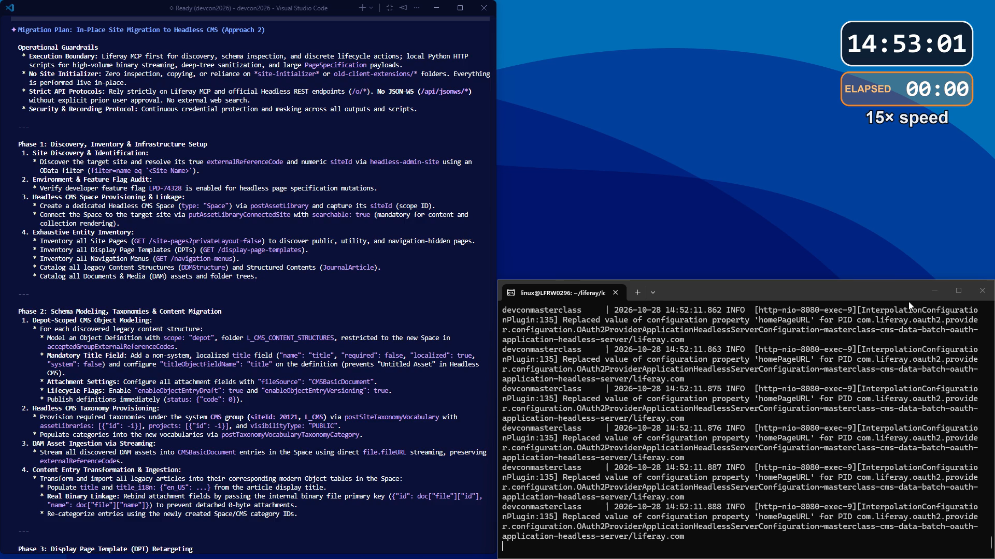
Notes:
Ok here we are, this video is going at 15x speed and it’s 1 minute and 15 sec, being 20 min in real time. As you can see from time to time I am even trying to show you the progress while AI is thinking, but ok I get it it’s too fast
Anyways you can see things. Here it’s creating the different structures in the headless CMS, now it’s migrating the documents and media and now it’s migrating the contents.
Next is the display page templates, now the pages and finally the navigation menus. We also instructed it to delete the original non headless webcontents as you can see and the final proof.
But let’s see it live with Peter now
Ok so let’s start there Peter, can you show them that the original webcontents aren’t there anymore? There’s the folders, but each folder is empty, ok enough. Now if we go to the site we still can see the Courses, you can click on a course now, here you can see the original masterclass but migrated right, remember: 3 modules and teachers that are not related to courses, this is a pure migration. No sessions, no enrollment, that’s additions we could do now if needed, with AI of course.
If you click on blogs now, then, there you are, the blogs. Finally going to the CMS, this is the Space, this is the site that is connected, and clicking on the dashboard reveals the 20 structure content and the 30 DAM files. Great
Once AI was able to do this one shoot, we thought, ok, let’s try with another one. Who remembers Clarity? That site full of glasses from a fictional company that is used a lot in our courses and documentation? OK, great, good amount of hands. Peter, can you please move to the other tab? Here you can see the home page, as a quick sample: there’s again blogs, there’s also FAQs, products, etc. ok, a different site in the end.
Let’s see, next video now

Slide 26
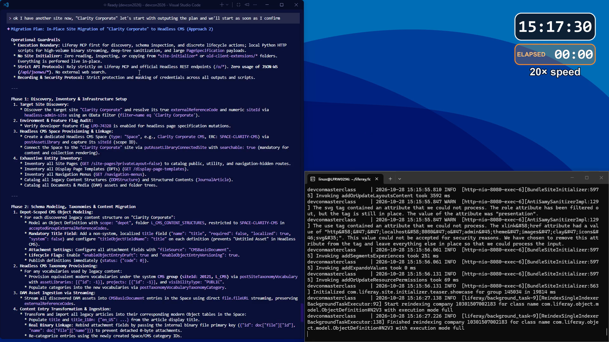
Notes:
The video is very similar right, but if you can see, it’s 20x now but it’s still needing more time, 1 minute and 40 seconds. Clarity is bigger, has much more contents and files to it needed 30 minutes, not 20.
As you can see here it’s still migrating Documents and MEdia and I am showing from time to time the count. Now as before, display page templates, then pages, menus….and the quick quick end result.
OK done. It was also migrated. Fully migrated? Not really. As I said in the beginning each site is a little bit of a mystery with Liferay, each site is different. In Clarity there’s search blueprints, there’s also uses of collections and categories. Part of it can’t be migrated easily, part needs specific new instructions for AI. Again, remember, you need to keep teaching AI, there’s hundreds of use cases, but still 80% or more of job was done already.

Slide 27
When the endpoint you ask doesn't know the answer exists.
Notes:
Rafa: To migrate the live site, the agent needed the site External Reference Code to begin with. It asked the corresponding API, the headless-admin-user, but it got null. That’s not retrieved by default, unless explicitly asked. But AI doesn’t know that. As headless-admin-site needs that code on every page path AI starts to look into other possibilities that are not a good procedure like Going to the Database, trying to call the JSON/WS, etc. You better stop it, investigate and finally you add a small clue in MD files: or you use the headless-admin-site API instead of headless-admin-user, so you get the proper ERC, or if you use ID then you need to pass it through a filter using OData.

Slide 28
A 204 is not a publish.
Notes:
Rafa: The agent published each migrated display page template over REST and got 204 No Content, so it reported success. However in the UI. the templates were still drafts. In the portal source, that publish endpoint isn’t implemented: the generated stub returns an empty object and touches nothing. The way that works is to Approve both the parent and the display page template itself. Once AI was instructed, we got all three publish with no extra clicks in the ui. Like the 200 with zero bytes in Approach 1: the status code said yes, the result said no.

Slide 29
Inventory the site from the API, not from the menu.
Notes:
Peter: We listed the pages to migrate by browsing the header: Home, Courses, Blog, Apply. My Learning wasn’t there.
It’s hidden from navigation and lives in the private area menu, so a page with a live collection on it nearly got left behind; we only caught it in the final review.
The fix: list every page with GET /site-pages, and for every model you migrate, ask where on the site it’s listed and who should see it.
Rafa, back to you.

Slide 30
Let the agent pick the tool: MCP to look, a script to change.
Notes:
Rafa: MCP was right for discovery and small, discrete changes. But Liferay has no endpoint to change one fragment in a page: you send the whole page specification, which is often 100 to 200 KB of JSON. Through tool calls that costs tokens, time and timeouts. Quite the contrary, a short Python script reads, edits and puts the tree back in milliseconds. That’s another lesson learnt: let the agent decide when to use MCP and when to use a script if the payload gets big.

Slide 31
What we measured
3/3
3/6
0
1
5
Approach 2, in numbers
DPTs published with 0 clicks
Menu items silently broke with 0 log errors
Items in trash after REST deletions
Extra page discovered after navbar check
Bugs / FRs raised to improve Headless CMS
Each one a check on a clean instance, from a story you've just heard.
Notes:
Same summary as Approach 1, but now for approach 2
Once we knew how to fully publish DPTs, we got 3 with no more draft on it
3 menu items were broken, the old courses, so you need to not only review pages and dots but also menus
Trash can be different depending on where you call it from. In headless CMS using REST you go to the trash, but in structured web content you don’t, 0 items in the trash after deleting all old webcontents
The extra page we discovered, My Learning, by instructing AI to gather all pages with the corresponding headless API
And finally the 5 bugs and feature requests we have raised to the product teams, to keep improving, that’s always good.

Slide 32
Improving Headless CMS
Live migration
Collections
Missing Admin Headless API for CRUD and Criteria
Blueprints as the evolution and integration of collections
Pages
Complex process to publish a page programmatically
Current approach requires two approvals at parent level
Object
Draft enabled entities trigger onAfterAdd just with the primary key value
Requires calling onAfterUpdate to get all data, but then no way to update / add on another object with no-code approach
Notes:
Rafa: Three things we’d ask for in the Headless CMS. Collections: there’s no headless API to create or manage them, criteria included, so we’ve raised it, Discuss 1075. Product is bringing collections and blueprints together, so that’s probably where it will land. Pages: you heard about publishing a display page template; it works, but it takes two approvals at the parent level, when it should be one call. And objects: you have heard already the draft story in Approach 1

Slide 33
Improving Headless CMS (2)
Live migration
Pages
Support semantic field names for Image fields
Complex calculation depending on the primary key of a field or use of infotemplate
Pages
InfoTemplates for ChildEntities once inside a given Collection are not exposed
You can’t use infoTemplates hence flexibility is decreased
Notes:
Rafa: Two more, both bugs. Pages: an image field can only be mapped by the field’s primary key, a number you can’t know in advance. You heard Peter’s module work around it in Approach 1; we hit it again here. We’d like semantic field names instead, LPD-110573. And templates: once child entities sit inside a collection, their info templates aren’t exposed, so you lose that flexibility, LPD-110572.

Slide 34
Numbers, numbers, numbers
Take home
6 New Skills
13 Skills Modified
9 Shared rules modified
Manage-cms
Manage-data-sets
Manage-form-containers
Migrate-batch-to-site-initializer
Migrate-cms-to-objects
Site-initializer-portability
Manage-objects
Mcp-server
Manage-object-logic
Integrate-external-data
Manage-pages
Theme-and-design
Workspace-init
Build-site
Feature-flags
…
Liferay rules
Site-initializer-format
Client-extension-types
Oauth-scopes
Headless-apis
Feature-flags-catalog
Object-actions-catalog
Page-types
Guest-access
Notes:
Rafa: Liferay has evolved a lot when it comes to the MD files that are included OOTB as soon as you create a LR Workspace with Blade. However, that doesn’t mean you won’t need more. Depending on your specific task you might need to create your own skills, like these 6 ones here, improve some of the OOTB ones, like these 13 in the middle or slightly modify rules, similar to skills but more direct. This is opensource so we can send a PR at some point to keep improving all the areas a Liferay developer might touch.

Slide 35




What to take home
Take home
Test as the visitor, on a clean instance
A status code or one good run is not proof
Discover through the API, not the screen
Fix the skill, not just the bug
Notes:
Peter: To wrap up, four habits to take home.
First, test as the visitor, on a clean instance each time. Automated tests are fine, but someone has to look at the page; that’s how we caught the empty image.
Rafa: Second, a status code or one good run is not proof. A 200, a 204, one lucky run: check it from every angle. Is it visible in the UI? Can I edit it? Can I delete it?
Rafa: Third, discover through the API, not the screen. Pages, menus, display page templates: if you only look at what the screen shows, you’ll miss the hidden parts, like My Learning.
Peter: And fourth, fix the skill, not just the bug.
That’s where the real improvement is: every fix you teach the agent saves time and tokens on the next migration.

Slide 36
Insert your
QR Code here!
Scan to keep the discussion alive
Everything is in the repo: github.com/rlluis/devcon2026
If you enjoyed it….
Rate our session now in the App!
Notes:
Peter: That’s it from us. Everything we showed today is in the repo: the site initializer, the skills, and every lesson, split by approach.
Rafa: If you enjoyed it, please rate the session in the app now; it really helps. And if you have questions, scan the QR code and ask us on Discuss. We’ll answer every one there.
Peter: Thank you.

