Slide 1
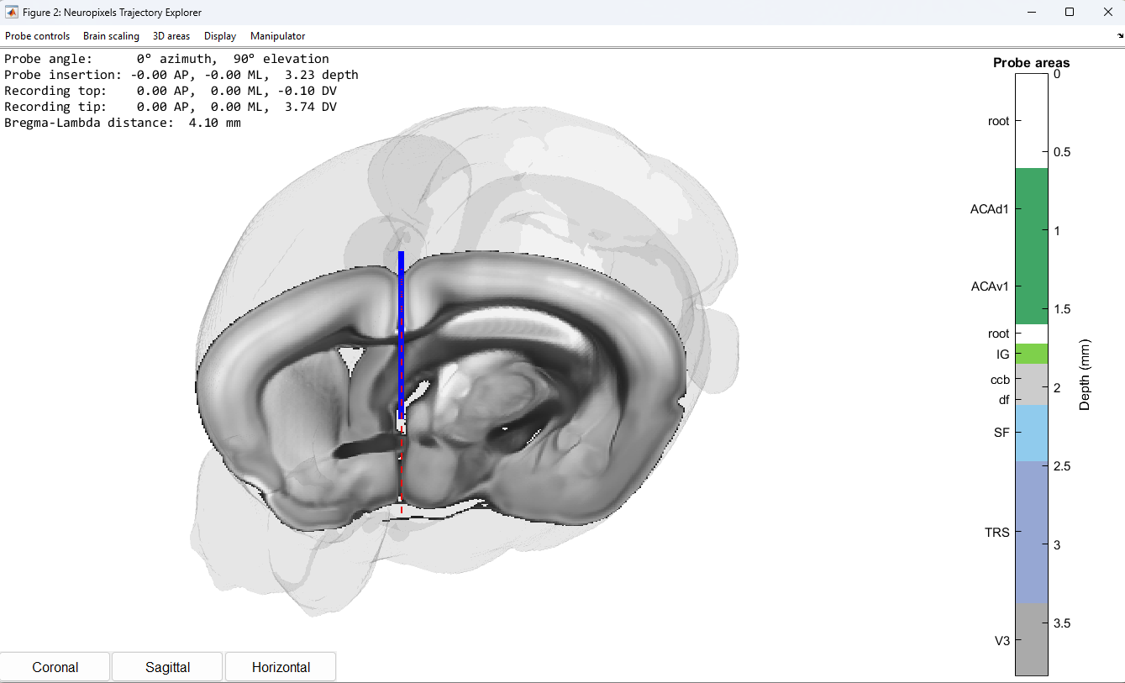
Control menu
Probe coordinates
Brain areas across probe
Solid blue line:
Probe position
Red dotted line:
Probe trajectory
Brain outline
Atlas slice through probe
Viewpoint buttons

