Slide 1
Stock Exchange Simulation Application
Purpose:
React web application for a stock market simulation. Users can browse available stocks, buy and sell positions, track portfolio value, simulate price changes over days, and review budget development with charted cash, portfolio, and total value lines.
The app is built with Vite, React, React Router, Material UI, and Axios. It expects a JSON API backend with `companies` and `stocks` resources.

Slide 2
Stock Exchange Simulation Application
Features:
- Market overview with searchable stock list
- Add, edit, and delete stock/company data
- Buy and sell shares from a stock detail page
- Portfolio page with current holdings and gains/losses
- Budget page with daily value development chart
- Toggle chart lines for cash, portfolio value, and total value
- Simulation day button that changes stock prices and stores daily budget snapshots
- Local persistence for transactions, day counter, budget history, and chart visibility
- Vercel-compatible single page app routing

Slide 3
Stock Exchange Simulation Application
Mock JSON Server
This is the mock backend for the stock exchange simulator. It uses`json-server` to expose the data in `db.json` as a REST API, so the React client can load, create, update, and delete project data without a real database.
The mock server provides the app data during development:
- companies and their profile information
- stocks and their current prices
- certificates and bonds
- example transactions
- logo/image assets from the `assets` folder

Slide 4
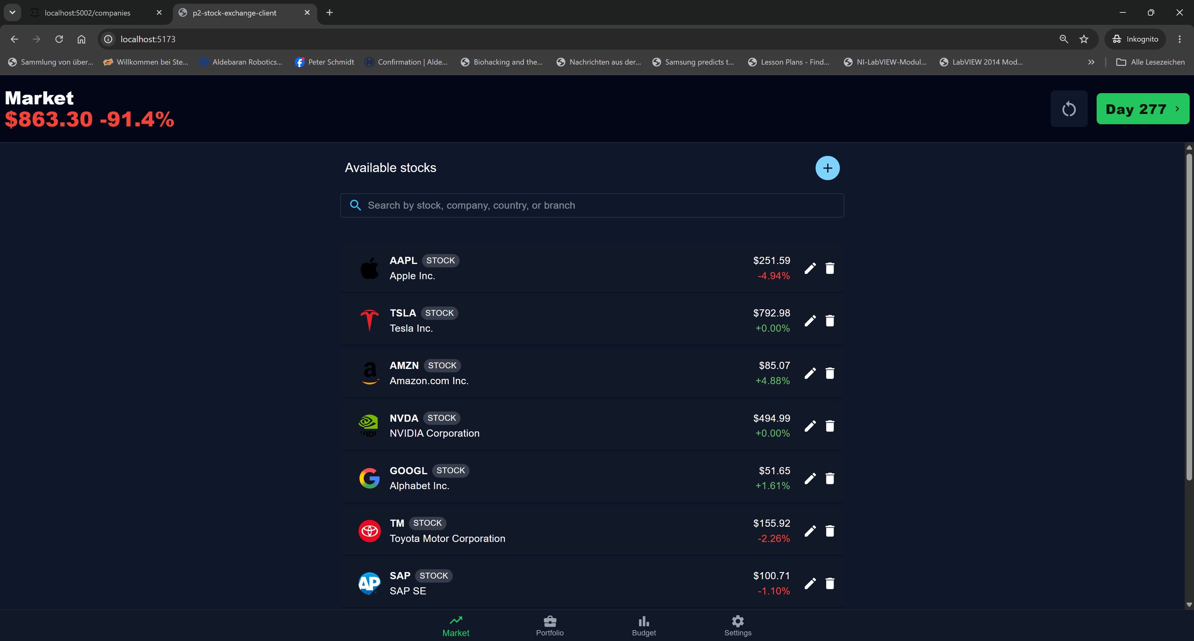

Slide 5
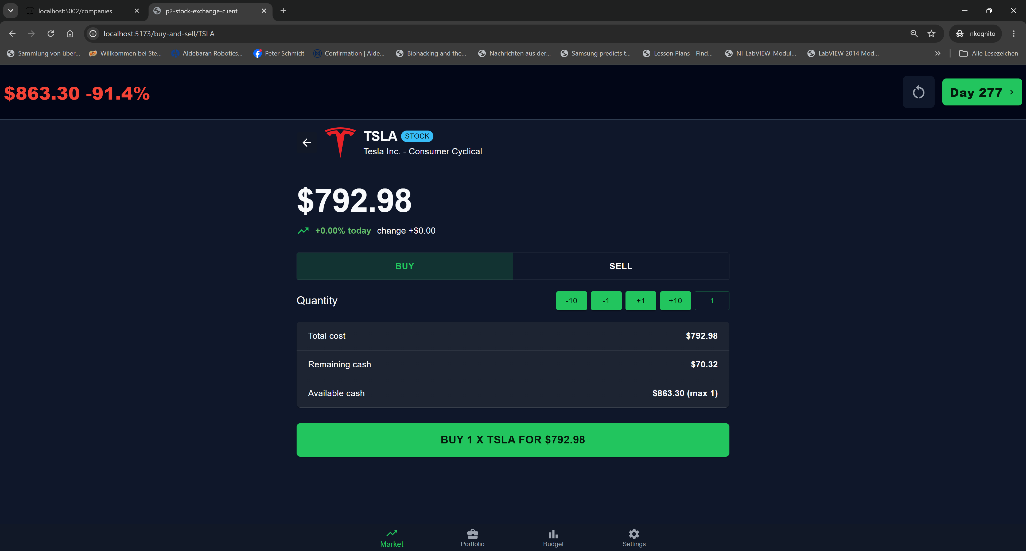

Slide 6
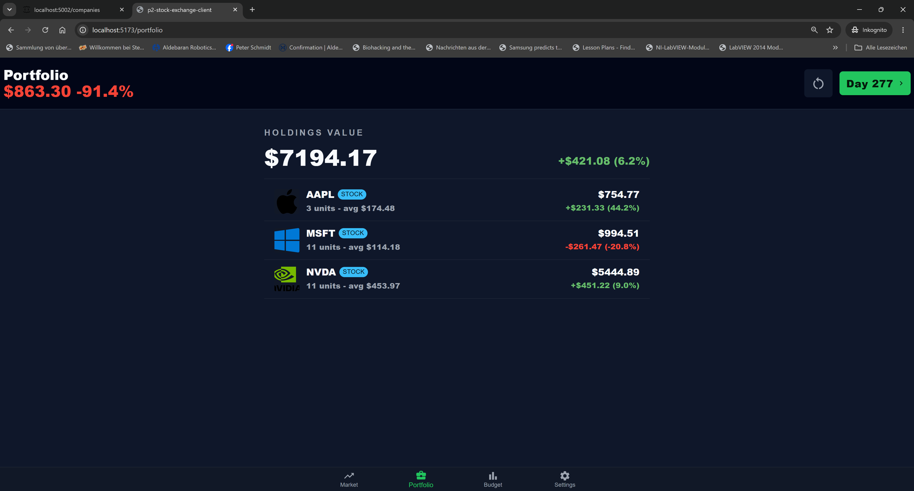

Slide 7
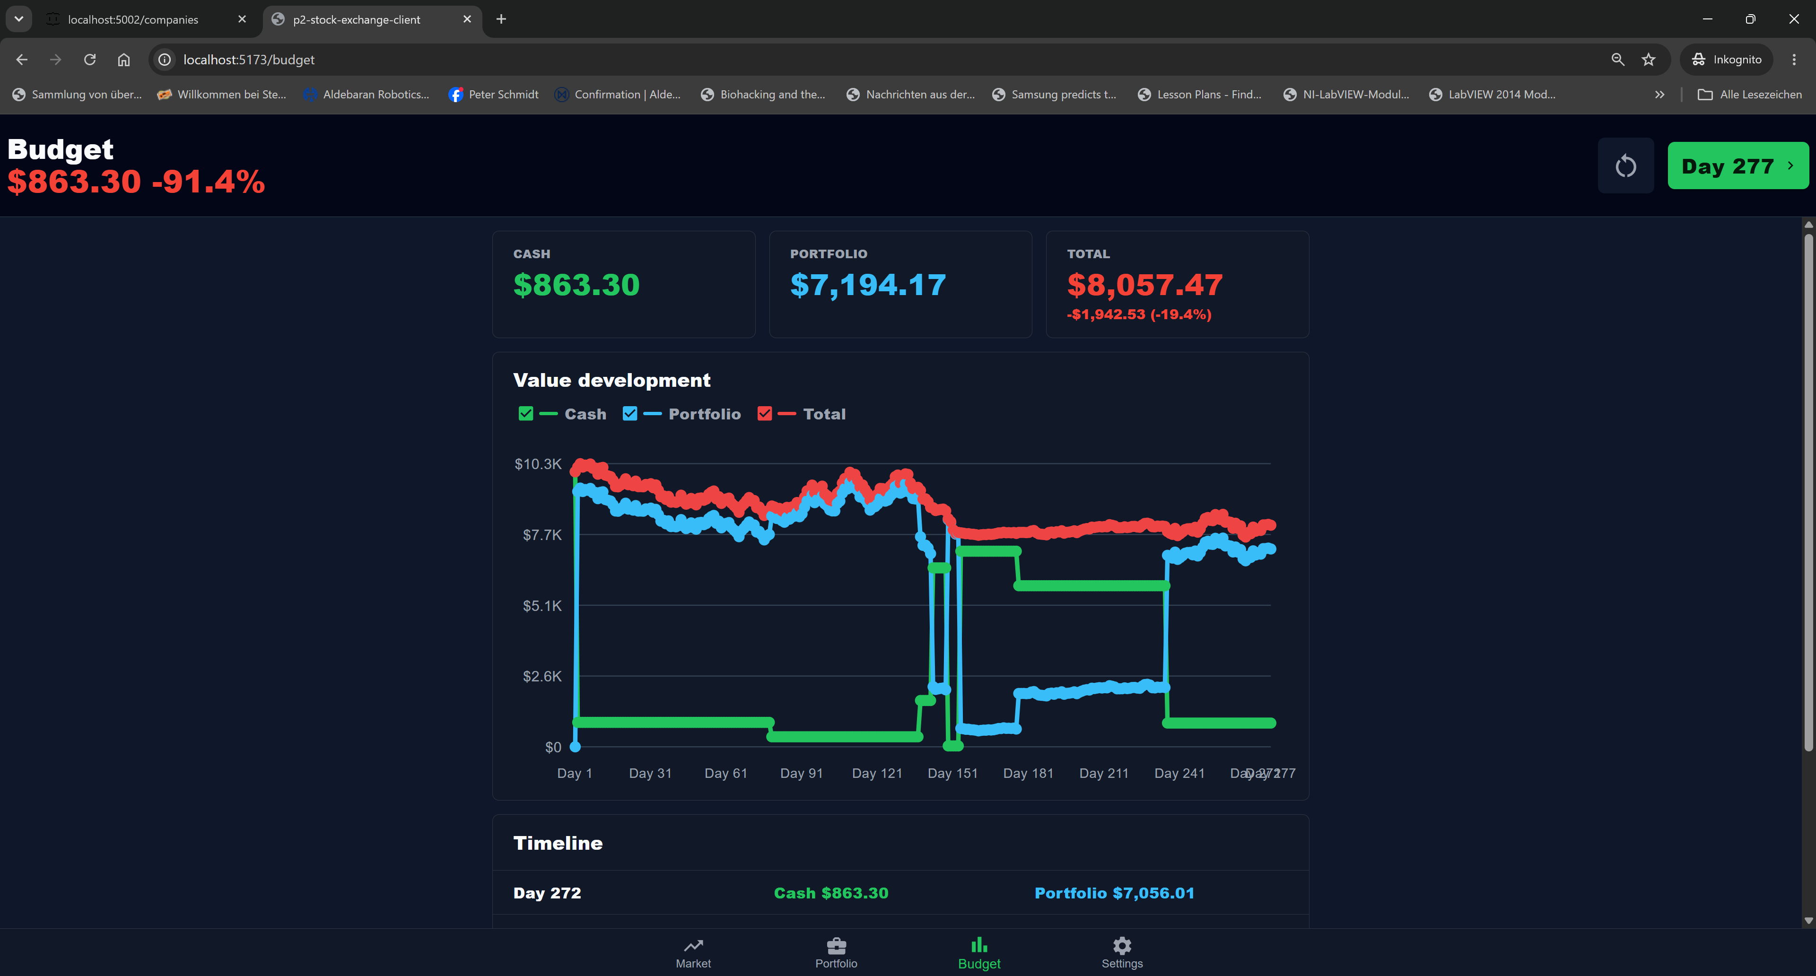

Slide 8
Stock Exchange Simulation Application
End of the presentation

