Slide 1
Transportation Accessibility and Its Impact on Livingston County, NY
Misfer Mohammed Hamid & Emily Peters

Slide 2
Demand-Side Analysis: Households Without Vehicles
Data Source: CDC/ATSDR 2022 SVI
Calculate average percentile of households with no personal vehicle per county
Filter through values within 2% of Livingston County
Dutchess
Lewis
Livingston
Madison
Ontario
Nassau
Schoharie
Tioga
Ulster
Wayne
Wyoming

Slide 3
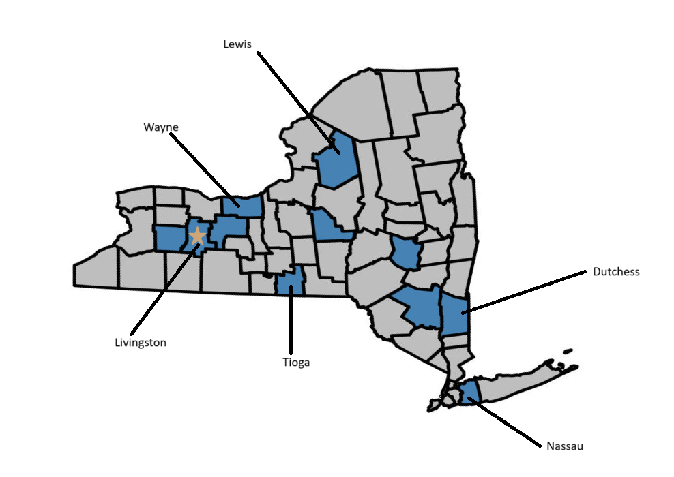
Demand-Side Analysis: County Locations

Slide 4
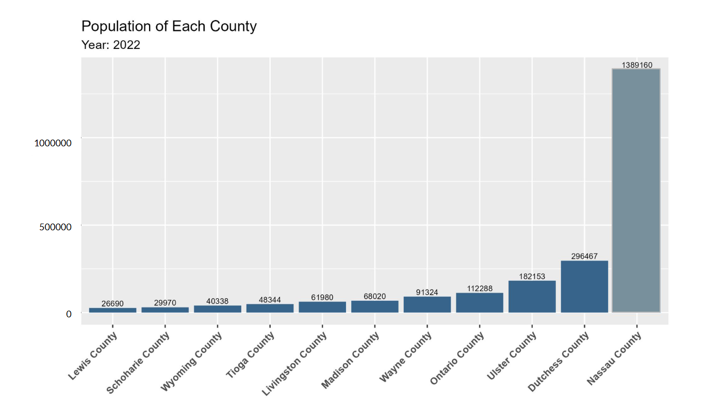
Demand-Side Analysis: County Populations
1 M
500k

Slide 5
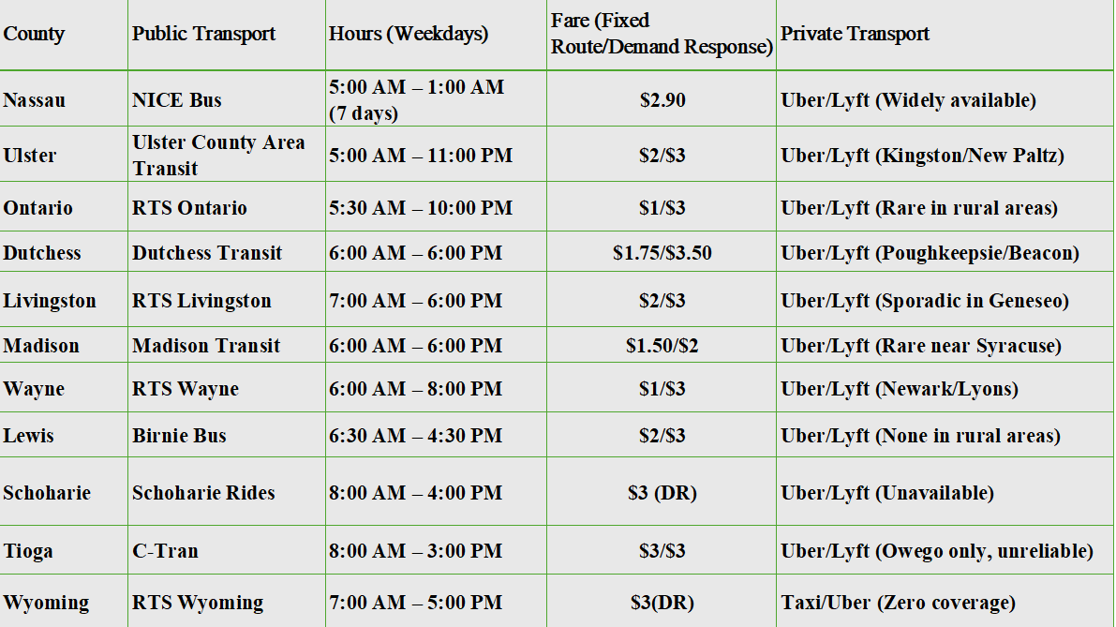
Sources: Dutchess County Public Transit, RTS Livingston, NICE Bus, [Uber/Lyft Coverage](www.uber.com/global/en/cities/ | www.lyft.com/cities)& ETC

Slide 6
Supply-Side Analysis: Transit Service Levels
Best-Served: Nassau County
24+ public bus routes (NICE Bus)
Direct NYC connections
24/7 ride-hailing availability
Well-Served: Ulster and Ontario Counties
Weekend service (Ulster)
Low-cost fares (Ontario)
Limited Service:
Lewis, Schoharie, Wyoming Counties
Demand-response transit only
Weekday-only operations
Minimal private transportation options
Variable Service:
Dutchess, Livingston Counties
Adequate urban coverage
Rural areas face long wait times and high costs

Slide 7
Supply-Side Analysis: Classification of Public Transportation, With Respect to Availability
Unideal
Sufficient
Good
Shortest hours of operation
10 hours or less
Only available within the average workday
No weekend hours
Longer hours of operation
Open 11-12 hours during the week
No weekend hours
Longer hours of operation
Weekend hours
Lewis, Schoharie, Tioga, Wyoming
Dutchess, Livingston, Madison,
Wayne
Ontario, Nassau, Ulster

Slide 8
Comparative Analysis: Social Vulnerability Factors Among Similar Counties
Is there a relationship between the percentage of households without a vehicle and other social vulnerability indicators?
What causes counties with very similar no vehicle percentiles to have varying availability of public transportation?
Are other social vulnerability factors similar as well?
Variable Description:
AGE17: households with person/people aged 17 or under
AGE65: households with person/people aged 65 or over
DISABL: people with a disability
MINRTY: people who fall under minority status
NOHSDP: people without a high school diploma
NOVEH: households with no vehicle
UNEMP: people who are unemployed
UNINSUR: people who do not have health insurance

Slide 9
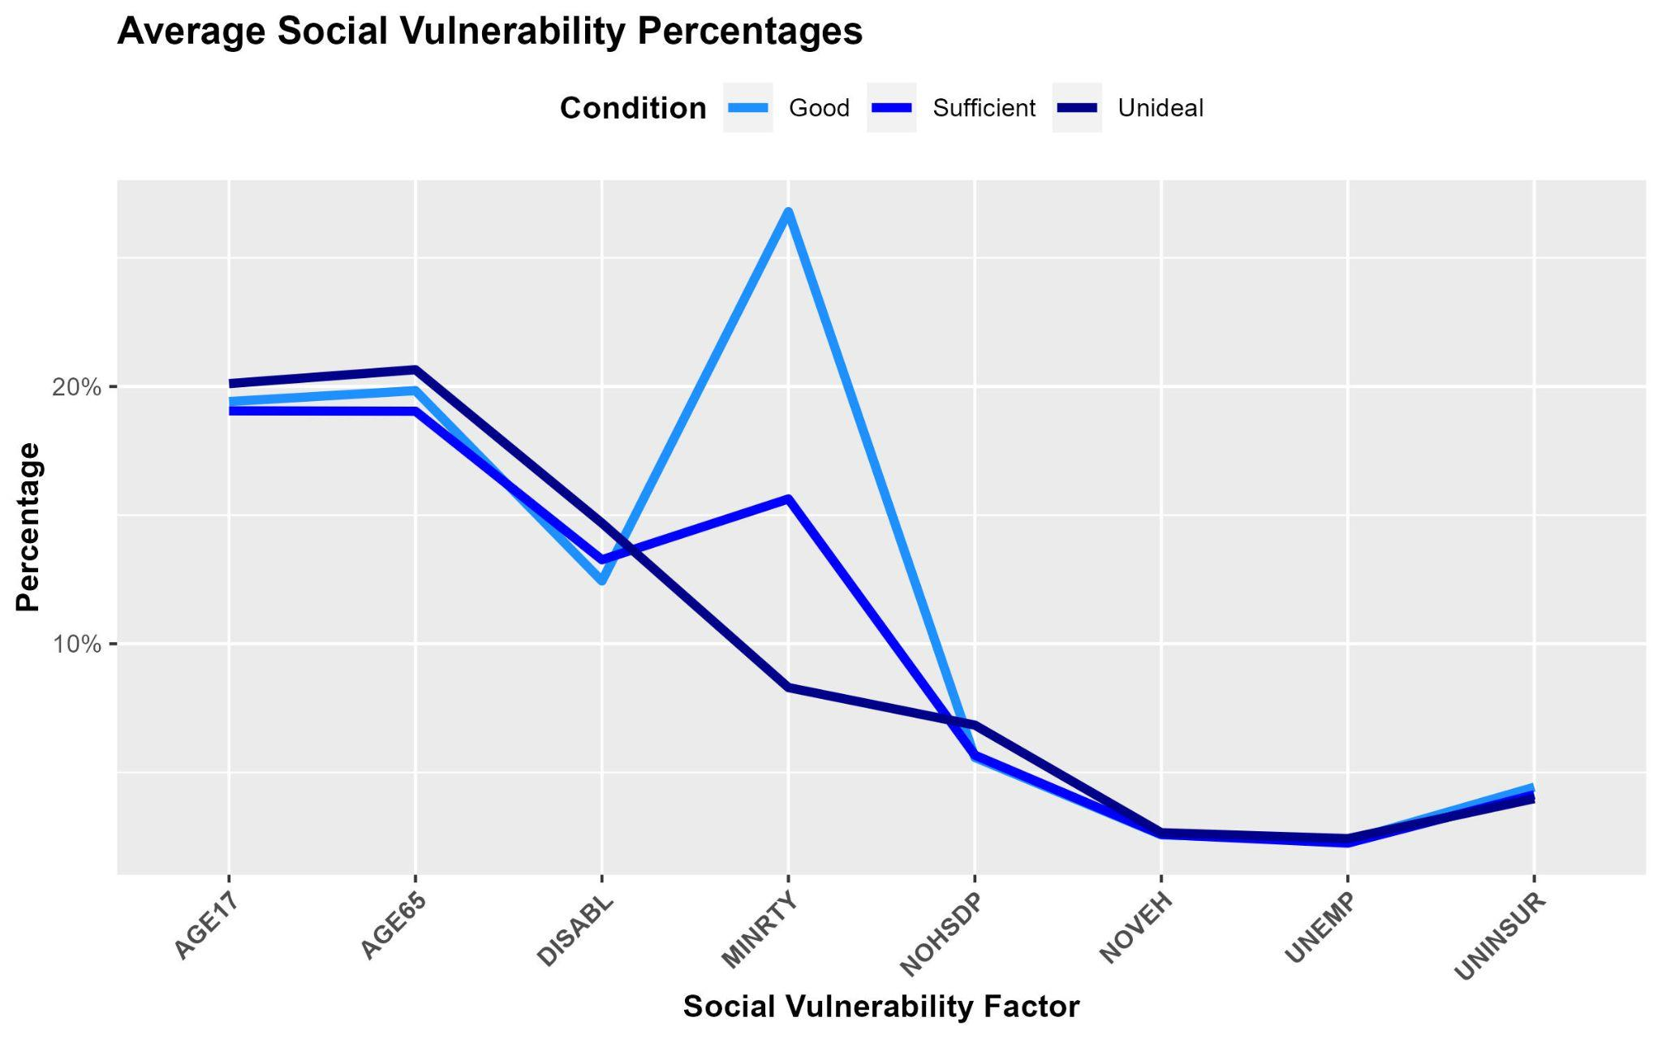

Slide 10
Comparative Analysis: Health Outcomes Among Similar Counties

Slide 11
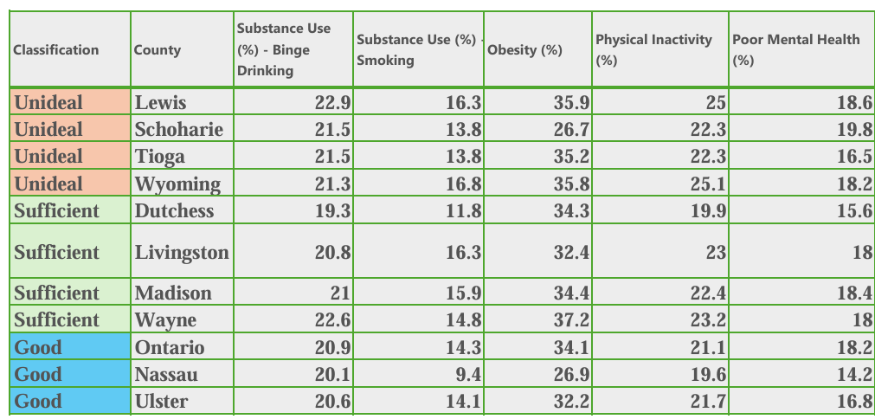
Sources: CDC.GOV , DATACOMMONS.ORG & ETC

Slide 12
Robust Check
Key Variables:
SNAP: Received Supplemental Nutrition Assistance Program benefits (yes/no);
Unemployment: Currently unemployed (yes/no);
Fair/Poor Health: Self-reported fair or poor health status;
Vision Difficulty: Difficulty seeing even with glasses;
Mobility Limitation: Serious difficulty walking or climbing stairs;
Any Disability: Affirmative response to any of six CPS physical/cognitive difficulties;
Work Disability: Health problem or disability that limits or prevents work.
Data Sources:
Merge 2023 Current Population Survey (CPS) Annual Social and Economic Supplement (ASEC) with SVI.
Observation Total: 4219
Main Independent Variable:
No Vehicle (%): Share of households without a vehicle in respondent’s county (from SVI).
Notes:
Find number of observations

Slide 13
Robust Check
Model:
𝑂𝑢𝑡𝑐𝑜𝑚𝑒_{𝑖𝑐}= 𝛽₀ + 𝛽₁·𝑁𝑜𝑉𝑒ℎ𝑖𝑐𝑙𝑒𝑃𝑐𝑡_{𝑐} + 𝛽₂·𝑋_{𝑖𝑐}+ 𝜀_{𝑖𝑐}
Control variables (X_{ic}) include:
Gender
age groups (18-44, 45-64, 65+)
race/ethnicity (NH-white, NH-black, Hispanic, and NH-other)
Educational attainment is grouped into standard categories
Insurance status is captured by a binary variable indicating whether the respondent has any private health insurance
Poverty indicator identifies individuals with income below the federal poverty threshold.
*CPS weights and strata used to produce population-representative estimates.

Slide 14
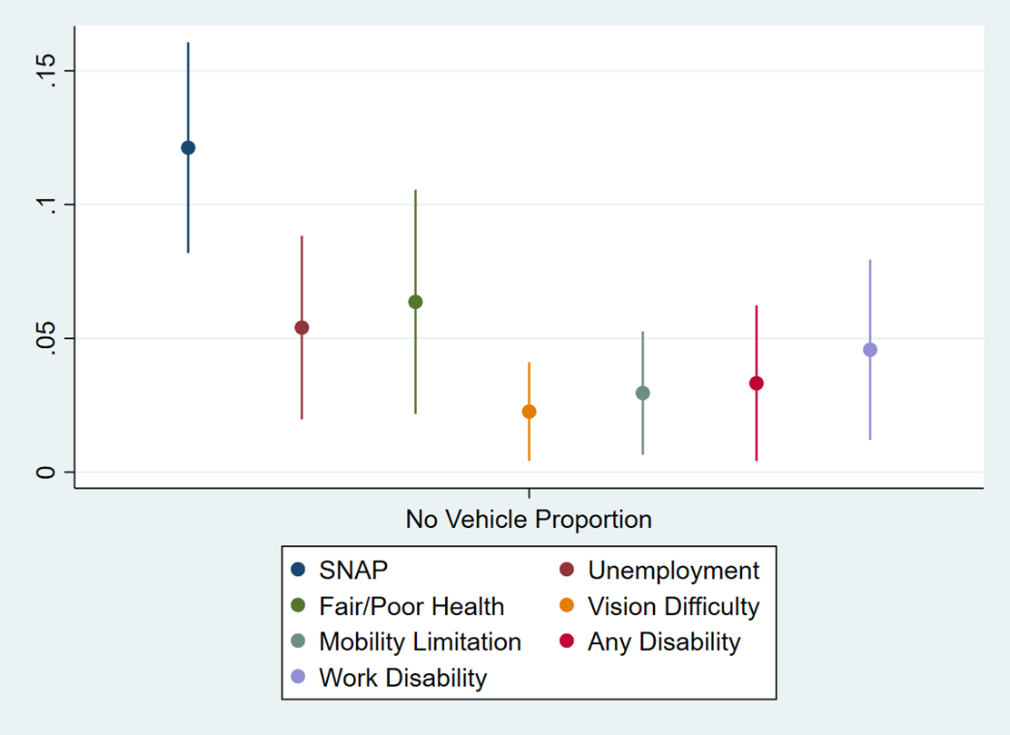
Robust Check

Slide 15
Conclusion
Demand-Side Analysis
Determine percentiles of no-vehicle households
Find similar counties to Livingston
Supply-Side Analysis
Research each county’s public transportation systems
Comparative Analysis
Find relationships between the no vehicle percentage, other SVI factors, and public transportation availability
Robust Check
Verify relationships between health outcomes and the no vehicle percentage

