Slide 1

Performance analysis Hands-on
Peter Senna Tschudin <peter.senna@collabora.com>

Slide 2
Hi, I'm Peter
I work for Collabora…
And you? Tell me about yourself...

Slide 3
Agenda
Performance analysis on embedded devices (10 min)
Linux perf introduction (20 min)
Linux perf demos (20 min)
Hands-on labs (60 min)

Slide 4
Why performance profiling
Understand CPU usage
  Quickly
  Completely

Slide 5
Value for your product
Can use CPU profiling to:
  Increase customer's perception of quality
  Maximize battery life (minimize power consumption)
  Maximize life cycle of hardware platform
  Identify performance tuning targets:
    Usually not complicated optimizations on hidden paths
    But code paths that are obvious candidates for tuning

Slide 6
Workload perspectives
CPU workload perspectives:
  Who
  When
  Why
  What

Slide 7
Workload perspectives
CPU workload perspectives:
  Who: PIDs, users, …
  When: changing over time, when started, ...
  Why: code paths, contexts
  What: CPU instructions, cycles, events

Slide 8
Workload perspectives
CPU workload perspectives:
  Who: PIDs, users, …
  When: changing over time, when started, ...
  Why: code paths, contexts
  What: CPU instructions, cycles, events
# top Mem: 459728K used, 1594412K free, 20100K shrd, 10244K buff, 141308K cached CPU: 40% usr 15% sys 0% nic 39% idle 4% io 0% irq 0% sirq Load average: 1.23 0.33 0.11 2/247 747 PID PPID USER STAT VSZ %VSZ %CPU COMMAND 597 1 xuser S 411m 20% 44% /usr/bin/firefox 142 1 root S 27384 1% 5% /usr/lib/systemd/systemd-journald 280 1 root S 27808 1% 5% /usr/sbin/syslog-ng -F -p /var/run/syslogd.pid 591 588 root R 2996 0% 0% top 599 496 xuser S 107m 5% 0% /usr/bin/Xwayland :0 281 1 root S 2760 0% 0% /usr/sbin/klogd -n

Slide 9
Workload perspectives
CPU workload perspectives:
  Who: PIDs, users, …
  When: changing over time, when started, ...
  Why: code paths, contexts
  What: CPU instructions, cycles, events
# perf stat -a -- sleep 5 20006.740280 task-clock (msec) # 4.000 CPUs utilized 89,027 context-switches # 0.004 M/sec 27,293 cpu-migrations # 0.001 M/sec 1,351,205 page-faults # 0.068 M/sec 33,504,143,547 cycles # 1.675 GHz (83.32%) 40,018,296,242 stalled-cycles-frontend # 119.44% frontend cycles idle (83.32%) 33,794,873,378 stalled-cycles-backend # 100.87% backend cycles idle (66.68%) 24,973,687,866 instructions # 0.75 insn per cycle # 1.60 stalled cycles per insn (83.35%) 3,636,423,775 branches # 181.760 M/sec (83.36%) 101,647,558 branch-misses # 2.80% of all branches (83.33%)

Slide 10
Workload perspectives
Using top-like tools was enough in the past
But now we need to understand why CPUs are used:
  Which code paths are running for more time?
  What are these code paths consuming?
  How can we visualize it?
  It should have low overhead.
  It should be easy to do.

Slide 11
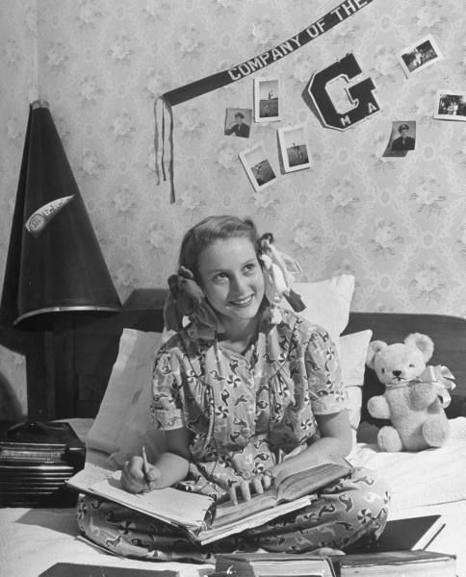
Wouldn't it be dreamy
if there was a performance analysis
tool that was more fun than going
to the dentist? It is probably nothing
but a fantasy...

Slide 12
Linux perf introduction
“perf began as a tool for using the performance counters subsystem in Linux, and has had various enhancements to add tracing capabilities.”
Performance counters are the basis for profiling, and are CPU hardware registers that count events:
  instructions executed, cache-misses suffered, branches mispredicted, ...

Slide 13
Linux perf introduction
Tracepoints are instrumentation points placed at logical locations in code, such as for:
  system calls, TCP/IP events, file system operations, …
perf can also create tracepoints for kernel and userspace dynamic tracing.
Endless possibilities!

Slide 14
Linux perf introduction
Profiling two main use cases
  Macro-scope: System-wide impact
  Micro-scope: Focus on a smaller execution path

Slide 15
Linux perf introduction
Macro-scope
Perf report goes here

Slide 16
Linux perf introduction
Macro-scope
Perf report goes here
Perf report annotate goes here
Micro-scope

Slide 17
Linux perf introduction
perf also does tracing
And does it with low overhead
Example of perf trace output:
# cat /tmp/perf_trace.out ... 0.340 ( 0.005 ms): dd/23521 open(filename: 0xd93f0880, flags: CLOEXEC ) = 4 0.342 ( 0.001 ms): dd/23521 fstat(fd: 4, statbuf: 0x7f93d96219a0 ) = 0 0.347 ( 0.003 ms): dd/23521 mmap(len: 111950656, prot: READ, flags: PRIVATE, fd: 4 ) = 0x7f93d27a1000 0.352 ( 0.001 ms): dd/23521 close(fd: 4 ) = 0 0.389 ( 0.005 ms): dd/23521 open(filename: 0xec35056d ) = 4 0.391 ( 0.001 ms): dd/23521 dup2(oldfd: 4 ) = 0 0.393 ( 0.001 ms): dd/23521 close(fd: 4 ) = 0 0.395 ( 0.001 ms): dd/23521 lseek(whence: CUR ) = 0 0.399 ( 0.003 ms): dd/23521 open(filename: 0xec35057a, flags: CREAT|TRUNC|WRONLY, mode: 438 ) = 4 0.401 ( 0.001 ms): dd/23521 dup2(oldfd: 4, newfd: 1 ) = 1 0.403 ( 0.001 ms): dd/23521 close(fd: 4 ) = 0 0.410 ( 0.001 ms): dd/23521 read(buf: 0x5642140a4000, count: 1 ) = 1 0.412 ( 0.001 ms): dd/23521 write(fd: 1</dev/null>, buf: 0x5642140a4000, count: 1 ) = 1 0.414 ( 0.001 ms): dd/23521 read(buf: 0x5642140a4000, count: 1 ) = 1 0.416 ( 0.001 ms): dd/23521 write(fd: 1</dev/null>, buf: 0x5642140a4000, count: 1 ) = 1

Slide 18
Linux perf introduction
Strace overhead
104 times slower
# dd if=/dev/zero of=/dev/null bs=1 count=500k 512000+0 records in 512000+0 records out 512000 bytes (512 kB) copied, 0.106753 s, 4.8 MB/s #
# strace dd if=/dev/zero of=/dev/null bs=1 count=500k 512000+0 records in 512000+0 records out 512000 bytes (512 kB) copied, 11.1873 s, 45.8 kB/s #

Slide 19
Linux perf introduction
Perf trace overhead
6.5 times slower
# dd if=/dev/zero of=/dev/null bs=1 count=500k 512000+0 records in 512000+0 records out 512000 bytes (512 kB) copied, 0.106753 s, 4.8 MB/s #
# perf trace dd if=/dev/zero of=/dev/null bs=1 count=500k 512000+0 records in 512000+0 records out 512000 bytes (512 kB) copied, 0.698036 s, 733 kB/s #

Slide 20
Flame graphs
“Flame graphs are a visualization of profiled software, allowing the most frequent code-paths to be identified quickly and accurately.”
They can be generated using Brendan Gregg's open source programs which create interactive SVGs.

Slide 21
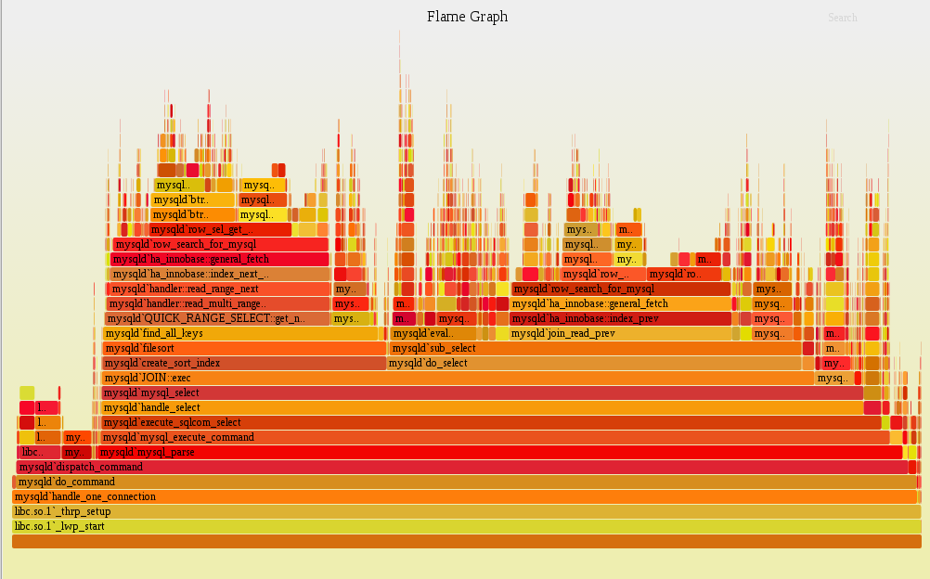
Flame graph of ???
The interactive version is at:
  http://github.com/petersenna/perf-labs/...

Slide 22
More stuff goes here including
Live demos
Labs
References mainly to Brendan Gregg and Arnaldo Carvalho de Melo

