Slide 1
Analysis of L.A. Housing Market
Group C: Jiyang Liu,
Yulin Shih,
Tianyi Deng

Slide 2
Introduction
Market price trend
Factors influencing the price
Recommendations

Slide 3








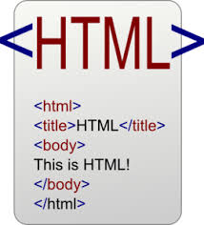



Tools
Row Data
Queried Data
Local
Cloud
Code
putty/pscp
Data source
.csv
.csv
.hql
.pig

Slide 4
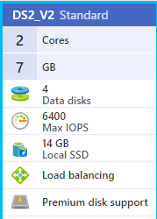
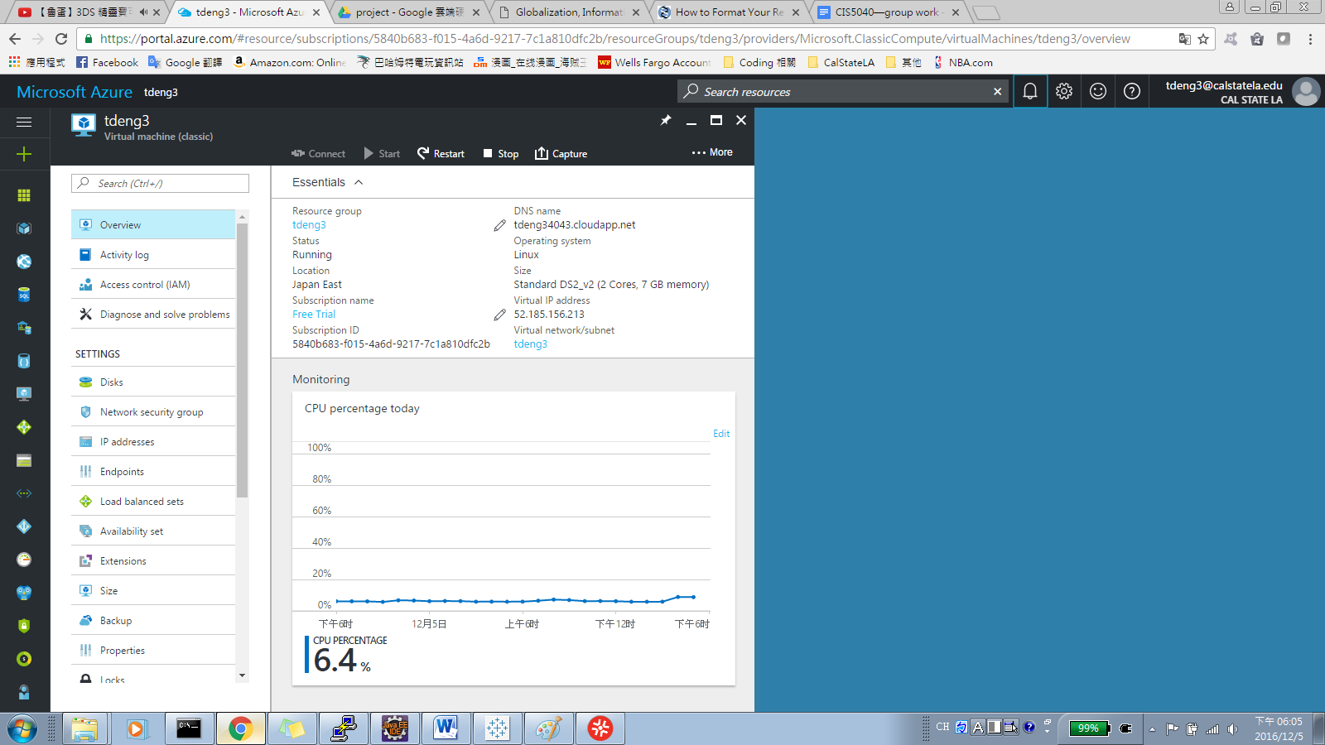
H/W experimental Specs
2 Nodes

Slide 5
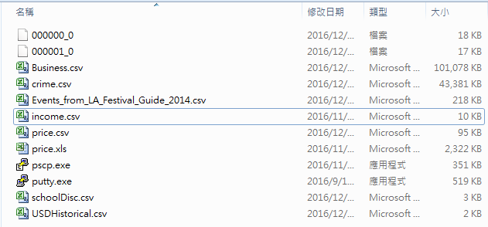
Data size

Slide 6
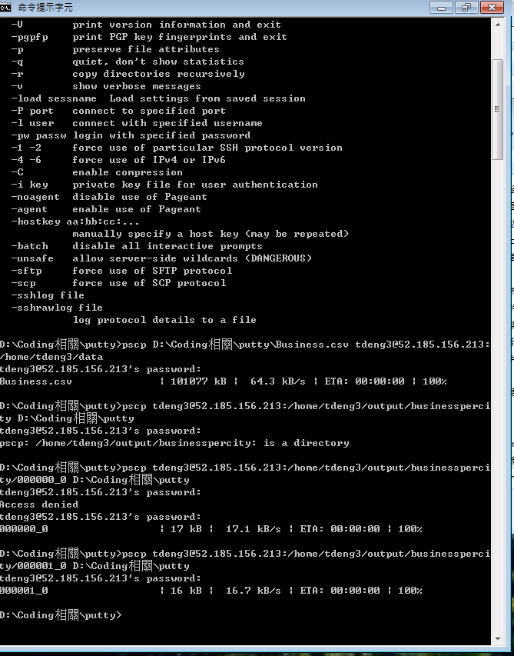
Using Microsoft Azure

Slide 7
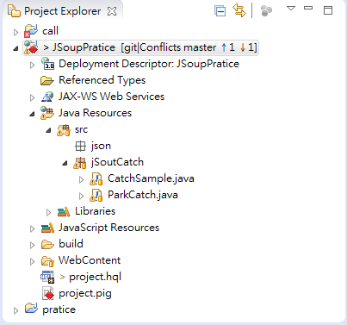
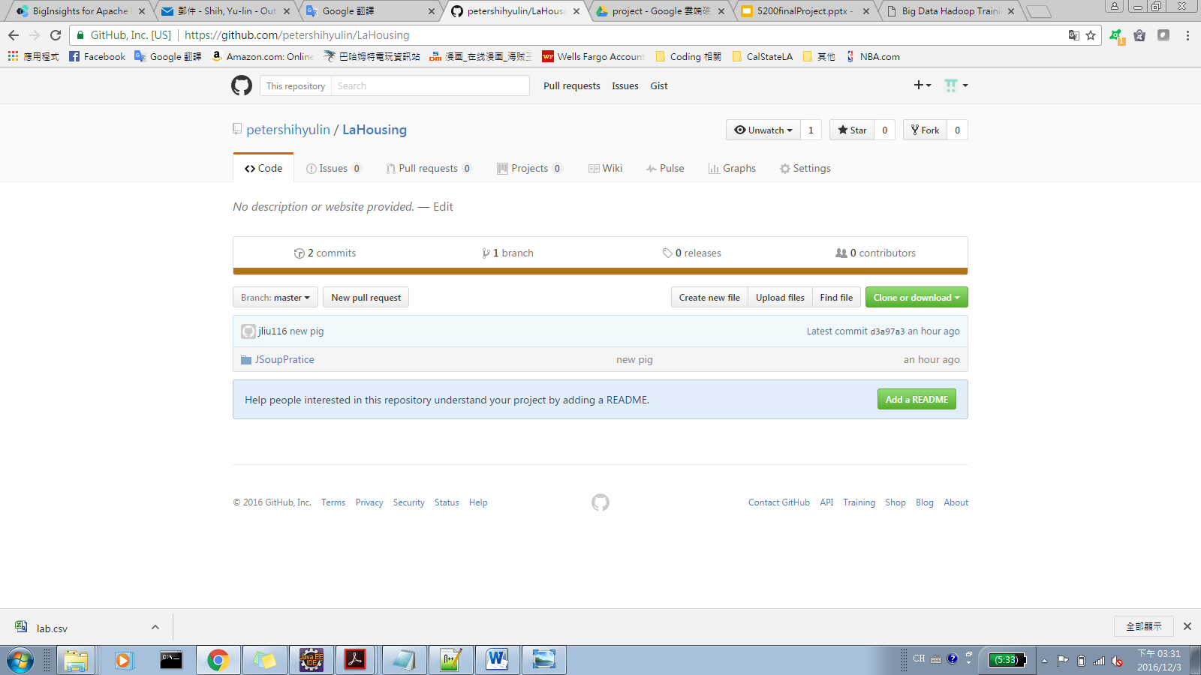

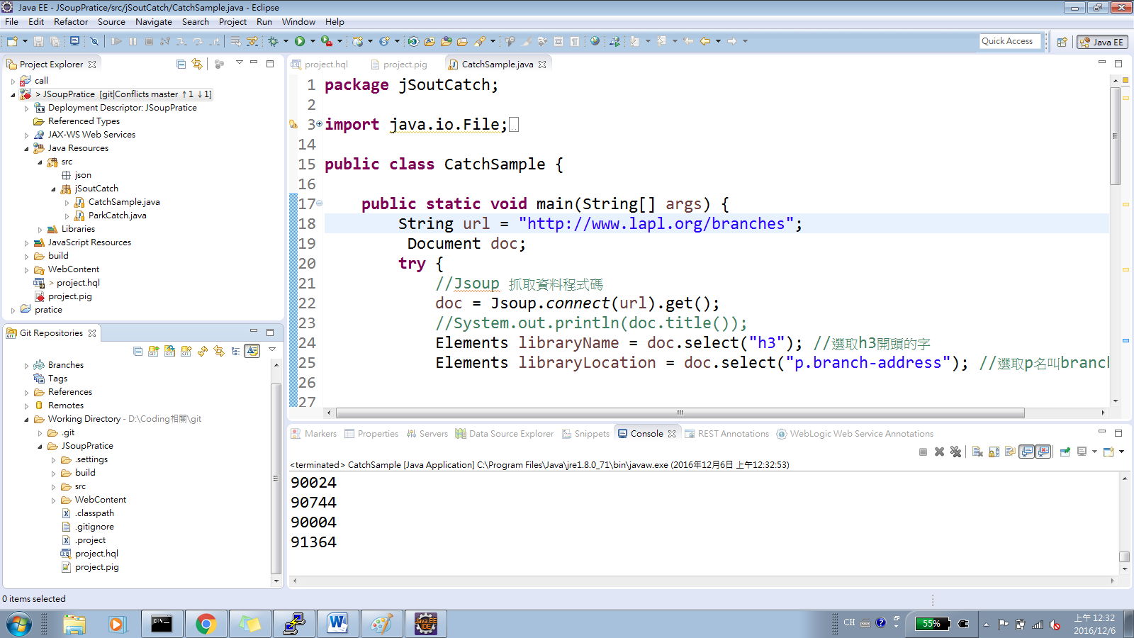
GitHub
https://github.com/petershihyulin/LaHousing.git

Slide 8
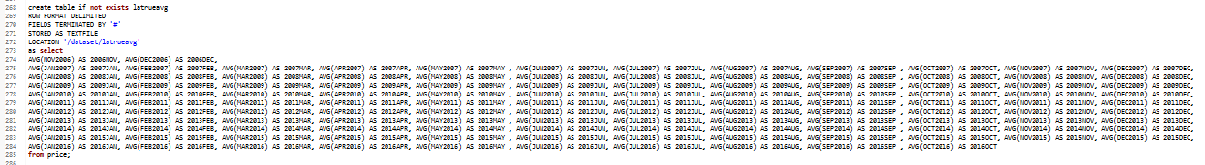
Analysis of Pricing Trend

Slide 9
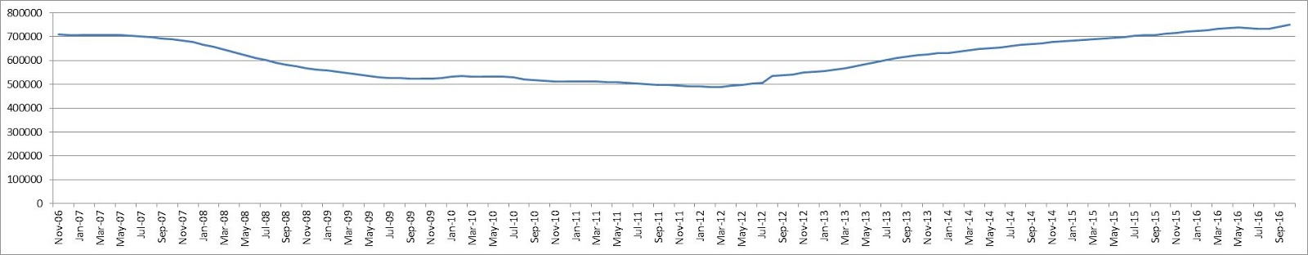
Analysis of Price Trend
2006-2016 L.A. County Housing Price Trend

Slide 10
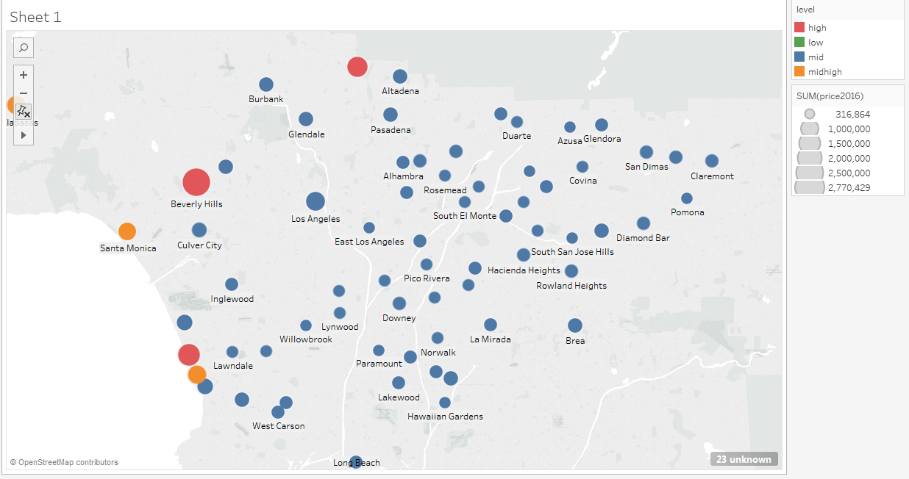
Market Price
2006-2007 L.A. County Housing Price
high(red)>=1,200,000 mid high(orange)>=800,000 mid(blue)>=400,000 low(green) <400,000

Slide 11
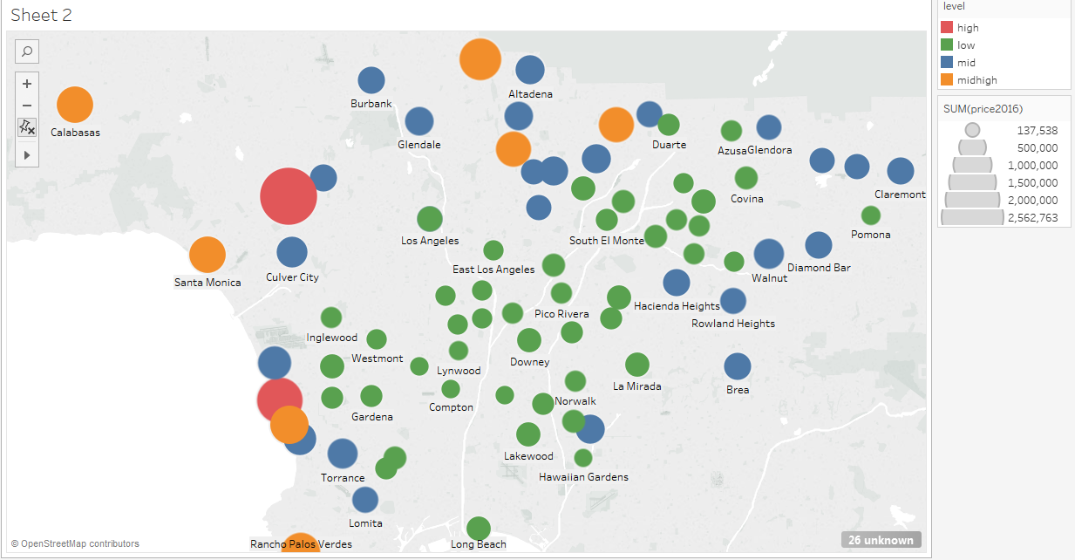
Market Price
2012-2013 L.A. County Housing Price
high(red)>=1,200,000 mid high(orange)>=800,000 mid(blue)>=400,000 low(green) <400,000

Slide 12
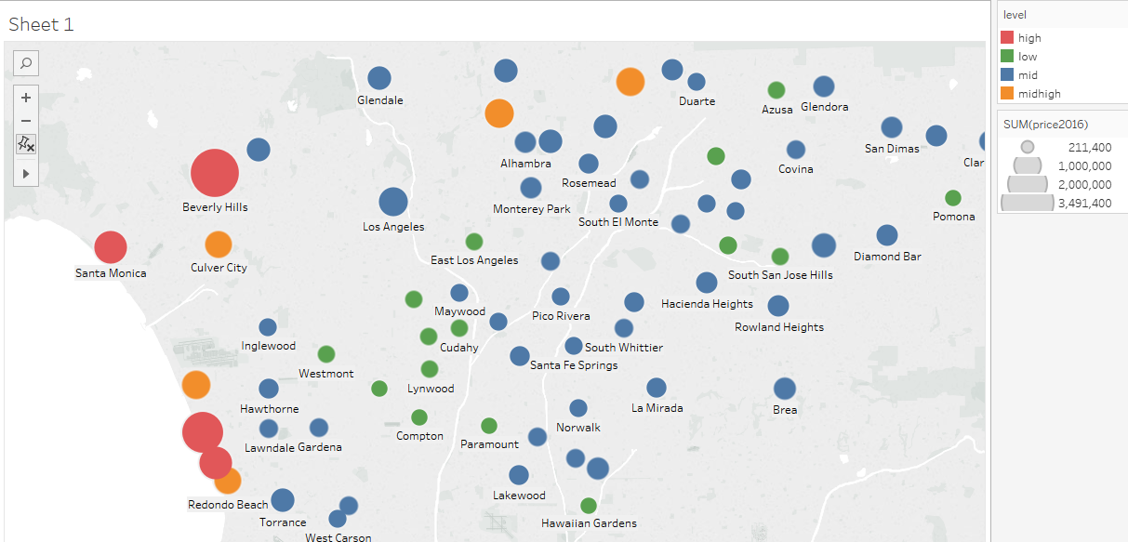
Market Price
2016 L.A. County Housing Price
--- high(red)>=1,200,000 mid high(orange)>=800,000 mid(blue)>=400,000 low(green) <400,000

Slide 13
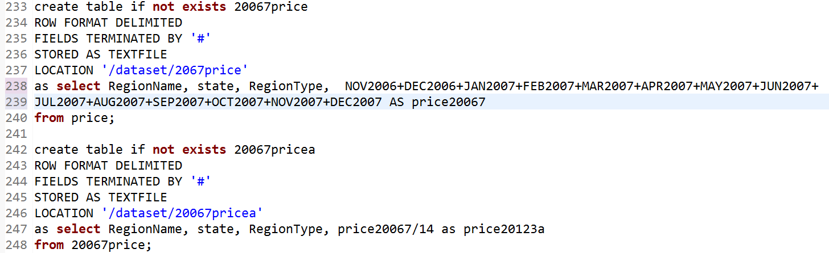
Market Price

Slide 14
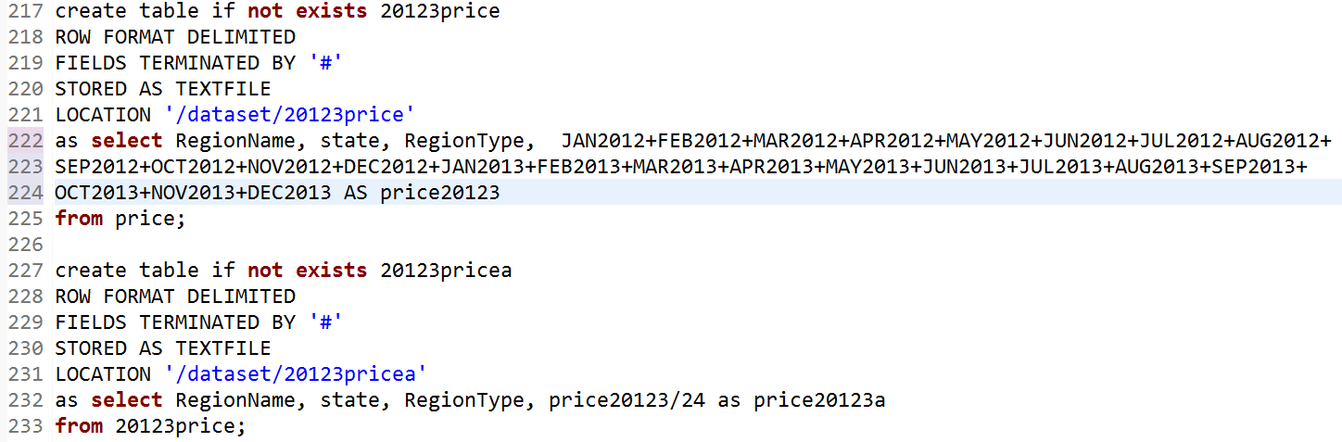
Market Price

Slide 15
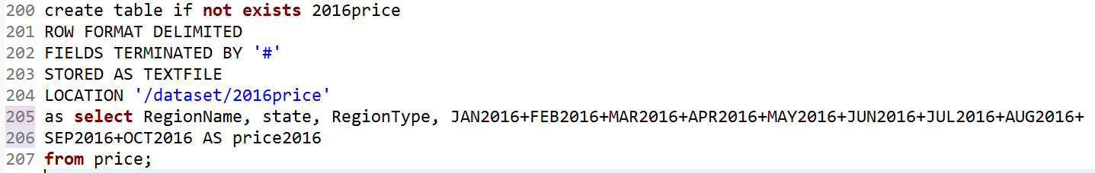
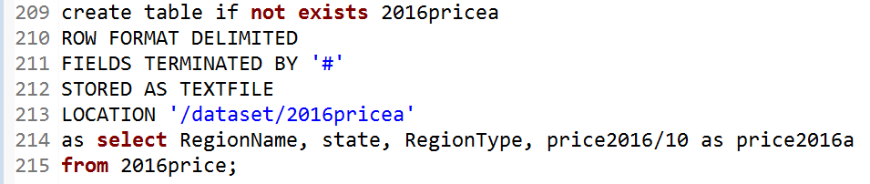
Market Price

Slide 16
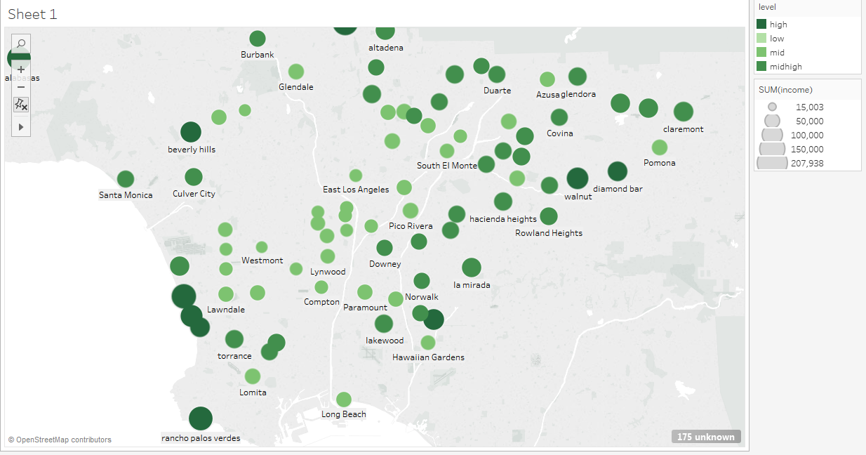
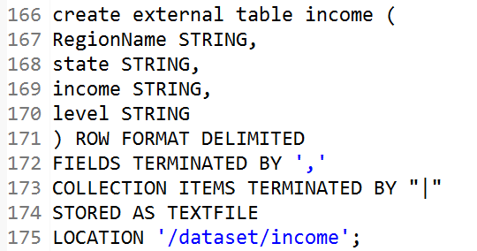
Mapview of Income
L.A. County Income
Hidden Hills
high>=900,000 midhigh>=600,000 mid>=300,000 low <300,000

Slide 17
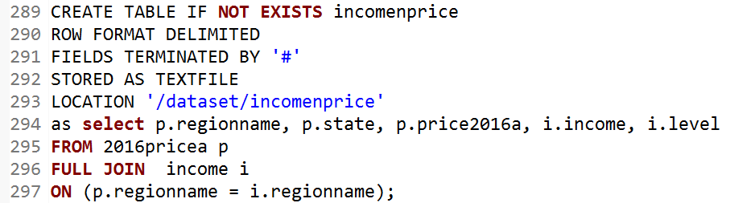
TreeMaps of Income

Slide 18
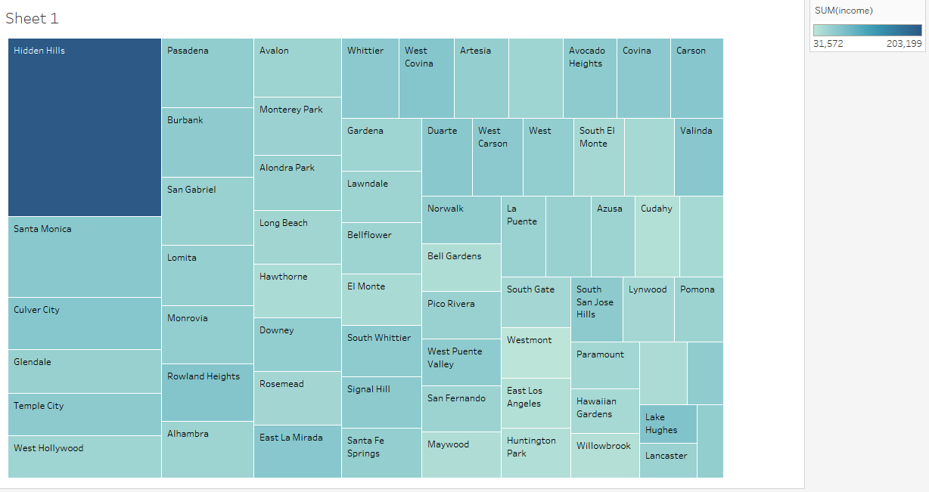
TreeMaps of Income
2016 L.A. County Residential Median Income

Slide 19
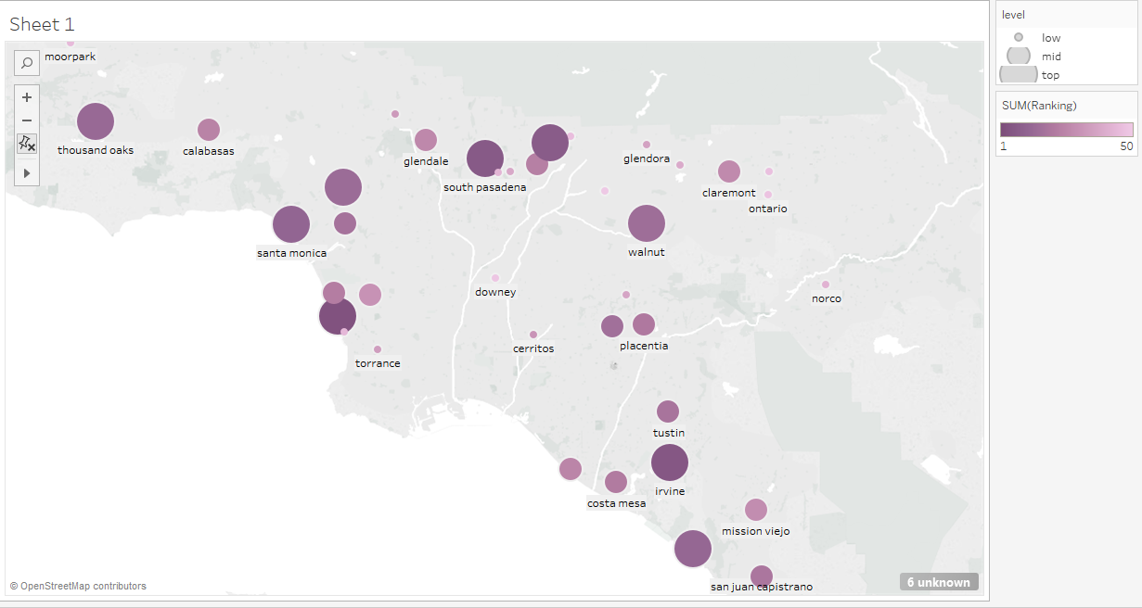
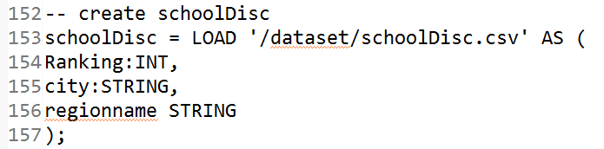
Mapview of School Ranking
L.A. County School Ranking

Slide 20
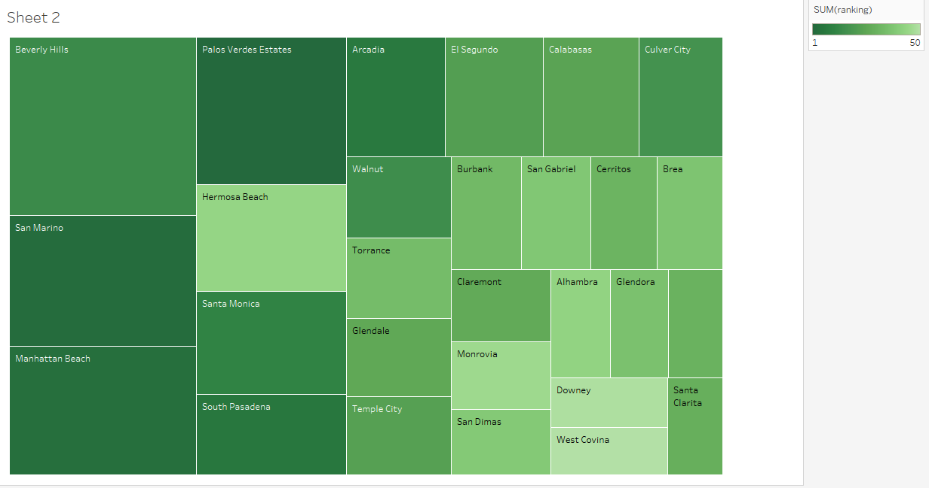
TreeMaps of School Rank
2016 L.A. County School Rank

Slide 21
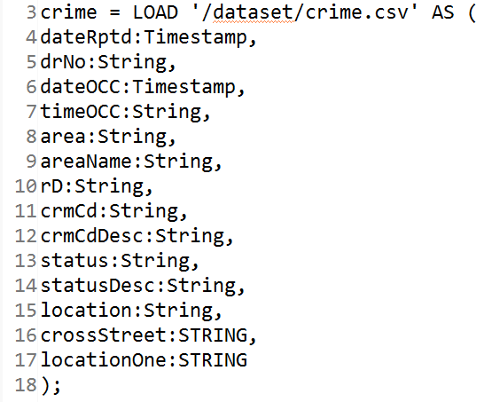
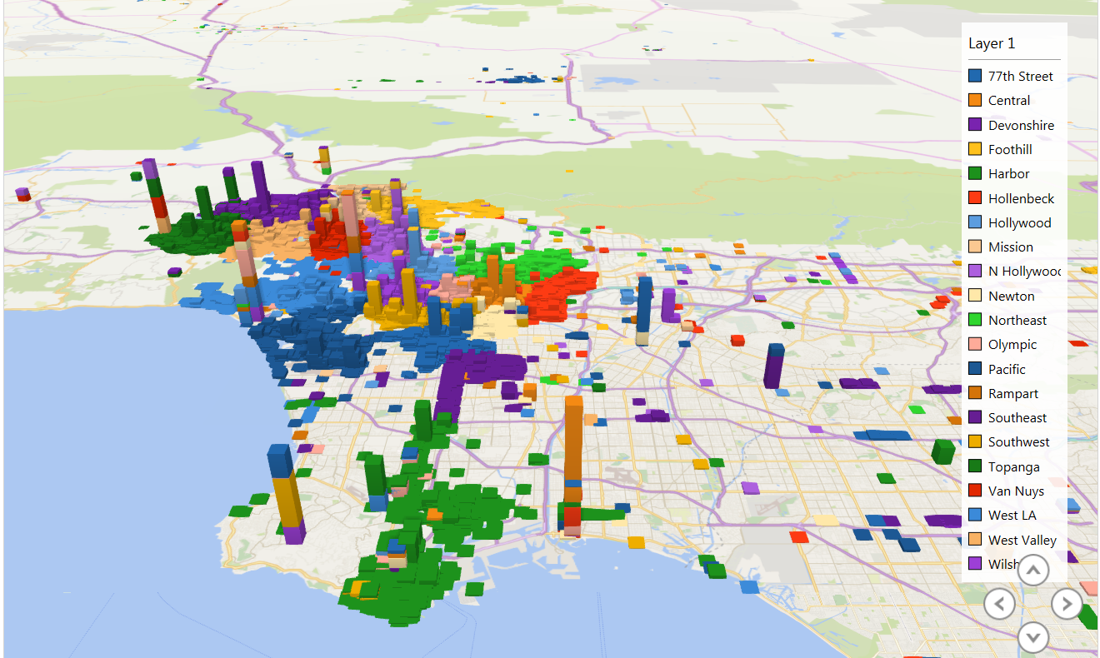
MapView of Crime Rate
Overall L.A. Crime Rate

Slide 22
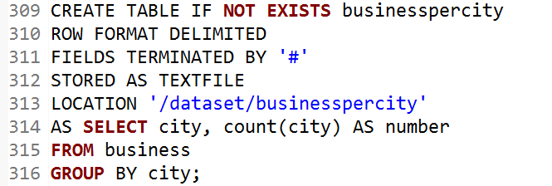
Business per city

Slide 23
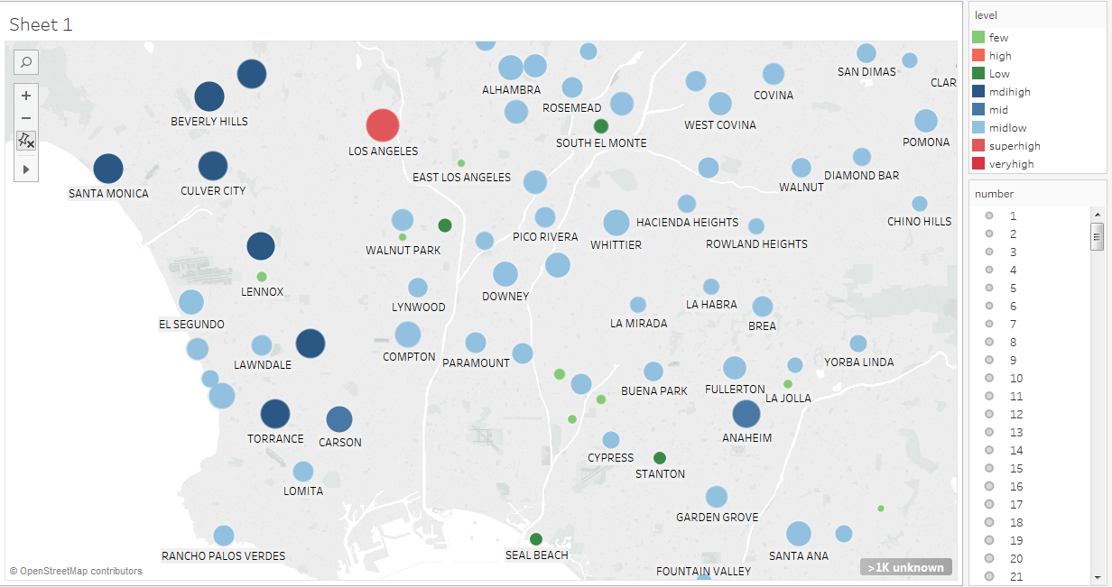
Business per city

Slide 24
Conclusion
Top 3 recommendations
Redondo Beach
Culver City
Temple City

Slide 25
References
1."LAPD Crime and Collision Raw Data for 2015 | Los Angeles - Open Data Portal." LAPD Crime and Collision Raw Data for 2015 | Los Angeles - Open Data Portal. N.p., n.d. Web. 01 Dec. 2016.
2."Housing Affordability Data System (HADS)." Housing Affordability Data System (HADS) - Data.gov. Publisher US Department of Housing and Urban Development, 15 Mar. 2015. Web. 01 Dec. 2016.
3.Zillow, Inc. "Los Angeles County CA Home Prices & Home Values | Zillow." Zillow. N.p., n.d. Web. 01 Dec. 2016.
4."2017 Best School Districts in Los Angeles Area." Niche. N.p., n.d. Web. 01 Dec. 2016.
5."Housing Affordability Data System (HADS)." Housing Affordability Data System (HADS) - Data.gov. Publisher US Department of Housing and Urban Development, 15 Mar. 2015. Web. 01 Dec. 2016.
6.Research on 1/24/2013, By Zillow. "Zillow Home Value Forecast: Methodology - Zillow Research." Zillow Research. N.p., 09 May 2016. Web. 01 Dec. 2016.

Slide 26
Thank you!

