Slide 1

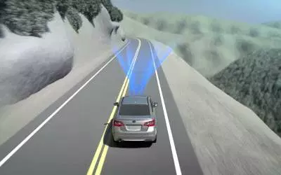
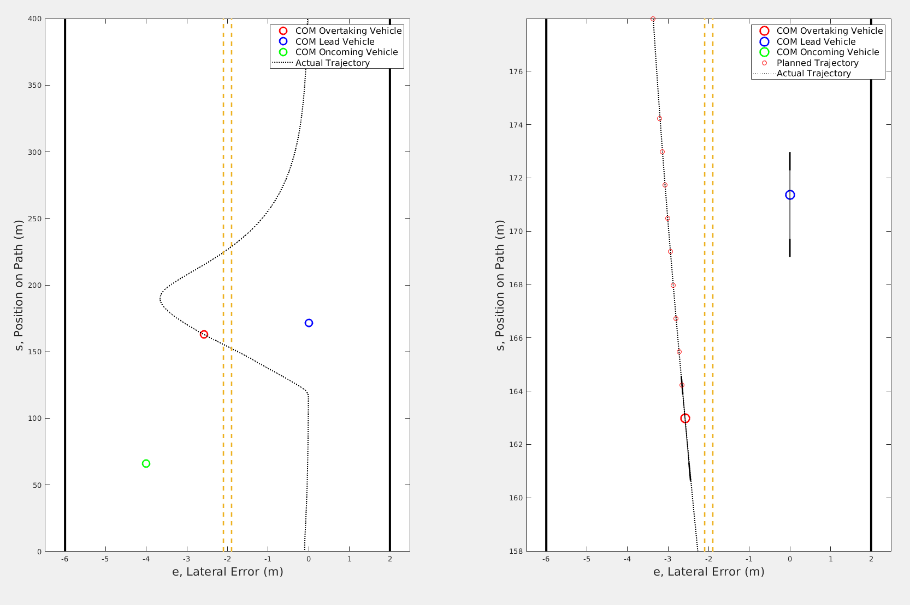


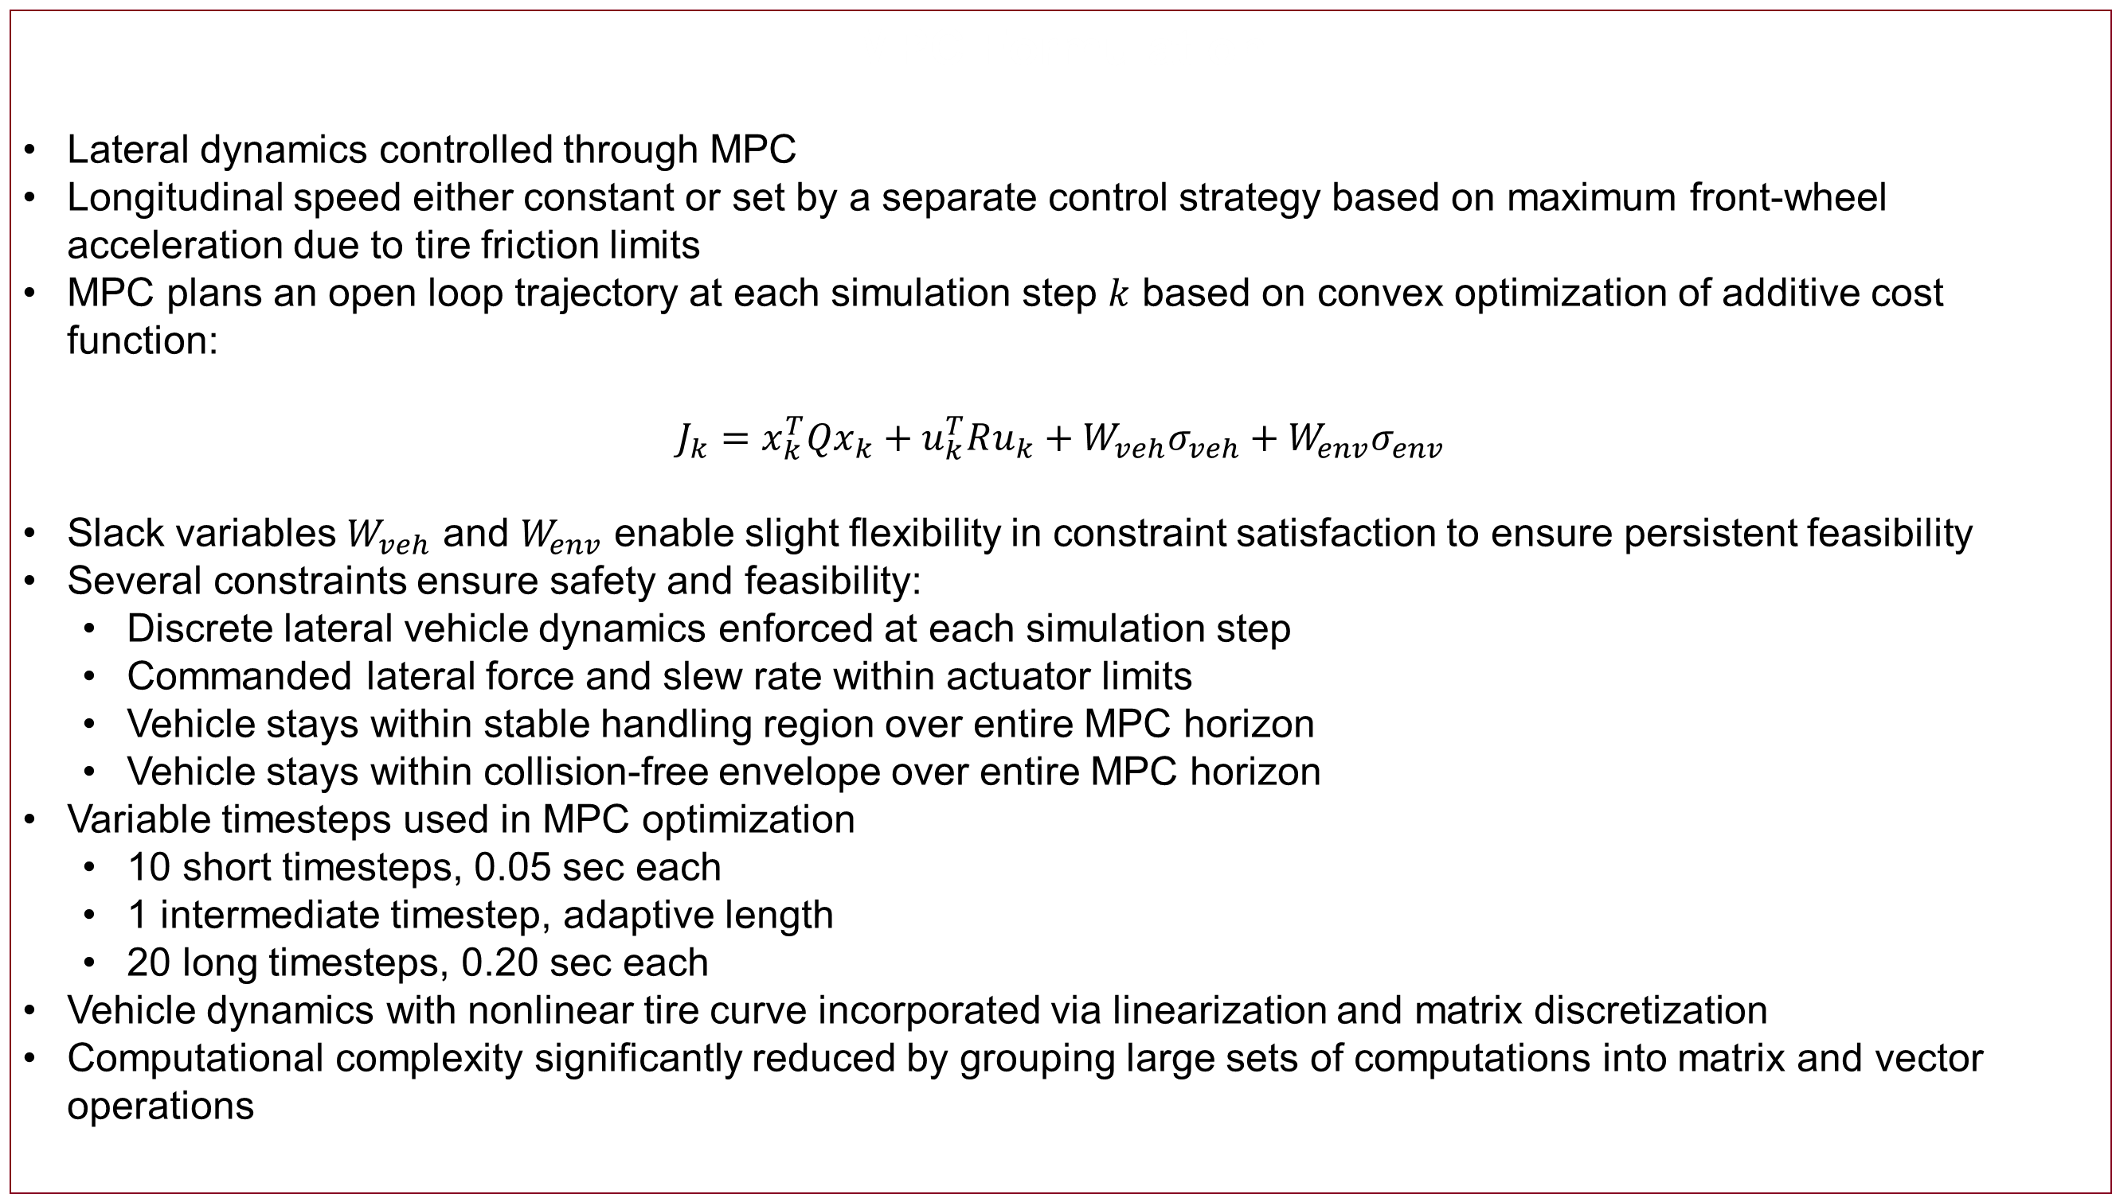
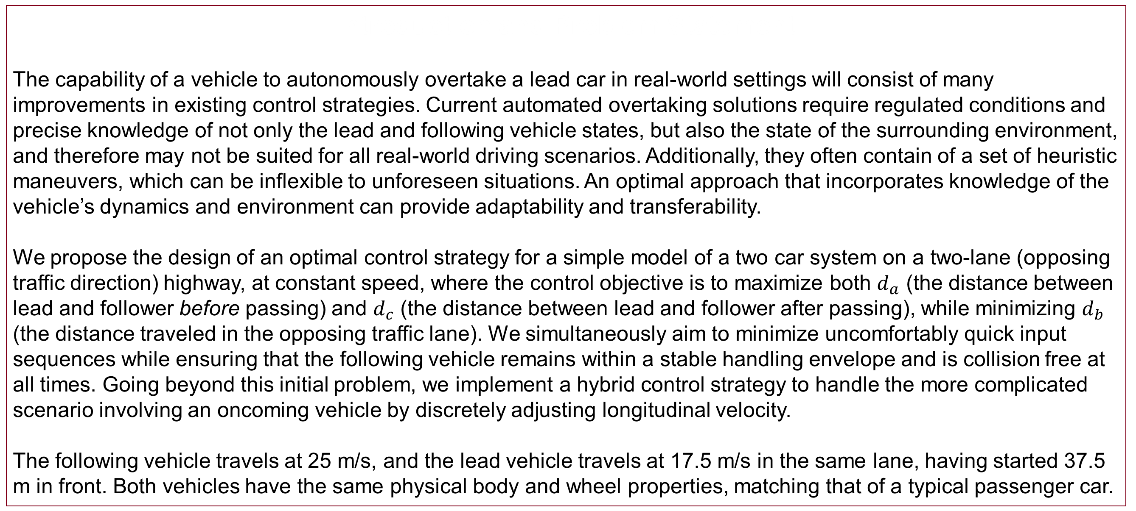
Optimal Overtaking on
a Two-Lane Highway
Andrew Shoats, Peter Schleede, and Elliot Weiss Stanford University
Introduction and Problem Statement
The capability of a vehicle to autonomously overtake a lead car in real-world settings will consist of many improvements in existing control strategies. Current automated overtaking solutions require regulated conditions and precise knowledge of not only the lead and following vehicle states, but also the state of the surrounding environment, and therefore may not be suited for all real-world driving scenarios. Additionally, they often contain of a set of heuristic maneuvers, which can be inflexible to unforeseen situations. An optimal approach that incorporates knowledge of the vehicle’s dynamics and environment can provide adaptability and transferability.
We propose the design of an optimal control strategy for a simple model of a two car system on a two-lane (opposing traffic direction) highway, at constant speed, where the control objective is to maximize both $d_{a}$ (the distance between lead and follower before passing) and $d_{c}$ (the distance between lead and follower after passing), while minimizing $d_{b}$ (the distance traveled in the opposing traffic lane). We simultaneously aim to minimize uncomfortably quick input sequences while ensuring that the following vehicle remains within a stable handling envelope and is collision free at all times. Going beyond this initial problem, we implement a hybrid control strategy to handle the more complicated scenario involving an oncoming vehicle by discretely adjusting longitudinal velocity.
The following vehicle travels at 25 m/s, and the lead vehicle travels at 17.5 m/s in the same lane, having started 37.5 m in front. Both vehicles have the same physical body and wheel properties, matching that of a typical passenger car.
Sensitivity Analysis
Figure 5: Mass variations from -300 to +300 kgs lead to similar trajectories.
Figure 6: Similarly, we can change cornering stiffness values by +- 40,000 with no change to final trajectory.
MPC framework proves to be very robust to modeling errors in most parameters
Parameters such as mass, tire cornering stiffness, mass moment of inertia, center of gravity location, and friction coefficient varied largely without major changes to trajectory, stability, or safety
Mismatch in estimated longitudinal velocity presents greatest issue
Minor changes in velocity lead to quite different trajectories, making discrete velocity changes difficult in linear MPC
MPC Formulation
Lateral dynamics controlled through MPC
Longitudinal speed either constant or set by a separate control strategy based on maximum front-wheel acceleration due to tire friction limits
MPC plans an open loop trajectory at each simulation step $k$ based on convex optimization of additive cost function:
$$J_{k}=x_{k}^{T}Qx_{k}+u_{k}^{T}Ru_{k}+W_{veh}σ_{veh}+W_{env}σ_{env}$$
Slack variables $W_{veh}$ and $W_{env}$ enable slight flexibility in constraint satisfaction to ensure persistent feasibility
Several constraints ensure safety and feasibility:
Discrete lateral vehicle dynamics enforced at each simulation step
Commanded lateral force and slew rate within actuator limits
Vehicle stays within stable handling region over entire MPC horizon
Vehicle stays within collision-free envelope over entire MPC horizon
Variable timesteps used in MPC optimization
10 short timesteps, 0.05 sec each
1 intermediate timestep, adaptive length
20 long timesteps, 0.20 sec each
Vehicle dynamics with nonlinear tire curve incorporated via linearization and matrix discretization
Computational complexity significantly reduced by grouping large sets of computations into matrix and vector operations
Figure 7: Velocity variations as little as 1 m/s can lead to very different trajectories.
Interactions with Oncoming Vehicle
Oncoming vehicle traveling at 15 m/s in passing lane introduced
For certain scenarios, no feasible trajectory computed at current longitudinal speed
Longitudinal speed controller needed to safely navigate all potential passing scenarios
Figures 8,9: Keeping a constant speed, the vehicle can’t find a feasible trajectory for certain scenarios.
Speed Control
As shown above, with a fixed speed, passing is not guaranteed in oncoming vehicle scenario. Also cannot guarantee ability to navigate tight turns at handling limits
Some solutions that don’t work:
Planning at a fixed speed (different than the actual speed) while still decelerating to fixed speed
Classifying “accelerating” and “decelerating” modes and adjusting the dynamics to plan for speeds according to the maximum acceleration propagated forward
Ultimately, these maneuvers use a lot of tire friction and reduce the ability to accelerate and decelerate
Dynamics are very non-linear in forward velocity, so linearizing about vehicle speed is likely insufficient
A (brittle) solution:
When an infeasible solution is found for the nominal forward speed, move into a state of deceleration with the original cost function
Assume sufficient gap behind lead vehicle when entering this deceleration state
When the oncoming vehicle has passed with some margin, begin to accelerate back up to desired passing speed according to MPC path, in order to overtake lead vehicle
Solution is not always guaranteed but enables overtaking in a much broader range of scenarios
Initial Overtaking Results
The vehicle correctly handles maneuvering around
a lead vehicle without collision or becoming unstable
Cost is voluntarily incurred by deviating from the path
to ensure all constraints are satisfied
Figure 1: Overall trajectory (blue) and planned trajectories at each time step (yellow) generated by MPC in overtaking of a single slower vehicle.
Figure 2: The vehicle stays well within the stable handling envelope for the entire maneuver.
Figures 10,11,12: With longitudinal velocity changes, the vehicle can now safely and stably navigate this overtaking maneuver.
Conclusions and Future Steps
We’ve implemented a safe and robust controller for overtaking one vehicle while avoiding an oncoming vehicle
Ability to change speed is a necessary part of any realistic vehicle model. To handle this within the controller, further work will utilize nonlinear MPC using CasADi nonlinear optimization software
This is a simple straight track scenario (although the code works with curved paths) with the lead vehicle tracking the centerline. Future scenarios will have the lead vehicle equipped with a controller and desired racing line
Racing scenarios will also lead to more aggressive dynamics and maneuvers
Looking to using POMDP’s to model the expected dynamics and decisions of lead vehicle for optimal passing.
Figure 3: The vehicle incurs various costs throughout the simulation to ensure a safe and feasible trajectory is always followed.
Use the scanner on your phone to check out a cool animation or to poke through our code. Thanks for stopping by our poster!
Figure 4: Screenshot of animation of overtaking maneuver. The entire trajectory is plotted on the left, while a vehicle-fixed frame is shown on the right.
References
[1] M. Brown, J. Funke, S. Erlien, and J. C. Gerdes, “Safe driving envelopes for path tracking in autonomous vehicles”, en, Control Engineering Practice, vol. 61, pp. 307–316, Apr. 2017, issn: 09670661. doi: 10.1016/j. conengprac.2016.04.013.
[2] J. Funke, M. Brown, S. M. Erlien, and J. C. Gerdes, “Collision Avoidance and Stabilization for Autonomous Vehicles in Emergency Scenarios”, IEEE Transactions on Control Systems Technology, vol. 25, no. 4, pp. 1204–1216, Jul. 2017, issn: 1063-6536. doi: 10.1109/TCST.2016.2599783.
[3] Elsevier Enhanced Reader – Trajectory planning and tracking for autonomous overtaking: State-of-the-art and future prospects, en. doi: 10. 1016/j.arcontrol.2018.02.001.

