Slide 1


Slide 2

McCLOUD BUX
$1,000,000 PLATINUM
HOLLY SPRINGS MINT · MMXXVI

Slide 3
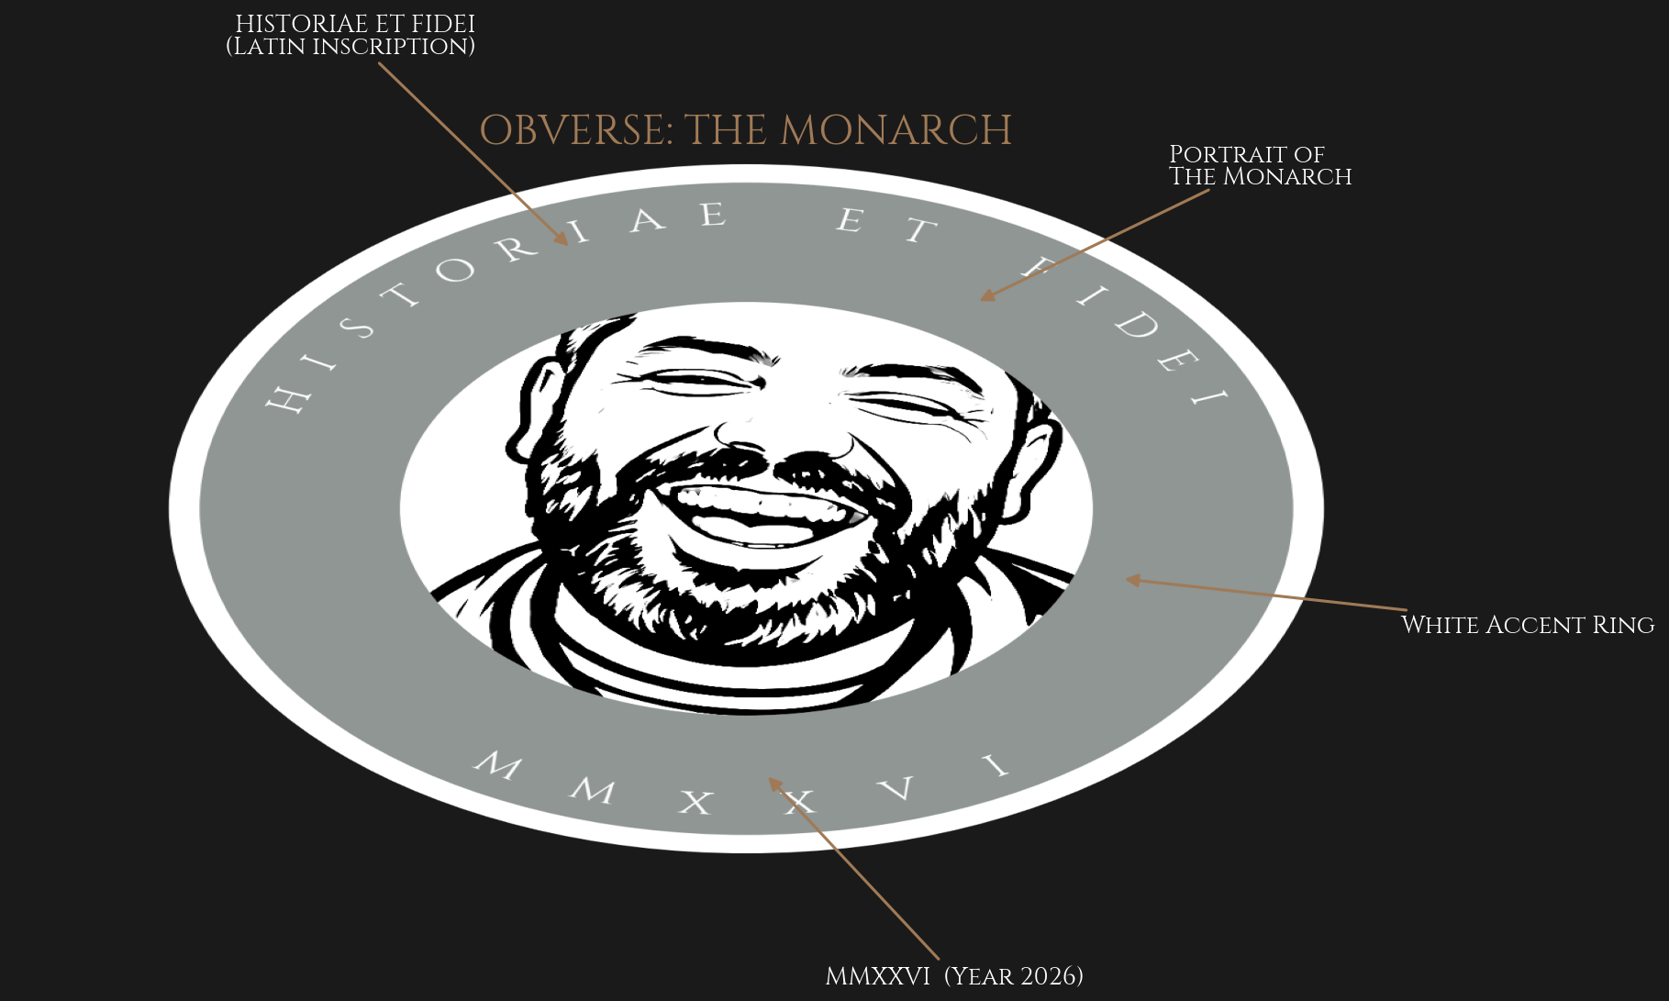

Slide 4
────────────────────────────────────────────────────────────
HISTORIAE ET FIDEI
History and Faith
────────────────────────────────────────────────────────────
These two words were chosen because every great coin tells a story. History reminds us of where we came from — Faith reminds us where we are going.
MMXXVI

Slide 5
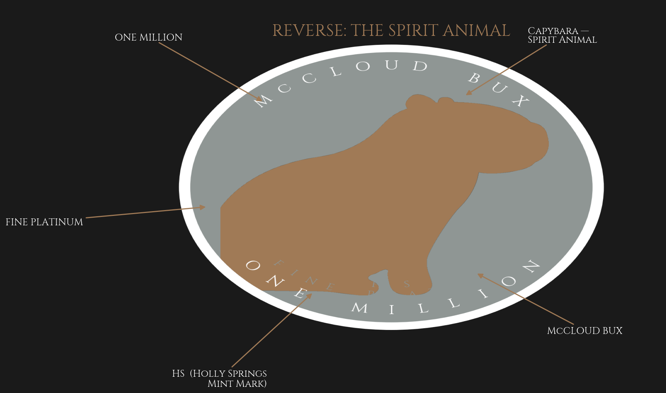

Slide 6
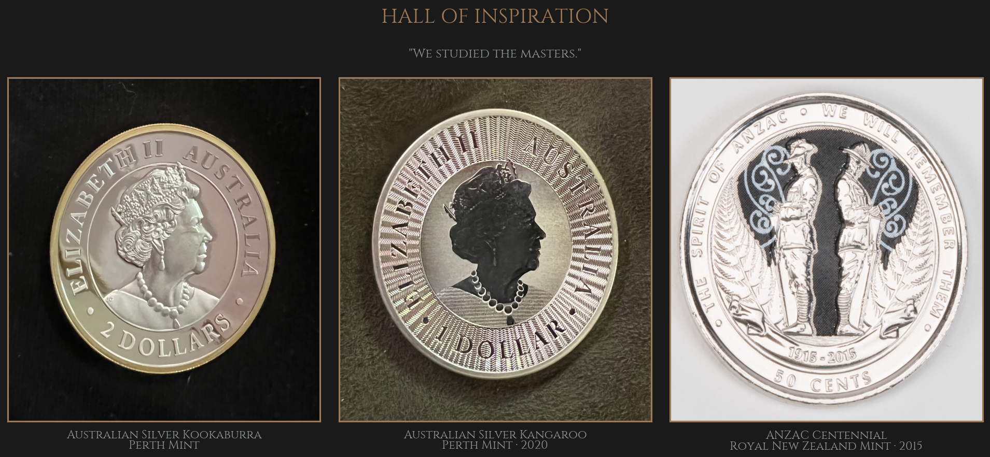

Slide 7
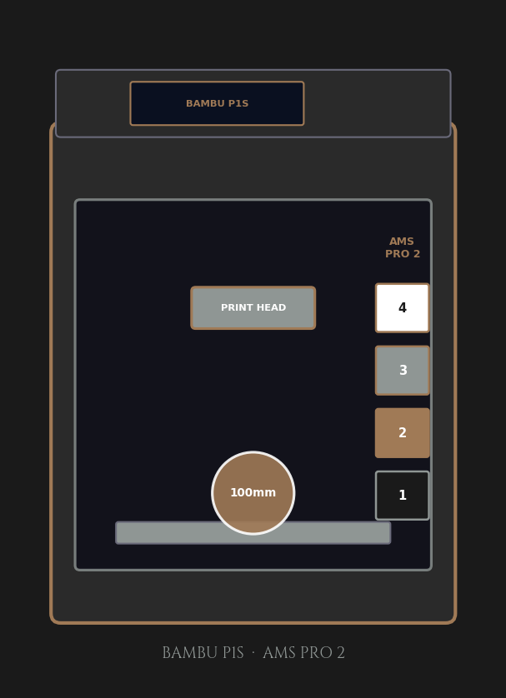
THE HOLLY SPRINGS MINT
──────────────────────────────────────
Every great coin needs a mint.
• Bambu P1S with AMS Pro 2
• 4 simultaneous filament colors
• 100 mm oversized display coin
• Overture PLA filament
• Bambu Studio 02.05.00.66 slicer
• 18-test automated validation suite
Location: Holly Springs, North Carolina

Slide 8
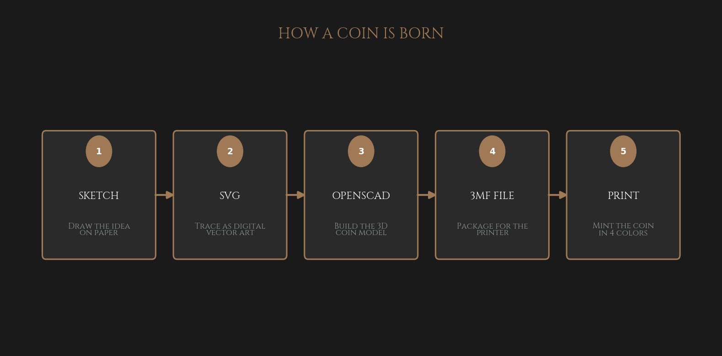

Slide 9
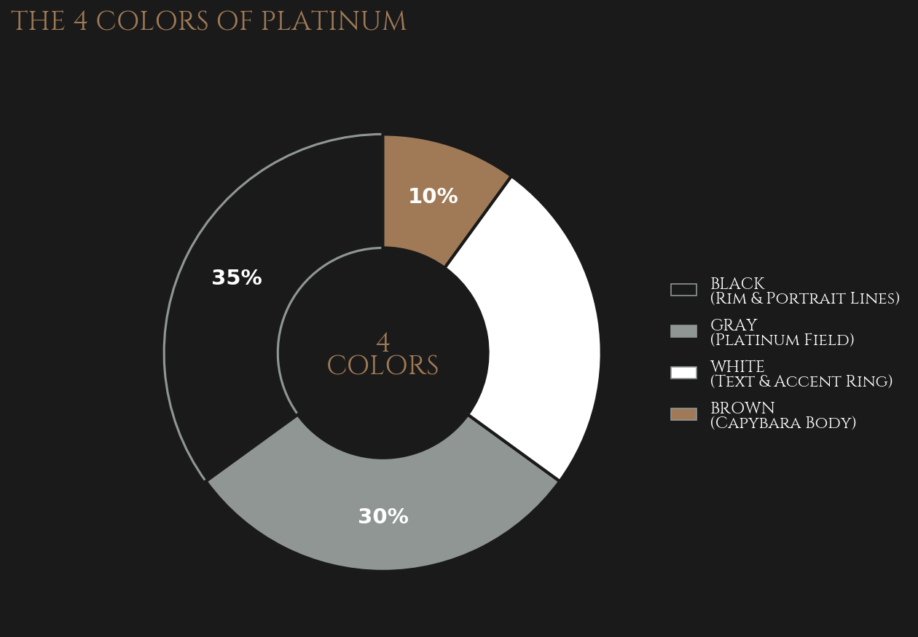

Slide 10
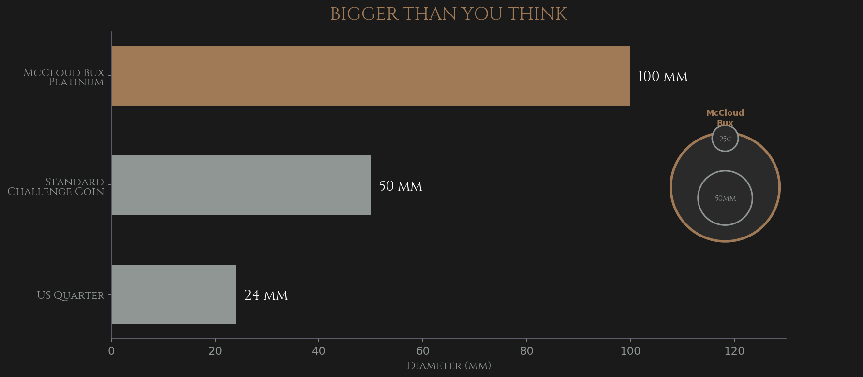

Slide 11
SPEC SHEET
SPECIFICATION | McCLOUD BUX Platinum | Standard Challenge Coin | Real Silver Dollar
Diameter | 100 mm | 50 mm | 38.1 mm
Thickness | 8.0 mm | 5.0 mm | 2.4 mm
Relief | 1.0 mm | 0.6 mm | Variable
Material | PLA Filament | PLA Filament | Fine Silver
Colors | 4 (printed) | 4 (printed) | 2 (struck)
Made By | Bambu P1S | Bambu P1S | Government Mint
Quantity | ONE OF ONE | Small batch | Millions

Slide 12
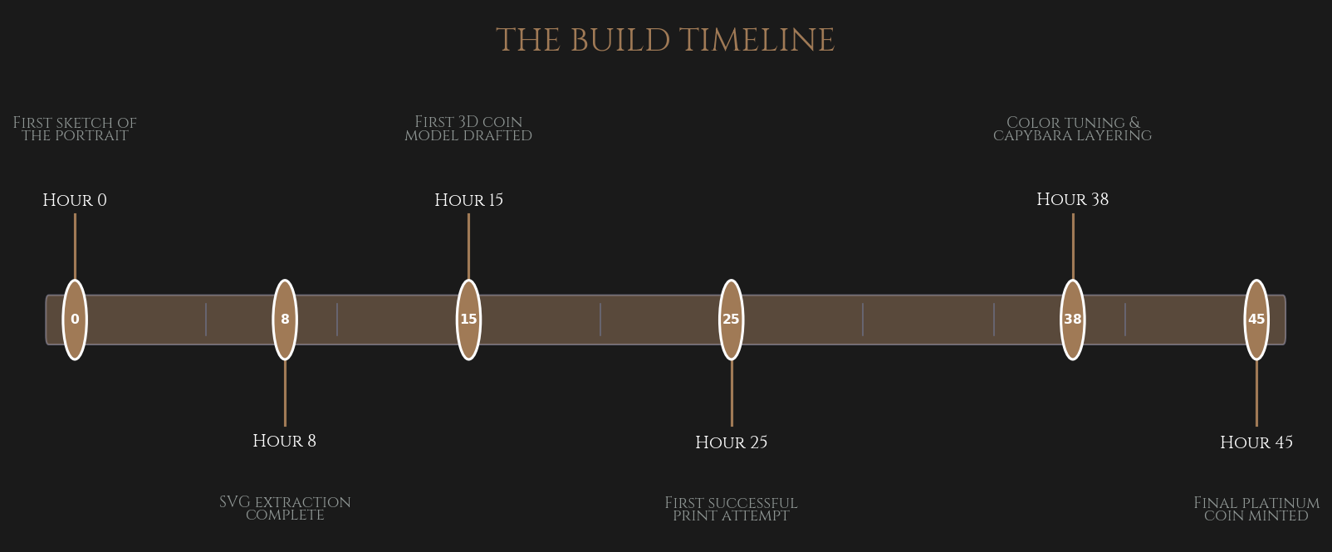

Slide 13
BY THE NUMBERS
100 mm
8 mm
4
DIAMETER
THICKNESS
COLORS
45
1
1
HOURS OF WORK
COIN MINTED
MINT IN HOLLY SPRINGS

Slide 14
There is only one.

