Slide 1
CSSE 220
Sorting Algorithms
Algorithm Analysis and Big-O
Searching
Checkout SortingAndSearching project from SVN
Notes:
Bring a few playing cards or preferably BIG LETTERS or BIG NUMBERS.
Bring a copy of the yellow pages. Make sure the page numbers on the “Searching” slide are correct.

Slide 2
Questions?

Slide 3
What is sorting?
Let’s see…
Notes:
Odd term, "sorting". Knuth: He was sort of out of sorts from sorting that sort of data.
My boss ordered me to order a new tape drive so we can order our data several orders of magnitude faster.

Slide 4
Why study sorting?
Shlemiel the Painter
Notes:
[see story on next hidden slide]

Slide 5
Shlemiel gets a job as a street painter, painting the dotted lines down the middle of the road. On the first day he takes a can of paint out to the road and finishes 300 yards of the road. "That's pretty good!" says his boss, "you're a fast worker!" and pays him $70.
The next day Shlemiel only gets 150 yards done. "Well, that's not nearly as good as yesterday, but you're still a fast worker. 150 yards is respectable," and pays him $70.
The next day Shlemiel paints 30 yards of the road. "Only 30!" shouts his boss. "That's unacceptable! On the first day you did ten times that much work! What's going on?"
"I can't help it," says Shlemiel. "Every day I get farther and farther away from the paint can!"

Slide 6
Course Goals for Sorting: You should…
Be able to describe basic sorting algorithms:
Selection sort
Insertion sort
Merge sort
Know the run-time efficiency of each
Know the best and worst case inputs for each

Slide 7
Selection Sort
Basic idea:
Think of the list as having a sorted part (at the beginning) and an unsorted part (the rest)
Find the smallest value in the unsorted part
Move it to the end of the sorted part (making the sorted part bigger and the unsorted part smaller)
Repeat until unsorted part is empty
Notes:
Review algorithm with a few of the cards or preferably the BIG LETTERS or big numbers
Look at sortAndSearch.SelectionSort(), briefly explain use of generic methods.
Takeaways:
Start iterating from index 0 (firstUnsortedIndex)
Smallest remaining starts with value at index 0;
When smallest remaining element is found, swap with value at index from outer loop (firstUnsortedIndex).

Slide 8
Profiling Selection Sort
Profiling: collecting data on the run-time behavior of an algorithm
How long does selection sort take on:
10,000 elements?
20,000 elements?
…
80,000 elements?
Q1
Notes:
[Plot data on whiteboard after they’re done]
[Or use Excel]

Slide 9
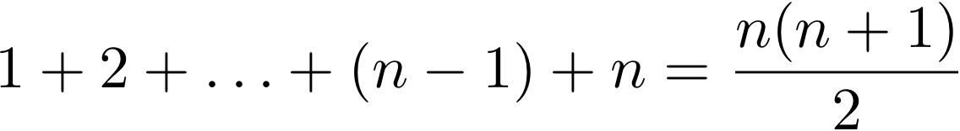
Analyzing Selection Sort
Analyzing: calculating the performance of an algorithm by studying how it works, typically mathematically
Typically we want the relative performance as a function of input size
Example: For an array of length n, how many times does selectionSort() call compareTo()?
Handy Fact
Q2-Q7
Notes:
- Remember Shlemiel. His technique worked well for small inputs (i.e., short roads), but got worse and worse.
Handy fact is animated. Note that we can derive the fact for even n by working outside in.
Have them work on Q2-6. Solve Q7 together on board.
After solving, ask: For very large n, what term of solution matters most? What term grows fastest? Do the other terms contribute much to the growth of the function?

Slide 10
Big-Oh Notation
In analysis of algorithms we care about differences between algorithms on very large inputs
We say, “selection sort takes on the order of n² steps”
Big-Oh gives a formal definition for “on the order of”
Q8

Slide 11
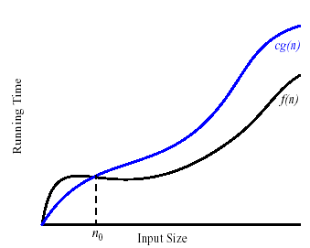
Formally
We write f(n) = O(g(n)), and say “f is big-Oh of g”
if there exists positive constants c and n₀ such that
0 ≤ f(n) ≤ c g(n) for all n > n₀
g is a ceiling on f
Notes:
Work out c and n0 for each of the examples on the quiz.

Slide 12
Insertion Sort
Basic idea:
Think of the list as having a sorted part (at the beginning) and an unsorted part (the rest)
Get the first value in the unsorted part
Insert it into the correct location in the sorted part, moving larger values up to make room
Repeat until unsorted part is empty
Notes:
[Review algorithm using cards or BIG LETTERS]
Takeaways:
First item in the array is in the sorted part.
start iterating over the unsorted part from index 1
Bubble elements up from sorted part to make room for next element in unsorted part.
Put that element at rightful location in sorted part.

Slide 13
Insertion Sort Exercise
Profile insertion sort
Analyze insertion sort assuming the inner while loop runs the maximum number of times
What input causes the worst case behavior? The best case?
Does the input affect selection sort?
Ask for help if you’re stuck!
Q9-Q18

Slide 14
Searching
Consider:
Find China Express’s number in the phone book
Find who has the number 208-2063
Is one task harder than the other? Why?
For searching unsorted data, what’s the worst case number of comparisons we would have to make?
Notes:
BEFORE animating any bullets:
Ask student to find China Express’s number; time them. (You may need to hint that they go to the restaurant section… they don’t understand phone books ☺ )
Ask if anyone thinks they can beat that time. (page 337 of yellow book 2008-2009 phone book)
Ask them to find who has the number 208-2063.
208-2063 is Precision Lawn Plus (page 252 of yellow book 2008-2009 phone book)
Then build by major bullet
- n, for n items

Slide 15
Binary Search of Sorted Data
A divide and conquer strategy
Basic idea:
Divide the list in half
Decide whether result should be in upper or lower half
Recursively search that half
Notes:
Look at code for binary search.

Slide 16
Analyzing Binary Search
What’s the best case?
What’s the worst case?
Analyze Binary search assuming the value searched for is at the start or end of the list
Q19
Notes:
Solve Q19 together

Slide 17
Work Time
Study MergeSort for next class
Q20-Q21

