Slide 1
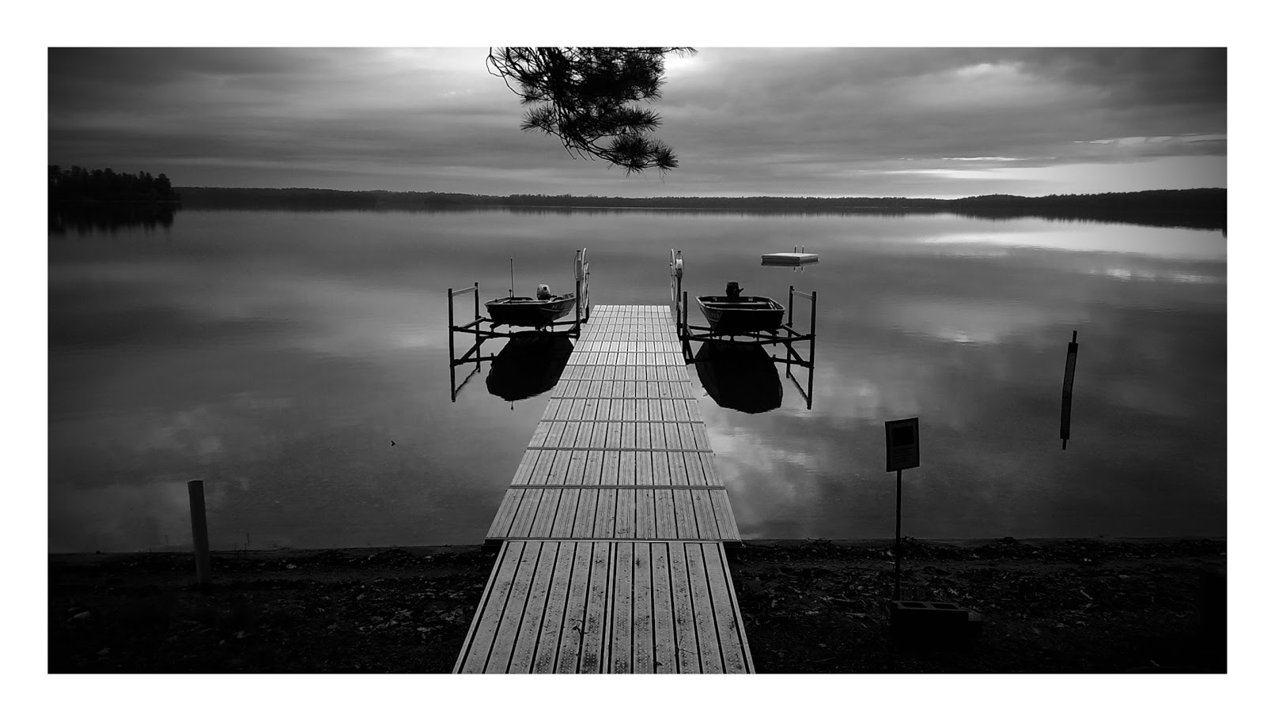
4th Year Committee Meeting
Sarah Stevens
@microStevens
McMahon Lab

Slide 2
Agenda
Introduction / Sequence-discrete populations
Contrasting patterns of genome-level diversity across distinct co-occurring populations
Next Questions
Selection within vs between sequence-discrete populations
Comparison of shared Trout Bog and Crystal Bog populations

Slide 3
Microbes Perform Many Nutrient Transformations in Lakes
Azam and Malfatti Nature Rev Microbiol 2007
Notes:
Azam and Malfatti Nature Rev Microbiol 2007

Slide 4
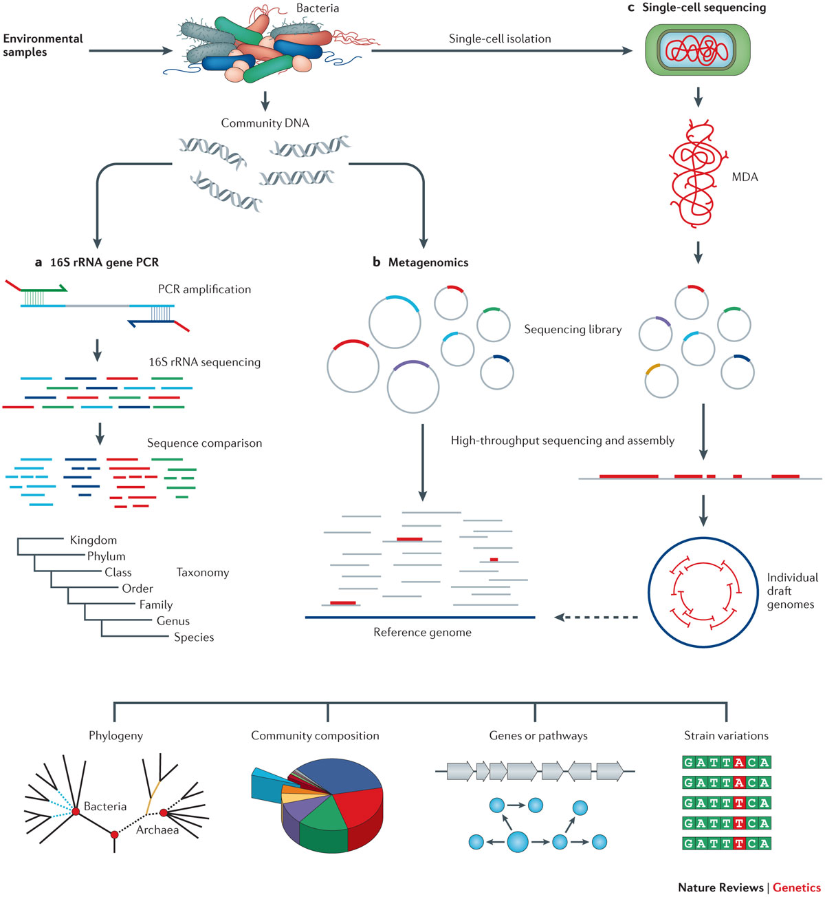
Lasken and McLean Nature Rev Genetics 2014

Slide 5
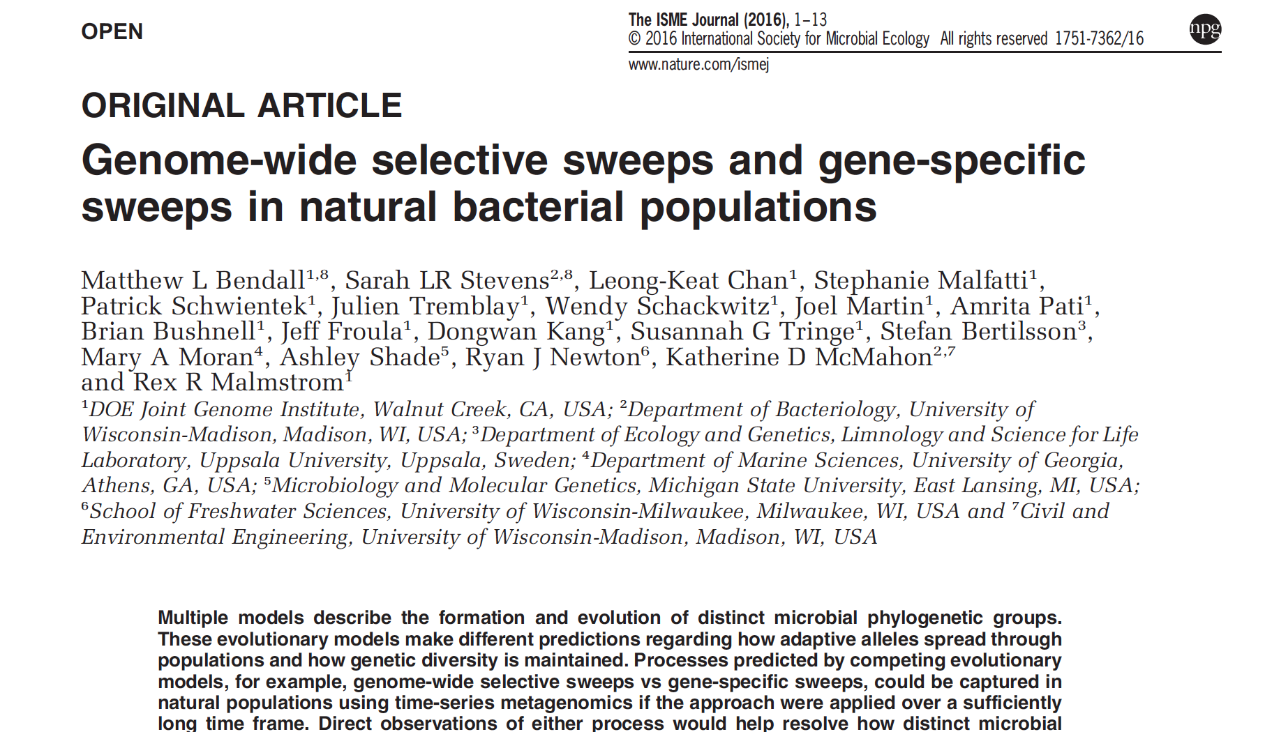

Slide 6
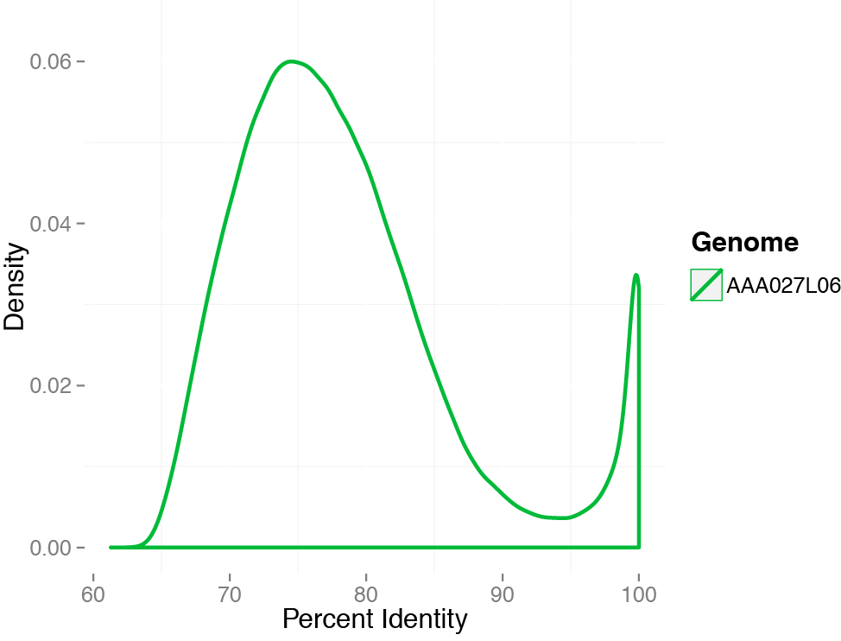
SAGs allow us to capture sequence discrete populations
Subject: acI-B1 from L. Mendota
discontinuity
Mendota metagenome: 9 June 2009

Slide 7
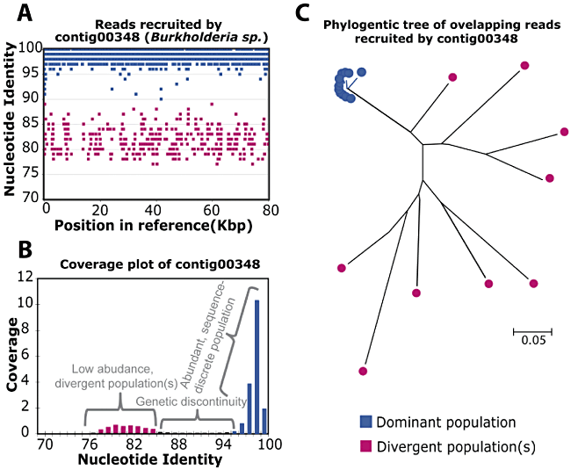
Sequence discrete populations
Caro-Quintero and Konstantinidis 2012 EnvMicro
Notes:
Lake Lanier to isolate genome

Slide 8
SAGs allow us to capture sequence discrete populations
Subject: acI-B1 from L. Mendota
discontinuity
Mendota metagenome: 9 June 2009

Slide 10
acI SAGs from Lake Mendota recruit reads and are discrete at ~95-97%ID
Notes:
And the SAGs from other lakes don’t many recruit reads with high ID
14 acI SAGs
Point out more distantly related peak before transitioning

Slide 11
LD12 populations are highly similar
Notes:
The two Sparkling metagenomes
LD12 are in earlier stages of differentiation?
10 LD12 total (5ME, 5 non)

Slide 12
What about other lineages?

Slide 13
acI populations have different abundance patterns though time, where LD12 are tightly synchronized
Notes:
This is with competitive
Abund of J17 poorly correlated with the other acI-B1 L06 and A23 (maximum Spearman rank correlation = 0.294)
Abund of J10, L15, and C06 strongly correlated (Spearman rank correlation = 0.997-0.999). D10 not as strongly correlated to the other LD12 populations (Spearman rank correlation = 0.712-0.725). C07 was also correlated to both the J10-L15-C06 populations and the D10 population (Spearman rank correlation = 0.861-0.873) - lowest correlation within LD12 (0.712)

Slide 14
New Questions

Slide 15
Next Questions
How does selection differ within vs between sequence-discrete populations? (past vs. current selection)
How many genotypes are within a population?
Neutral variation or ecologically distinct?
Does selection act differently on homologous genes shared by different populations?
Which (shared) traits are under strong selection?
Notes:
Do the SNPs change as expected based on the selection values though time?

Slide 16
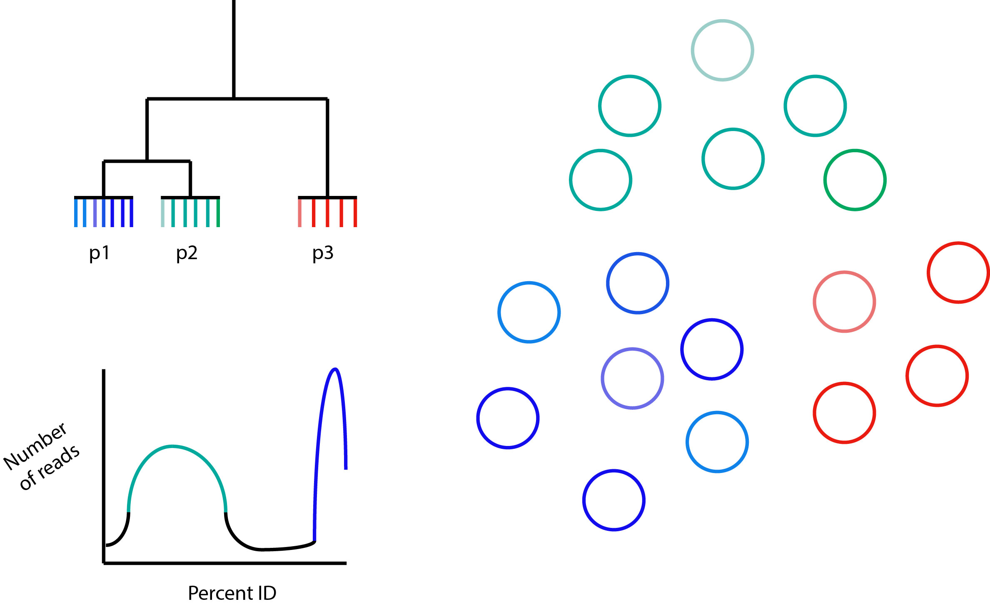
Schematic
Notes:
Neg/purifying – remove deleterious alleles – dnds <1???
Pos/darwinian – advantageous alleles go to fixation – dnds > 1
McDonald-Kreitman test – Dn/Ds to Pn/Ps (test for selection within species/ populations?)
- DnDs > PnPs →positive selection
- DnDs < PnPS → negative selection
- alpha (prop of nonsyn subs under pos select) calculated for each gene or genome-wide
L06, J17, I14 (A1)

Slide 17
Next Questions
How does selection differ within vs between sequence-discrete populations? (past vs. current selection)
Consistent through time?
How many genotypes are within a population?
Does selection act differently on homologous genes shared by different populations?
Which (shared) traits are under strong selection?
Notes:
Do the SNPs change as expected based on the selection values though time?

Slide 18
Crystal Bog (CB) v. Trout Bog (TB)
Both dystrophic (high in DOC)
Both seepage lakes
Share 45-60% of their top 20 clades based on 16S tags
Different mixing regimes
CB has a smaller surface area
TB is deeper
About 5 miles apart
Notes:
TB – Dimictic
CB -- Polymictic

Slide 19
Next Questions
Are there related sequence-discrete populations in TB and CB?
How similar are they based on ANI?
ANI for reference MAGs to each other
ANI when mapping reads from same vs different lake
For populations that are very similar between the two lakes:
Are there genes present in one lake but not the other?
Is there evidence for (ecological or physical) barrier to recombination?
Might also be able to compare MAGs from Mary Lake
Notes:
Mary Lake never mixes-meromictic
*Are there related sequence-discrete populations in TB and CB? How closely related are they? Do they share a common gene pool? Are there genes present in one lake but not the other for these closely related populations? Is there an ecological or physical barrier to recombination between these two lakes?*

