Slide 1

3rd Year Committee Meeting
Sarah Stevens
MDTP

Slide 2
Agenda

Slide 3
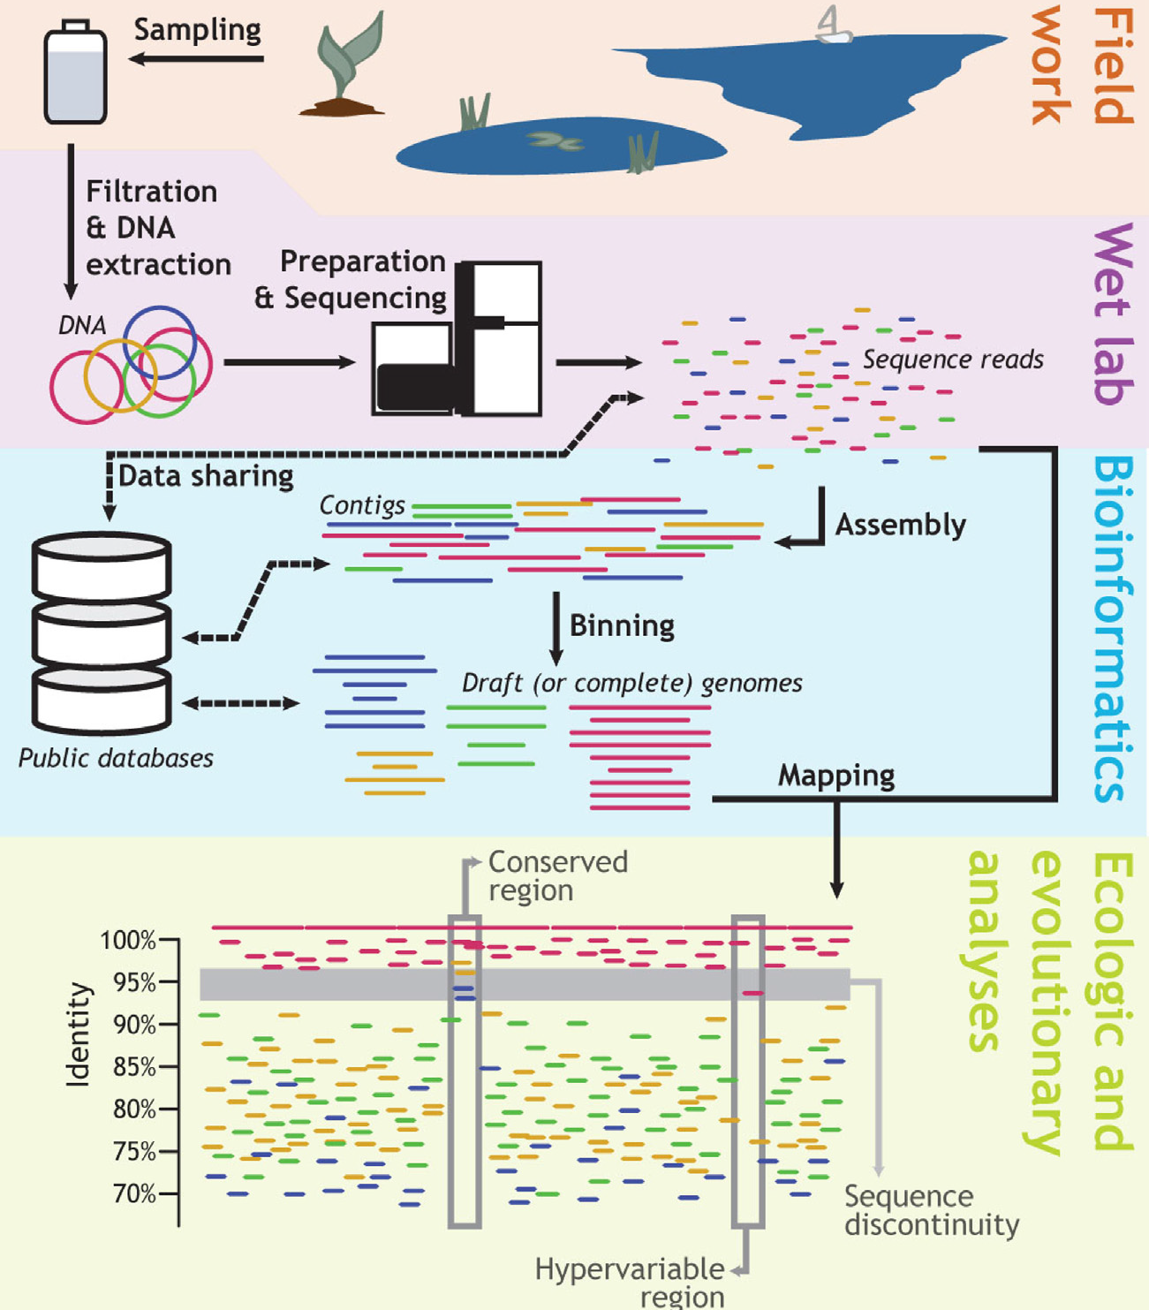
Konstantinidis, K. T., & Rosselló-Móra, R. (2015). Classifying the uncultivated microbial majority: A place for metagenomic data in the Candidatus proposal. Systematic and Applied Microbiology, 38(4), 223–230.

Slide 4
One L06 slide

Slide 5
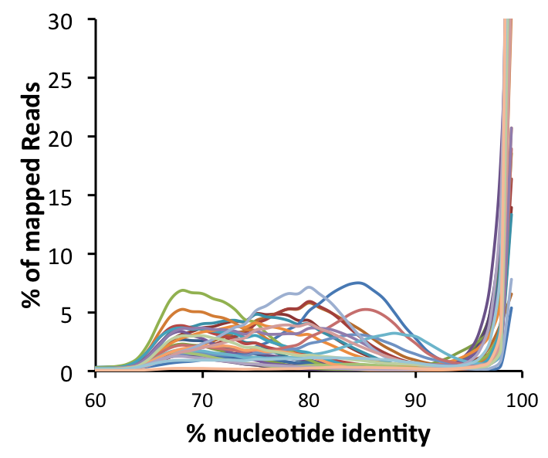
All 30 Genomes Assembled from Metagenomes Show Sequence-discrete Pattern

Slide 6
Speciation Models
Shapiro, B. J., & Polz, M. F. (2014). Ordering microbial diversity into ecologically and genetically cohesive units. Trends in Microbiology, 22(5), 235–247.
Notes:
[s, the average fitness difference experienced by a niche-specifying (adaptive) allele in different niches] and recombination (r, the recombination rate per locus per generation) is expressed as the r/s ratio
In application to speciation event, for recombination model, the recombina

Slide 7
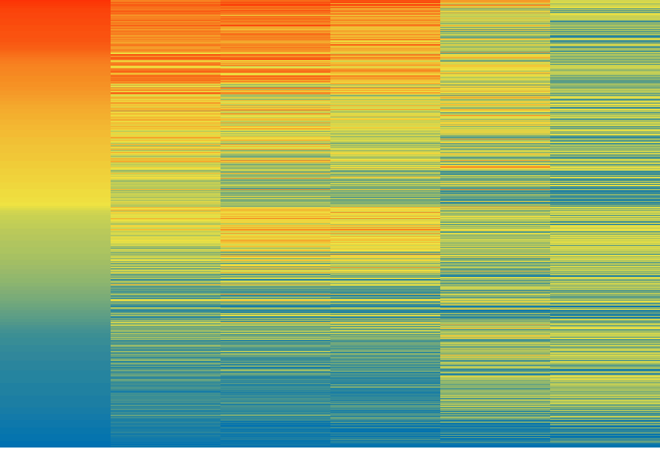
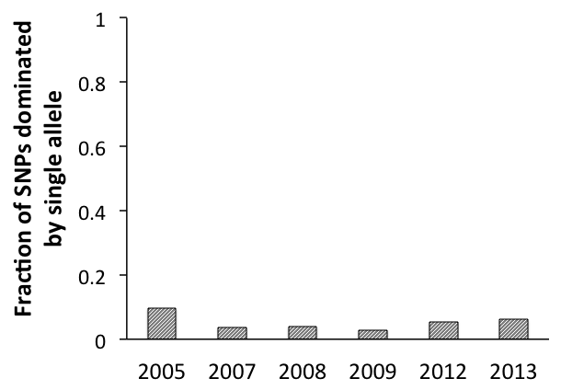
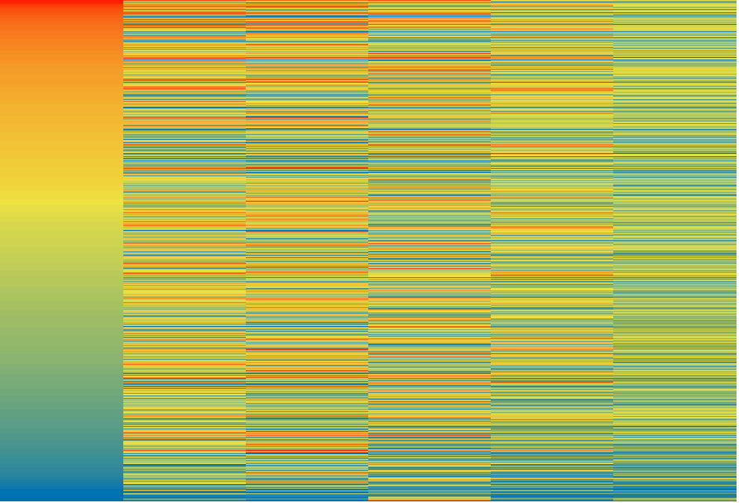
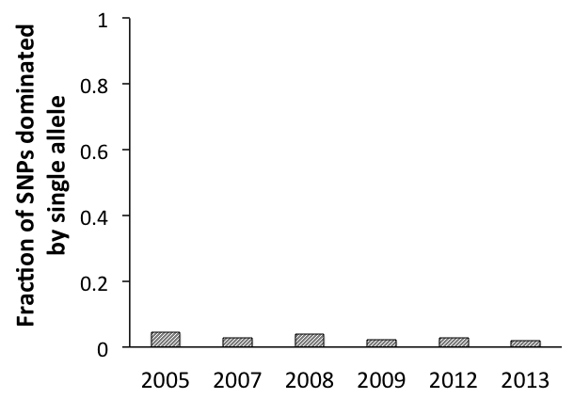
The SNPs for Most Sequence-discrete Populations Show No Trend
Holophagales-254
Holophagales-254
8,501 SNPs
100
75
50
2005 2007 2008 2009 2012 2013
% reads supporting reference base at each SNP locus
Actinobacterium-2152
Actinobacterium-2152
25
0
4,209 SNPs
2005 2007 2008 2009 2012 2013

Slide 8
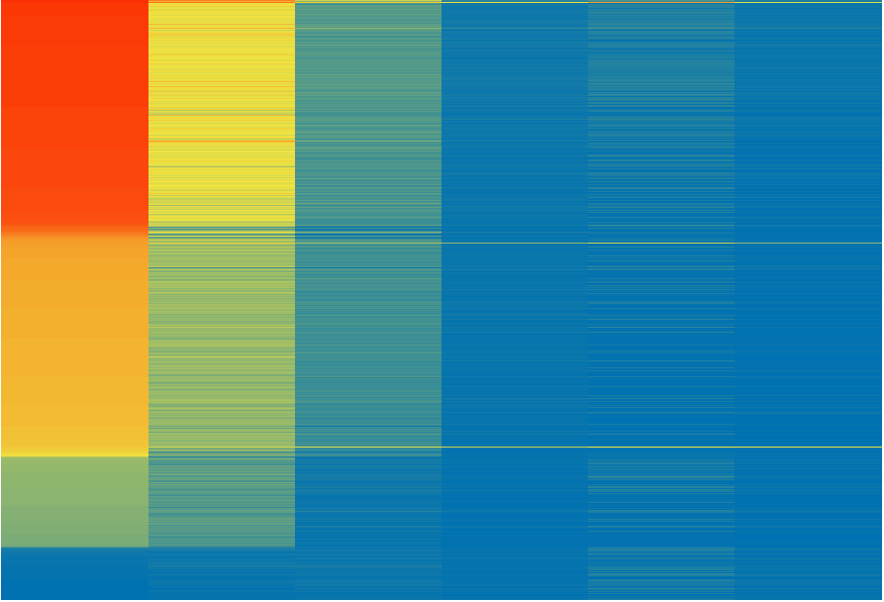
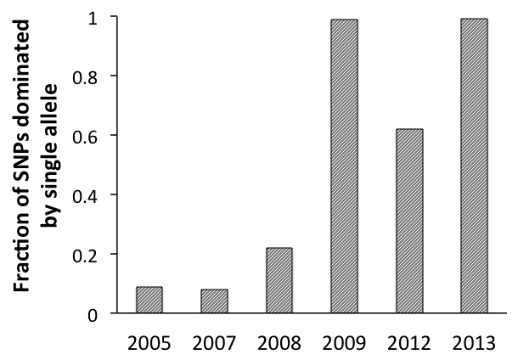
One Population Experiences a Major Loss of Diversity, Consistent with a Genome-wide Sweep
100
Chlorobium-111
Chlorobium-111
75
50
3,111 SNPs
% reads supporting reference base at each SNP locus
25
0
2005 2007 2008 2009 2012 2013

Slide 9
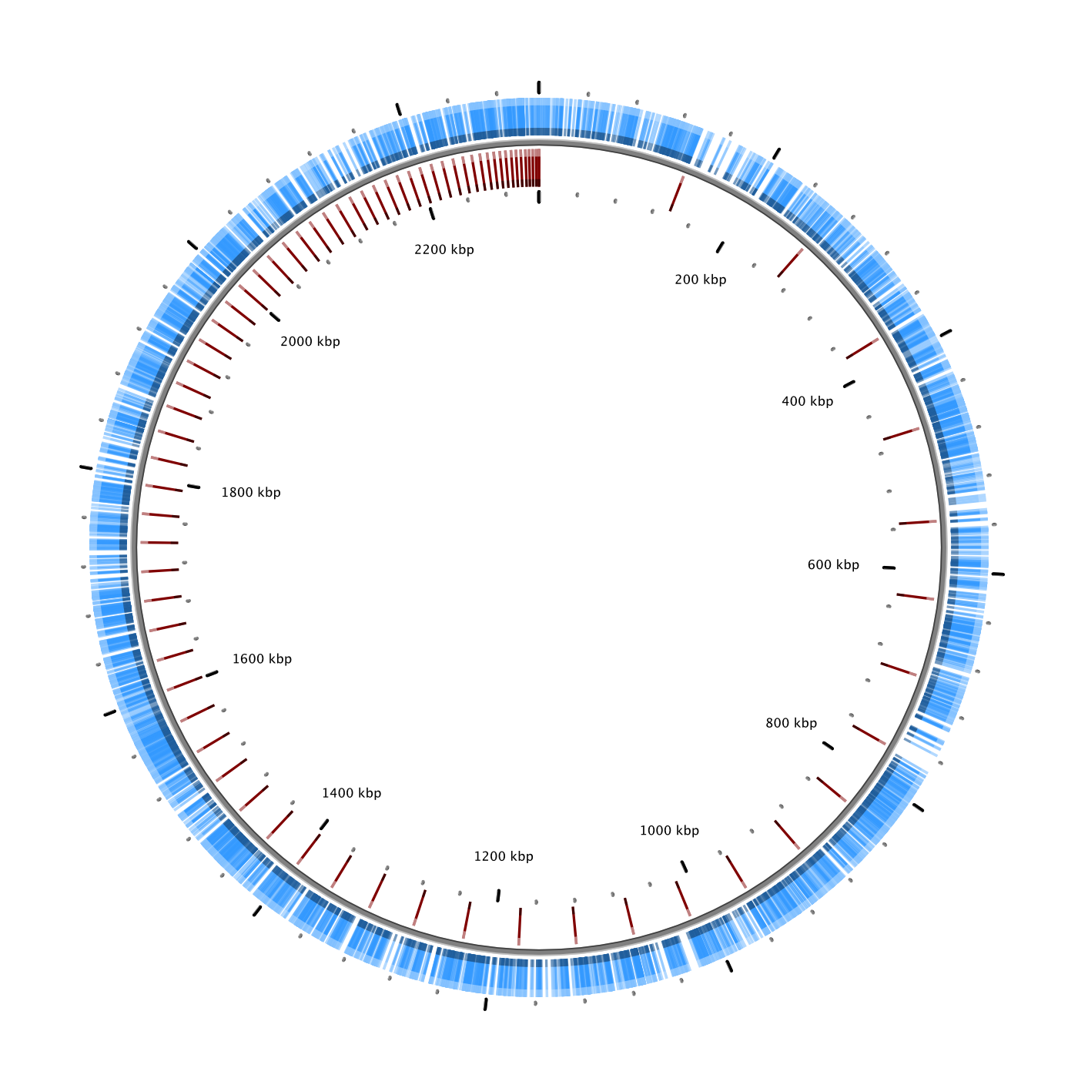
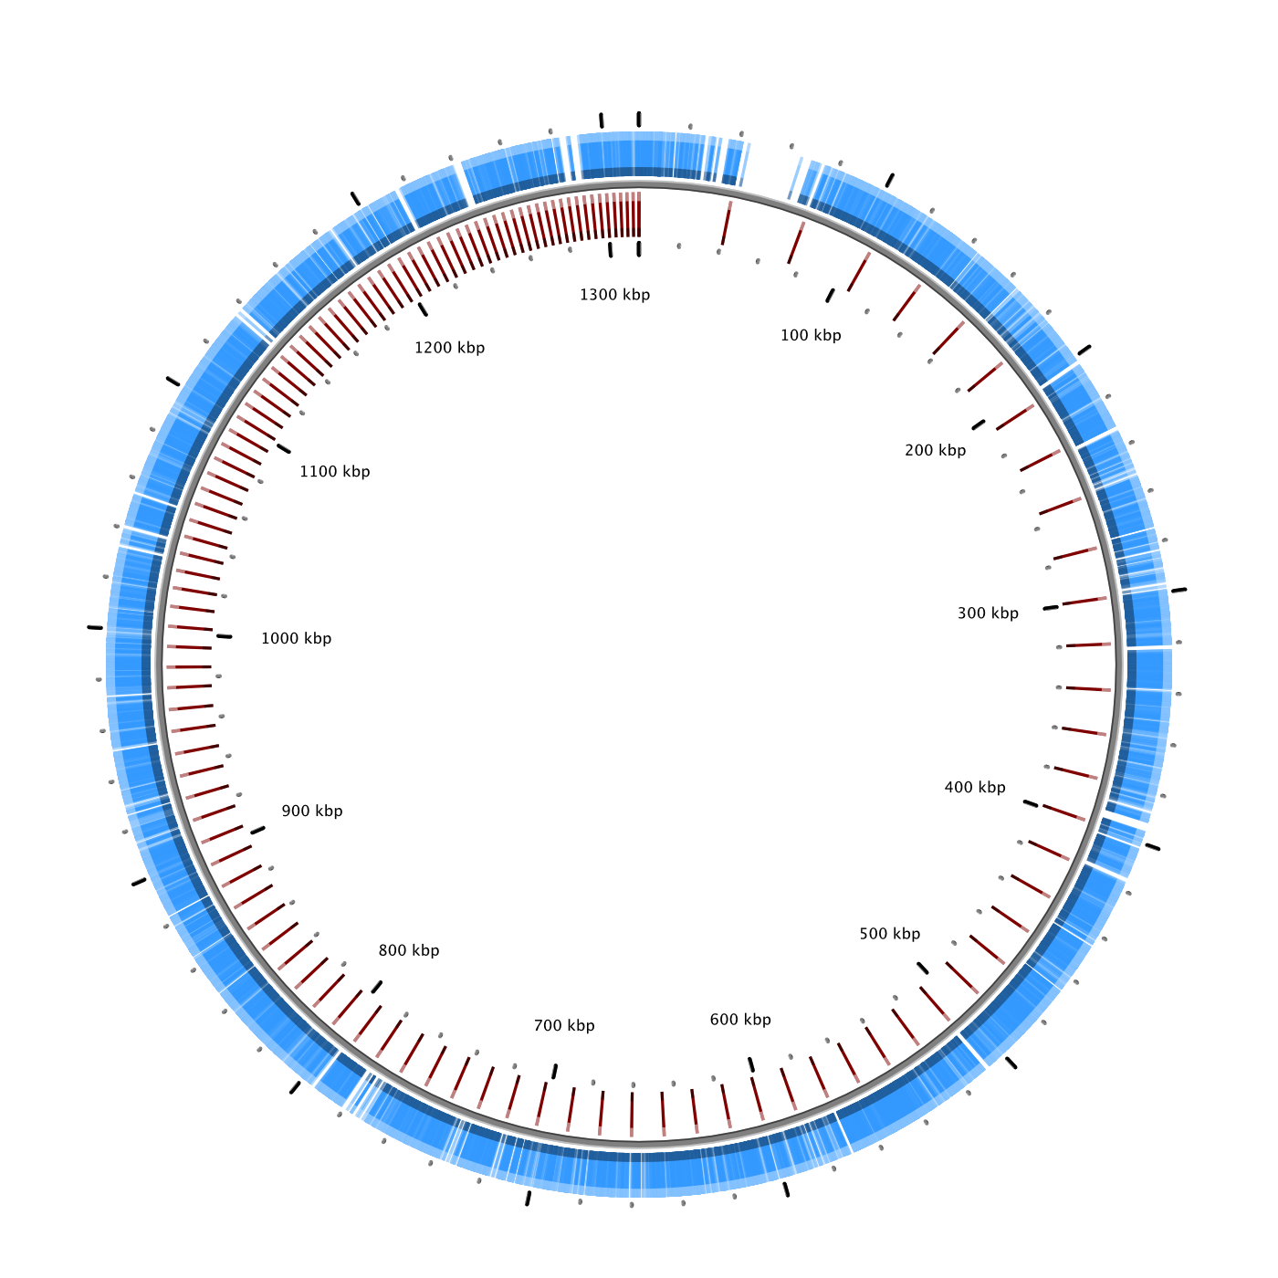
Others Showed Evidence of Past Gene-specific Sweeps
A) Chlorobium-111
B) Polynucleobacter-238

Slide 10
Conclusion
Diversity within co-occurring populations may be controlled by different mechanisms and explained by different evolutionary models

Slide 11
16S rRNA Gene Relationships Reflected in Gene Phylogeny
Notes:
Based on the subset of 400 genes which were present using PhyloPhlan

Slide 12
SEQ-DISC PLOTS FOR ACI SEP BY MENDOTA VS. OTHER

Slide 13
SAGs Only Recruit Reads from the Same Sequence-discrete Population
Notes:
Considering using # of reads instead of relative recruitment on the X axis? What do you think?

Slide 14
J17 Represents the Most Abundant Sequence-discrete Population
Notes:
L06 show the same pattern, since they are tracking the same population, which is reassuring
I14 and M14 are lower abundance (of our set)

Slide 15
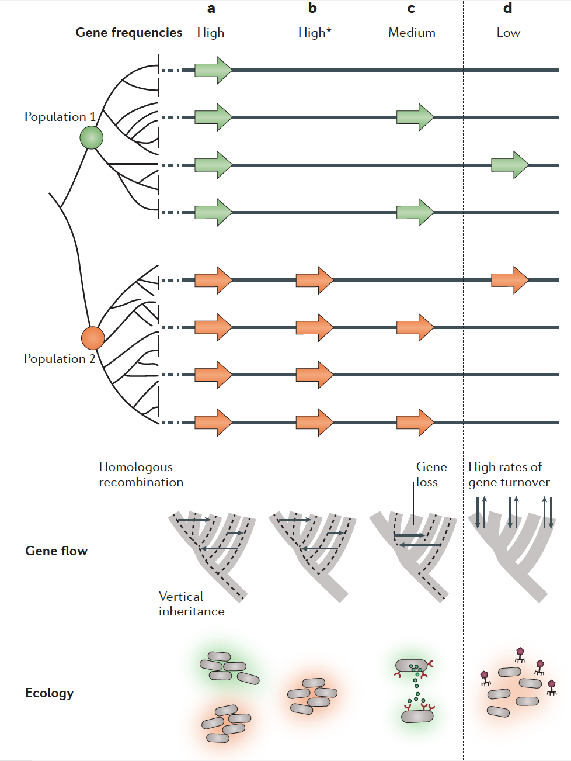
High frequency genes
evolve by vertical inheritance and homologous recombination
probably encode essential metabolic and housekeeping functions that are under purifying selection
Low frequency genes
gained and lost at high rates
selectively neutral or under strong negative frequency-dependent selection
Cordero, O. X., & Polz, M. F. (2014). Explaining microbial genomic diversity in light of evolutionary ecology. Nature Reviews. Microbiology, 12(4), 263–73. doi:10.1038/nrmicro3218

Slide 16
Crystal Bog (CB) v. Trout Bog (TB)
Both dystrophic (high in DOC)
Both seepage lakes
Share 45-60% of their top 20 clades based on 16S tags
Different mixing regimes
CB has a smaller surface area
TB is deeper
About 5 miles apart

Slide 17
Next Questions
Do these two bogs have similar populations in them?
How similar are they based on ANI?
ANI for reference GFMs to each other
ANI when mapping reads from same or different lake
Might also be able to compare GFMs from Mary Lake
Notes:
Mary Lake never mixes
Bog too?

Slide 18
Sequence-discrete Population Survey
GFMs likely must be sequence-discrete to assemble
Are there groups which do not fit the sequence discrete pattern?
How do these population structures vary through time?

Slide 19
LD12 SAGs show different population structure
Alpha-LD12 (freshwater SAR11)
All from Mendota
Notes:
Very little diversity between these populations, not surprising given that the whole lineage only has one tribe

Slide 20
AAA028D10
Alpha-LD12 (freshwater SAR11)

Slide 21
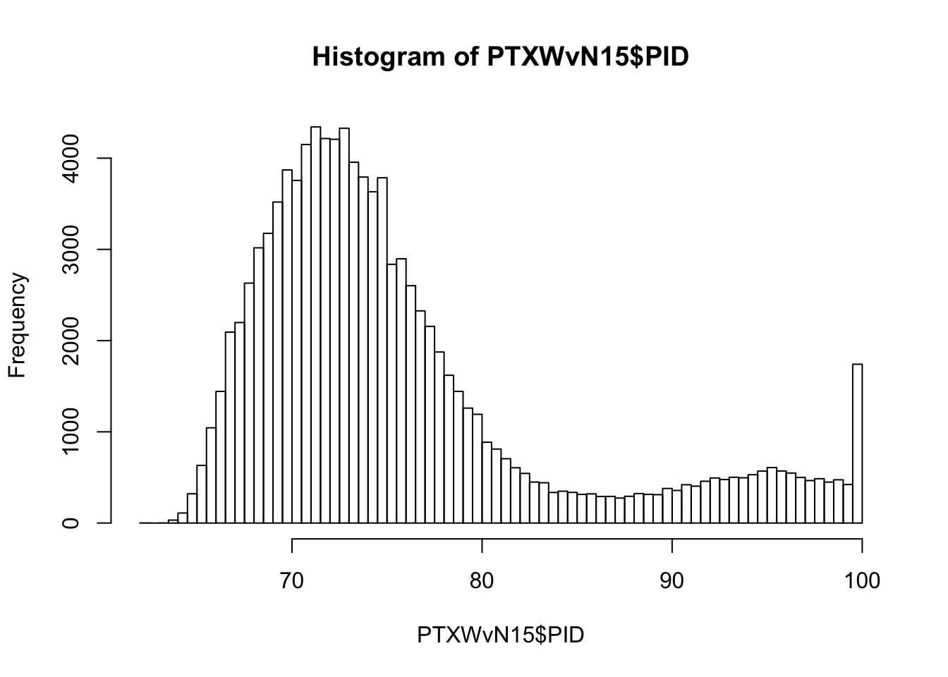
acTH1 has a different ANI pattern
Actino-acTH1
Percent Identity

Slide 22
Next Steps
Examine ANI for all SAG versus metagenome pairs from our lake time series
Examine SAG and fosmids versus metagenome pairs from:
Marine dataset (Hallam Lab)
Soil datasets (Brodie)
Develop method to quantify ANI density plot structure above 90-95%
Distance between top 3 bins
Matrix of bin heights
Summary statistics (mean, median, standard deviation, etc.)

