Slide 1
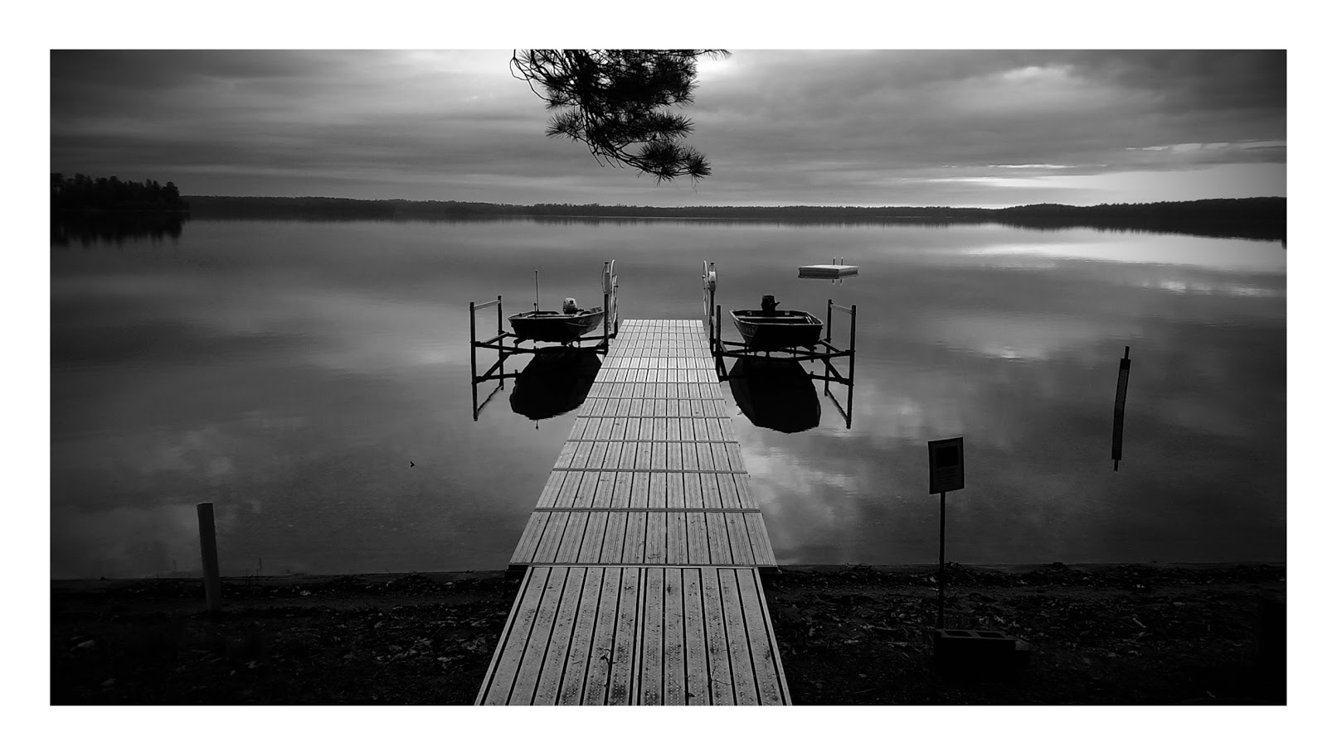
4th Year Committee Meeting
Sarah Stevens
@microStevens
McMahon Lab

Slide 2
Agenda
Introduction / Sequence-discrete populations
Contrasting patterns of genome-level diversity across distinct co-occurring populations
Next Questions
Selection within vs between sequence-discrete populations
Comparison of shared Trout Bog and Crystal Bog populations

Slide 3
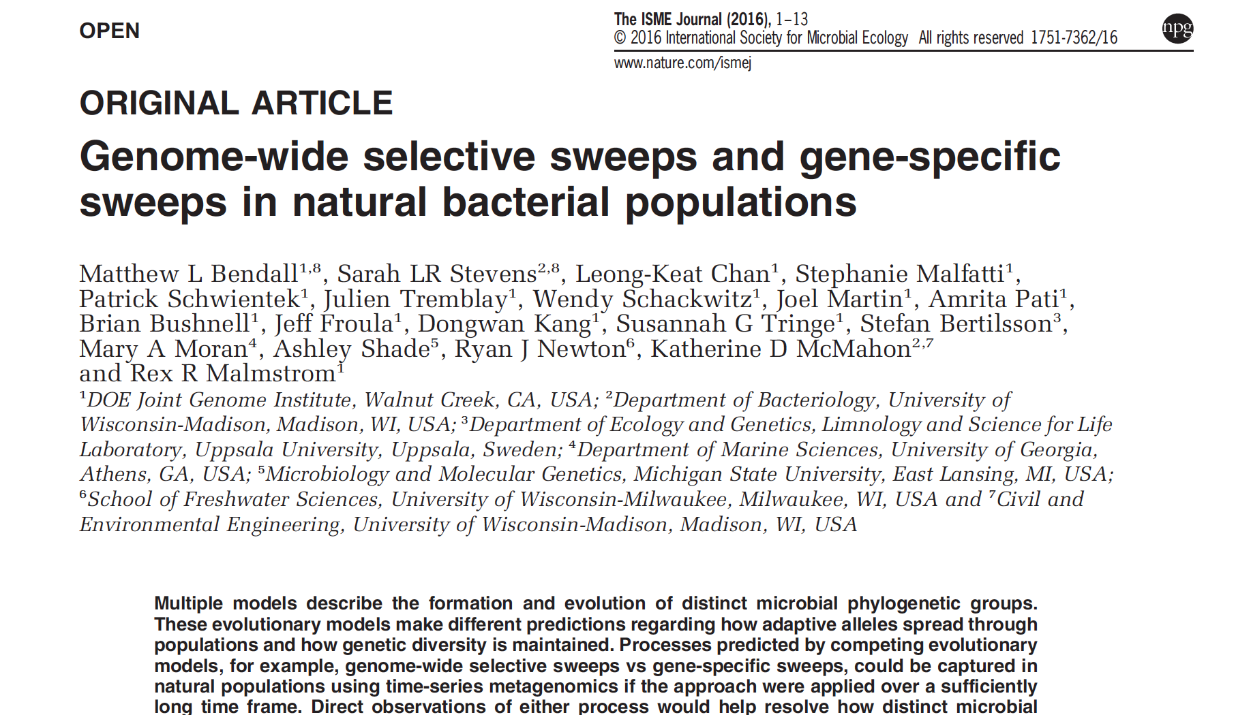

Slide 4
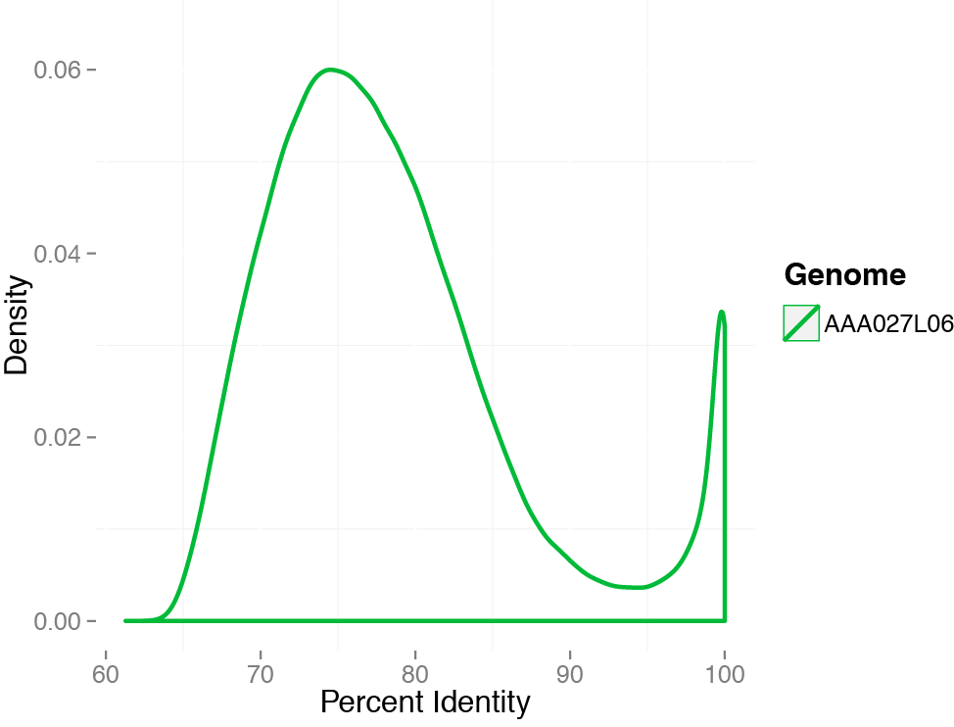
SAGs allow us to capture sequence discrete populations
Subject: acI-B1 from L. Mendota
discontinuity
Mendota metagenome: 9 June 2009

Slide 5
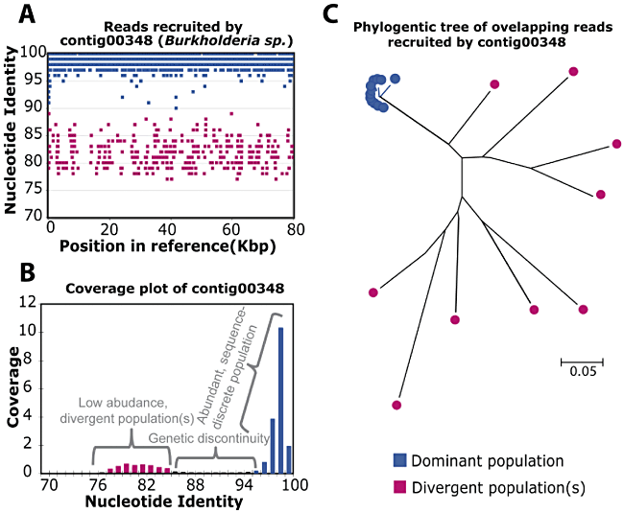
Sequence discrete populations
Caro-Quintero and Konstantinidis 2012 EnvMicro
Notes:
Lake Lanier to isolate genome

Slide 6
SAGs allow us to capture sequence discrete populations
Subject: acI-B1 from L. Mendota
discontinuity
Mendota metagenome: 9 June 2009

Slide 9
What about other lineages?

Slide 10
Notes:
This is with competitive

Slide 11
QUESTIONS

Slide 12
Microbes as colored dots figure

Slide 13
Crystal Bog (CB) v. Trout Bog (TB)
Both dystrophic (high in DOC)
Both seepage lakes
Share 45-60% of their top 20 clades based on 16S tags
Different mixing regimes
CB has a smaller surface area
TB is deeper
About 5 miles apart
Notes:
TB – Dimictic
CB -- Polymictic

Slide 14
Next Questions
Are there related sequence-discrete populations in TB and CB?
How similar are they based on ANI?
ANI for reference GFMs to each other
ANI when mapping reads from same vs different lake
For populations that are very similar between the two lakes:
Are there genes present in one lake but not the other?
Is there evidence for (ecological or physical) barrier to recombination?
Might also be able to compare MAGs from Mary Lake
Notes:
Mary Lake never mixes-meromictic
Bog too?
*Are there related sequence-discrete populations in TB and CB? How closely related are they? Do they share a common gene pool? Are there genes present in one lake but not the other for these closely related populations? Is there an ecological or physical barrier to recombination between these two lakes?*

