Slide 1
Sarah Stevens
McMahon Lab
First Year Committee Meeting

Slide 2
Previous Education
B.S. in Molecular and Cellular Biology
University of Illinois Urbana-Champaign
Undergraduate Research (Rachel Whitaker Lab)
Culturing and Isolating Sulfolobus
Insertion Sequence Assembly Project
Laboratory Technician Research (William Metcalf Lab)
Assembling and comparing Methanosarcina genome sequences

Slide 3
Course Work
Major – 10 total
Micro 612(3), Micro 810(1), Micro 625(3), Micro 875-Quantitative Methods in Microbiology(3)
Minor (Distributed) – 4 total
CBE 560(3), Micro 811(1)
Planned – 5 total
ZOO 315 – Limnology(2), STAT 371(3)
Still need 1 hr in minor, maybe seminar class or summer Wood’s Hole class
Notes:
CBE – Chemical and Biological Engineering, BME – Biomedical engineering
Major and minor 11 total

Slide 4
Professional Development
Attended Microbial Ecology and Water Engineering Conference this summer
Mentoring Undergraduate REU student this summer
Taking Delta Program’s Mentor Training Seminar course this summer
TAing undergraduate microbiology class in the fall/spring
Apply for the NSF fellowship in the fall

Slide 5
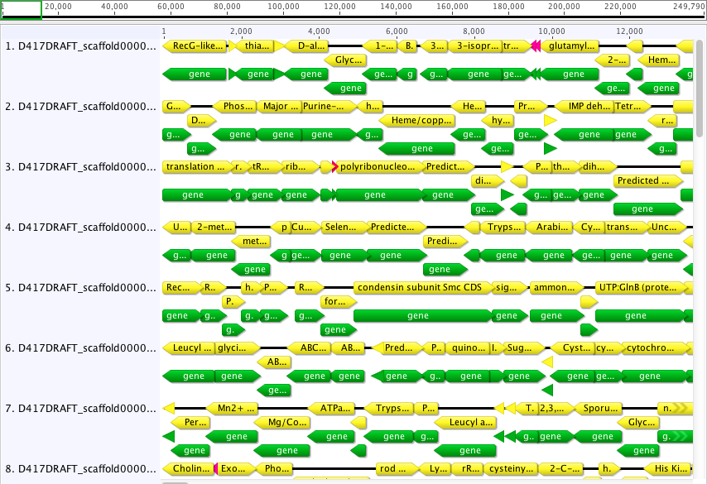
Single Amplified Genomes (SAGs)
Single cells separated into wells, lysed, amplified with random hexomers
Sent to JGI for sequencing, assembly, gene calls, and annotation
Variety of freshwater SAGs
Includes Actinobacteria, Betaproteobacteria, Bacteriodetes, Verrucomicrobia,
Quality Control
GC content, tetramer frequency, and BLAST distribution
Completeness estimates
Find single copy conserved genes at family level
Check for these genes in related SAG
Geneious visualization of a SAG’s contigs/annotations
Notes:
SAGs mostly from Mentota

Slide 6
Genomes from Metagenomes (GFM)
Trout Bog
Humic bog in northern WI
Epilimnion – 45 metagenomes, 82 tags
Hypolimnion – 45 metagenomes, 87 tags
Assembly of metagenome reads
Have assembly of all metagenomes from JGI
Make own assemblies for single metagenomes or specific metagenomes
Plot coverage from two samples for all contigs
PCA of tetranucleotide frequency for each
Notes:
Humic – dark stained water(tea colored) from humic acids leaching in from decaying peat and plant life
bog is a mire that accumulates peat, a deposit of dead plant material
Epilimnion – top most layer in thermal stratification, warmer higher pH and DO than hypo
Hypolimnion – lower layer, below the thermocline(layer where the temperture changes more rapidly with depth than in other layers), low light, coldest layer in summer(warmest in winter)
Metagenomes range from 2007 to 2009
Tags range from 2005 - 2009

Slide 7
Genomes from Metagenomes (GFM)
Assembled Contigs
Assembled Contigs
Image created by Ben Oyserman and adapted

Slide 8
Genomes from Metagenomes (GFM)
Image created by Ben Oyserman

Slide 9
SAGs and GFM
Physiology
Do these microbes use nutrients differentially? Are some taxa specialists for a particular nutrient source? Are there generalists which can take advantage of many nutrients? How does the genomic context reflect the changes in community given different conditions? R vs. K strategists?
Find genes involved in carbon metabolism, phosphorus metabolism, nitrogen metabolism, oxidative phosphorylation

Slide 10
SAGs and GFM
Ecology
How does the abundance of these taxa change over time? How well is a specific SAG represented in the environment? Do any of these taxa correlate with specific environmental conditions? Do any of these taxa co-vary?
Map the metagenomic time series reads to the genomes
Find coverage changes and correlation to environmental conditions or other taxa

Slide 11
Polynucleobater Genome Comparison
2 published genomes, 1 SAG from ME, 2 GFM from TB
Look for GFM from ME
Compare genome arrangement, find core set of conserved genes, genes/functions specific to particular environments
How do these populations change over time?
Map metagenome reads back onto the genomes
Notes:
Do GFM recruit reads better from their own lake?

Slide 12
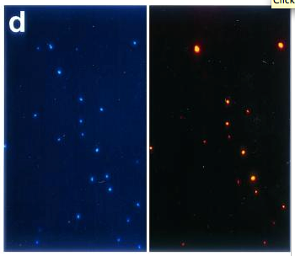
Addition Experiments
Lake water in 500mL bottles
Addition of nutrients
Incubation in the lake
Time series counts of how the community changes, using CARD FISH
Attempting this summer with succinic acid, predicted to be specific for the LD12’s (alphaproteobacteria)
DAPI staining in blue (left) and probe staining in red (right)
Pernthaler, A., Pernthaler, J., & Amann, R. (2002). Fluorescence In Situ Hybridization and Catalyzed Reporter Deposition for the Identification of Marine Bacteria. Applied and environmental microbiology, 68(6), 3094–3101.
Notes:
Fluorescence in situ hybridization (FISH) with horseradish peroxidase (HRP)-labeled oligonucleotide probes and tyramide signal amplification, also known as catalyzed reporter deposition (CARD)
LD12 is the phylogenetic distinct freshwater sister group of SAR 11 and exclusive to freshwater habitats - Stefan Bertilsson
 LD12 seem to be of quantitative and functional significance in lakes and has been described as an ultramicrobacterium with heterotrophic lifestyle (3, 4)
 The knowledge about the ecology of LD12 is still incomplete

Slide 13
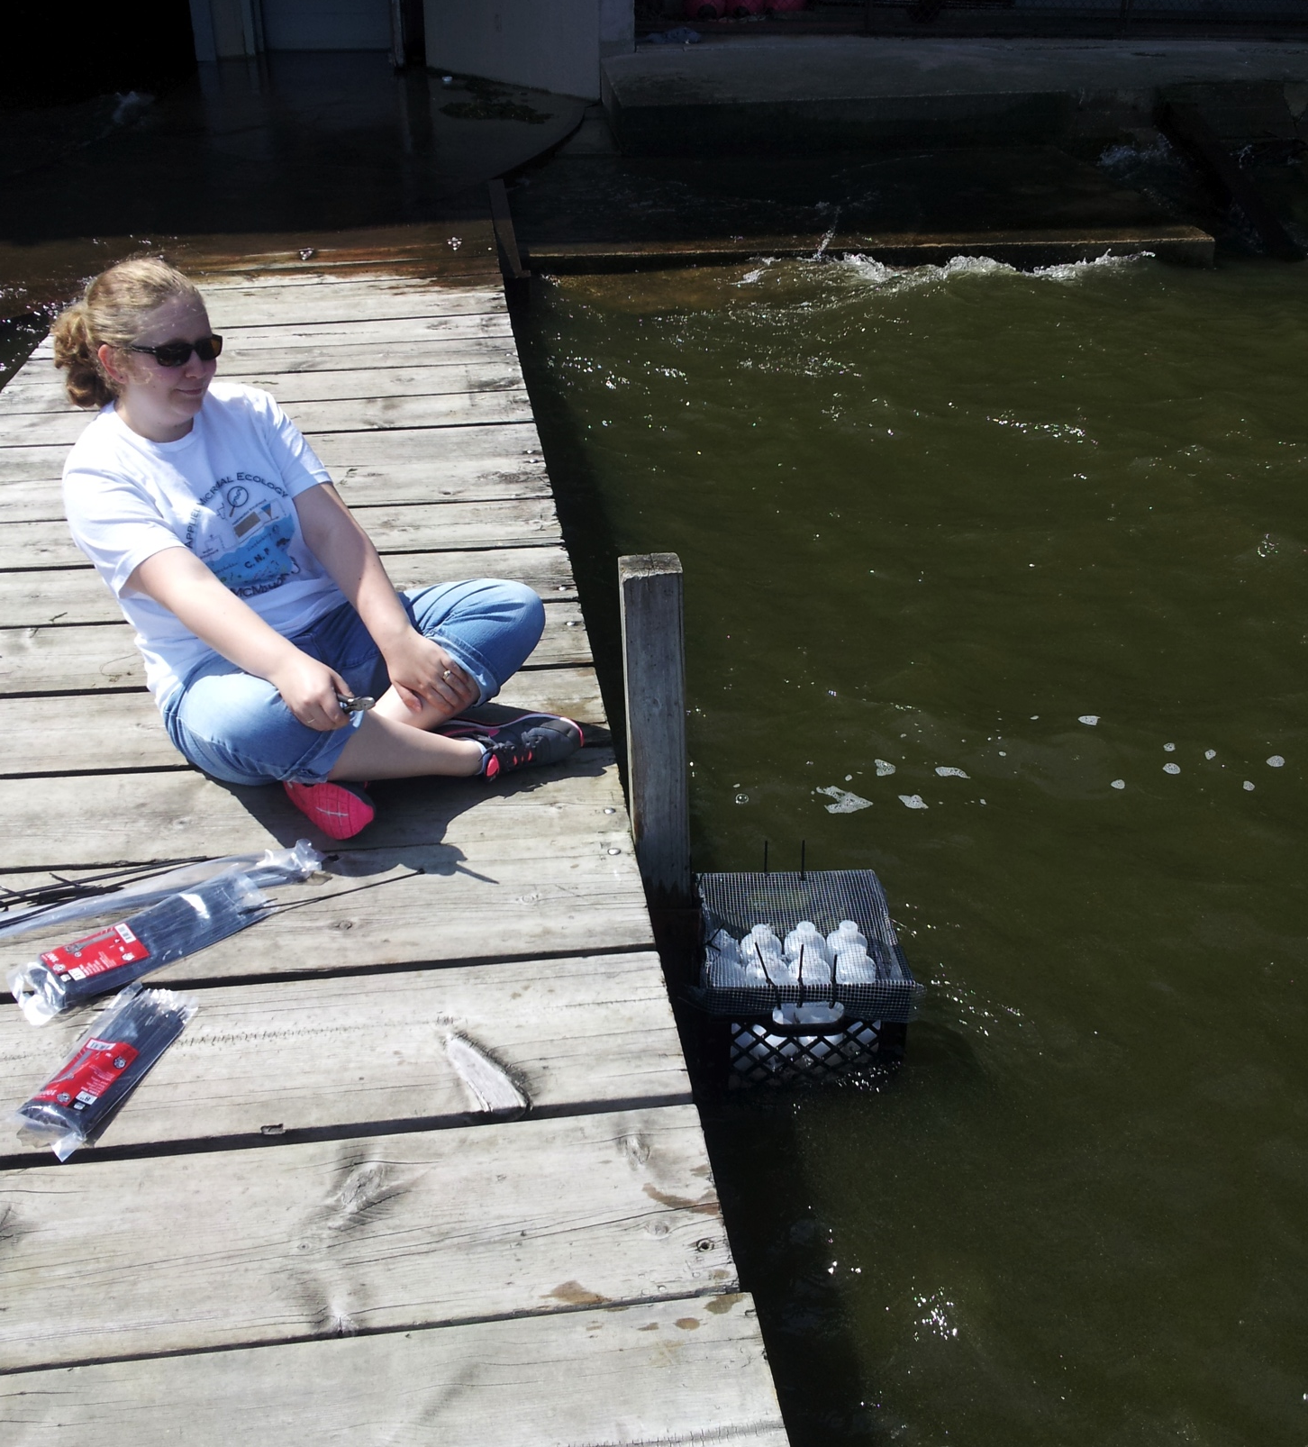
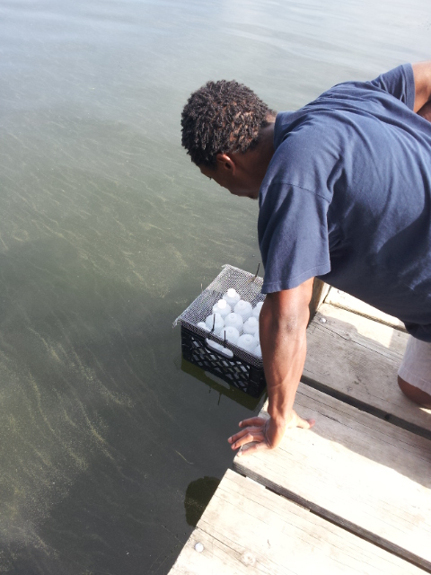
Addition Experiments

