Slide 1

3rd Year Committee Meeting
Sarah Stevens
MDTP

Slide 2
Agenda

Slide 3
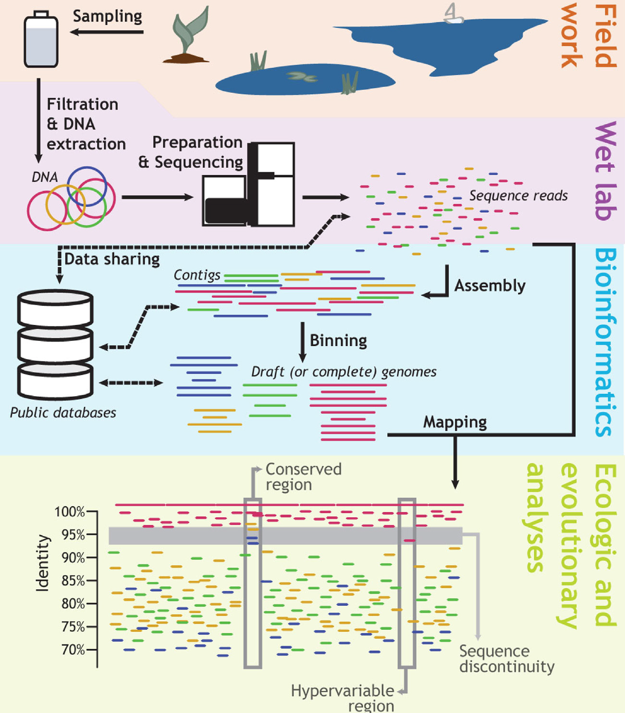
Konstantinidis, K. T., & Rosselló-Móra, R. (2015). Classifying the uncultivated microbial majority: A place for metagenomic data in the Candidatus proposal. Systematic and Applied Microbiology, 38(4), 223–230.

Slide 4
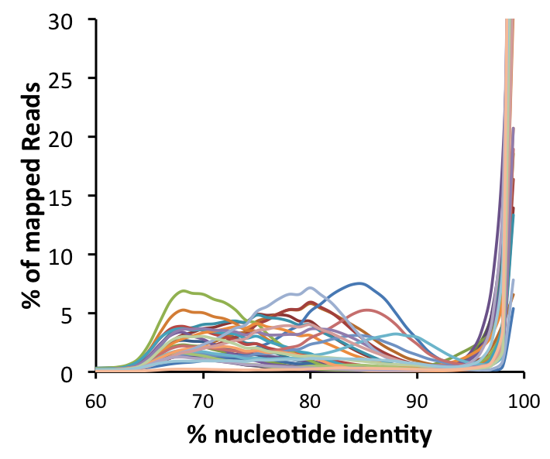
All Genomes Assembled from Metagenomes Show Sequence-discrete Pattern

Slide 5
Speciation Models
Shapiro, B. J., & Polz, M. F. (2014). Ordering microbial diversity into ecologically and genetically cohesive units. Trends in Microbiology, 22(5), 235–247.
Notes:
[s, the average fitness difference experienced by a niche-specifying (adaptive) allele in different niches] and recombination (r, the recombination rate per locus per generation) is expressed as the r/s ratio
In application to speciation event, for recombination model, the recombina

Slide 6
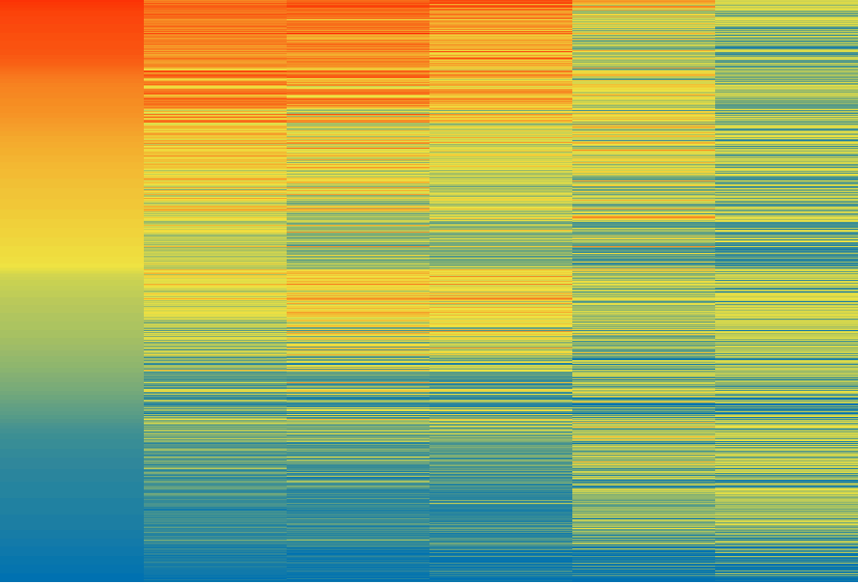
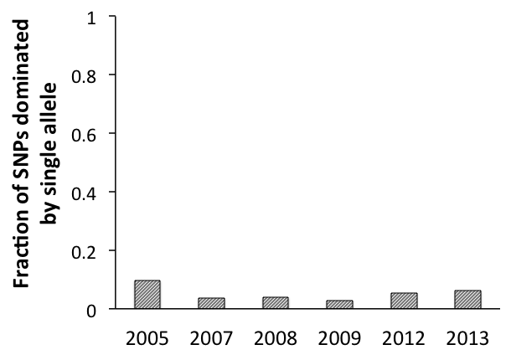
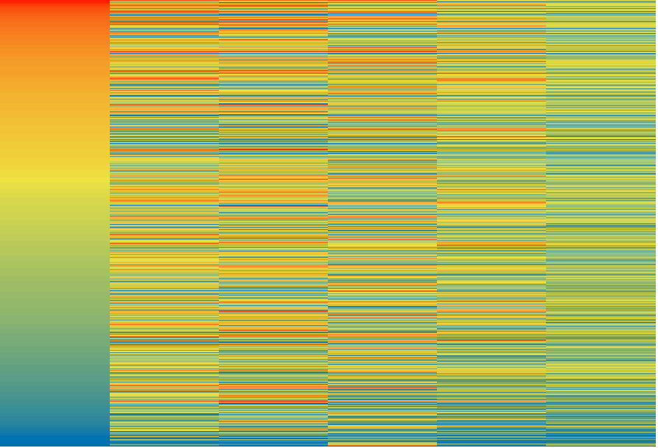
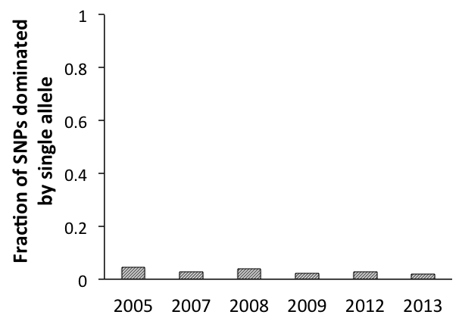
The SNPs for Most Sequence-discrete Populations Show No Trend
Holophagales-254
Holophagales-254
8,501 SNPs
100
75
50
2005 2007 2008 2009 2012 2013
% reads supporting reference base at each SNP locus
Actinobacterium-2152
Actinobacterium-2152
25
0
4,209 SNPs
2005 2007 2008 2009 2012 2013

Slide 7
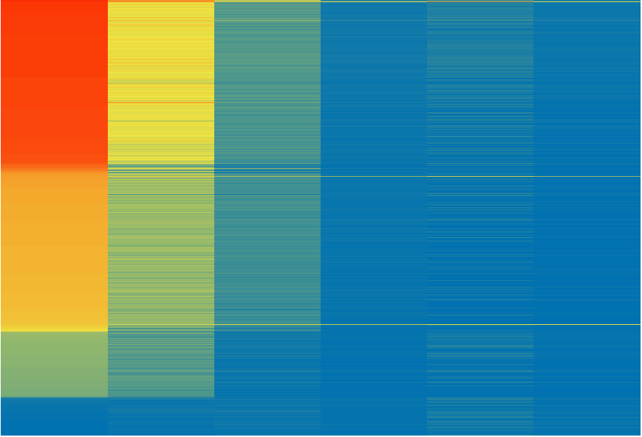
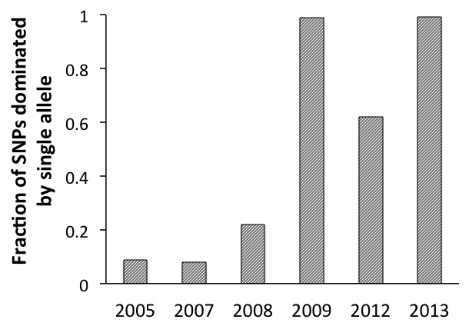
One Population Experiences a Major Loss of Diversity, Consistent with a Genome-wide Sweep
100
Chlorobium-111
Chlorobium-111
75
50
3,111 SNPs
% reads supporting reference base at each SNP locus
25
0
2005 2007 2008 2009 2012 2013

Slide 8
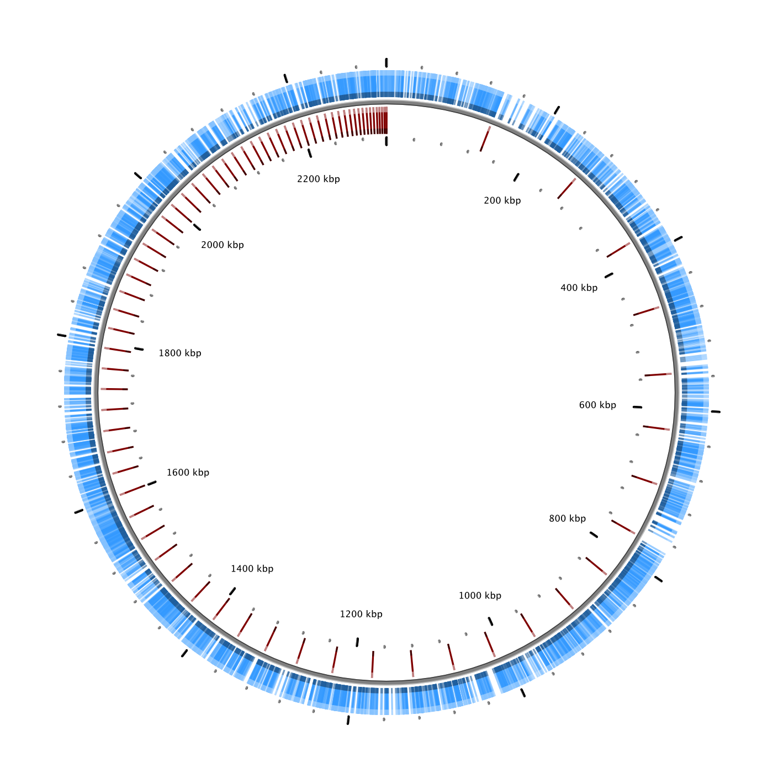
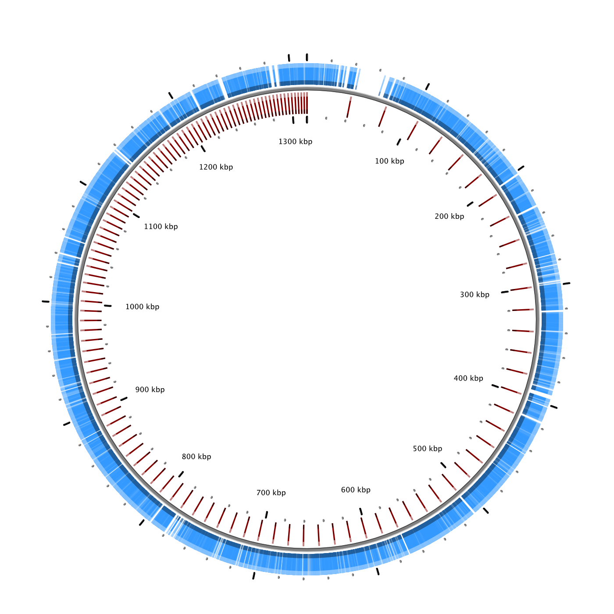
Others Showed Evidence of Past Gene-specific Sweeps
A) Chlorobium-111
B) Polynucleobacter-238

Slide 9
Conclusion
That diversity within co-occurring populations may be controlled by different mechanisms and explained by different evolutionary models

Slide 10
16S rRNA Gene Relationships Reflected in Gene Phylogeny
Notes:
Based on the subset of 400 genes which were present using PhyloPhlan

Slide 11
SEQ-DISC PLOTS FOR ACI SEP BY MENDOTA VS. OTHER

Slide 12
SAGs Only Recruit Reads from the Same Sequence-discrete population

Slide 13
J17 Represents the Most Abundant Sequence-discrete Population
Notes:
L06 show the same pattern, since they are tracking the same population, which is reassuring
I14 and M14 are lower abundance (of our set)

Slide 14
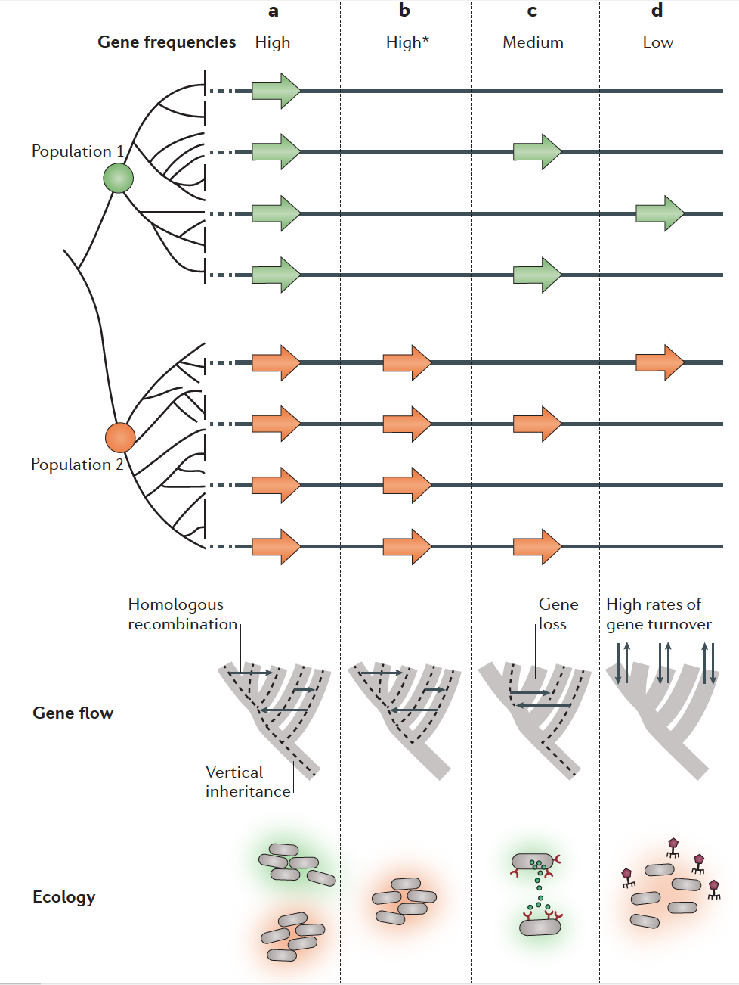
High frequency genes
evolve by vertical inheritance and homologous recombination
probably encode essential metabolic and housekeeping functions that are under purifying selection
Low frequency genes
gained and lost at high rates
selectively neutral or under strong negative frequency-dependent selection
Cordero, O. X., & Polz, M. F. (2014). Explaining microbial genomic diversity in light of evolutionary ecology. Nature Reviews. Microbiology, 12(4), 263–73. doi:10.1038/nrmicro3218

