Slide 1
Chapter 3
NEW Chapter 3

Slide 2
Over dispersion of among cell measures
Wang 2019 paper found that the ‘within cell covariation’ of SC lengths was a major component of the total variance (for both SC length and COs per cell)
(permutations/simulations showed there was more variance among cells than expected by chance)
MY CHAP:
Use whole cell measures (all 19-20 bivalents within a cell) to compare the within cell covarition and study the total variance for animals

Slide 5
Maybe all bivalents have similar / distinct structure across males
Should I try a PCA comparison? (compressing data / is there a way to describe this without PCA?
Expected patterns
Males: smaller ranges for all metrics (across mice within strain)

Slide 6
Within mouse variance of meiotic features
Evolution and sexual dimorphism of meiotic features

Slide 7
Mixed model (no sig effects)

Slide 8
Results
Male pattern
More interference in high RR musc males, there are more 2COs in these strains
CO position is conserved
Female pattern
?

Slide 9
Initial bivData results
MasterBivData - (no duplicates)
curatedBivData -

Slide 10
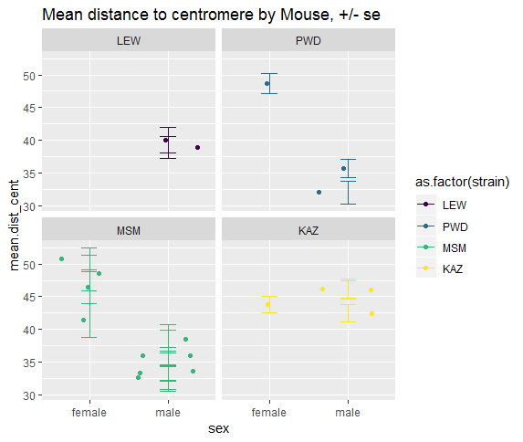

Slide 12
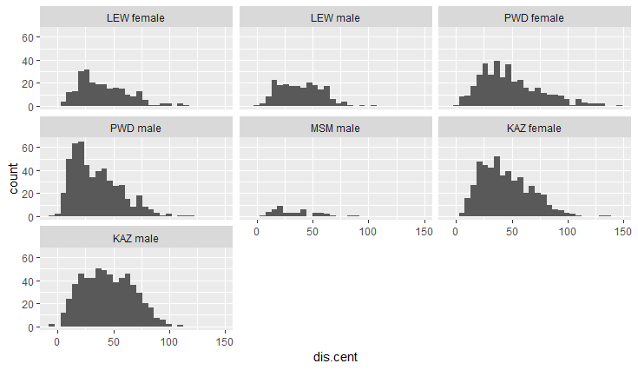
Distance to centromere
What’s the best way to quant centromere suppression

Slide 13
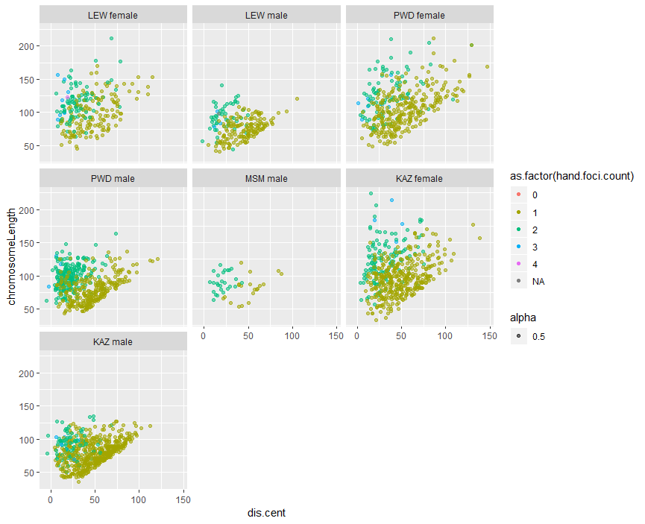

Slide 14
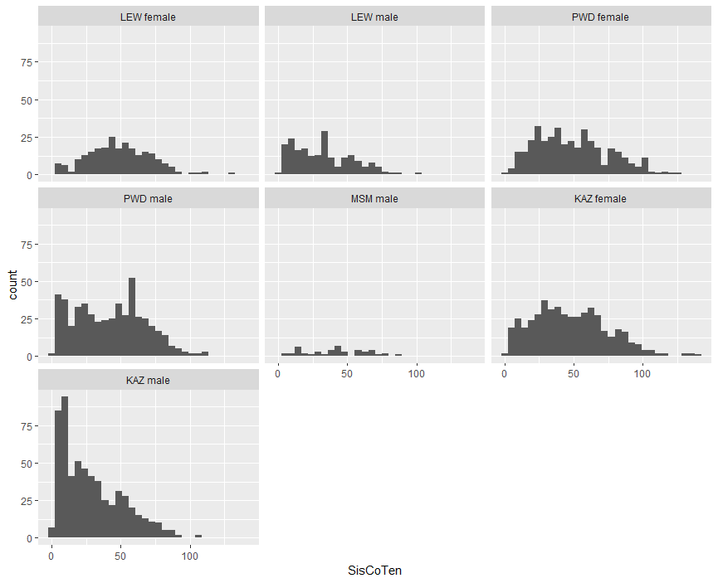

Slide 15
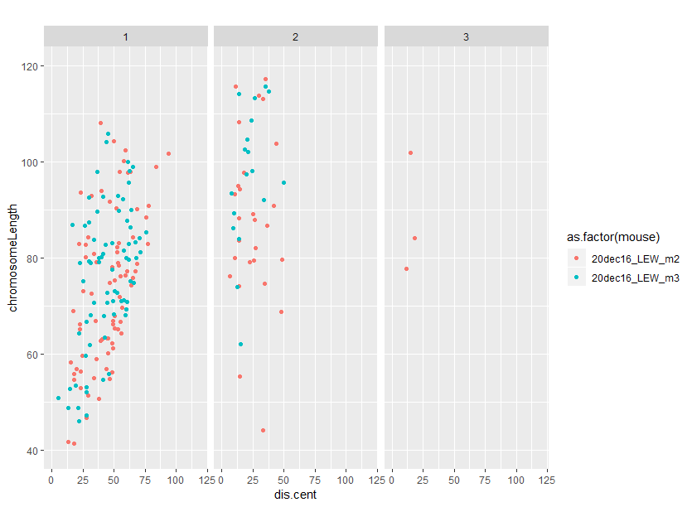
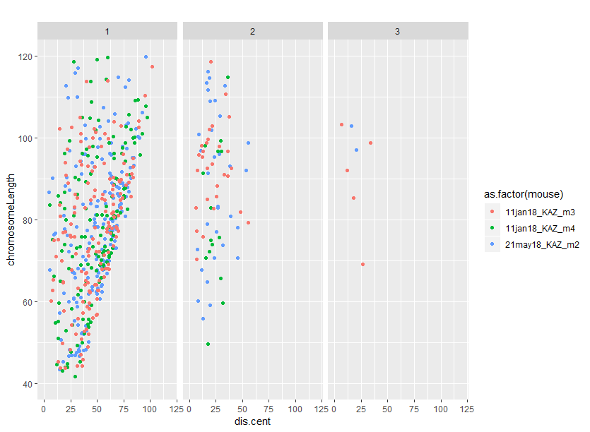
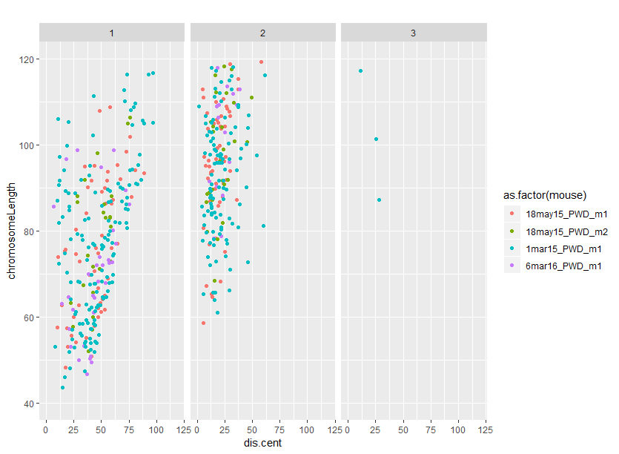
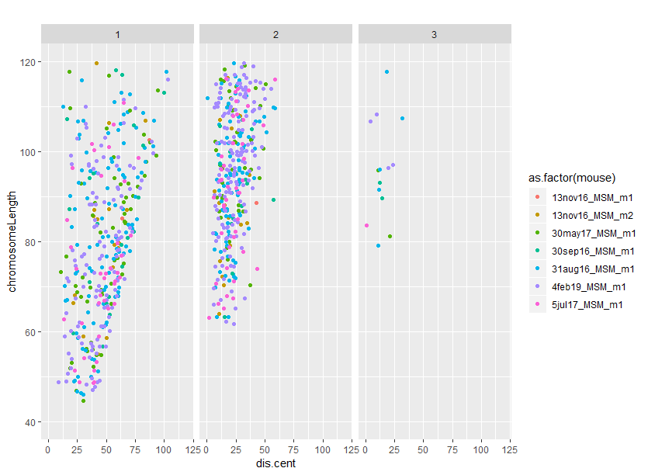
SC.length.points.bivs
Notes:
PWD and MSM have significant length effect on 1CO 2CO and also seem to have weaker centromere suppression
What tests will I use?
What about telomere bias?
Kaz male seems to have telomere bias

