Slide 1
MS results/outline
12.2.20
Notes:
Goals for getting out of lab meeting:
Feed back for test choices
Push to write and distribute a draft of my results outline
Practice summarizing results

Slide 2
Background (how does heterochiasmy evolve given sex specific traits/ patterns)
(FINAL MM / GLM syntax)
Basic frame work – to investigate the patterns of variation and evolution – use Mixed model;
- Subsp -- ( divergence in the evolution of gwRR)
Sex – sex specific factors
Interaction (synergistic effect of the two factors)
-strain -- polymorphism
No clear significant effects… is this
Notes:
Themes for intro
MM: finalizing

Slide 3
Main models
MLH1 count averages (sex specific effects)
MLH1 count variance
Musc male MLH1.av– strain differences? (post hoc)
- Can SKIVE be classified as intermediate to PWD vs others,
Which are diff from a ‘low’ level (all) –HOW DO these compare to other DOM
Which strains are most different from others
-Do these predictions hold for MSM – MOLF comparison?

Slide 4
Sex specific – gwRR patterns
- lm( mouse.av.CO ~ strain )
For males: PWD, MSM and SKIVE have significant effects
For female: G, LEW, PWD, MSM are significant (G and MSM are the most sig)
-MSM, both sexes have ‘evolution’ / increase of gwRR.
G, PWD, SKIVE have sex specific pattern (higher than other mice)

Slide 5
Female specific

Slide 6
Male specific

Slide 7
Gwrr estimates

Slide 8
gwRR mixed model

Slide 9
MLH1 var

Slide 10
DMC1 Results

Slide 11
Strains divided into high and low strains
Only significant difference is observed for the earlier timepoint

Slide 12
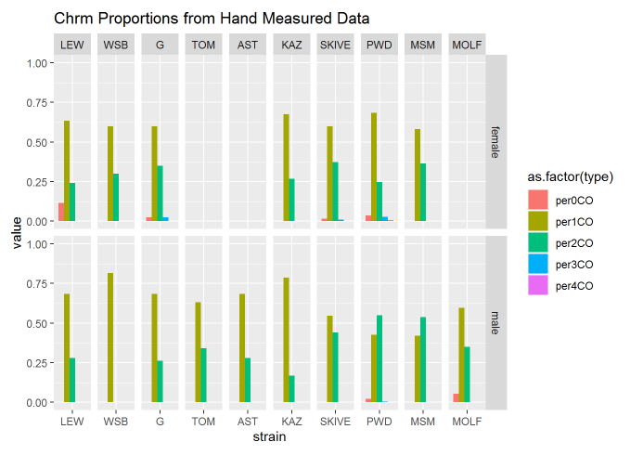
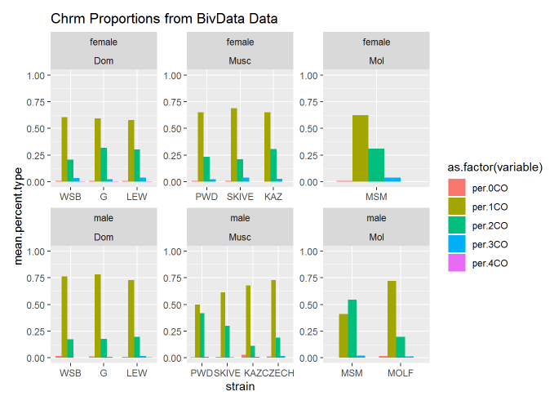
Chromosome proportions
The mice with distinct gwRR
Male pattern
**MSM 60% > PWD 50% > SKIVE 30% > 20 - 10% remaining (low) strains**
Chi square test ? Not done yet
Notes:
(genome wide rate supported by chromosome level observations)
(test?)
(gwRR evolution is facilitated through chrm levels)
(what about the female findings: G, MSM, )
Test for these data …. ./
**MSM 60% > PWD 50% > SKIVE 30% > 20 - 10% remaining (low) strains**

Slide 13
Female pattern
High female strains, G and LEW,
High Rec females have more 2CO chrms, ~33% vs (23% - 27%)
Male pattern
**MSM 60% > PWD 50% > SKIVE 30% > 20 - 10% remaining (low) strains**

Slide 15
Single Bivalent Dataset
~ 10,400 Automated Single Bivalent Measures
(Curated – make sure the algorithm ran correctly)
3 types of metrics
1. Length of individual bivalents (SC signal)
2. Position of single CO on a bivalent
3. Interference strength, InterFocal Distance (IFD)
Notes:
Example to illustrate the Bivalent Data
Almost all the mice used in the MLH1 data set – have Bivalent observations

Slide 16
Single Bivalent Sex Specific Patterns
Driving questions
Q1) What are the main differences between males and females?
Q2) What are the differences between high musc and low musc strain?
Predictions
1. SC length will be sexually dimorphic
2. 1CO normalized positions will be sexually dimorphic
3. No difference in physical distance between foci on the same bivalent.*
*only 1 paper with cytological data for IFD of both sexes (mice B6). No difference found in physical (um) scale.
de Boer, E., Stam, P., Dietrich, A. J., Pastink, A., & Heyting, C. (2006). Two levels of interference in mouse meiotic recombination. Proceedings of the National Academy of Sciences, 103(25), 9607-9612.
Notes:
(motivation)
Given the findings with the gwRR -> chrm proportions -> look at single bivalent pattern
(chromatin compaction, interference and known sex specific rec landscape features)
(Brief summary for dataset)
(Focus is on 2 main questions)
Animate so that they appear sequentially, then ii) fades
Example questions
Walk through these predictions:
The first 2 are well supported by the literature, while the 3rd there is only 1 paper I could find with cytological data for interfocal distance for both sexes.

Slide 17


Bivalent Data Sex Specific Results
(tests used – the same mixed model)
Framework ()
1. lme(mean_co ~ subsp * sex + (1|strain)
2. lm( mouse av. metric) ~ sex * strain
1. SC length will be sexually dimorphic
2. 1CO normalized positions will be sexually dimorphic
3. No difference in physical distance between foci on the same bivalent.
Notes:
Frame work, use the same equations as for the MLH1
-- use mouse averages, for the single bivalent level

Slide 18
Sim means, for raw IFD
Male mean greater
--- Threshold for the males, not in the females

Slide 19
Threshold not as strict --- in ‘low’ rec straions

Slide 20
High rec males: Sharpe threshold of normalized IFDs ~ 30%
Females: enrichment of shorter normalized IFDs

Slide 21
(surprising IFD results)
Review results from de Boer (only sex comparison of both sexes)
(illustrate strange results for sex difference in interference?)n
Strange coefficients for the IFD values across sexes
over all pattern:
Female IFD are longer, but the lower nrmIFD in females is driven by enrichment for short nrmIFD compared to males.
(can I connect this result to a less regulated meiotic pathway in females?)
Notes:
The overall narrative I’m trying to weave – more variance in females
-Between cells (MLH1 counts)
- Uniform spacing (the 1CO position is not regulated) (F1 variance is probably larger (F1nrm))
- IFD spacing / interference strength
- Lack of distinction between 1CO and 2CO lengths
(longer SC lengths (variance in SC length / I’m not sure this makes sense))
deBoer Summary:
MSH4, in WT and Sycp1 -/-. (found 2 classes of COs / two types of interference). Used FISH for chrms 1,2,18,19; calculated gamma distribution from chrm specific intervals
Interference much stronger for MLH1 in pachytene
Sex differences --- ?
(the density of MLH1 on SC-AE is more dense in males than females)
Male – short chrms had strong medial placement of MLH1
(Can I access these data?)

Slide 22
Notes:
WSB has the most telomeric landscape
High rec strains
For some reasons the patterns change – maybe the first one included more than 1CO

Slide 23
DeBoer et al 2006
Number of foci upper left,
Notes:
Interference / gamma curves are on the top --- don’t think any are female?
(Should I try to remake these cumulative foci plots?) --- smaller square curve plots are there are all distance to cent (do these pool foci from the same biv?!)
Fig. 1. Analysis of foci along bivalents. (A) Shape of gamma distributions for
different values. The average interfocus distance equals 10 for all distributions
shown. As increases, the very short and very long distances become
sparser, and the distributions become narrower and more symmetrical. (B–D)
Examples of histograms of observed interfocus distances in spermatocytes
(black bars), the best fit of the observed distances to the gamma distribution (red curves), the value for which the best fit was obtained (ˆ ), and the
distributions expected if there were no interference (i.e., 1; blue curves).
The observed interfocus distances were binned for representation only; the
best fits to the gamma distribution are based on the exact, unbinned distances.
Figs. 5 and 6 show histograms of all data sets. (E–G) Distribution of foci
along bivalents. Shown are the cumulative frequencies of foci as a function of
the distance to the centromeric end of the SC (wild type) or AE (Sycp1/). The
distances are expressed as percentage of the length of the SC AE on which the
focus was located. The numbers of foci on which the curves are based are
shown in the upper left corners, and the chromosome numbers are shown in
the lower right corners of the graphs. A uniform distribution of foci would
yield a straight line from the lower left to the upper right corner of the graph.
M, male; F, female; Wt, wild type; , Sycp1/.

Slide 24
Summarize sex specific bivalent patterns
(figure ideas?)
Main data / tables
Conserved sex specific metrics for single bivalents during meiosis
- SC compaction
- uniform CO placement
Surprise, interference is not conserved… (raw value long in females, normalized versions females have sub class of close together
General pattern – for revisiting in discussion
Female meiotic pathway is less controlled/regulated
Notes:
The overall narrative I’m trying to weave – more variance in females
-Between cells (MLH1 counts)
- Uniform spacing (the 1CO position is not regulated) (F1 variance is probably larger (F1nrm))
- IFD spacing / interference strength
- Lack of distinction between 1CO and 2CO lengths
(longer SC lengths (variance in SC length / I’m not sure this makes sense))

Slide 25
Single Bivalent patterns
(example of segmented cell)
-BRIEF, description of data, ()
Driving questions
i) What are the main differences between males and females?
ii) What are the differences between high musc and low musc strain?
3 types of metrics
1. Length of individual bivalents (SC signal)
2. Position of single CO on a bivalent
3. Interference strength (interfocal distance)
Notes:
(motivation)
Given the findings with the gwRR -> chrm proportions -> look at single bivalent pattern
(chromatin compaction, interference and known sex specific rec landscape features)
(Brief summary for dataset)
(Focus is on 2 main questions)
Animate so that they appear sequentially, then ii) fades
Example questions

Slide 26
Model for investigating variation in males
If gwRR variation is reflected by bivalent levels traits)… for each metric
1. Dom strains will not be different
2. In Musc, PWD and SKIVE will be different from others
3. MSM will be different from MOLF
1. Mouse.av ~ (mouse | strain) 2. mouse.av ~ strain
(should I run this type of model for all (sex * subsp combos?)
Notes:
1 way Anova – at least 1 of the group is different
2. Pairwise t.tests, (maybe I was using the wrong correction)
What would the point be to run these models?
Distinguish the higher than ‘low’ (Dom) level strains
Allows to add in additional strains not used for sexual differnces

Slide 27
SC Length
1. Dom are different
2. Musc strains? (PWD and SKIVE most different)
Inter-
Focal
Distance

Slide 28
-lme4 (use RLTR exact() for testing random effects --- what are the random effects in these models?
-ANOVA? (one way anova – 1 factor in this group is different from the others
fit <- aov(y ~ A, data=mydataframe)
ANOVA test hypotheses:
Null hypothesis: the means of the different groups are the same
Alternative hypothesis: At least one sample mean is not equal to the others.
http://www.sthda.com/english/wiki/one-way-anova-test-in-r
Non-sig anova
Sig anova
Sig anova
Pairwise t.test results for the 3 subsp
Notes:
Discussion
Table X, Current models and their predictions for the evolution of heterochiasmy
Table X, results from proposed predictions
(Figure X, cartoon of difference in bivalent on spindle for 1CO and 2COs)
Review main patterns
Male specific polymorphism for gwRR in musculus and molossisnus, may not be a species wide optimum for gwRR
More variance in females for meiotic features, resulting in greater variation in gwRR
Rapid male specific evolution upstream of CO repair stage
SACE predictions and bivalent selection models are not mutually exclusive,
Importance of broad scale patterns for recombination
(centromere effects for mis-segregation rates) - (high rate of robertsonian translocation in Dom, and absent in Musc – maybe something about centromeres (encourages transloactions + suppresses 2CO (rec near centromere) in DOM
(that has changed in Musc, REC near centromere suppresses rates of robertsonian translocation)
Discussion
Table X, Current models and their predictions for the evolution of heterochiasmy
Table X, results from proposed predictions
(Figure X, cartoon of difference in bivalent on spindle for 1CO and 2COs)
Review main patterns
Male specific polymorphism for gwRR in musculus and molossisnus, may not be a species wide optimum for gwRR
More variance in females for meiotic features, resulting in greater variation in gwRR
SACE predictions and bivalent selection models are not mutually exclusive,
Importance of broad scale patterns for recombination

