Slide 1
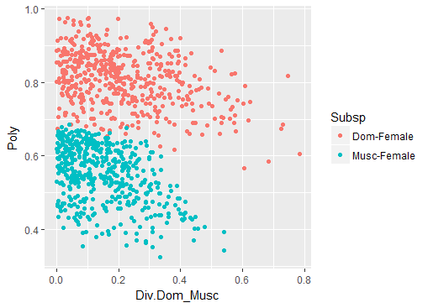
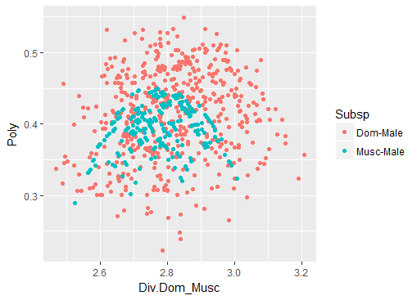
500 P and D points were simulated, from 10 random mice with the strain randomized.
Notes:
500 P and D points were simulated, from 10 random mice with the strain randomized.
Female plot, Dom females have more strains in the sampling, this is likely driving the larger Polymorphism
Male plot, Musc male polymorphism is smaller than Dom male.
The Divergence between Musc and Dom males is at a larger scale than females
Check if these follow the amount of variance

Slide 2
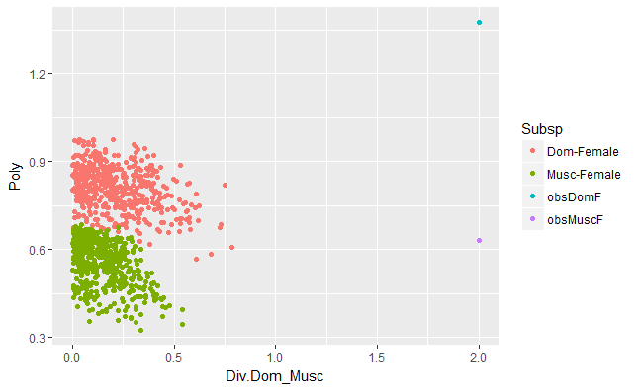
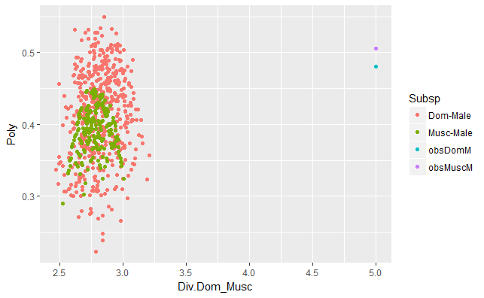

Slide 3
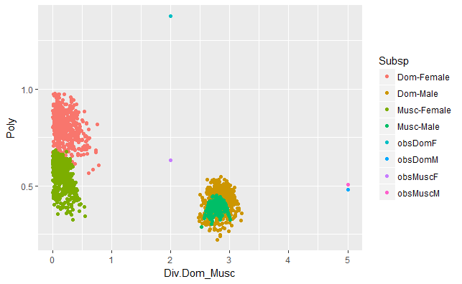

Slide 4
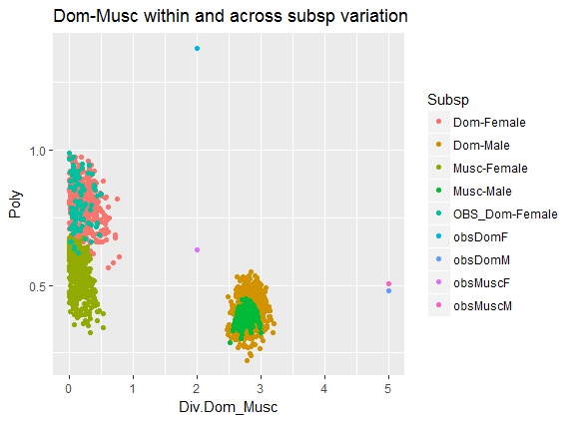
Make a subsampled version, without randomizing strain
Notes:
Add subsampled Dom f values in tourquois. The distribution doesn’t seem different than the randomized points.
But I think that shows that sub-sampling the data affect the distribution.

Slide 5
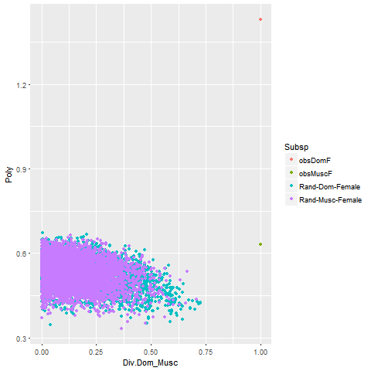
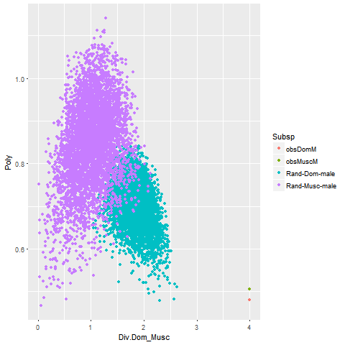
Notes:
Simulations of PnD ratios
Simulated P calculated by drawing a sample(same size of observed data) from pooled data set of female means. Calq the SE of that sample
Simulated D calculated by measuring the SE of the ‘new’/simulated subsp mean AND the other subsp mean.
<interpretations, (assuming it’s right)> (the male P calq is half has large as yesterday’s…)

Slide 6
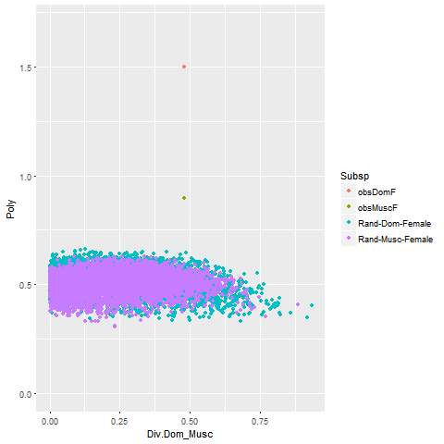
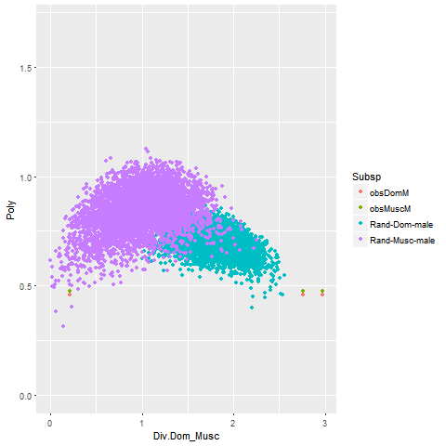
Notes:
Made an important change to make sure I was plotting numbers not factors
Added the Divergence points across all three subspecies in males, (Dom-Cast divergence in co_means is leftmost, and Musc-Dom, Musc-Cast div measures are on the right.
Given the simulations ---
Females have significantly more polymorphism in CO number compared to the ‘polymorphism’ from a equal sized set of random mice. The divergence of actual Dom – Musc means is not that different from the mean of the random pool and a subsp’s mean.
Male patterns of variation,
The amount of polymorphism of CO number in Musc and Dom, is very similar and slightly more significant than what would be calqluated from a set of random mice.
The divergence from

Slide 7

Notes:
Made an important change to make sure I was plotting numbers not factors
Added the Divergence points across all three subspecies in males, (Dom-Cast divergence in co_means is leftmost, and Musc-Dom, Musc-Cast div measures are on the right.
Given the simulations ---
Females have significantly more polymorphism in CO number compared to the ‘polymorphism’ from a equal sized set of random mice. The divergence of actual Dom – Musc means is not that different from the mean of the random pool and a subsp’s mean.
Male patterns of variation,
The amount of polymorphism of CO number in Musc and Dom, is very similar and slightly more significant than what would be calqluated from a set of random mice.
The divergence from

Slide 8
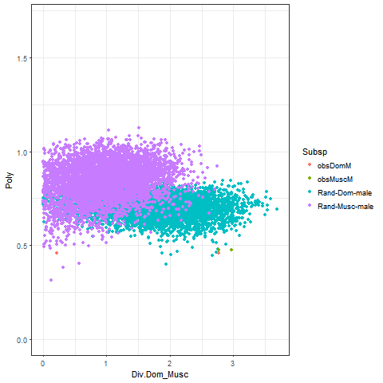
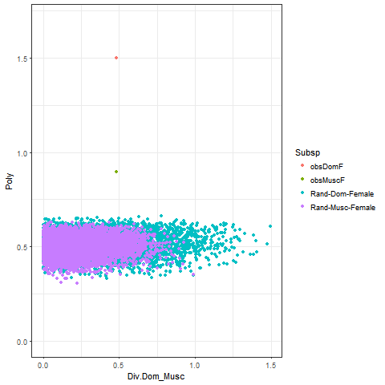
Notes:
Adjusted the calculation for Div
Male HM CO measures/ distributions have less polymorphism than a randomized male distribution
Female HM CO meansres have more polymorphism than a randomized male distribution

Slide 9
Sample from within all females
-- what would the distribution look like if I didn’t maintain the groups
-- remember to maintain the ‘data’ structure of the observed data (N mice ect) – make sure that they are comprable

Slide 10
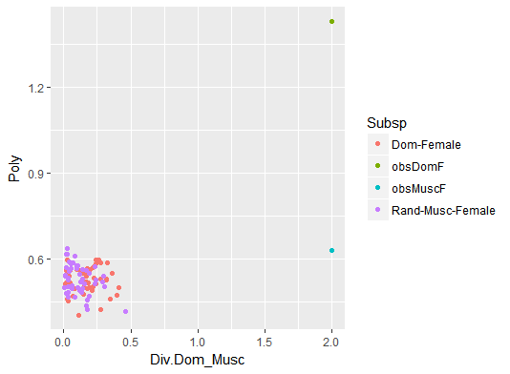
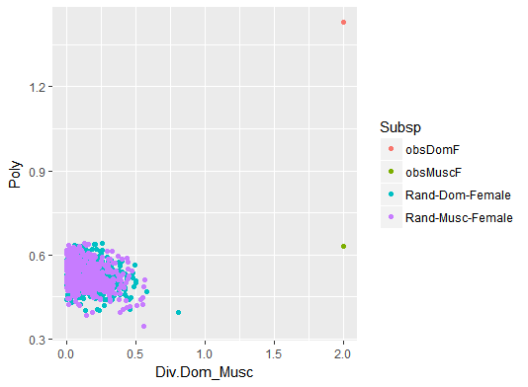
Notes:
When simulated data are drawn from random female pool. Makes more sense that calq for randomized draws overlap. --- especially because they have the same sample size.
I am 70% I calculated the observed values right… but dom female SE seems very high…

Slide 11
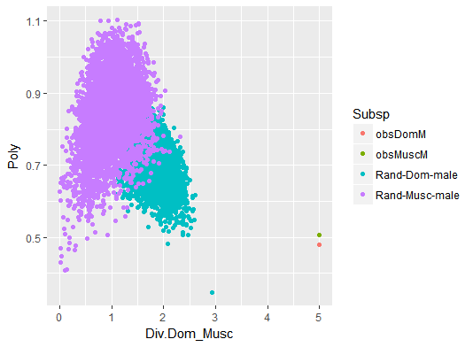

Slide 12
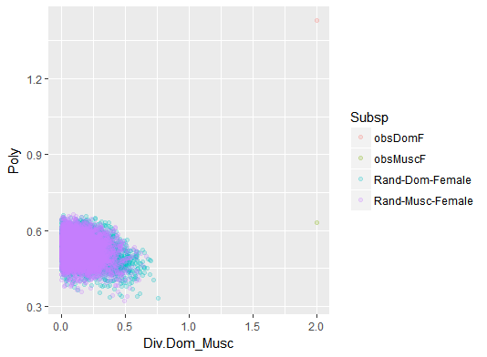
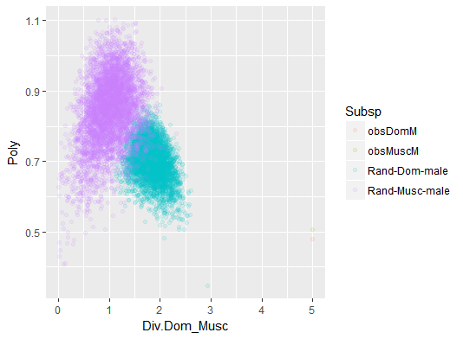
Notes:
Fewer musc male mice could explain the lower polymorphism

Slide 13
(Effects of changing the number of strains in each subsps)
Doms with G-Lew
Doms with Lew-WSB
Doms with WSB-Lew
Make sure to change the number of observations

Slide 14
Use Var instead of SE
Use sd instead of SE

Slide 15
…another form of variation…
Use sd instead of SE

