Slide 1
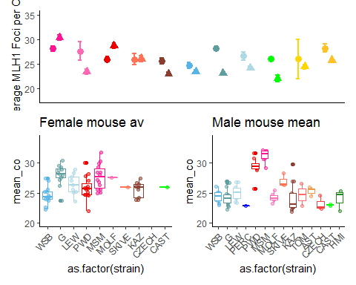
Main MLH1 figure
Notes:
Copy from code

Slide 2
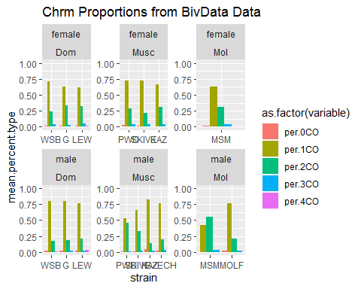
Chromosome Proportion differences

Slide 3
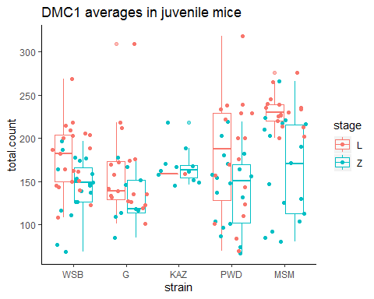
DMC1 results

Slide 4
Position (1CO)

Slide 5
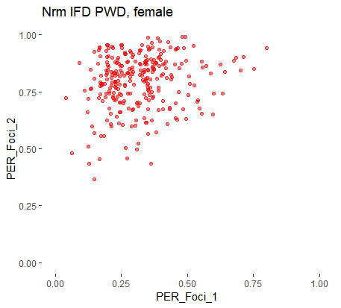
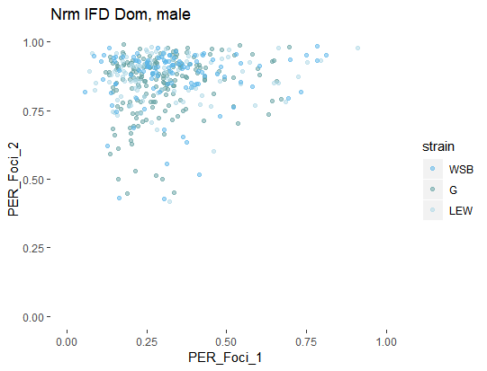
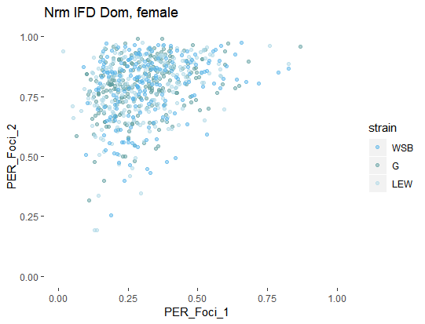
IFD figure
Longer IFD
Shorter IFDs
Notes:
Interference strength examples
(based on Dourad et al (link)
Generic example plot;
Show the difference in IFD length via closeness to diagonal line. Put example
(could try 3 axis for the 3 COs)
Centromere – supression,
Male – female difference – telomere bias (the enriched points around the top of plot
PWD – DOM, differences not quite clear (in contrast to the boxplots)

Slide 6
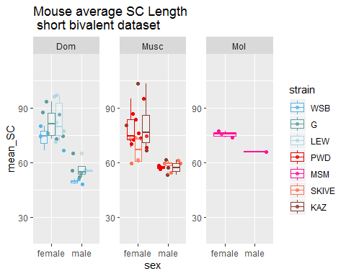
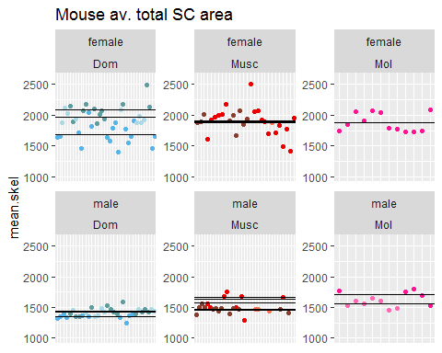
SC length (by chromosome class)

Slide 8
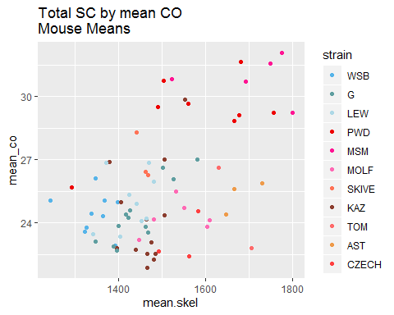
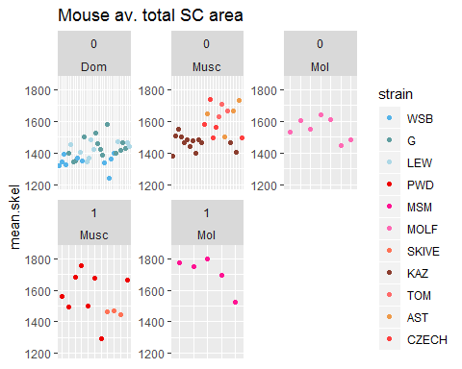
Q2 SC differences

