Slide 1
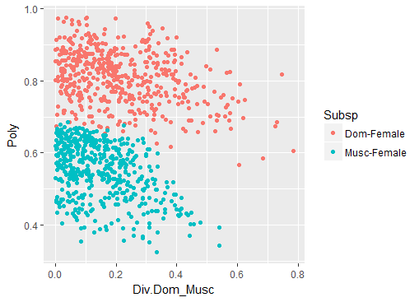
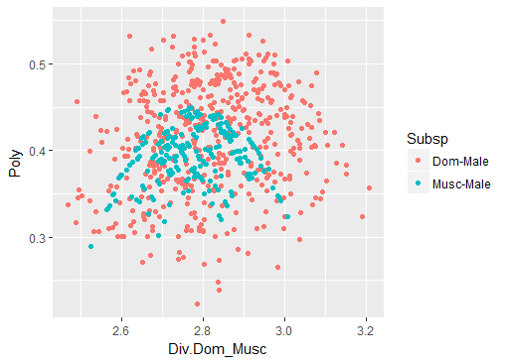
500 P and D points were simulated, from 10 random mice with the strain randomized.
Notes:
500 P and D points were simulated, from 10 random mice with the strain randomized.
Female plot, Dom females have more strains in the sampling, this is likely driving the larger Polymorphism
Male plot, Musc male polymorphism is smaller than Dom male.
The Divergence between Musc and Dom males is at a larger scale than females
Check if these follow the amount of variance

Slide 2
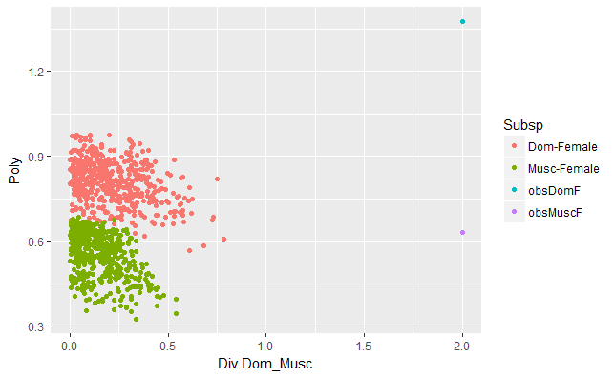
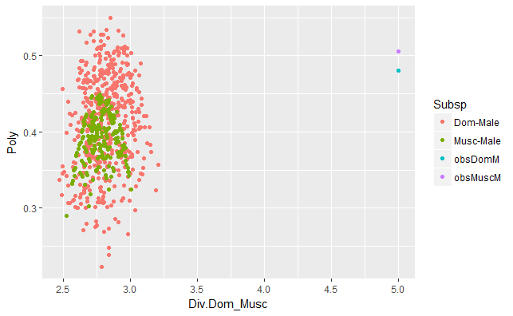

Slide 3
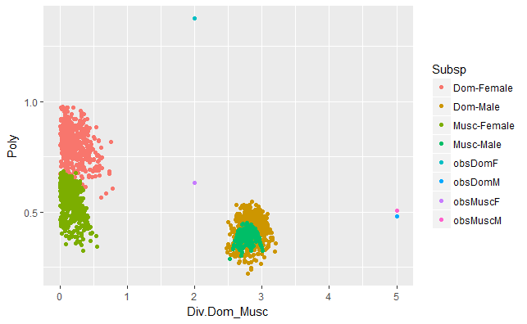

Slide 4
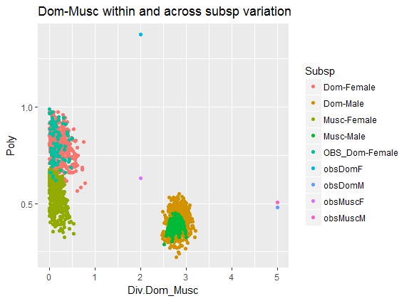
Make a subsampled version, without randomizing strain
Notes:
Add subsampled Dom f values in tourquois. The distribution doesn’t seem different than the randomized points.
But I think that shows that sub-sampling the data affect the distribution.

Slide 5
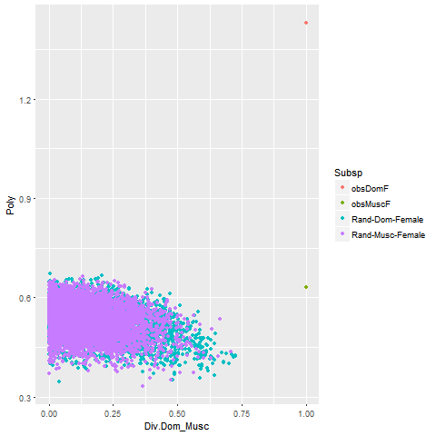
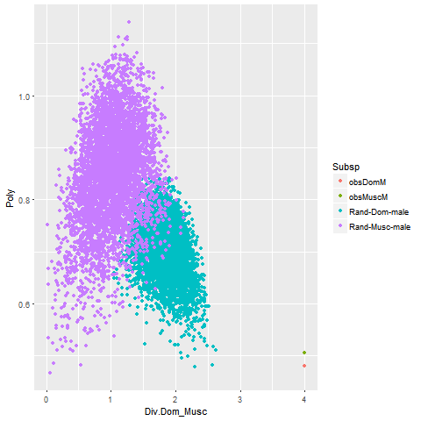
Notes:
Simulations of PnD ratios
Simulated P calculated by drawing a sample(same size of observed data) from pooled data set of female means. Calq the SE of that sample
Simulated D calculated by measuring the SE of the ‘new’/simulated subsp mean AND the other subsp mean.
<interpretations, (assuming it’s right)> (the male P calq is half has large as yesterday’s…)

Slide 6
Sample from within all females
-- what would the distribution look like if I didn’t maintain the groups
-- remember to maintain the ‘data’ structure of the observed data (N mice ect) – make sure that they are comprable

Slide 7
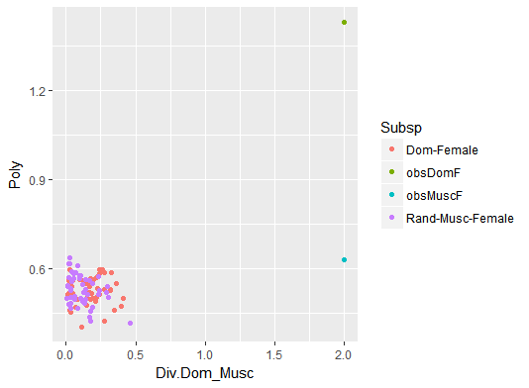
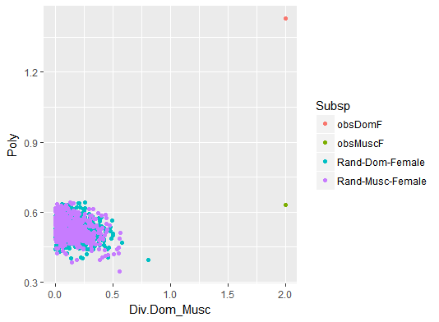
Notes:
When simulated data are drawn from random female pool. Makes more sense that calq for randomized draws overlap. --- especially because they have the same sample size.
I am 70% I calculated the observed values right… but dom female SE seems very high…

Slide 8
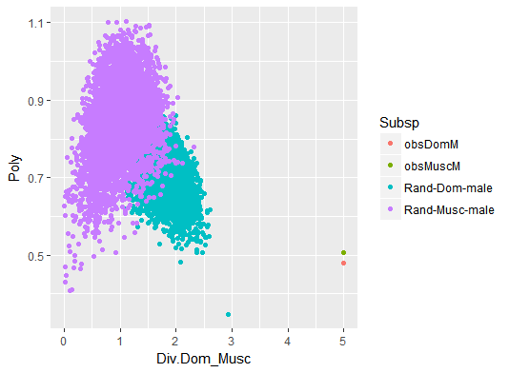

Slide 9
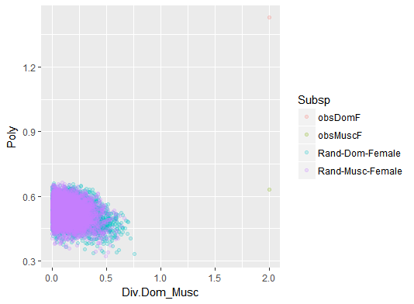
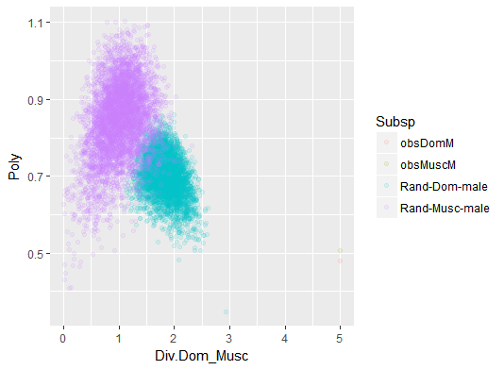
Notes:
Fewer musc male mice could explain the lower polymorphism

Slide 10
(Effects of changing the number of strains in each subsps)
Doms with G-Lew
Doms with Lew-WSB
Doms with WSB-Lew
Make sure to change the number of observations

Slide 11
Use Var instead of SE
Use sd instead of SE

Slide 12
…another form of variation…
Use sd instead of SE

