Slide 1
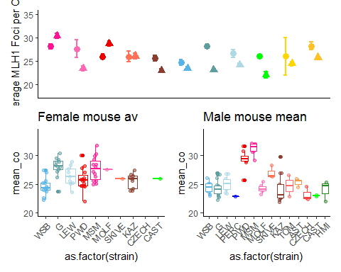
Main MLH1 figure
Notes:
Copy from code

Slide 2
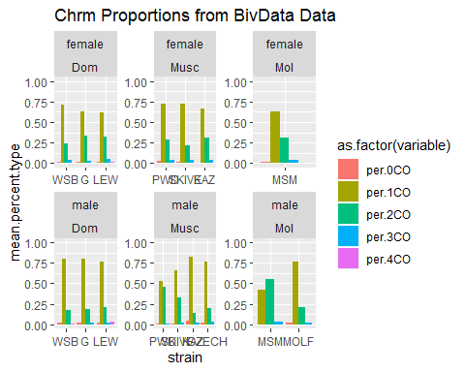
Chromosome Proportion differences

Slide 3
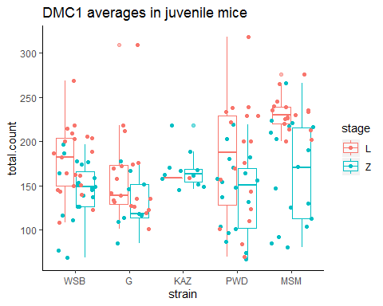
DMC1 results

Slide 4
Position (1CO)

Slide 5
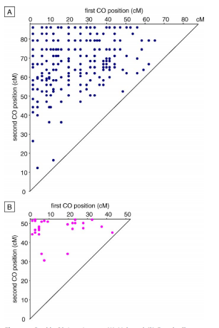
Male
First CO position
Double crossover Chrm4, Arabidopsis thaliana.
Diagonal line, 1:1 values, the shortest interfocal distance (IFD).
Near top corner, longest IFD
Enrichment of longest IFDs
Lack of small IFDs
Second CO position
Female
First CO position
Enrichment of longest IFDs
Drouaud, J., Mercier, R., Chelysheva, L., Bérard, A., Falque, M., Martin, O., ... & Mezard, C. (2007). Sex-specific crossover distributions and variations in interference level along Arabidopsis thaliana chromosome 4. PLoS genetics, 3(6).

Slide 6
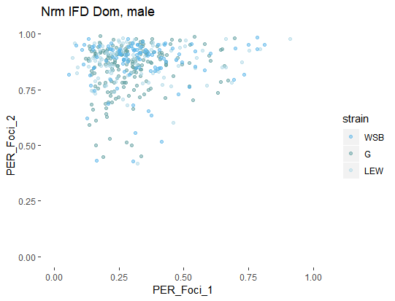
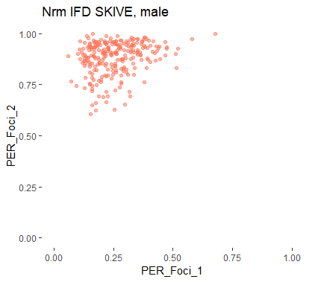
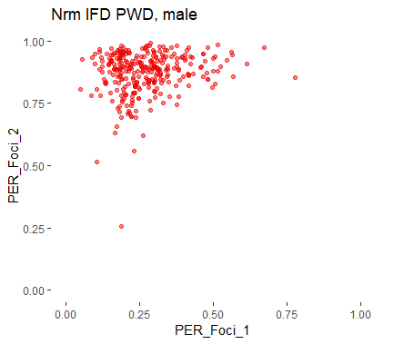
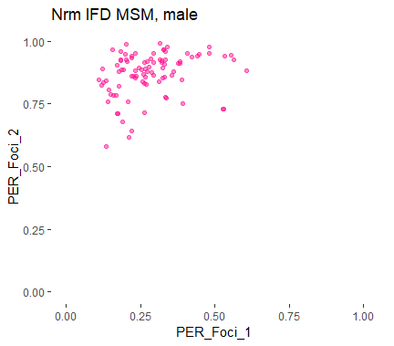
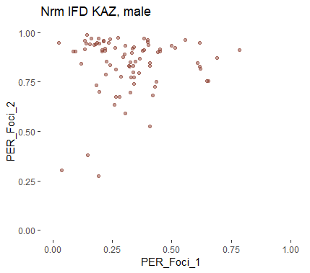
Rapid evolution of interference IFDs
‘normal’ IFD lengths
Significantly longer IFD

Slide 7
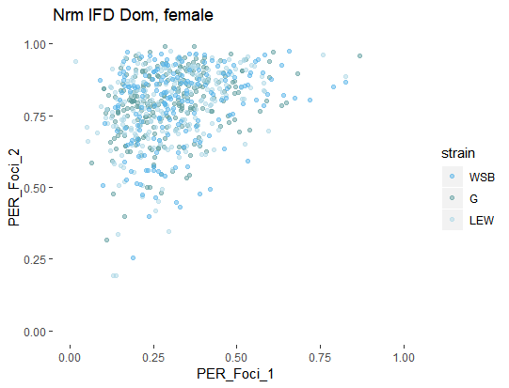
Sex difference in IFD distributions
Notes:
Interference strength examples
(based on Dourad et al (link)
Generic example plot;
Show the difference in IFD length via closeness to diagonal line. Put example
(could try 3 axis for the 3 COs)
Centromere – supression,
Male – female difference – telomere bias (the enriched points around the top of plot
PWD – DOM, differences not quite clear (in contrast to the boxplots)

Slide 8
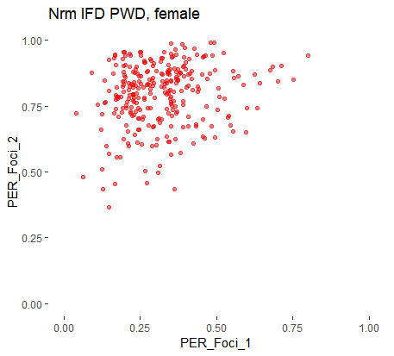
IFD figure
Longer IFD
Shorter IFDs
Notes:
Interference strength examples
(based on Dourad et al (link)
Generic example plot;
Show the difference in IFD length via closeness to diagonal line. Put example
(could try 3 axis for the 3 COs)
Centromere – supression,
Male – female difference – telomere bias (the enriched points around the top of plot
PWD – DOM, differences not quite clear (in contrast to the boxplots)

Slide 9
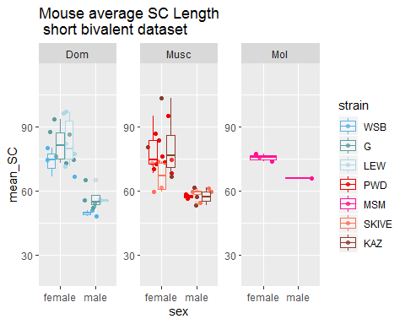
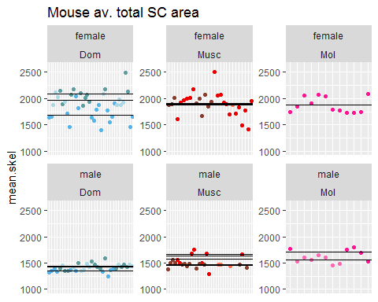
SC length (by chromosome class)

Slide 11
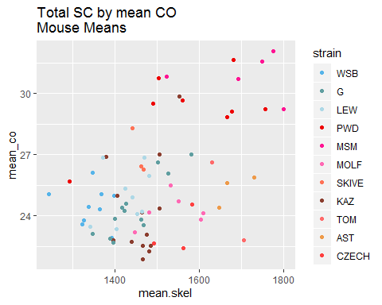
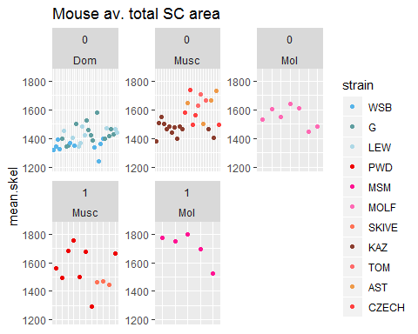
Q2 SC differences

