Slide 1
Payseur Lab Meeting 9.11.19
April Peterson Research Updates

Slide 2
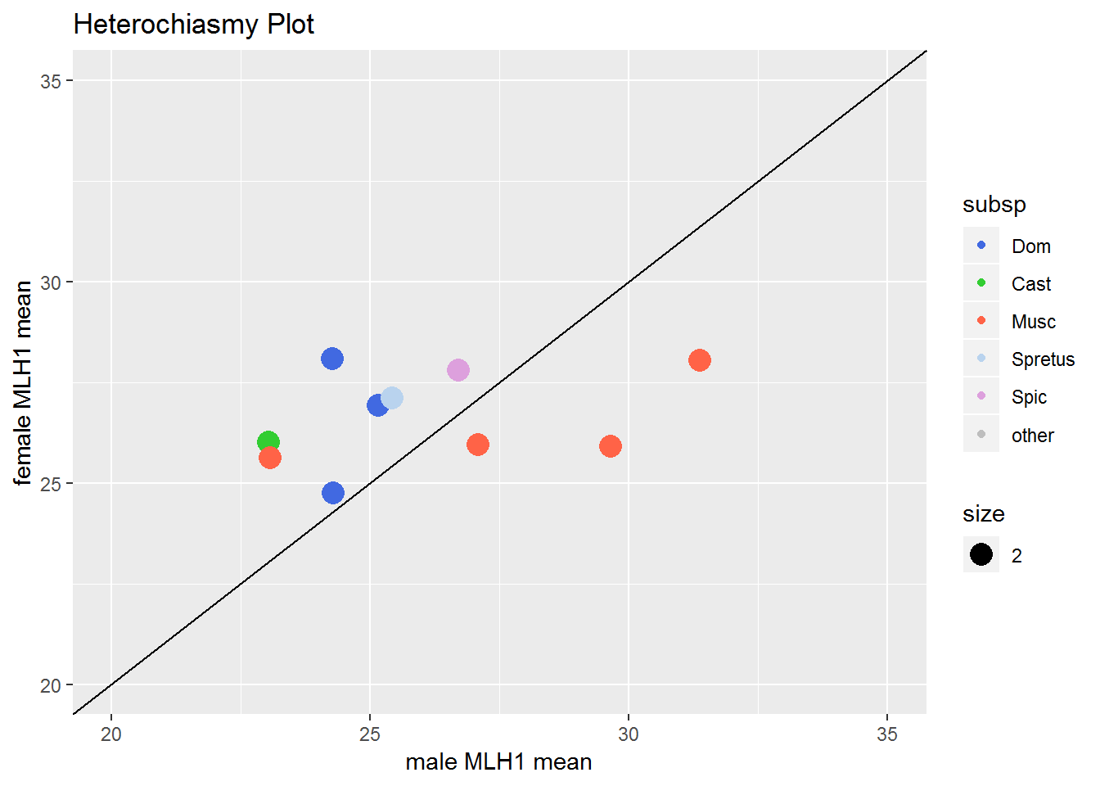
Heterochiasmy patterns across Mus
*male mean MLH1
MSM, 31
PWD,
29
KAZ,
23
SKIVE,
27
How did high RecRate Musc males evolve high RecRate?
1CO → 2CO?
Fewer 0COs?
Notes:
Variation in heterochiasmy patter in musc males
‘polymorphism’ in musc males (that will be the focus)

Slide 3
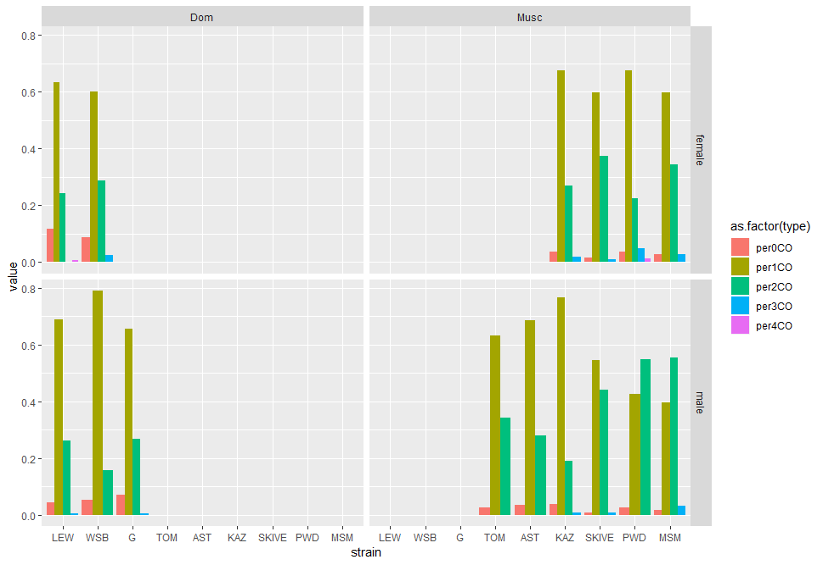
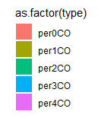
Chromosome class proportions
Dataset
~40 cells
~1000 bivalents scored
-male and female cells
Dom
Musc
Female biased Musc
Male biased Musc
Notes:
Try to order the Musc by CO count (males)
From running a lm on the male data (mean_CO ~ 0co + 1CO + 2CO + 3CO), the 1 and 2 COs were the most significant
(there might have also been a power effect)

Slide 4
Chromosome class proportions
Strain | mice | Av.MLH1 | HetC (F/M) | 0CO | 1CO | 2CO | 3CO
WSB | 10 | 24.3 | 1.02 | 5% | 79% | 16% | 0
LEW | 10 | 24.3 | 1.02 | 4% | 67% | 26% | 0.5%
G | 14 | 24.3 | 1.16 | 7% | 65% | 27% | 0.6%
Strain | mice | Av.MLH1 | HetC (F/M) | 0CO | 1CO | 2CO | 3CO
MSM | 7 | 31.36 | 0.89 | 2% | 39% | 55% | 3%
PWD | 8 | 29.64 | 0.88 | 3% | 42% | 55% | 0
SKIVE | 3 | 27.08 | 0.96 | 0.7% | 54% | 44% | 0.7%
KAZ | 9 | 23.07 | 1.11 | 4% | 76% | 19% | 0.7%
Dom strains have low variation for MLH1 and chromosome class proportions
Musc, High and Low RR strains have distinct proportions
Differences between Dom and high RR Musc males
i. 1CO -> 2CO
ii. fewer 0COs
Notes:
There are more 0COs in the Dom than Musc
There are more 3COs in more Musc
The increase in 2COs in Musc is not seen in females
In Dom females, there are a few more 2COs
(females have more lower proportion of 1COs (and mostly higher proportion of 2COs)– there are more 0COs in females,
The results support the 1CO -> 2CO
In male biased mice, there are more 2COs than 1COs
-what else happened? What facilitated this?
-more SC?
-smaller IFD?
The amount of 2CO chrms kind of track with the mean MLH1 for strains
The KAZ strain – proportions are closer to KAZ
-- the difference in 0COs is more different for Dom

Slide 5
Notes:
Female data, Just in case
Females don’t show the striking amount of variation across subsp

Slide 6
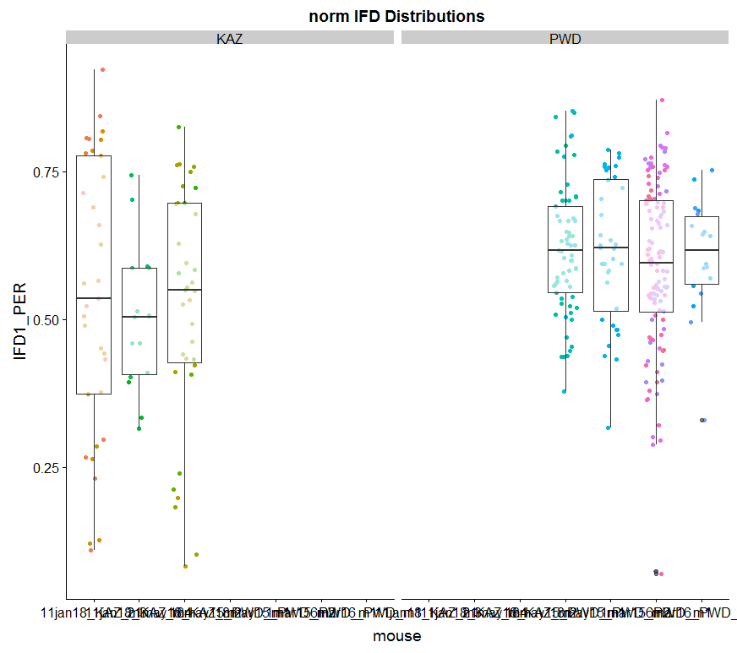
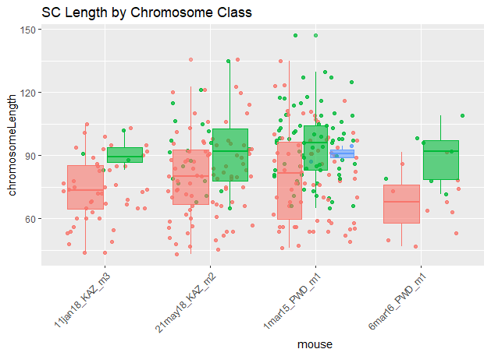
Last time…
Longer bivalents in PWD
Weaker Interference in PWD
KAZ
PWD
KAZ
PWD

Slide 7
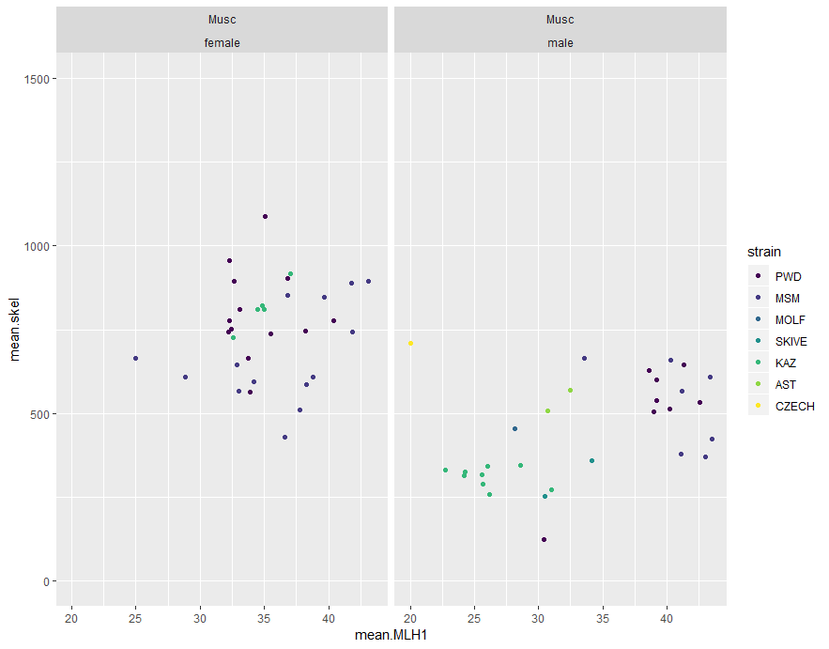
Total SC, mouse averages
Dataset
Current MLH1 dataset
Mouse averages
High RR Musc males have more total SC compared to low RR Musc males
High RR Musc males
Longer axis -> more 2COs, (despite stronger interference?)
Total SC
Wang, Richard J., et al. "A first genetic portrait of synaptonemal complex variation." PLoS genetics 15.8 (2019): e1008337.
Notes:
This code in is main_report.rmd
PWD and MSM have higher SC skel lengths– the mice separate into 2 groups
Looks like skive, molf and kaz have

Slide 9
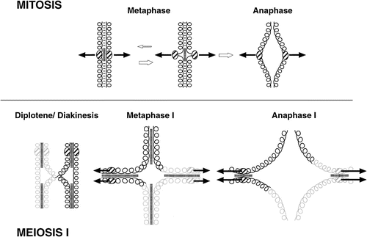
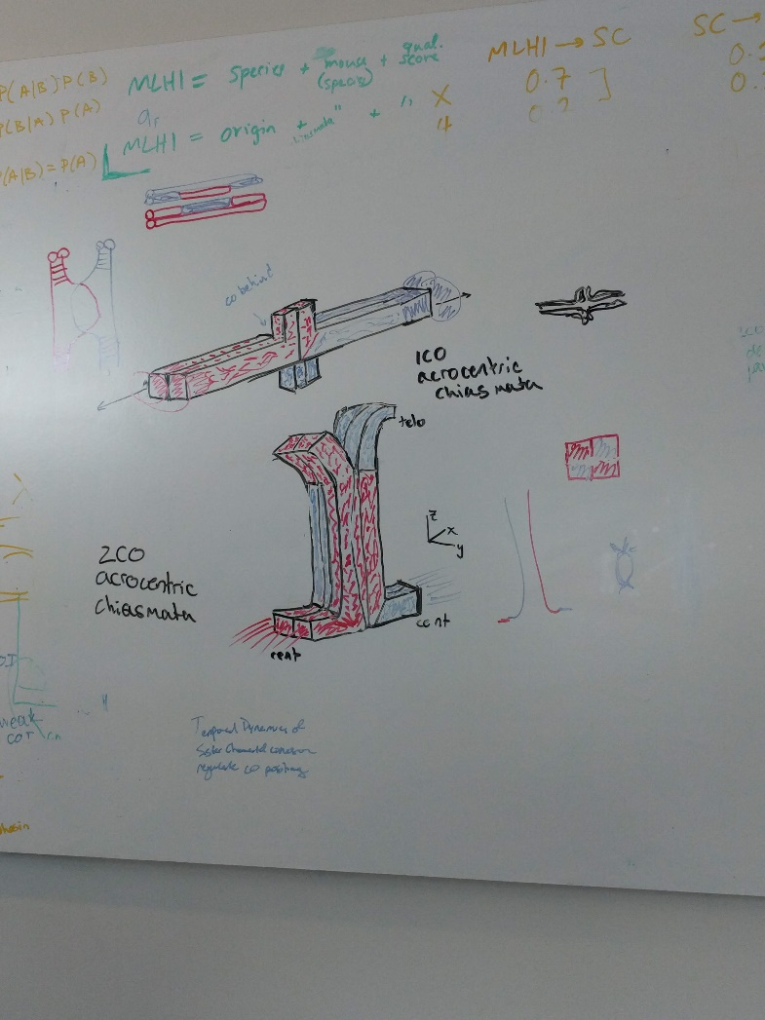
Tension at metaphase modulated by CO number and position
Notes:
puppet

Slide 10
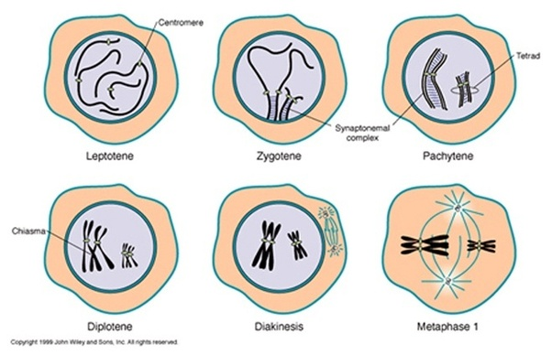
Prophase review

Slide 11
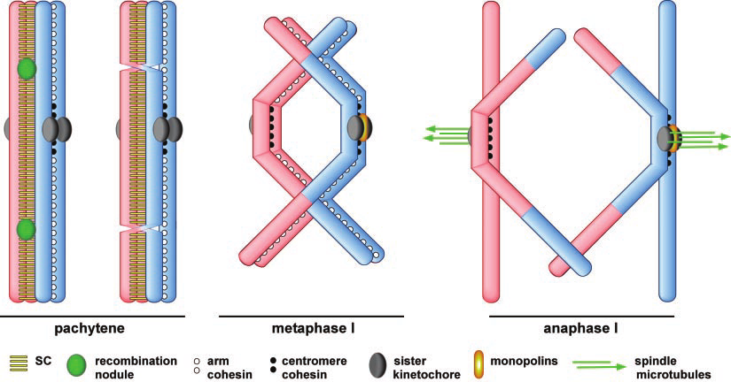
Page, Scott L., and R. Scott Hawley. "Chromosome choreography: the meiotic ballet." Science 301.5634 (2003): 785-789.APA
Notes:
Assumption of bivalent interference (meaning only inside pair of homologous sisters participate in COs
The release of sister chromatid cohesion distal to chiasmata allows homologs to separate.

Slide 12
Sister cohesion tension metric
Assumptions
Bivalent interference: only 2 of 4 chromatids have COs
Uniform condensation across chromatids from pachytene to metaphase
Notes:
From bivalent measures: (intervals for calculating sis-coten)
If bivalent is 2CO: sis-co-ten = IFD
If bivalent is 1CO: sis-co-ten = foci1 to end
If 3CO: sis-co-ten = IFD1 + foci3 to end

Slide 13
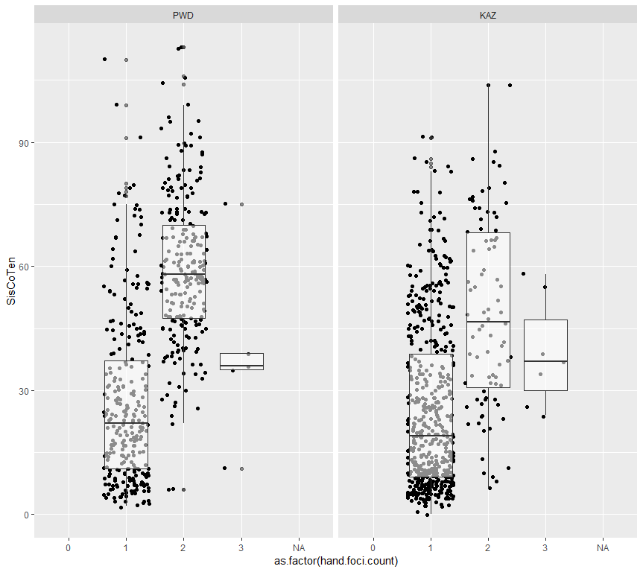
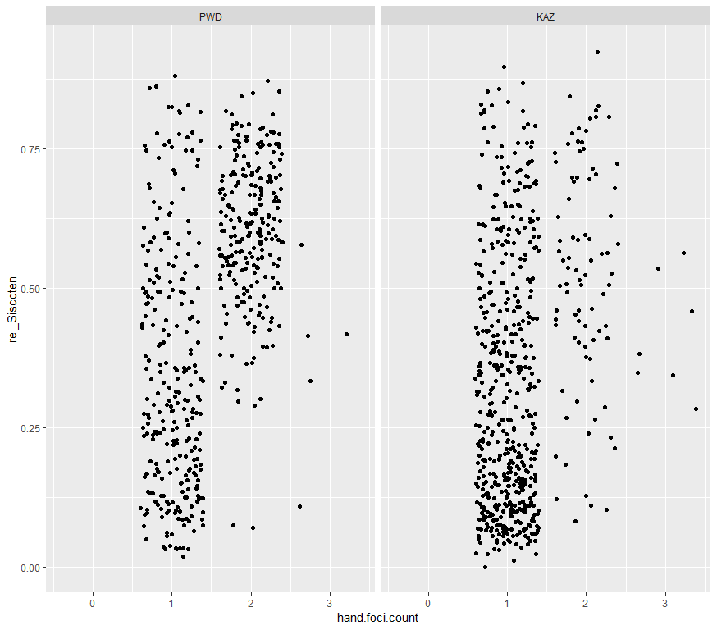
Make relative box
Notes:
siscoten by chromosome class

Slide 14
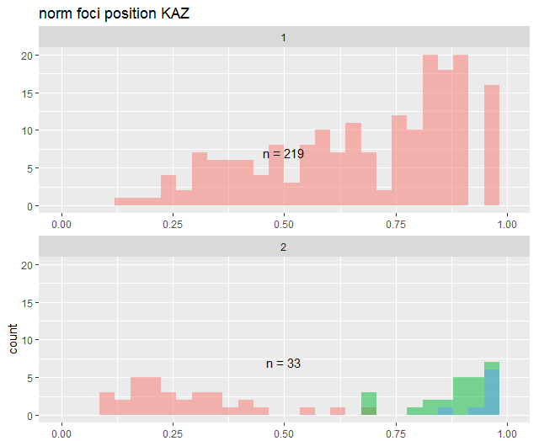
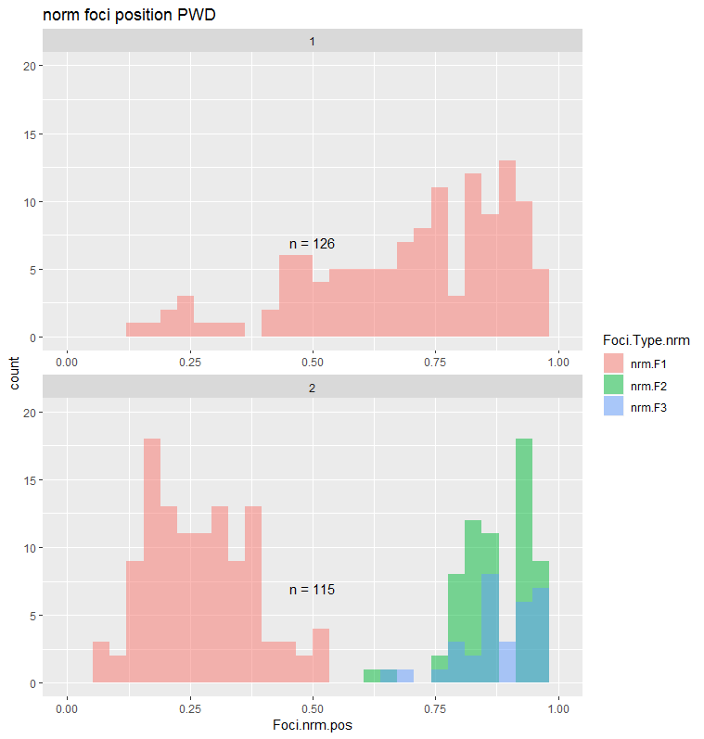
No Difference in Average
Normalized CO Positions
t.test | p.value
1CO | 0.5468
2CO 1st | 0.9421
2CO 2nd | 0.5403
KAZ
PWD

Slide 16
Compare sis-coten with normalized foci positions

Slide 18
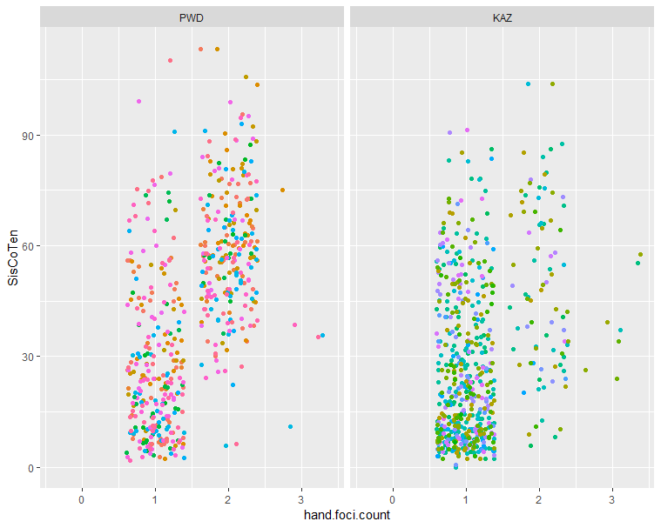
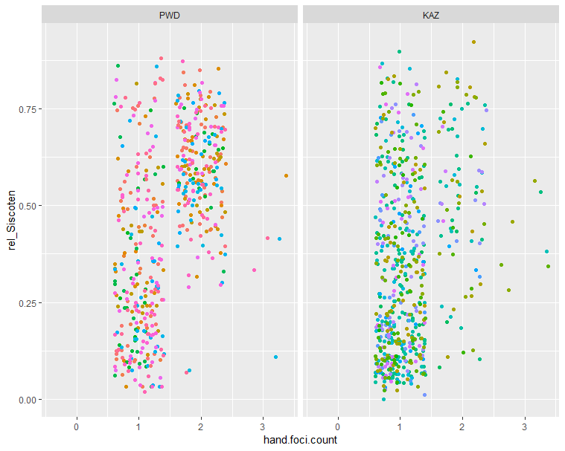
Notes:
PWD has more
It seems like the 2CO bivs in PWD provide more tension compared to KAZ (the average is higher)

Slide 19
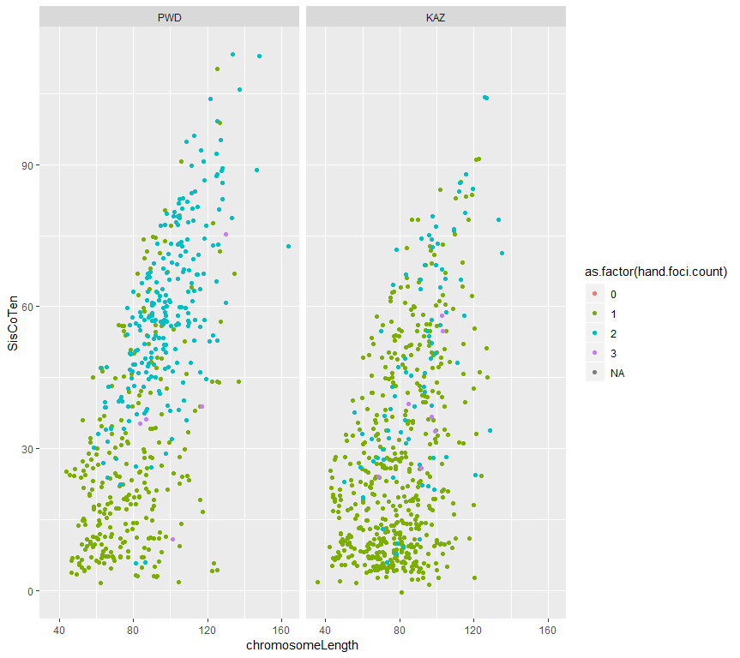

Slide 20
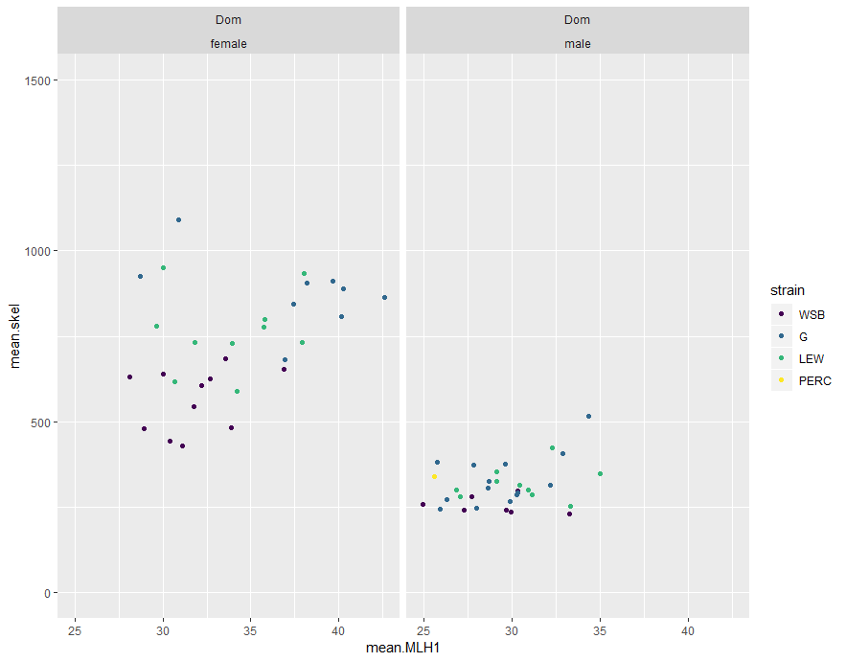

Slide 22
Sister cohesion tension
Notes:
Pactyene SC – the glue holding the chrms together is the SC
Pachtyene – breaks down at diplotyene
Diplotene on wards the glue holding the chrms together are sister cohesin
Because of crossovers – the DNA material changes the centromere / kinetochore it’s attached to.

Slide 23
Musc,
Female biased strain,
More 1COs (similar to Dom
Musc,
2 or 3 male biased, have more 2COs.
Data description,
48 cells
~900 bivalents
Dom,
Mostly 1COs
Low levels of 0COs
Female biased Dom
Male biased Musc
Female biased Musc
Are the proportions significantly different?
0CO
3CO
Notes:
Try to order the Musc by CO count (males)
From running a lm on the male data (mean_CO ~ 0co + 1CO + 2CO + 3CO), the 1 and 2 COs were the most significant
(there might have also been a power effect)

Slide 24
Strain | Passing Male mice | Av.MLH1 | HetC (F/M) | 0CO | 1CO | 2CO | 3CO
WSB | 10 | 24.29150 | 1.019997 | 0.052631579 | 0.7894737 | 0.157894
LEW | 10 | 24.2915 | 1.019974 | 0 0.043062201 | 0.6889952 | 0.2631579 | 0.004784689
G | 14 | 24.27551 | 1.164134 | 0.070175439 | 0.6549708 | 0.2690058 | 0.005847953
Strain | Passing Male mice | Av.MLH1 | HetC (F/M) | 0CO % | 1CO % | 2CO% | 3CO%
PWD | 8 | 29.64198 | 0.8772831 | 0.026548673 | 0.4247788 | 0.5486726 | 0
CZECH* | ~1 | 22 | NA
SKIVE* | 3 | 27.0814 | 0.9577608 | 0.007575758 | 0.5454545 | 0.4393939 | 0.007575758
KAZ | 9 | 23.07292 | 1.110609
TOM | 1 | 26.6 | NA
AST | 2 | 25.78261 | NA

