Slide 1
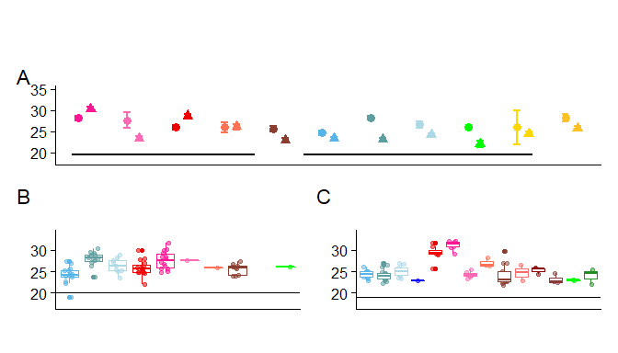
Mus spretus
M. m. molossinus
M. m. musculus
M. m. domesticus
Mus specilegus
Notes:
Figure 1 Mean MLH1 count distributions by strain. A) Strain averages of MLH1 counts per cell. B) Female specific MLH1 count distributions. C) Male specific MLH1 counts per cell. Example stained cells are inset.
*Circles females, triangle male
*Mus - M. Spicilegus!!! Spell check
-question of colors – put color names in legend.

Slide 2
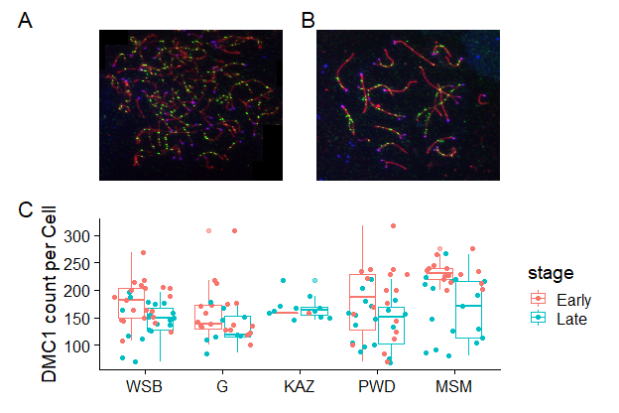
Notes:
Figure 2 Male DSB estimates A) Example early zygotene spermatocyte spread, B) Example late zygotene spermatocyte spread. Green foci show DMC1. C) Distribution of DMC1 counts per cell by strains.
Change the strain names --- to superscript
Add antibody label to text,
Stage -- zygotene

Slide 3
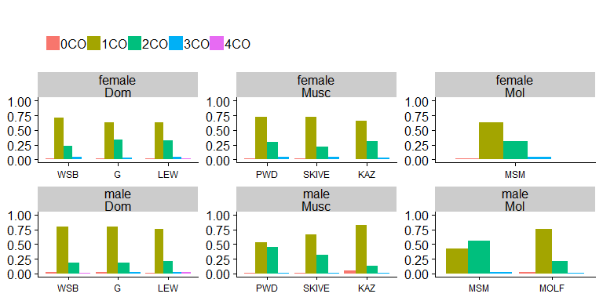
Notes:
Figure 3 Chromosome Class Proportions. Proportions calculated from pooled single bivalent data by strain.
*change to supplemental figure
*change strain names!! And subspecies (M.m. musculus)

Slide 4
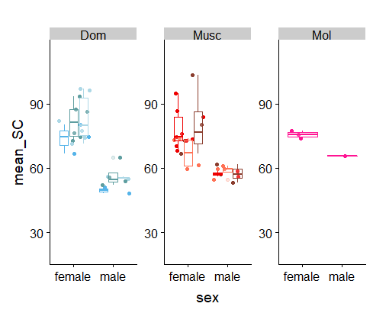
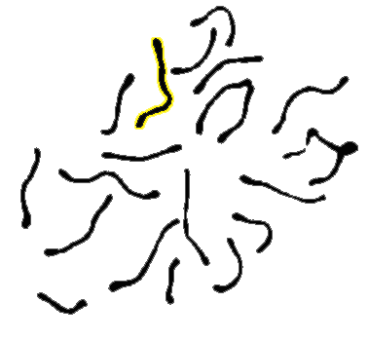
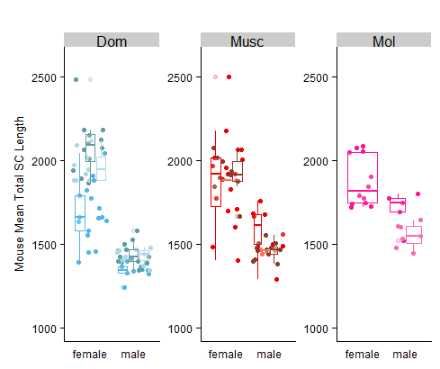
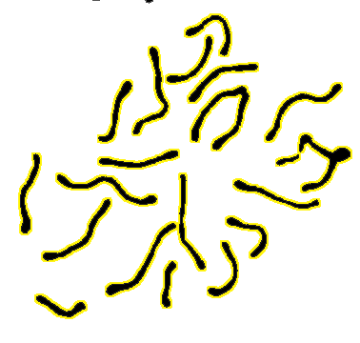
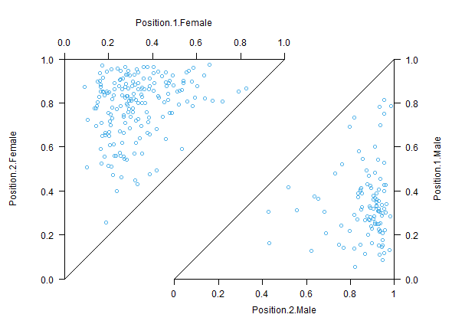
A.
B.
C.
D.
♀
Area of shortest IFDs
♀
1. Female more uniform placement.
2. Male strong terminal placement of second foci.
3. Enrichment of long IFD, few short IFD.
1st Foci Position
2nd Foci Position
Area of longest IFDs
1st Foci Position
♂
2nd Foci Position
♂
Notes:
Figure 4 Sex Differences in meiotic traits A) Mouse averages of short bivalents. B) Mouse averages of total SC area per cell. (explain outline)
C) Example of interpretations for IFD-Foci location. Female plots shown in top triangle, male plots shown in bottom triangle.
D) Sex differences in IFD distribution for one strain. Main patterns of sexual dimorphism for IFD distributions.
Merge – C and D
*Foci -> Foucus
*remove text box
0change subspecies names
axis lable – short bivalents B) axis ‘total SC’ in legend state mouse mean

Slide 5
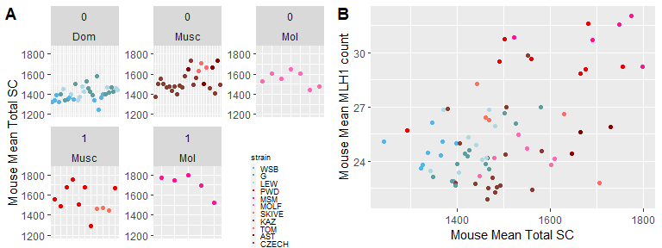
Notes:
Figure 5 SC length metrics in male mice. A) Mouse averages for total SC area per cell. B) Relationship of mean MLH1 counts and mean SC area per mouse. Colors are the same as in A.
Variation in total SC area per cell across strains and Relationship between total sc and mean MLH1 count per cell across male mice. A) Mean total SC area per mouse across subspecies and recombination groups. High- and low-recombining groups are indicated by 1 and 0 respectively. (Horizontal lines indicate strain averages for total SC area.)B) Mouse averaged rates of MLH1 and total SC per cell
--remove this figure // just use A – make a supplemental figure
--Change 1 and 0 to high and low recombining
-remove grey background
-remove strain legend
Q2 – just show traits which whow pattern

Slide 6
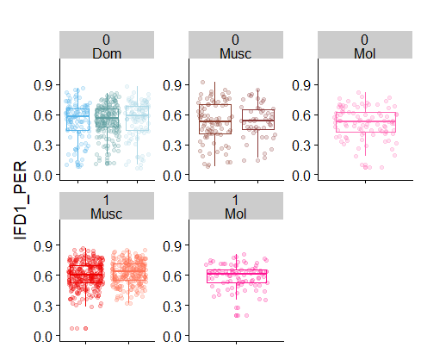
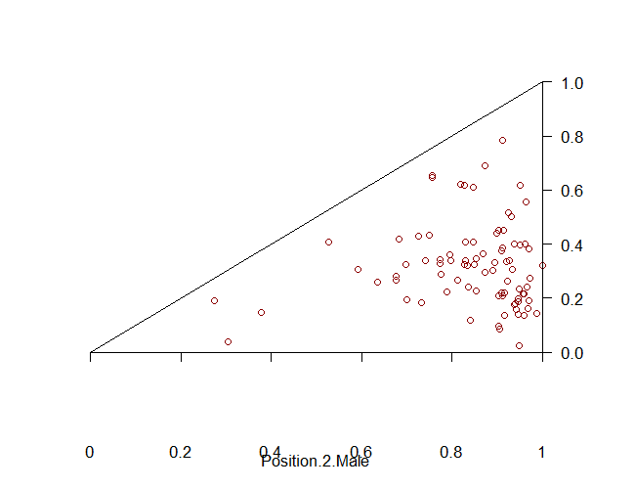
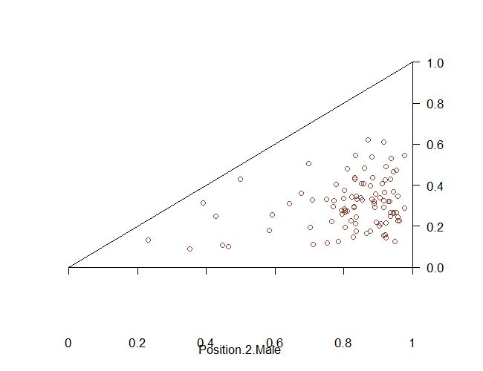
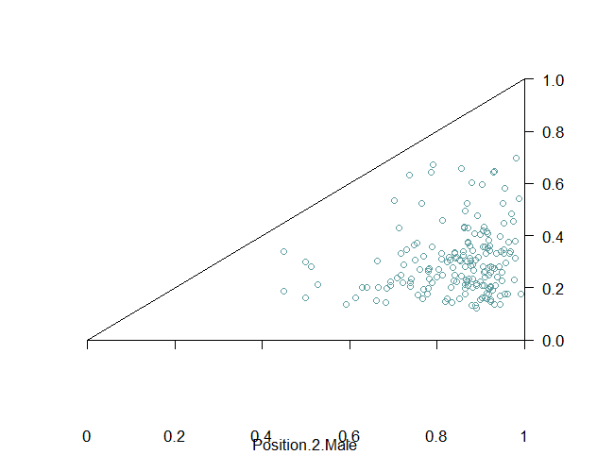
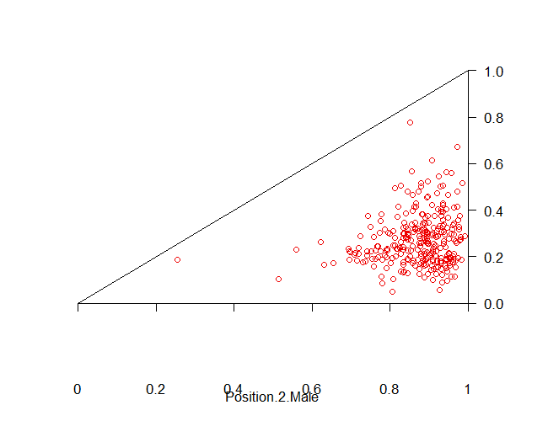
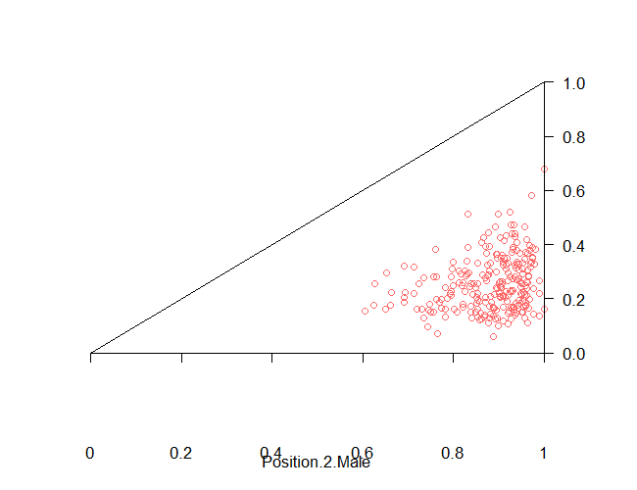
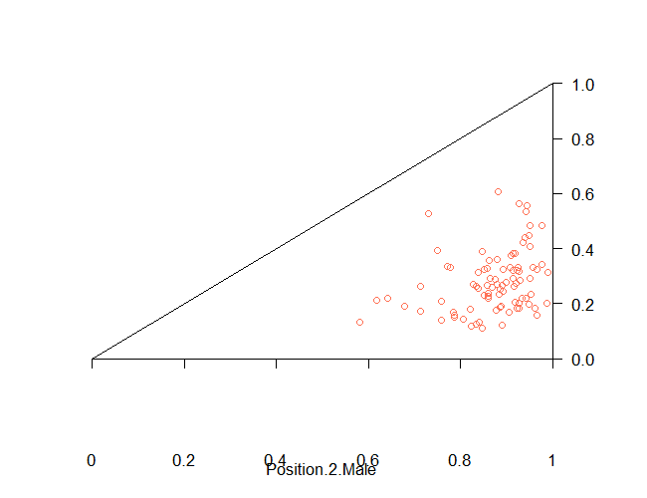
A.
B.
M. m. musculus
M. m. molossinus
M. m. domesticus
Low recombining strains
High recombining strains
Notes:
Figure 6 Evolution of IFD is associated with gwRR evolution. A) Distributions of IFD-foci position for males. B) Boxplots of IFD, high- and low- recombining strains denoted by 1 and 0 respectively.
“High-recombination”
High – longer and consistently longer
-add boxes around subspecies columns
Remove B?
Add male symbol

Slide 7
Model | Reverse heterochiasmy direction Male > Female gwRR | Within mouse variance for CO number Eggs more variable than sperm in crossover per cell | Broad Scale Recombination Landscape Male telomere bias, Female uniform placement | Chromatin Compaction Female, longer axis Male, shorter axis | Evolution of positive correlation interference strength and CO number
Haploid selection (Lenormand, 2003; Lenormand and Dutheil, 2005) | No Generally males should evolve lower gwRR. | NA | NA No prediction for broad scale recombination landscape. | NA No prediction for chromosome axis. | NA
Two locus modifier (Brandvain and Coop, 2012) | Yes Depends on if rec. modifier: i) suppresses or increases recombination, ii) linked to driving loci, iii) the stage in which the driver acts (MI or MII) | NA | Yes Females will evolve higher RR and COs closer to centromeres to break up MI drive systems. | NA No prediction for chromosome axis. | NA
S.A.C.E. (Sardell and Kirkpatrick, 2020) | No Males should evolve to be lower gwRR. | Yes Maintaining regulatory and coding regions together lowers between cell variance in males. | Yes Maintaining larger blocks of chromosomes positions crossovers to telomeres. | NA No prediction for chromosome axis. | Yes Stronger interference is equivalent to larger blocks of chromosomes segregation together.
MI Spindle based selection (Altendorfer et al., 2020; Dernburg, 2001; Lee, 2019; van Veen and Hawley, 2003) | Yes More effective checkpoint (SAC) will cause faster evolution in males relative to females. | Yes Relaxed selection on SAC would increases variance across oocytes relative to spermatocytes. | Yes Telomere position of single crossover chromosomes maximizes sister cohesion with tension and may synchronize division of bivalents. | NA No prediction for chromosome axis. | Yes Amount of sister cohesion could: i) stabilize bivalents and allow SAC to detect tension or ii) regulate the timing of entry into anaphase via modulating the rate of degradation of the sister cohesion.
Pairing based selection, C.O.M. (Hultén, 2011) | NA No evolution predictions. | NA No prediction for between gamete variance. | Yes Difference of interference in sexes is due to axis length differences. | Yes Longer female axis driven by larger cell volume. | No No prediction for reduction phase.
Notes:
Table X. Comparison of results from to models of heterochiasmy and recombination rate evolution.
References:
Altendorfer, E., Láscarez-Lagunas, L.I., Nadarajan, S., Mathieson, I., and Colaiácovo, M.P. (2020). Crossover Position Drives Chromosome Remodeling for Accurate Meiotic Chromosome Segregation. Curr. Biol.
Brandvain, Y., and Coop, G. (2012). Scrambling eggs: meiotic drive and the evolution of female recombination rates. Genetics 190, 709–723.
Dernburg, A.F. (2001). Here, there, and everywhere: kinetochore function on holocentric chromosomes. J. Cell Biol. 153, F33–F38.
Hultén, M.A. (2011). On the origin of crossover interference: A chromosome oscillatory movement (COM) model. Mol. Cytogenet. 4, 10.
Lee, J. (2019). Is age-related increase of chromosome segregation errors in mammalian oocytes caused by cohesin deterioration? Reprod. Med. Biol.
Lenormand, T. (2003). The evolution of sex dimorphism in recombination. Genetics 163, 811–822.
Lenormand, T., and Dutheil, J. (2005). Recombination difference between sexes: a role for haploid selection. PLoS Biol. 3, e63.
Sardell, J.M., and Kirkpatrick, M. (2020). Sex Differences in the Recombination Landscape. Am. Nat. 195, 361–379.
van Veen, J.E., and Hawley, R.S. (2003). Meiosis: when even two is a crowd. Curr. Biol. 13, R831–R833.

Slide 8
Species | SubSpecies | Strain | Sex | Number of Mice | Number of Cells | Mean MLH1 Count | se | cV | var
M. musculus | M. m. domesticus | WSB | female | 14 | 184 | 24.70 | 0.27 | 14.64 | 13.07
 |  |  | male | 11 | 222 | 23.38 | 0.18 | 11.48 | 7.21
 |  | G | female | 12 | 318 | 28.21 | 0.24 | 14.84 | 17.52
 |  |  | male | 18 | 355 | 23.16 | 0.14 | 11.35 | 6.92
 |  | LEW | female | 9 | 147 | 26.59 | 0.40 | 18.16 | 23.31
 |  |  | male | 10 | 253 | 24.16 | 0.20 | 12.84 | 9.62
 | M. m. musculus | PWD | female | 15 | 222 | 25.98 | 0.25 | 14.41 | 14.01
 |  |  | male | 8 | 161 | 28.67 | 0.25 | 10.90 | 9.76
 |  | SKIVE | female | 1 | 32 | 25.94 | 0.55 | 12.07 | 9.80
 |  |  | male | 3 | 86 | 26.08 | 0.29 | 10.41 | 7.37
 |  | KAZ | female | 9 | 184 | 25.63 | 0.30 | 15.63 | 16.04
 |  |  | male | 13 | 264 | 22.99 | 0.19 | 13.16 | 9.15
 | M. m. molossinus | MSM | female | 14 | 300 | 28.12 | 0.25 | 15.64 | 19.35
 |  |  | male | 7 | 166 | 30.37 | 0.24 | 10.26 | 9.71
 |  | MOLF | female | 1 | 21 | 27.62 | 0.92 | 15.34 | 17.95
 |  |  | male | 6 | 119 | 23.42 | 0.23 | 10.80 | 6.40
Mus spertus |  | SPRET | female | 2 | 2 | 26.00 | 2.00 | 10.88 | 8.00
 |  |  | male | 5 | 103 | 24.43 | 0.25 | 10.23 | 6.25
Mus spicilegus |  | SPIC | female | 6 | 97 | 28.24 | 0.45 | 15.63 | 19.47
 |  |  | male | 4 | 133 | 25.77 | 0.24 | 10.78 | 7.72
Notes:
Table 1. MLH1 count statistics.
Table 2. DMC1 count statistics.

