Slide 1
Payseur Lab Meeting 9.11.19
April Peterson Research Updates

Slide 2
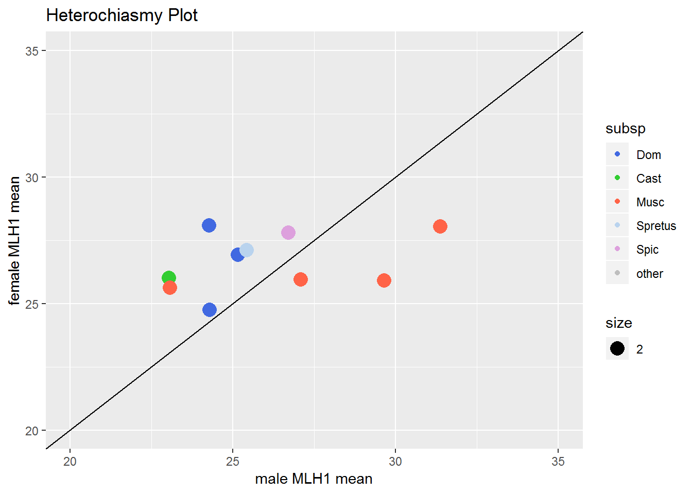
Heterochiasmy patterns across Mus
*male mean MLH1
MSM, 31
PWD,
29
KAZ,
23
SKIVE,
27
How did high RecRate Musc males evolve high RecRate?
1CO → 2CO?
Fewer 0COs?
Notes:
Variation in heterochiasmy patter in musc males
‘polymorphism’ in musc males (that will be the focus)

Slide 3
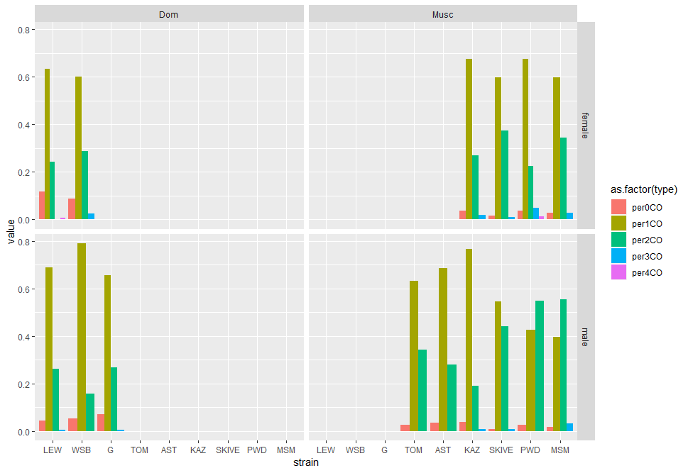
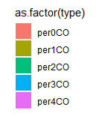
Chromosome class proportions
Dataset
~40 cells
~1000 bivalents scored
-male and female cells
Dom
Musc
Female biased Musc
Male biased Musc
Notes:
Try to order the Musc by CO count (males)
From running a lm on the male data (mean_CO ~ 0co + 1CO + 2CO + 3CO), the 1 and 2 COs were the most significant
(there might have also been a power effect)

Slide 4
Chromosome class proportions
Strain | mice | Av.MLH1 | HetC (F/M) | 0CO | 1CO | 2CO | 3CO
WSB | 10 | 24.3 | 1.02 | 5% | 79% | 16% | 0
LEW | 10 | 24.3 | 1.02 | 4% | 67% | 26% | 0.5%
G | 14 | 24.3 | 1.16 | 7% | 65% | 27% | 0.6%
Strain | mice | Av.MLH1 | HetC (F/M) | 0CO | 1CO | 2CO | 3CO
MSM | 7 | 31.36 | 0.89 | 2% | 39% | 55% | 3%
PWD | 8 | 29.64 | 0.88 | 3% | 42% | 55% | 0
SKIVE | 3 | 27.08 | 0.96 | 0.7% | 54% | 44% | 0.7%
KAZ | 9 | 23.07 | 1.11 | 4% | 76% | 19% | 0.7%
Dom strains have low variation for MLH1 and chromosome class proportions
Musc, High and Low RR strains have distinct proportions
Differences between Dom and high RR Musc males
i. 1CO -> 2CO
ii. fewer 0COs
Notes:
There are more 0COs in the Dom than Musc
There are more 3COs in more Musc
The increase in 2COs in Musc is not seen in females
In Dom females, there are a few more 2COs
(females have more lower proportion of 1COs (and mostly higher proportion of 2COs)– there are more 0COs in females,
The results support the 1CO -> 2CO
In male biased mice, there are more 2COs than 1COs
-what else happened? What facilitated this?
-more SC?
-smaller IFD?
The amount of 2CO chrms kind of track with the mean MLH1 for strains
The KAZ strain – proportions are closer to KAZ
-- the difference in 0COs is more different for Dom

Slide 5
Notes:
Female data, Just in case
Females don’t show the striking amount of variation across subsp

Slide 6
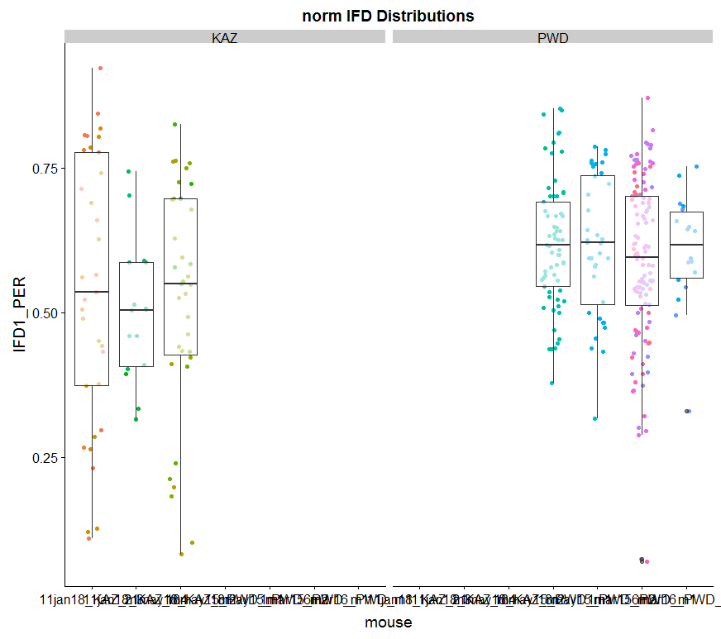
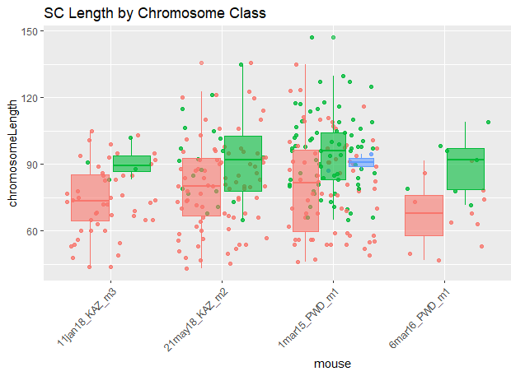
Last time…
Longer bivalents in PWD
Weaker Interference in PWD
KAZ
PWD
KAZ
PWD

Slide 7
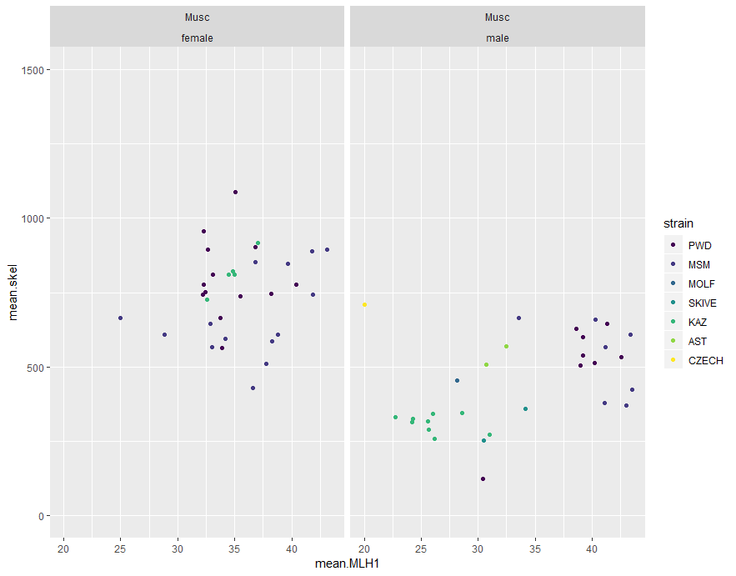
Total SC mouse averages
Dataset
Current MLH1 dataset
Mouse averages
High RR Musc males have more total SC compared to low RR Musc males
Total SC
Wang, Richard J., et al. "A first genetic portrait of synaptonemal complex variation." PLoS genetics 15.8 (2019): e1008337.
Notes:
This code in is main_report.rmd
PWD and MSM have higher SC skel lengths– the mice separate into 2 groups
Looks like skive, molf and kaz have

Slide 8
Part II / trying to fit everything together…

Slide 9
Fitting everything together in constraint context…
Higher RR (musc males)
-more 2CO
-longer SC (biv and total)
*weaker Interferenece*
-- reflects constraint on sister cohesin tension
sister cohesin
Centromere suppression?
Map / show centromere
Notes:
Still a constraint in Dom males (and outgroups)
But it is different in Musc
High RR Musc males elevated gwRR due to more 2COs bivalents?
How? (different constraints)?
More SC
Less space
More DSBs
(motivation for measuring total SC) (total SC is good supplement for my bivalent data (it misses a lot of bivalents)

Slide 10
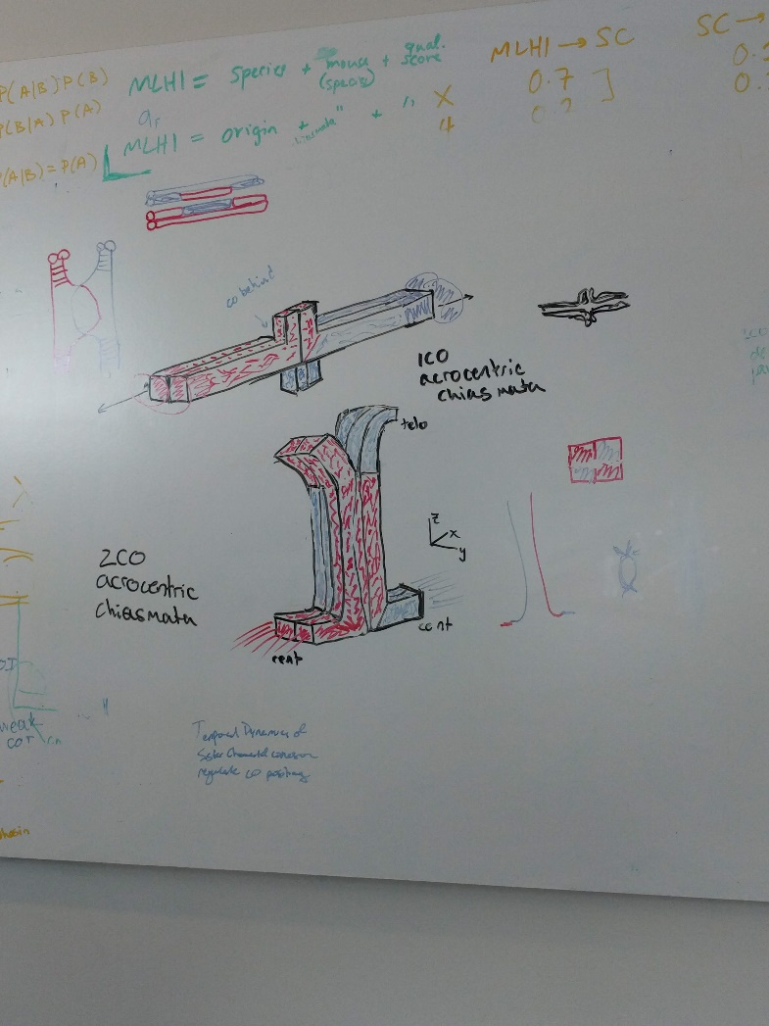
Bivalents at Metaphase
(lets think about the consequences / outcomes of CO number and position at metaphase)
Sister cohesin is the glue maintains helps the tension when kinetochore attaches to spindle.
Notes:
Pactyene SC – the glue holding the chrms together is the SC
Pachtyene – breaks down at diplotyene
Diplotene on wards the glue holding the chrms together are sister cohesin
Because of crossovers – the DNA material changes the centromere / kinetochore it’s attached to.

Slide 11
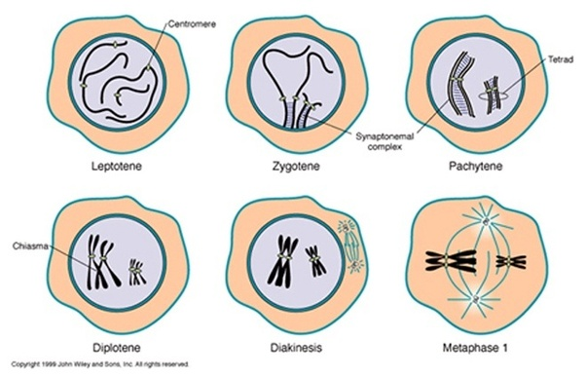
Prophase review

Slide 12
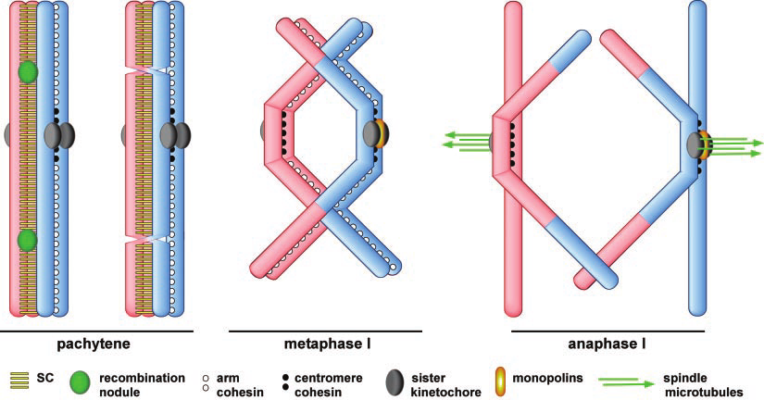
sister cohesion generated tension as a constraint
Page, Scott L., and R. Scott Hawley. "Chromosome choreography: the meiotic ballet." Science 301.5634 (2003): 785-789.APA
Notes:
Assumption of bivalent interference (meaning only inside pair of homologous sisters participate in COs
The release of sister chromatid cohesion distal to chiasmata allows homologs to separate.

Slide 13
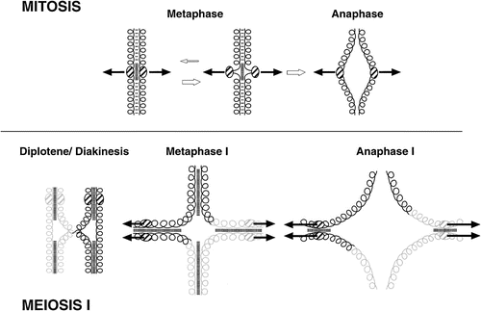
Sis-co-ten modulated by CO number and position
Notes:
puppet

Slide 14
Sis-co-ten as constraint
This value should be consistent across bivalents of similar size
Across cells and individuals
Assumptions
Uniform/ equivalent condensation of chromatids
Bivalent interference- only 2 of 4 chromatids have COs
Conserved / Same astral / MT tension force
(expected patterns)
Notes:
Example of non-proportional condensation
Metacentric chrm -- 1

Slide 15
Results?
From bivalent measures: (intervals for calculating sis-coten)
If bivalent is 2CO: sis-co-ten = IFD
If bivalent is 1CO: sis-co-ten = foci1 to end
If 3CO: sis-co-ten = IFD1 + foci3 to end

Slide 16
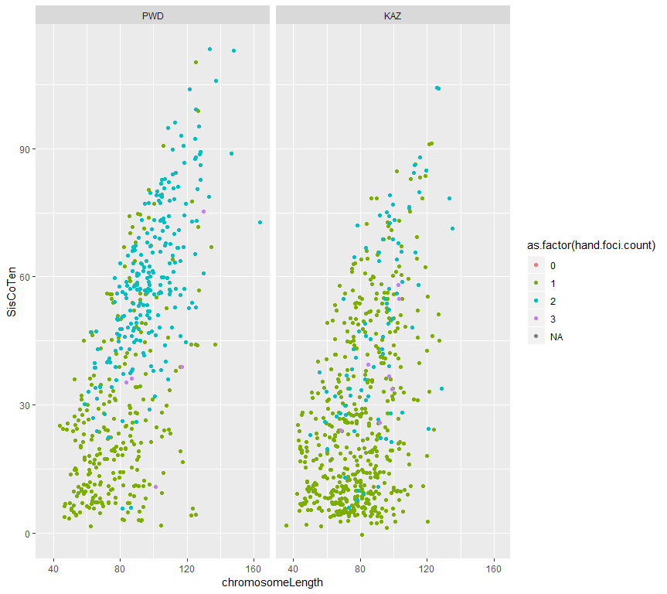

Slide 17
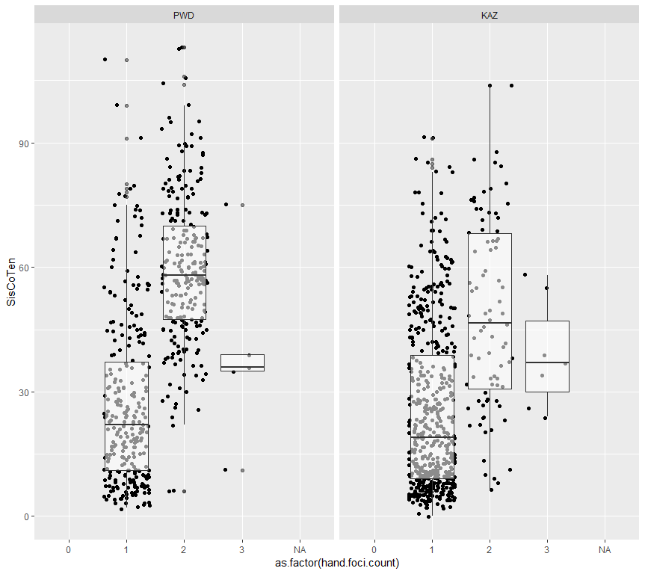
Notes:
siscoten by chromosome class

Slide 18
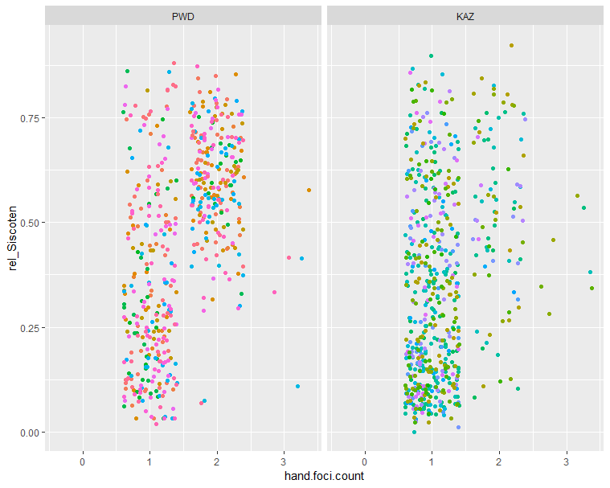
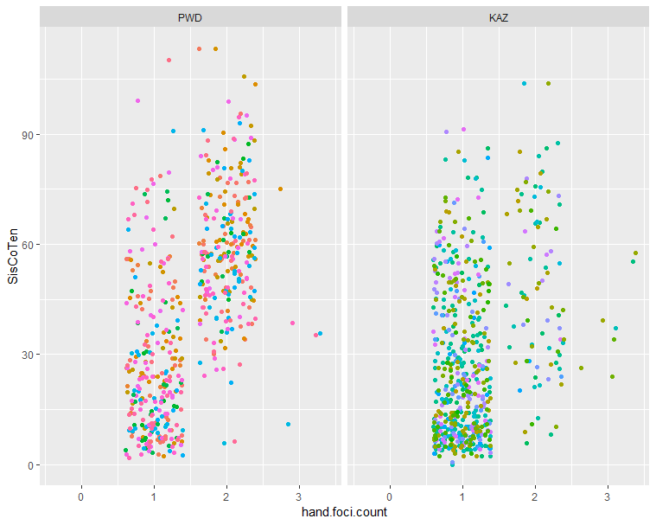
Notes:
PWD has more
It seems like the 2CO bivs in PWD provide more tension compared to KAZ (the average is higher)

Slide 19
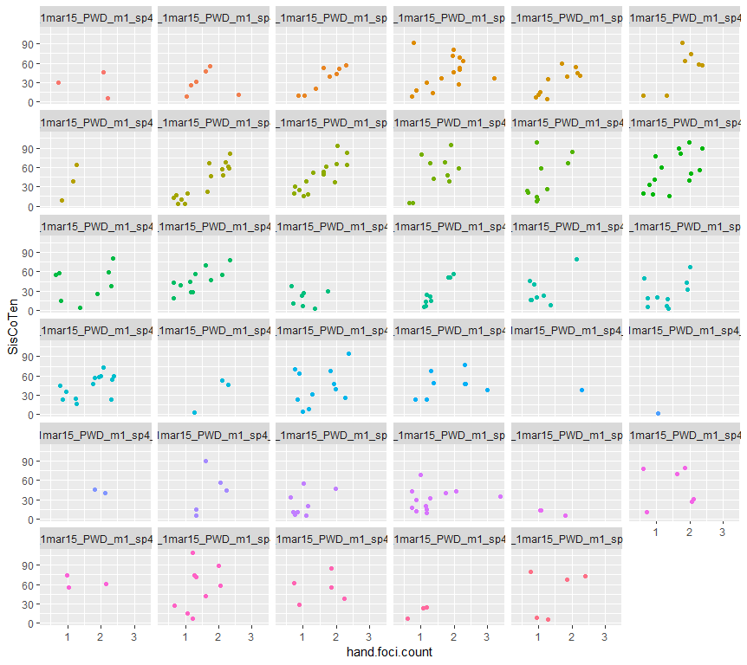
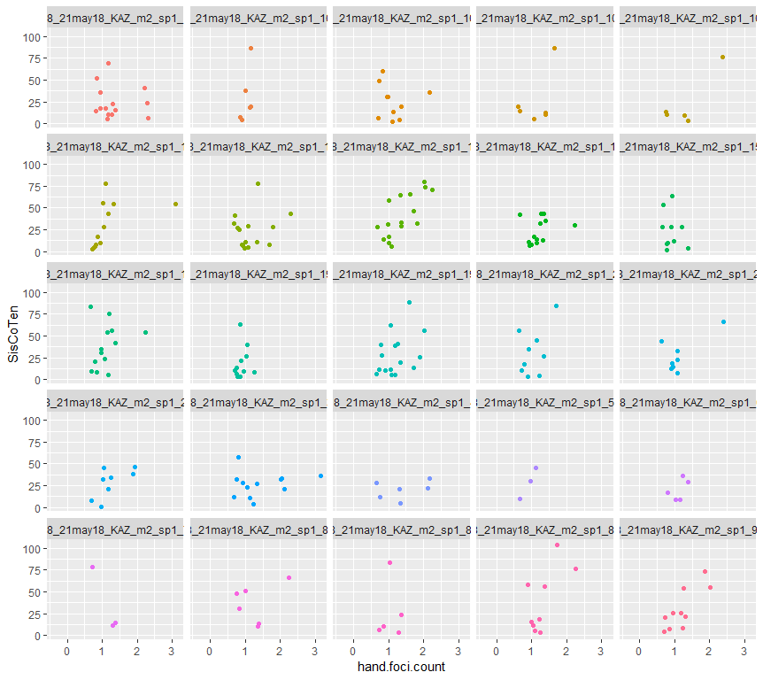

Slide 20
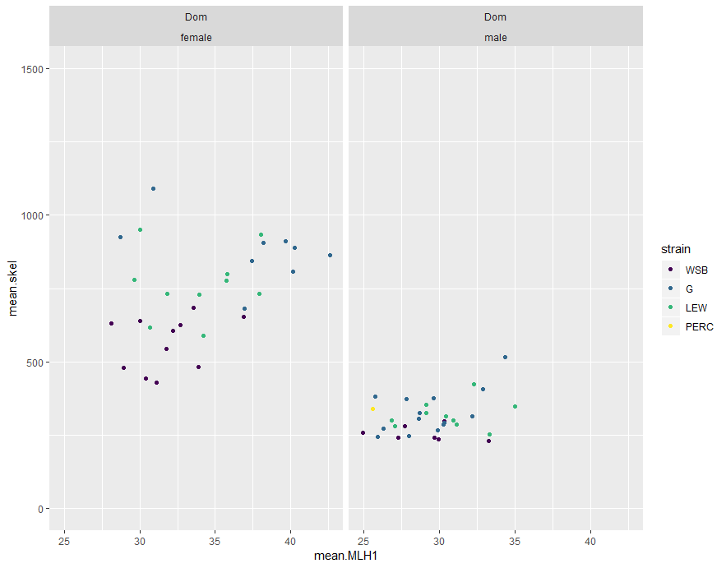

Slide 22
Musc,
Female biased strain,
More 1COs (similar to Dom
Musc,
2 or 3 male biased, have more 2COs.
Data description,
48 cells
~900 bivalents
Dom,
Mostly 1COs
Low levels of 0COs
Female biased Dom
Male biased Musc
Female biased Musc
Are the proportions significantly different?
0CO
3CO
Notes:
Try to order the Musc by CO count (males)
From running a lm on the male data (mean_CO ~ 0co + 1CO + 2CO + 3CO), the 1 and 2 COs were the most significant
(there might have also been a power effect)

Slide 23
Strain | Passing Male mice | Av.MLH1 | HetC (F/M) | 0CO | 1CO | 2CO | 3CO
WSB | 10 | 24.29150 | 1.019997 | 0.052631579 | 0.7894737 | 0.157894
LEW | 10 | 24.2915 | 1.019974 | 0 0.043062201 | 0.6889952 | 0.2631579 | 0.004784689
G | 14 | 24.27551 | 1.164134 | 0.070175439 | 0.6549708 | 0.2690058 | 0.005847953
Strain | Passing Male mice | Av.MLH1 | HetC (F/M) | 0CO % | 1CO % | 2CO% | 3CO%
PWD | 8 | 29.64198 | 0.8772831 | 0.026548673 | 0.4247788 | 0.5486726 | 0
CZECH* | ~1 | 22 | NA
SKIVE* | 3 | 27.0814 | 0.9577608 | 0.007575758 | 0.5454545 | 0.4393939 | 0.007575758
KAZ | 9 | 23.07292 | 1.110609
TOM | 1 | 26.6 | NA
AST | 2 | 25.78261 | NA

