Slide 1
Our Pricing
Percentage of Ad Spend
MANAGEMENT FEE
VARIABLE FEE
20% up to $30k 15% from $30k-$60k 10% above $60k
MINIMUM FEE
$1,500 per platform
MONTHLY CAP
$15,000 maximum
ONBOARDING
$1,500 per platform
The $1,500 minimum fee per platform acts as a floor, covering your first $7,500 in ad spend. Once you spend over $7,500, the 20% rate naturally takes over.

Slide 2
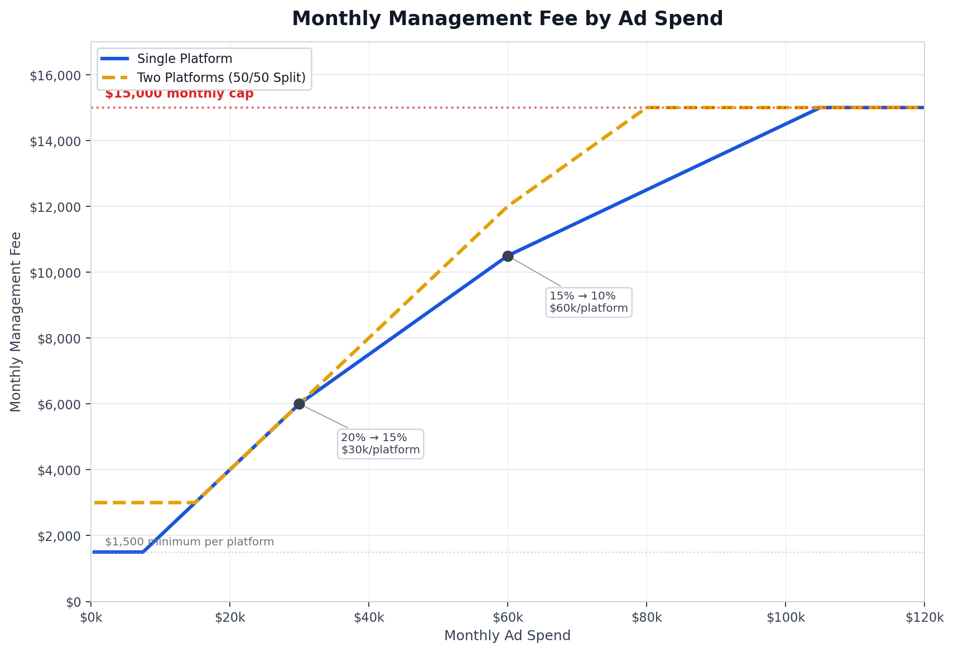
How It Scales
Your management fee scales with your ad spend. The percentage drops at $30,000 and again at $60,000 per platform. The $15,000 monthly cap means your costs are predictable even as you grow.

