Slide 1
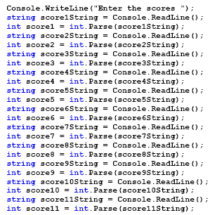
Imagine….
Imagine you want to input a list of 11 soccer scores:
Buy what about 100?
1000?
1 Million?!

Slide 2
Imagine
You need a list of student names
List of temperature measurements
Quiz answers
A sequence of the human genome
Etc etc etc

Slide 3

Arrays

Slide 4

Arrays to the rescue
Via arrays kunnen we een grote hoeveelheid data op eenvoudige manier gebruiken.

Slide 5
Square brackets in C# == arrays incoming!
[ ]

Slide 6
Array
List of data items that all have the same data type and the same name
Each item is distinguished from the others by an index

Slide 7


Declaration
Declare type as follows:
type [] variabelename
Examples:
int[] vars;
Read as: “array of ints, called vars”
float[] numbers;
Read as: “array of floats, called numbers”

Slide 8
All types can be arrays
If it’s a type, it can be an array
string[] sentences;
bool[] binarysequence;
ConsoleColor[] preferredColors;
Genre[] myfavgenres;
Etc.

Slide 9
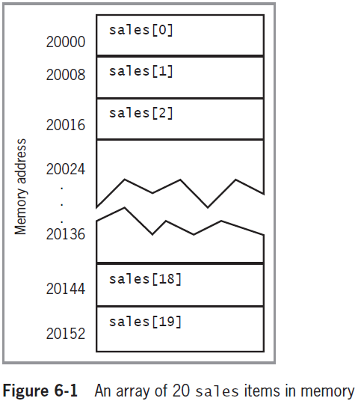
Array creation: size needed
double[] sales;
sales = new double[20];
You must provide a size once you initialize
(*hey, that’s a poem*)

Slide 10
Array creation: size can come from elsewhere
Arraysize is needed once you create, but doesn’t need to be hardcoded:
double[] sales;
Console.WriteLine(“How many sales did you make this year ?”);
int sizereq = Convert.ToInt32(Console.ReadLine());
sales = new double[sizereq];

Slide 11

Arrays can’t “grow”
You can’t change the size of an array once it’s created.
What if you do need a bigger one?:
Create a new, bigger, array and copy all values from smaller array to it

Slide 12

Array elements
Array element
Each object in an array
Subscript (or index)
Integer contained within square brackets that indicates the position of one of an array’s elements
Array’s elements are numbered beginning with 0
0 1 2 3 4 5

Slide 13
“Off by one” error
Occurs when you forget that the first element in an array is element 0 Counting starts from 0

Slide 14
« Eentje is geentje »
Lengte array = 6
Laatste pintje = index 5
0 1 2 3 4 5

Slide 15
Read and write values
Write/Assign
sales[5] = 2100.00;
Read
double mySale= sales[16];

Slide 16
Accessing Array Elements
The power of arrays becomes apparent when you use subscripts
Can be variables rather than constant values
Using a loop to perform arithmetic on each element
for (int sub = 0; sub < 5; ++sub)
myScores[sub] += 3;

Slide 17
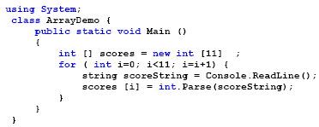
Arrays usage
Tip: replace 11 in this code with scores.Length!
Soccer example with arrays:
For-loop will be your arrays best friend
Always use .Length

Slide 18
Using the Length Property
Length property
Member of the System.Array class
Automatically holds an array’s length
Example:
int[] myScores = { 100, 76, 88, 100, 90 };
Console.WriteLine($"Array size: {myScores.Length}");
for (int x = 0; x < myScores.Length; ++x)
Console.WriteLine(myScores[x]);

Slide 19
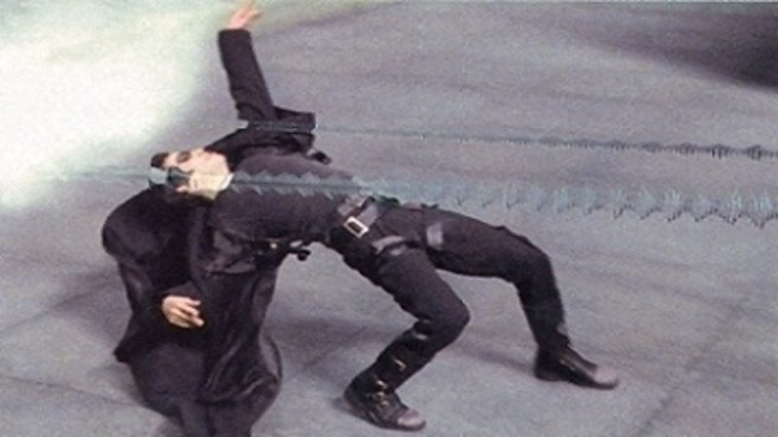
Arrays in slowmotion

Slide 20
Soccer example step by step
© ap | 20

Slide 21
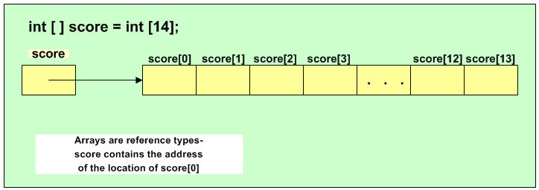
Arrays: behind the scenes
Declaring and creating an array
int[] score;
score= int[20];

Slide 22
Arrays
We create an empty spot that can contain an array of ints.
scores

Slide 23
Arrays
New keyword:
We create a new array in memory and return the memory location (reference)
scores
Int array object in memory location 0x0234567

Slide 24
Arrays
We store the memory location in scores (NOT THE ACTUAL INT VALUES)
scores
Int array object in memory location 0x0234567
#567

Slide 25
Accessing array using loops
Use for-counter as indexer if you want to access each element of your array

Slide 26
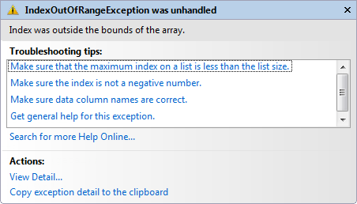
Array element nummering: IndexOutOfRangeException
Starts from 0
So following line will give an error as the size is only 11 (new int [11])
scores[11] =20;
IMPORTANT: Your compiler/VS won’t warn you if you write code that goes out of range.
Int array object in memory location 0x0234567
0
1
2
3
4
5
6
7
8
9
10

Slide 27
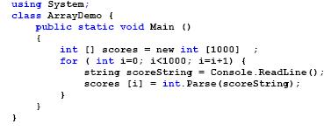
Big arrays
Array size doesn’t matter. Your code remains the same
Tip:
Use MAGIC NUMBERS and/or .Length

Slide 28
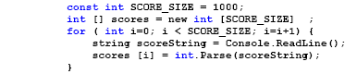
Magic numbers & arrays
Example with Magic Numbers:

Slide 29
Initializing an Array
In C#, arrays are objects
Arrays are instances of a class named System.Array
Initializing objects
Numeric fields: 0
Character fields: ‘\u0000’ or null
bool fields: false
Initializer list
List of values provided for an array

Slide 30
Array initialization with known values:
Use different syntax if you already know the content beforehand.
These are all equals ways (pick what you like the most):
int[] myScores = new int[5] { 100, 76, 88, 100, 90 };
int[] myScores = new int[] { 100, 76, 88, 100, 90 };
int[] myScores = { 100, 76, 88, 100, 90 };

Slide 31
Array initializer syntax
Other examples:
string[] possibleNames = { “Bo”, “Bob”, “Frank”, “Younes”, “Yin”, “Celeste” };
char[] klinkers = {‘a’, ‘e’, ‘i’, ‘o’, ‘u’};
bool[] binaryCode = { true, false, false, true, true };

Slide 32
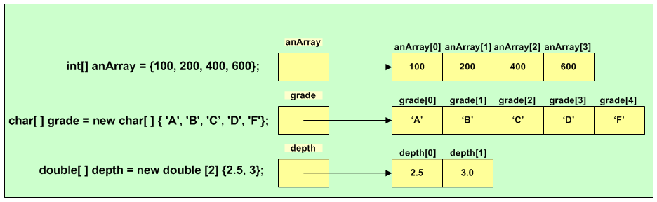
Array initializers: always by reference

Slide 33

Strings and char arrays

Slide 34

Strings and arrays
String = array of chars
We can convert in both ways:
String to char-array: .ToCharArray();
Char-array to string: using new String(…);

Slide 35
String -> char-array
What will be the output?
string origineleZin = "Ik ben Tom";
char[] karakters = origineleZin.ToCharArray();
karakters[8] = 'i';
string nieuweZin = new string(karakters);
Console.WriteLine(nieuweZin);

Slide 36
Char-array -> string
What will be the output?
char[] arrayOfLetters = { 'h', 'a', 'l', 'l', 'o' };
arrayOfLetters[2] = 'x';
string word = new string(arrayOfLetters);
Console.WriteLine(word);

