Slide 1
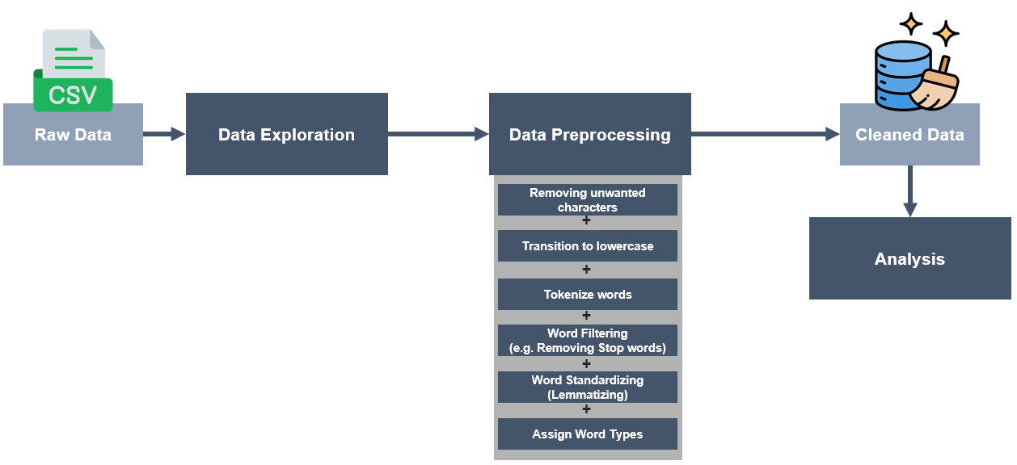
Pipeline / Website Overview

Slide 2

AI CASE STUDY
Patrick Petersen

Slide 3


Raw Data
Data Exploration
Data Preprocessing
Cleaned Data
Removing unwanted characters
+
Analysis
Transition to lowercase
+
Tokenize words
+
Word Filtering (e.g. Removing Stop words)
+
Word Standardizing (Lemmatizing)
+
Assign Word Types

Slide 4
Pipeline / Website Overview
Feature-Selektionsmethode
Feature-Ranking 1

