Slide 1
High Performance Library for Big Data Analysis (NotScared)
Preston Petersen, Shawn Robinson, Jadon Procter

Slide 2
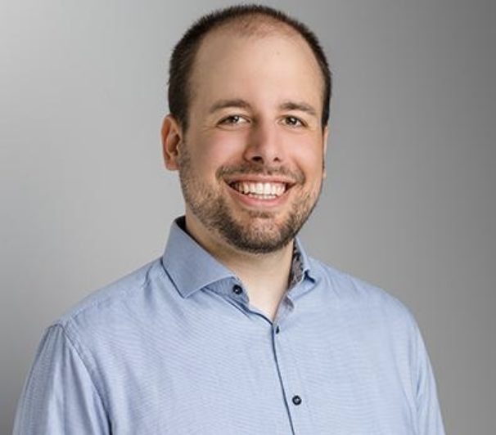
Team
Preston Petersen, Shawn Robinson, Jadon Procter
Computer Science Undergraduates at EECS eCampus
Senior Capstone Project Team
Vincent Immler (Project Partner)
Assistant Professor at Oregon State with a focus in hardware security
Provided a lot of guidance for the project and taught us fundamental hardware security ideas from the ground up.
Notes:
Our team consists of…
This project is for…
Our Project partner is…

Slide 3
What is our project?
The library is a collection of tools useful for hardware security research.
Side Channel Analysis (SCA)
Encryption is in theory perfect, but…
Extra information leakage (Power usage and magnetic fields)
Leakage correlates with the data (the data + the key) being processed
An oscilloscope is used to measure either power draw or magnetic field strength across the duration of encryption (creating a “trace”)
Since we know the encryption algorithm in advance (AES-128), we can calculate how strongly the trace correlates with each key value
Notes:
Library is a collection of tools targeted towards security researchers
SCA is the analysis of what we call “leakage” - such as the change in power consumption - that allows one to potentially break encryption

Slide 4
Key Features
Fast
Open-source
Expandable
Easily add tasks, models
Multiple Leakage Models
NxM Tile compatibility
Heat Map
Multiprocessing
Signal to Noise Ratio
Correlation Power Analysis

Slide 5
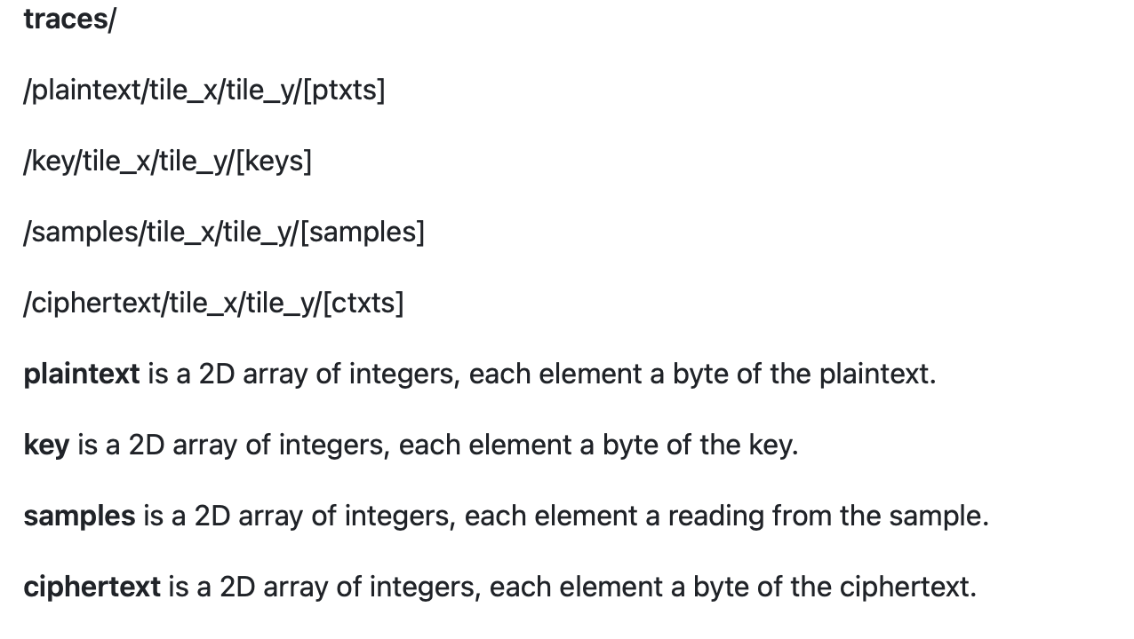
File Format
Custom specification
HDF5 files
Fast
Simple
Open-source
Works well with Numpy
Transparent compression
Metadata embedding
Notes:
We’ve defined a spec for storing measurements that uses the HDF5 file format.
When recording measurements, the operator will need to record into this format.
Our spec is defined in our project repository, and operators will need to record into this format when taking measurements.
Here’s an overview of the format on the right.

Slide 6
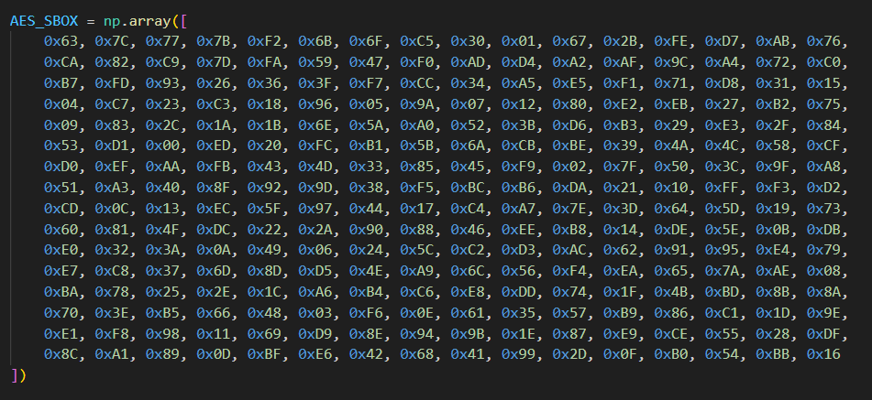
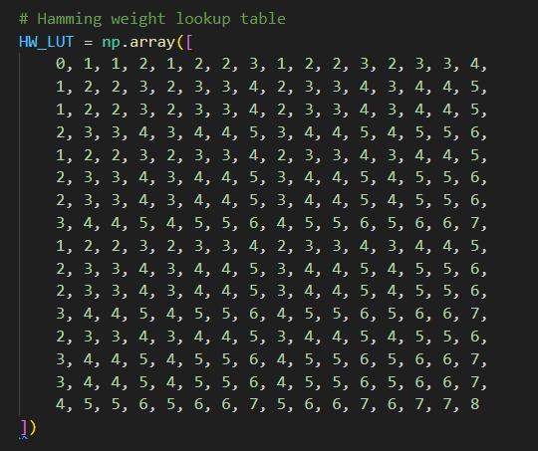
Leakage Models
Different Hardware Systems may have different leakage patterns based on how they flip bits during encryption.
Current models
Hamming weight - The number of bits set to 1 in the output
Hamming distance - The number of bits that differ between the output and input
Notes:
Leakage will differ across hardware due to different architectures.
To account for this, we need to be able to model how the inputs translate into leakage.
We have some basic models implemented, like hamming weight and hamming distance,
but our architecture allows the defining of new models relatively easily.

Slide 7
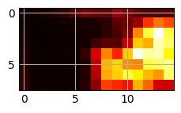
Gridded Data Compatibility
Different chip architectures have the highest magnetic field leakage in different spots
NxM tile processing is not supported by the current industry standard
Heat Map
Multithreading across tiles
Signal-To-Noise Ratio
Notes:
One of the big drivers for creating our project was to support gridded datasets.
When measuring the magnetic field strength over a processor, some spots will have a higher signal than others.
We can use a fast signal-to-noise ratio calculation to determine the tiles with the highest signal, like
With this graph that we did for our 15x8 dataset.
Then we can perform the more expensive side-channel attacks on just those spots.

Slide 8
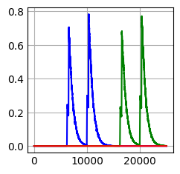
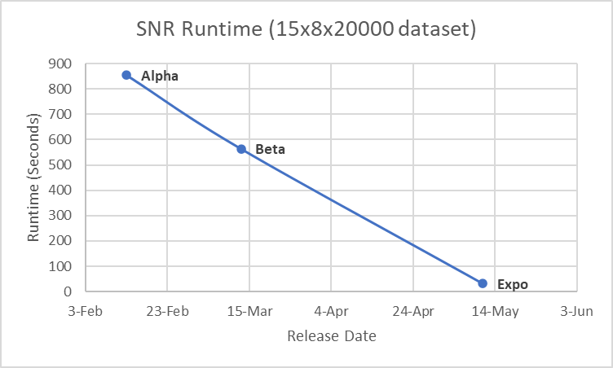
Signal to Noise Ratio
Signal to Noise Ratio is a measurement of desired signal against the background noise. This can be used to reveal points of interest within the traces.
Our Benchmarks
Alpha: 14 minutes, 14 seconds
Beta: 9 minutes 22.6 seconds
Current: 31.6 seconds
Scared Benchmark
5 minutes, 38 seconds
Notes:
SNR is used to find points of significance in data.
SNR task was implemented with Welfords Online Algorithm, to compute the signal versus the noise in one pass. This needed to be fast and as you see in our benchmarking the implementation sped up significantly with every version.

Slide 9
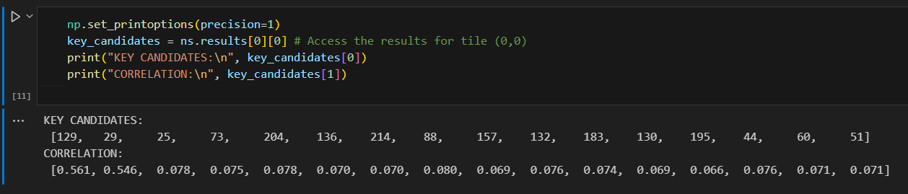
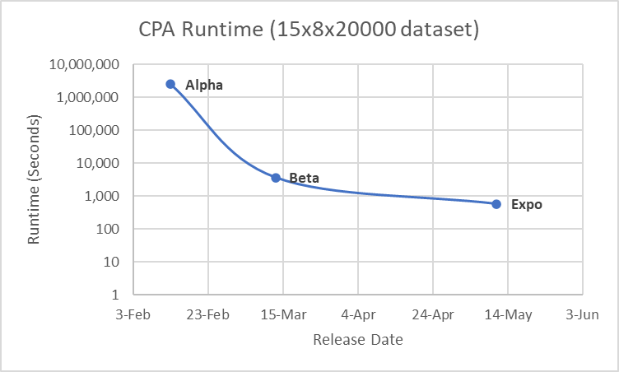
Correlation Power Analysis
Correlation Power Analysis is a statistical equation for calculating the relationship between two variables. In SCA this is the correlation between the oscilloscope readings and theoretical leakage model.
Our Benchmarks (Log Scale)
Alpha: 28.5 days
Beta: 70 minutes, 37 seconds
Current: 9 minutes, 32 seconds
Scared Benchmark
5 minutes, 46 seconds
Notes:
Correlation Power Analysis is our other task for side channel analysis.
This method looks at the correlation between measurements, and the modeled leakage.
If the correlation is high, then the key used to make that model is probably correct.
It is very computationally expensive to model the leakage for all possible keys, but throughout our development process we continued to improve the performance.
Our timing on a large dataset has gone from close to a month, to just over an hour, to just 9 and a half minutes.

Slide 10
Designing - Fall
Architecture Plan
Explanatory documents on the scope of the project.
Design documents
Technical requirements
Research
Algorithms
File formats
Numerical stability
Memory usage
Notes:
Fall was about creating an architecture plan and research.
We created technical requirements, instruction, and design documents through continual meetings with our project partner.
We began researching the one-pass algorithms.
We looked into file formats such as Zarr and Sqlite before deciding on HDF5.

Slide 11
Sprint #1 - Winter
Planned
Implement MIA
Implement CPA
Implement SNR
File Conversion (sqlite to hdf5)
Histogram Method for Variance and Mean
Welfords Online Algorithm
Completed
Barebones CPA
Barebones SNR
Single Tile File Conversion
Histogram
Welfords
Not completed
CLI (Postponed)
MIA (Cancelled)
Notes:
This was our first attempt at implementation.
While making great progress, we found that some portions may be more involved.
We completed a basic implementation of CPA, SNR, File Conversion, and One-pass Algorithms.
We had to postpone CLI and cancelled MIA to focus on CPA.

Slide 12
Sprint #2 - Winter
Planned
Command Line Interface
Conversion Filtering Profiled Data
Cursor based read
CPA results post-processing
Bug Bash
Alpha Release
Completed
Conversion Script Filtering
Cursor Based Read
CPA results post-processing
Exposed bugs
Bug Bash
Alpha Release
Not Completed
Command Line Interface (Cancelled)
Notes:
We improved upon the file-conversion script and decided to cancel the command-line interface, instead focusing on the library’s usage in jupyter notebooks
We implemented cursor based read, key extraction, and an Alpha release.

Slide 13
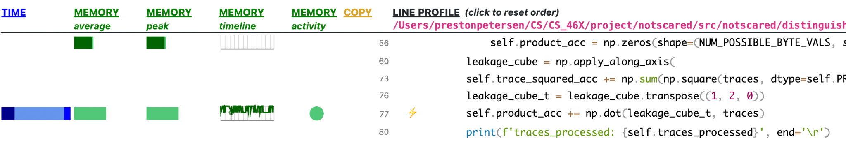
Sprint #3 - Winter
Planned
Optimize CPA
Vectorized (Switch to numpy broadcasting instead of loops)
Calculate (Method)
Push batch (Method)
Product accumulator (Data structure)
File handling
Tile handling
Fancy indexing
Demo jupyter notebook
SNR
Rewrite
Plotter
Compressed HDF5 benchmarks
Beta Release
Completed
Optimize CPA
File handling
Demo Jupyter Notebook
SNR Rewrite
Beta Release
Not completed
Compressed HDF5 Benchmarks (Postponed)
Notes:
Sprint 3 was focused on Optimization for CPA and SNR.
We created a jupyter notebook for demoing our features.
Completed minor tasks such as file handling changes, to complete our Beta Release.

Slide 14
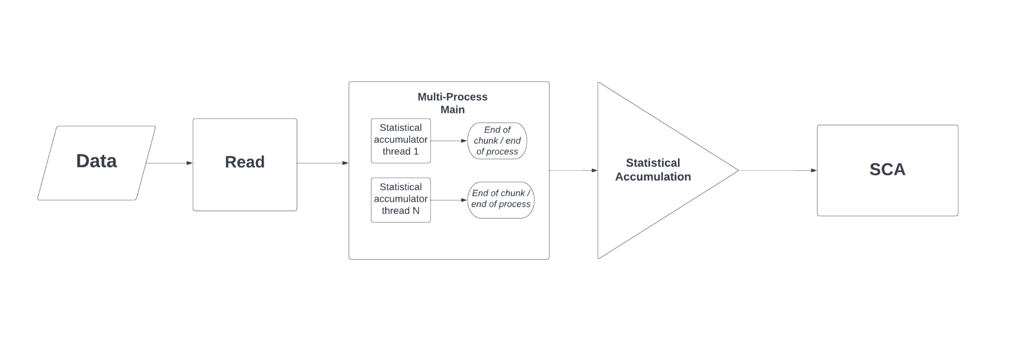
Sprint #4 - Spring
Planned
Re-architecture
Modularization for usability and expandability
Containerization
Tasks Class
NotScared Class
Byte-based threading
Compressed HDF5 Benchmarks
Completed
Re-architecture
Compressed HDF5 Benchmarks
Not Completed
Byte-based threading (Extended)
Notes:
Spring sprint 1 we went through a large restructuring to greatly improve usability and enable future expansion.
We tested compression reads and file size.
Byte-based threading went through an initial implementation but required additional investigation.

Slide 15
Sprint #5 - Spring - Ongoing
Planned
Dynamic Memory Management
Usability Improvements
Heat Map
Cache hit optimization
Byte-based threading
Continuation and Benchmarking
Thorough Unittesting
Data Mocking
Expo Materials
Completed
Heat Map
Tile-based threading
Thorough Unittesting
Expo Materials
Not Completed
Cache hit optimization (Cancelled)
Uninspiring performance benefits
Byte-based threading
Continuation and Benchmarking
Notes:
Sprint 5 is the final stretch.
We continue to look into optimizations such as cache hits, dynamic memory, and byte threading.
We completed finalizations such as usability improvements, unittesting, and Expo Materials.

Slide 16
Future of the Project
A full time research assistant will be taking over the project in the Summer
The combination of materials from our team as well as the other team will be used to continue research.
Huge thank you to Vincent Immler for creating opportunities for Oregon State Students to participate in industry relevant work. He has been an incredible resource for learning and progression towards career readiness.
Notes:
Our capstone project was taken on by two teams competing against each other.
These two projects will be handed off to a full-time research assistant for further exploration, potentially with our involvement.
Thank you ^^^^

