Slide 1
Mid-Coast Sediment TMDL
Sediment
Technical Working Group
Wednesday, January 14, 2015
Newport, Oregon
Peter Bryant
Oregon Department of Environmental Quality
Peter Bryant | Oregon Department of Environmental Quality
Notes:
Is there we see the notes?

Slide 2
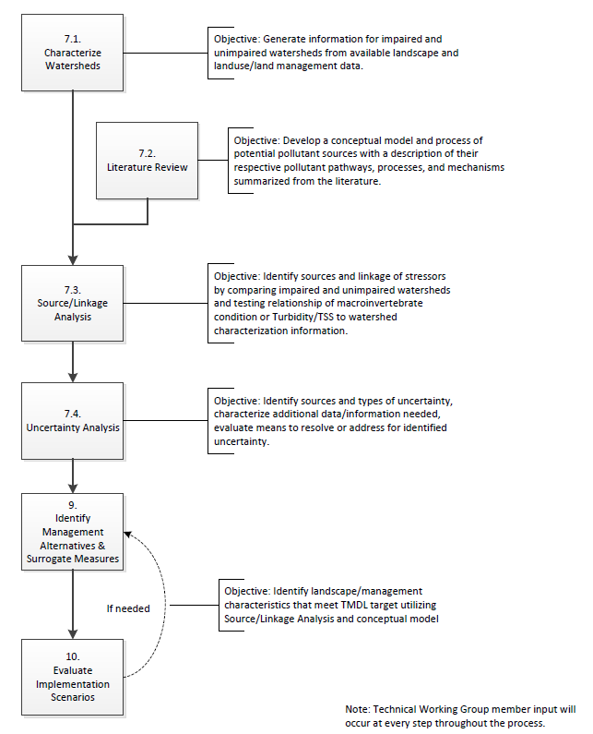
Sediment TMDL Process – Where we are

Slide 3
Goal for today Understand the approach for an informed discussion when we get into the results Outline
Review source analysis methods
Briefly discuss preliminary results of model selection
Demo Google Earth data layers

Slide 4
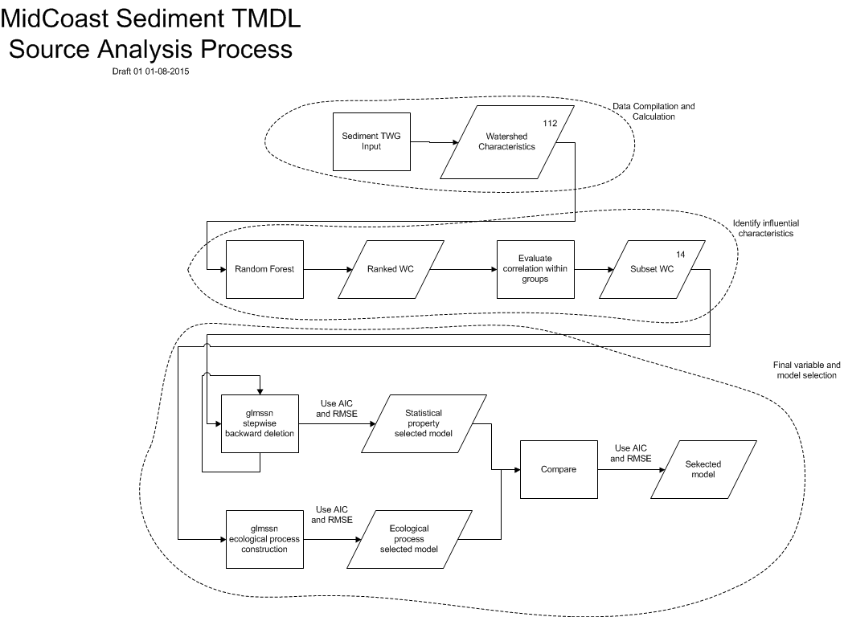

Slide 5
Source Analysis Steps
Organize the data
Relationships among characteristics
Select regression method, formulate potential models
Model selection
Analysis and Interpretation of results
Covered last time

Slide 6
2. Relationships among characteristics
Data finalization:
Added stream discharge and stream power variables for all stations
Re-ran Random forest

Slide 7
2. Relationships among characteristics
Random forest characteristic selection:
Random Forest on entire set of characteristics to identify influential characteristics
Take top 50% of ranked characteristics to use the most influential
Evaluate correlations and select highest importance characteristic
Advance the selected characteristics to the next step

Slide 8
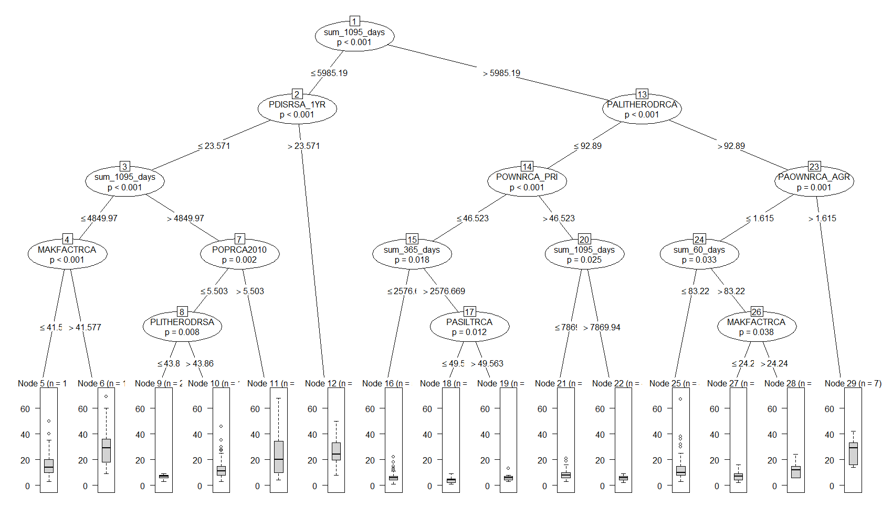
2. Relationships among characteristics
Random forest characteristic selection:
Random Forest on entire set of characteristics 2000 regression trees x 50 iterations

Slide 9
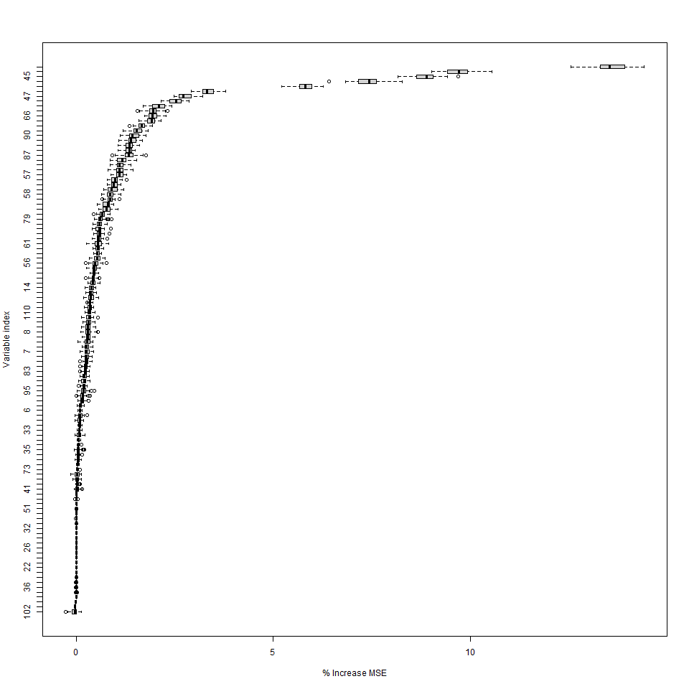
2. Relationships among characteristics
Random forest characteristic selection:
Take top 50% of ranked characteristics

Slide 10
2. Relationships among characteristics
Random forest characteristic selection:
Evaluate correlations within conceptual groups characteristics and removed characteristics that described the same concept

Slide 11
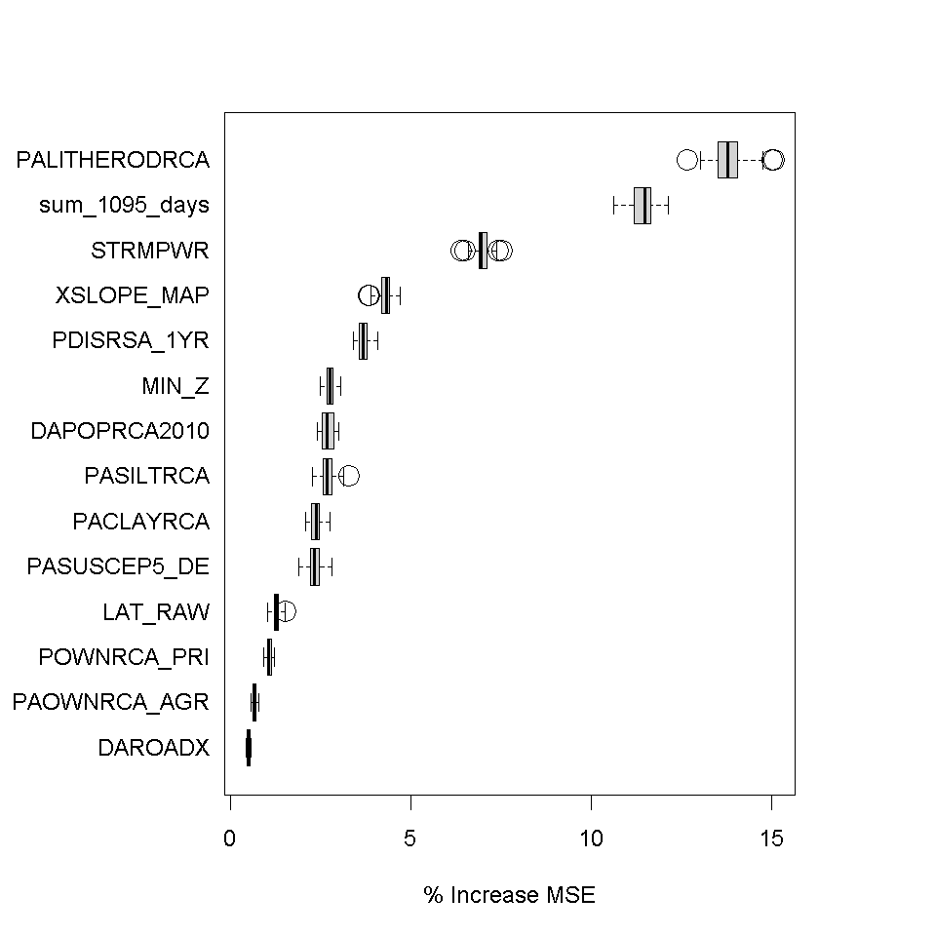
2. Relationships among characteristics
Random forest characteristic selection:
Advance 14 characteristics to next step

Slide 12
Source Analysis Steps
Organize the data
Relationships among characteristics
Select regression method, formulate potential models
Model selection
Analysis and Interpretation of results

Slide 13
3. Select regression method and formulate models
Objective:
Identify the quantitative relationship between watershed characteristics and macroinvertebrate response to fine sediment to evaluate management actions that will achieve target levels set to meet water quality criteria
Use this tool to identify pollutant sources and assign load allocations to their sources

Slide 14
3. Select regression method and formulate models
Method to achieve objective:
Mixed Effects Model
– Spatial Statistical Model on Stream Networks:
A general linear model that expands geostatistical methods to stream systems

Slide 15
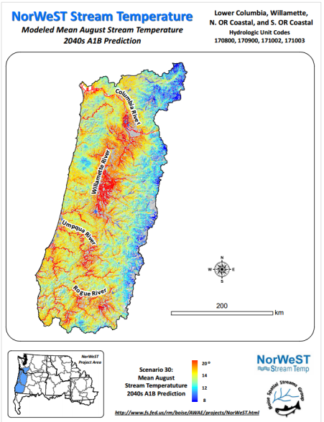
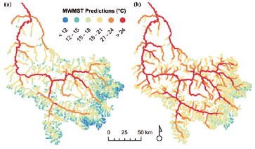
Spatial Statistical Model on Stream Networks
3. Select regression method and formulate models
Frieden et al (2014) for macroinvertebrate indices
United States Forest Service NorWeST Stream Temperature
Ver Hoef and Peterson (2010) for Water Chemistry
Frieden J.C., Peterson E.E., Webb J.A., and Negus P.M. 2014. Improving the predictive power of spatial statistical models of stream macroinvertebrates using weighted autocovariance functions. Environmental Modelling & Software, 60: 320-330.
Isaak, D.J., et al. 2011. NorWeST: An interagency stream temperature database and model for the Northwest United States. U.S. Fish and
Wildlife Service, Great Northern Landscape Conservation Cooperative Grant. Project website: www.fs.fed.us/rm/boise/AWAE/projects/NorWeST.html
Ver Hoef, J. M., and E. E. Peterson. 2010. A moving average approach for spatial statistical models of stream networks. Journal of the American Statistical Association.
105:6–18.

Slide 16
3. Select regression method and formulate models
Our data for general linear modeling:
Response variable:
Fine Sediment Score (FSS)
Explanatory variables:
Subset of 14 variables from Random Forest method
Note: Previously referred to as watershed characteristics. In this context we refer to them as variables. They are equivalent terms.
783 observations at 564 stations
Our data for geostatistical modeling:
Calculated spatial autocorrelation between stations
Notes:
Y = Xβ + Z + ɛ
Where
Y is FSS,
X are the watershed characteristics,
β are the coefficients of the watershed characteristics,
Z is the spatial autocorrelation and
ɛ is the unknown random component

Slide 17
3. Select regression method and formulate models
What is spatial autocorrelation?
How similar we would expect the FSS to be at two stations just because they are close to each other
1
2
4
3

Slide 18
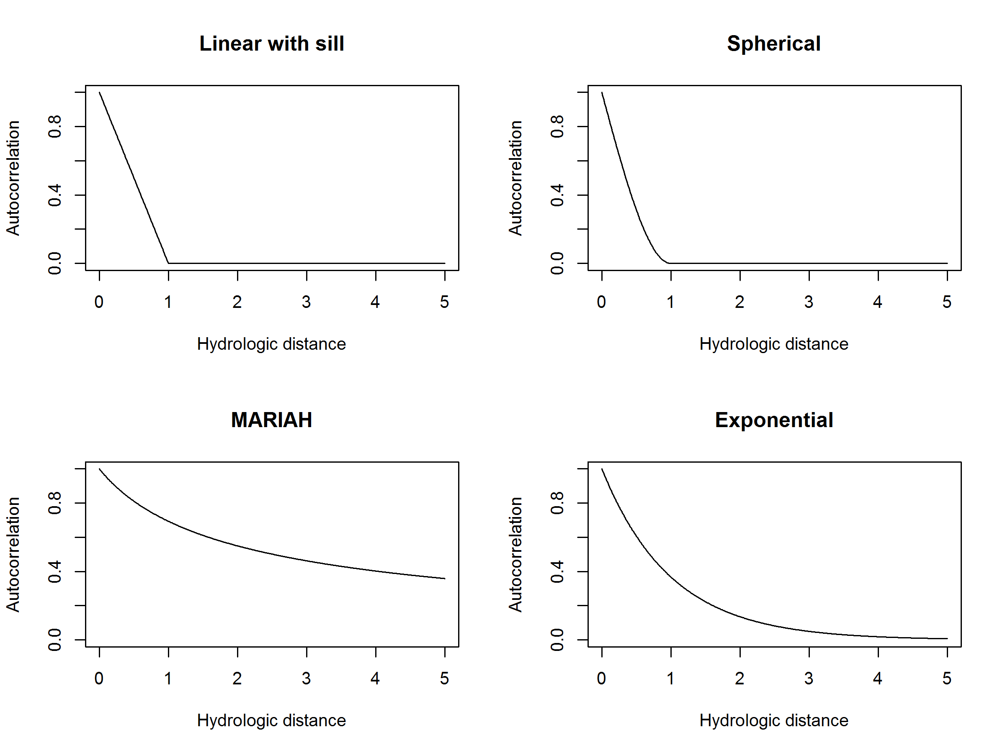
3. Select regression method and formulate models
How is it used?
Estimate the relationship using a function

Slide 19
3. Select regression method and formulate models
How is it used?
Estimate the relationship using a function
1
2
4
3
1
2
3
4

Slide 20
3. Select regression method and formulate models
How is it used?
Apply the function in 3 contexts for stream networks and combine with within site variability
Tail down
Tail up
Euclidean
1
2

Slide 21
3. Select regression method and formulate models
How is it used?
Apply the function in 3 contexts for stream networks and combine with within site variability
Tail down
Tail up
Euclidean
1
2

Slide 22
3. Select regression method and formulate models
How is it used?
Apply the function in 3 contexts for stream networks and combine with within site variability
Tail down
Tail up
Euclidean
1
2

Slide 23
3. Select regression method and formulate models
How is it used?
Apply the function in 3 contexts for stream networks and combine with within site variability
Tail up
Tail down
Euclidean
1
2
4
3

Slide 24
3. Select regression method and formulate models
How is it used?
Apply the function in 3 contexts for stream networks and combine with within site variability
Tail up
Tail down
Euclidean
1
2
4
3

Slide 25
3. Select regression method and formulate models
Bringing the general linear model piece and the geostatistical model pieces together:
We use the observations and the spatial relationships to estimate how each variable comes together to predict FSS
Notes:
Y = Xβ + Z + ɛ
Where
Y is FSS,
X are the watershed characteristics,
β are the coefficients of the watershed characteristics,
Z is the spatial autocorrelation and
ɛ is the unknown random component

Slide 26
3. Select regression method and formulate models
We implemented two approaches using the set of 14 variables identified using random forest:
Statistical properties
Ecological processes

Slide 27
3. Select regression method and formulate models
Statistical properties:
Stepwise backward deletion method for variable selection
Start with all 14 variables
Remove variable with highest p-value
Re-run model until all variables had p-value < 0.01
14
13
12
11
10
9
8
7
6
1
2
3
4
5
6
7
8
9
10
11
12
13
14
1
2
3
4
5
7
8
9
10
11
12
13
14
1
2
3
4
5
7
8
9
10
12
13
14
1
3
4
5
7
8
9
10
12
13
14
1
3
4
5
8
9
10
12
13
14
1
3
4
5
8
9
10
13
14
1
3
4
8
9
10
13
14
1
3
4
8
9
10
13
1
3
4
9
10
13
Notes:
Y = Xβ + Z + ɛ
Where
Y is FSS,
X are the watershed characteristics,
β are the coefficients of the watershed characteristics,
Z is the spatial autocorrelation and
ɛ is the unknown random component

Slide 28
3. Select regression method and formulate models
Ecological processes:
Used literature and knowledge of the system to formulate combinations of the 14 selected variables for candidate models
Considered 57 models representing:
Natural variables only
e.g. Precipitation and Lithology only
Human influence variables only
e.g. Streamside disturbance and roads only
Combination Natural and Human influence variables
e.g. Precipitation, lithology and streamside disturbance
Notes:
Y = Xβ + Z + ɛ
Where
Y is FSS,
X are the watershed characteristics,
β are the coefficients of the watershed characteristics,
Z is the spatial autocorrelation and
ɛ is the unknown random component

Slide 29
Source Analysis Steps
Organize the data
Relationships among characteristics
Select method, formulate potential models
Model selection
Analysis and Interpretation of results

Slide 30
4. Model selection
We implemented two approaches using the set of 14 variables:
Ecological processes Selected model
Compare Selected model
Statistical properties Selected model

Slide 31
4. Model selection
Compared models with model performance measures:
A measure of likelihood given the data that accounts for the number of model parameters (AIC)
Overall model prediction accuracy (RMSPE)

Slide 32
4. Model selection
What did we find?:
Very similar
Included same variables
Statistical Properties model had additional variable, Population Density
Based on model performance measures Statistical Properties model outperformed Ecological Processes model

Slide 33
Source Analysis Steps
Organize the data
Relationships among characteristics
Select method, formulate potential models
Model selection
Analysis and Interpretation of results

Slide 34
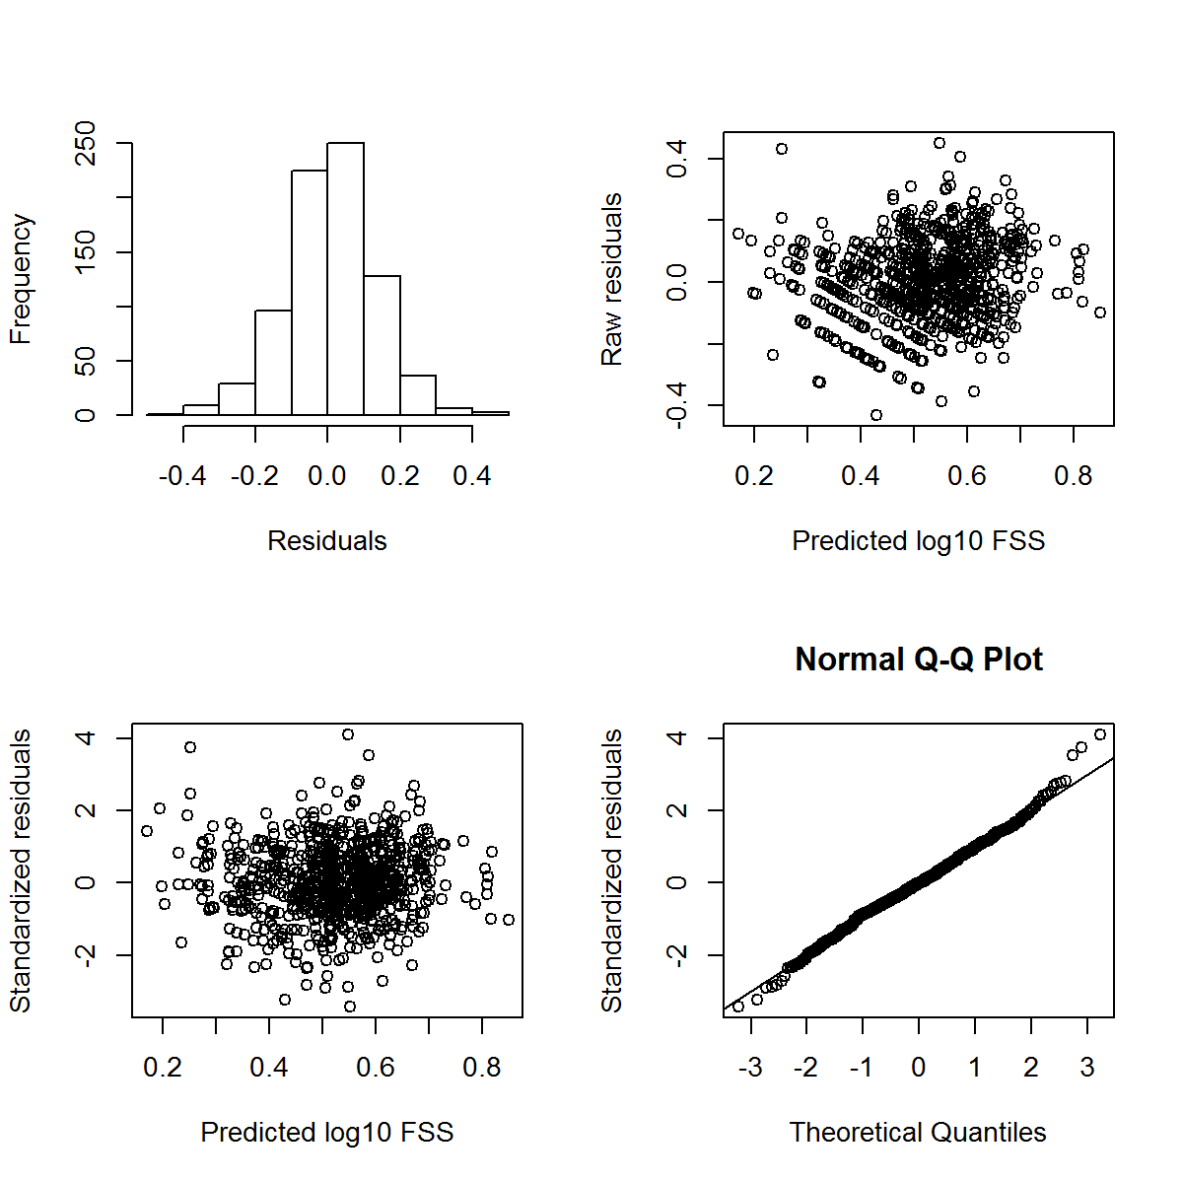
5. Analysis and Interpretation of results
Check model assumptions:
Residuals have:
Constant variance
Normal distribution
Statistical significance:
Likelihood Ratio test: Compare to Null model
Statistically significant difference
Spatial importance:
Compare to model with no spatial autocorrelation
Spatial model outperformed non spatial model
Notes:
Likelihood Ratio test: Compare to Null model
χ² test statistic =164.4
p-value <0.001

Slide 35
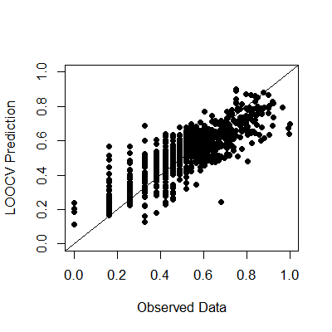
5. Analysis and Interpretation of results
Leave One Out Cross Validation (LOOCV):
Removes each response value one at a time and the estimated model is used to predict the removed value
Notes:
Likelihood Ratio test: Compare to Null model
χ² test statistic =164.4
p-value <0.001

Slide 36
3. Analysis and Interpretation of results
Refresh:
Response variable:
Fine Sediment Score (FSS)
Explanatory variables:
Watershed characteristics
Spatial autocorrelation among stations
Notes:
Y = Xβ + Z + ɛ
Where
Y is FSS,
X are the watershed characteristics,
β are the coefficients of the watershed characteristics,
Z is the spatial autocorrelation and
ɛ is the unknown random component

Slide 37
5. Analysis and Interpretation of results
Selected model:
Y = 0.443 - 0.316*x1 + 0.088*x2 + 0.059*x3+ 0.136*x4 + 0.119*x5 + 0.192*x6 + Z + ɛ
Y = FSS (log transformed)
x1 = Sum of rainfall over a 1095 day period prior to the sample date
x2 = Percent land disturbance in the last year since the sample date within the Reach Streamside Area
x3 = Percent of reach contributing area with private forest land
x4 = Percent of Accumulated Reach Contributing Area with erodible classified lithology
x5 = Percent of weighted average percent silt (0.002 to 0.05mm) between 6 – 36 inches within the Accumulated Reach Contributing Area
x6 = Estimated human population density in the Accumulated Reach Contributing Area in the year 2010
Z = Spatial component (within site variability + spatial autocorrelation)
ɛ = Random component
Note: All variables transformed to 0 to 1 scale to prevent measurement scale from having disproportionate influence on coefficient determination
Notes:
Parameters in Ecological function approach model:
All but DAPOPRCA_2010

Slide 38
5. Analysis and Interpretation of results
Conditions and Processes that affect FSS
Natural (Non-anthropogenic)
Human influence (Anthropogenic)
Combined effect on FSS
Notes:
Parameters in Ecological function approach model:
All but DAPOPRCA_2010

Slide 39
Next Steps:
Uncertainty analysis
Assign allocations to sources
Identify management measures
Next meeting:
Discuss how we will assign allocations to sources

Slide 40
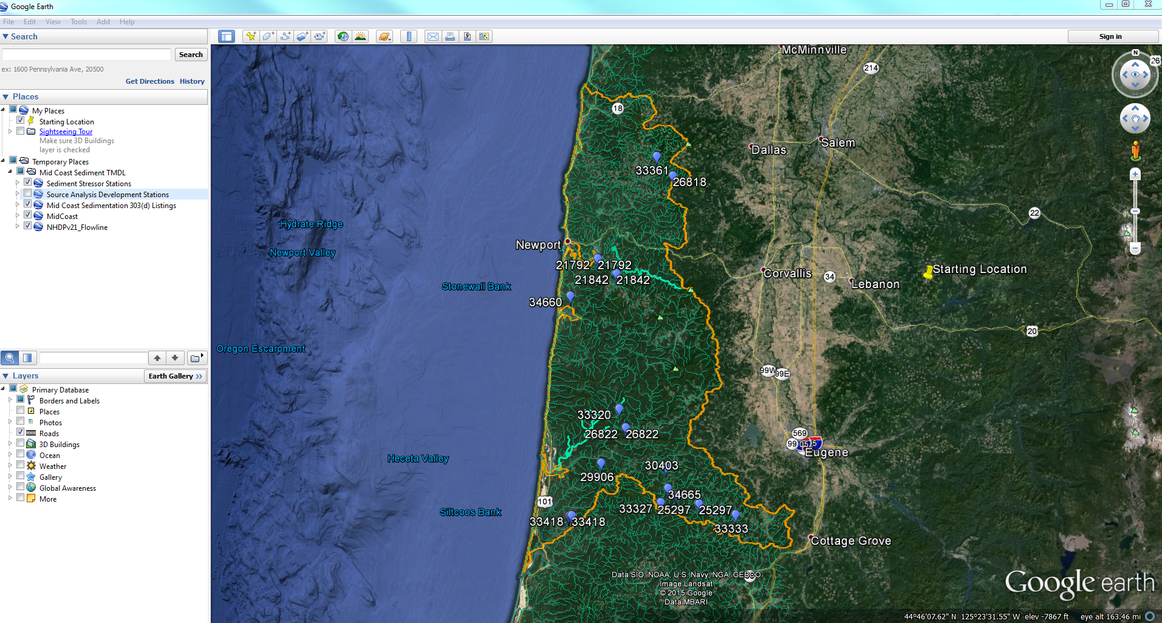
Google Earth for data visualization

