Slide 1
3) Basic UNIX: Useful commands
The following slide has some really useful commands
Don’t worry, it is a lot to learn (you wont remember them!)…. you can always look them up!!

Slide 2
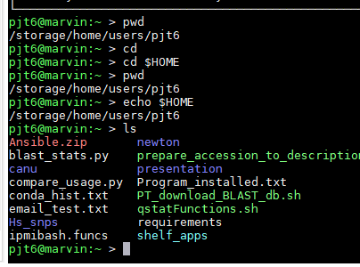
3) Basic UNIX: Home directory ($HOME)
ACTIVITY
(cheat sheets in the directory/ folder too…):
pwd (print working directory),
cd (change directory),
ls (show me the files which are here),
ll -l (see me more details about the files),
$HOME (this is YOUR home directory),
(Directory is a folder)

Slide 3
3) Basic UNIX: Home directory ($HOME)
ACTIVITY
(Directory is a folder)
head (show me to top of a file)
mkdir name (make a directory called name).
touch file01.sh (make a file called file01.sh)
more file (scroll through a file)
less file (scroll through a file)

Slide 4
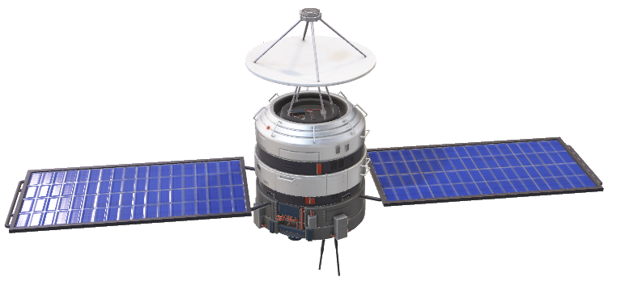
3) Basic UNIX: Filesystem navigation
Moving around the file system is hard, but it is vital!!
cd ../ (go back a directory)
cd ../../ (go back two directories)
cd - (go back to where you were last - this is handy!!)
cd full/path/to/where_you_want
cd (nothing after), cd $HOME, cd ~ (all take you to you home directory)
pwd (print the directory that I am in)

Slide 5
3) Basic UNIX: Filesystem navigation
Note: windows uses \ to separate and path. Where as Linux uses /
If you try this at the Windows command line you will soon find out.
cd ../

Slide 6
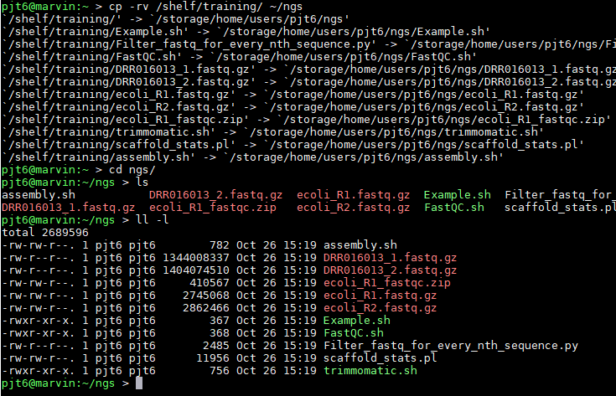
3) Basic UNIX: Copy files (cp) for training
ACTIVITY
Lets copy the training files to your home directory (no spaces in paths):
cp -rv /scratch/bioinf/BL4273/genome_assembly_workshop ~/scratch/bioinf/${USER}
(tip: ~ is the same as $HOME)
Change directory in Computational_Genomics and have a look at what is in here:
cd Computational_Genomics (tip: use the tab button to auto - complete)
ls (see what is in here)
ll -l (more details)

Slide 7
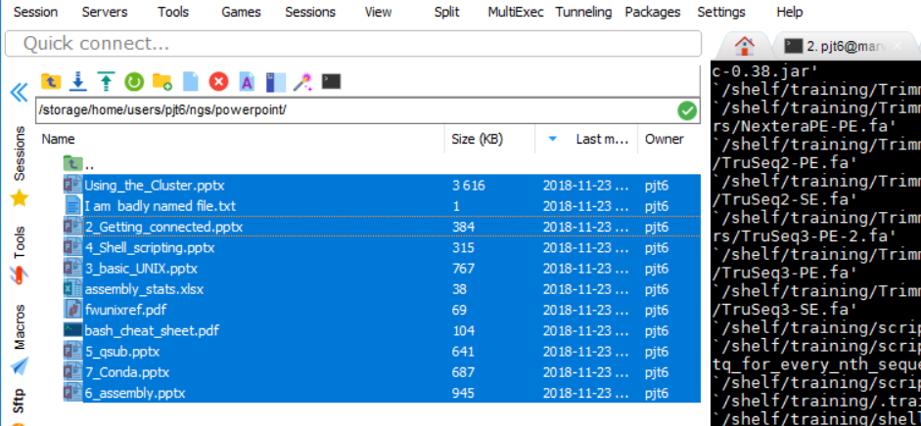
3) Basic UNIX: Copy files (cp) for training
ACTIVITY
“Drag and drop” way: go into the ~/ genome_assembly_workshop /powerpoint folder (double click in the left file browser window). (TIP: if you don’t see the files, press refresh or F5)
Then drag and drop the files
to your computer.
*Remember this is an option throughout this course

Slide 8
3) Basic UNIX: tab button, auto complete
ACTIVITY
When you start typing the name of a file or folder.
Instead of writing it correctly every time, which no one can do.
Start typing the name and press the tab button.
If it does not auto complete, then the spelling is wrong, it is not in the directory you are looking at, or there are multiple other reasons.
Press the tab key twice to see all the possible options….

Slide 9
3) Basic UNIX: copy and paste
ACTIVITY
Every program is slightly different.
.. But if you highlight it. Then it is automatically copied to your clipboard.
This is super useful.
To paste (one of the following): centre mouse button, right click, right click and select paste (depends on the program you are using).
Windows command line is horrible for this, and for that reason I would not use it.

Slide 10
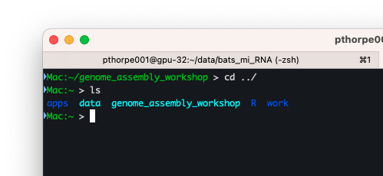
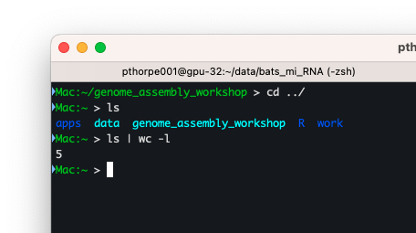
3) Basic UNIX: pipes
ACTIVITY
The output of commands can be piped to another:
ls (what is in the directory)
ls | wc -l (… pass this to word count)

Slide 11
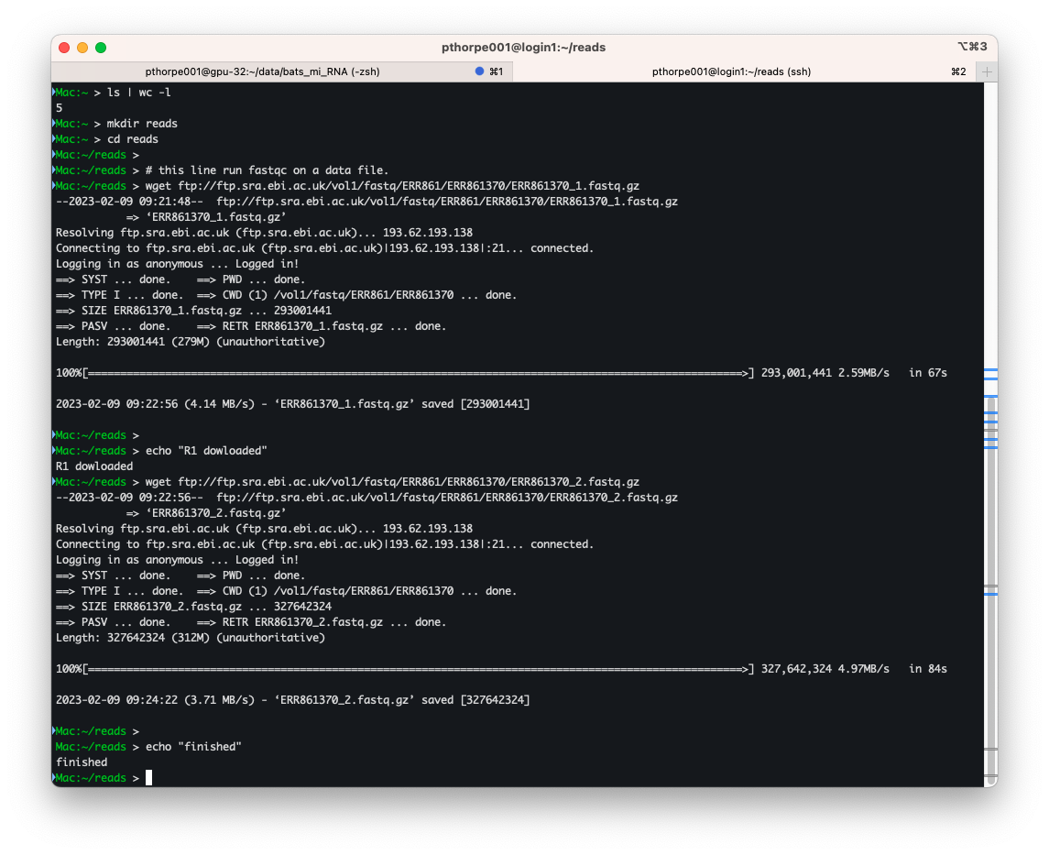
3) Basic UNIX: prepare some reads files
ACTIVITY
For some input for the next example, we need to download some files
mkdir (make a directory/ folder)
wget (this downloads files from the internet)

Slide 12
3) Basic UNIX: prepare some reads files
ACTIVITY
wget (this downloads files from the internet)
echo (… print a message to screen)

Slide 13
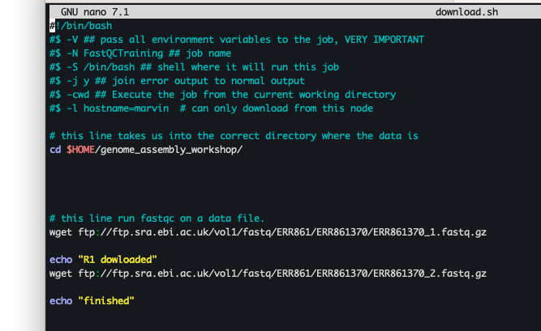
3) Basic UNIX: prepare some reads files
ACTIVITY
File downloads can be put into scripts, best practise if you have long and lots to download. (what you have just seen in a shell script, more on this later)

Slide 14
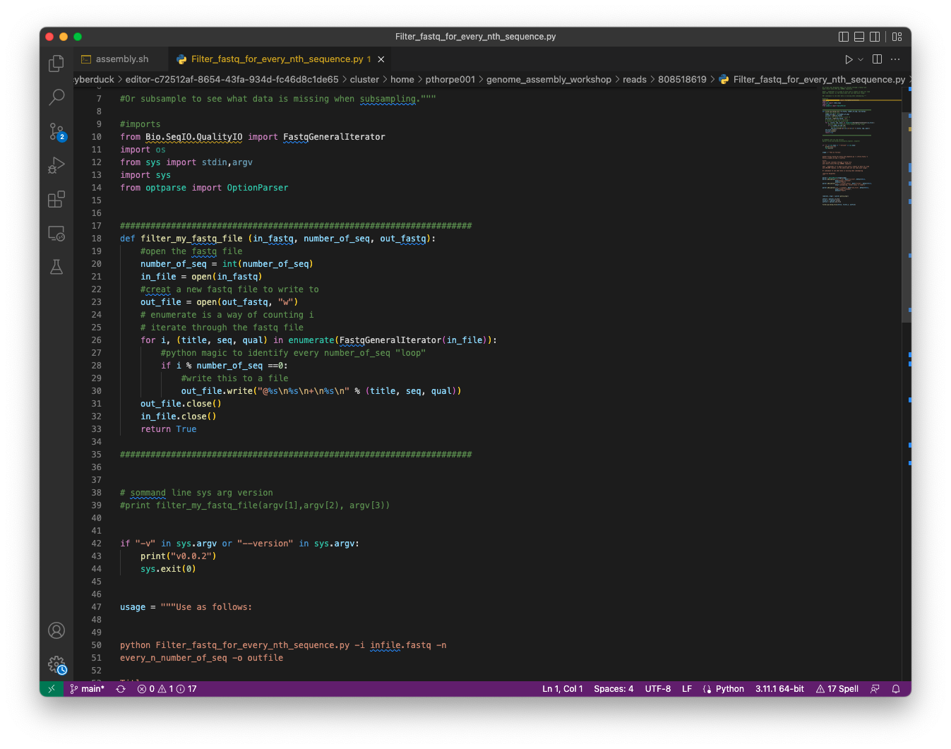
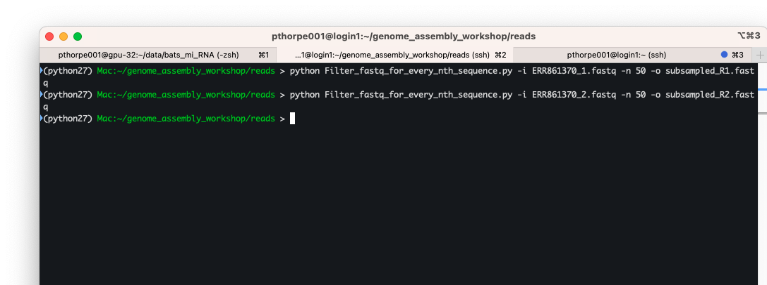
3) Basic UNIX: prepare some reads files
ACTIVITY
Subsample he reads files to take every 50th read to reduce the time taken for processing. This is for training only and you wouldn’t do this with a real dataset.

Slide 15


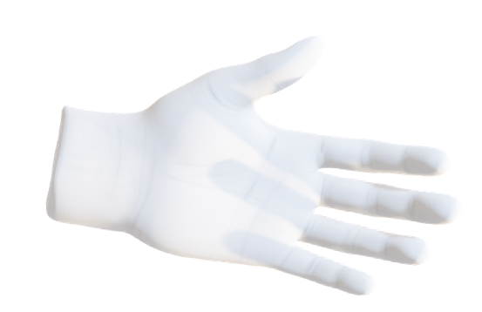
3) Basic UNIX: Grep a zcat through a pipe!
ACTIVITY
To have a look at the read file, which is compressed we can
Don’t forget tab competition!
cd ./genome_assembly_workshop/reads/
zcat subsampled_R1.fastq.gz | head
Count the number of reads in a file
zcat subsampled_R1.fastq.gz | grep -c “@ERR”
Scroll through the file:
zcat subsampled_R1.fastq.gz | more

Slide 16
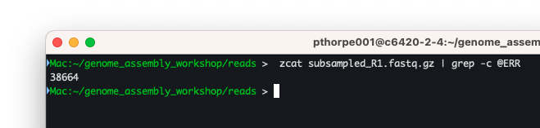
3) Basic UNIX: Grep a zcat through a pipe!
ACTIVITY
To have a look at the read file, which is compressed we can
Don’t forget tab competition!
cd ./genome_assembly_workshop/reads/
zcat subsampled_R1.fastq.gz | head
Count the number of reads in a file
zcat subsampled_R1.fastq.gz | grep -c “@ERR”
Scroll through the file:
zcat subsampled_R1.fastq.gz | more

Slide 17
3) Basic UNIX: Some “gotchas” (character changes)
Line endings: Linux uses /n (newline) windows uses /r/n (carriage return newline).
Programs will fail is they come across this - they don’t know what to do with it.
Either change the file with :
dos2unix Filename
Or in Notepad++: Edit > EOL > UNIX
Change of characters in Microsoft Office products.
Ll –l (capital when it is not supposed to be)
ll -l ( - gets changed to a big dash)

Slide 18
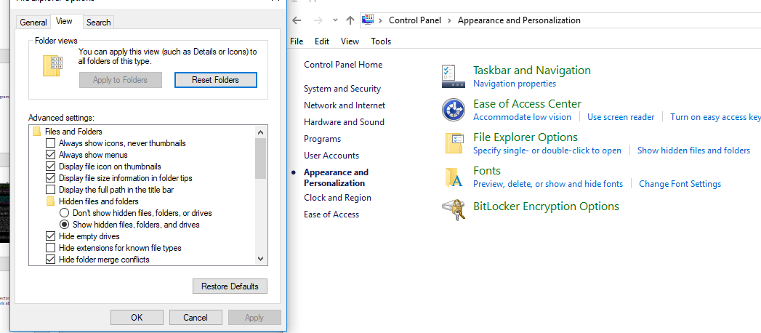
3) Basic UNIX: Some “gotchas”: Windows disable hide extensions.
This is a useless feature and sooner or later will be the cause of something not working. CHANGE IT!! (control panel > appearance …)

Slide 19
3) Basic UNIX: Spaces in filenames
ACTIVITY
Linux doesn’t like spaces in filenames.
Linux sees spaces in commands as another command.
You have the wrapped quotes around the filename if you want spaces...
Easier just to get in the habit of not using spaces.
You should see a file in the directory called: I am badly named file.txt
Try looking at the contents of this file …. ☺

