Slide 1
4) Shell scripting: prepare reads
We will now go though an example process of preparing reads for bacterial genome assembly.
There are many different tools that do each step. This is just an example.
QC -> quality trim -> QC -> assembly -> assembly stats -> gene prediction
BLAST: what have we just assembled?
In order to do any of this, we need a way of talking to the computer … shell scripting.

Slide 2
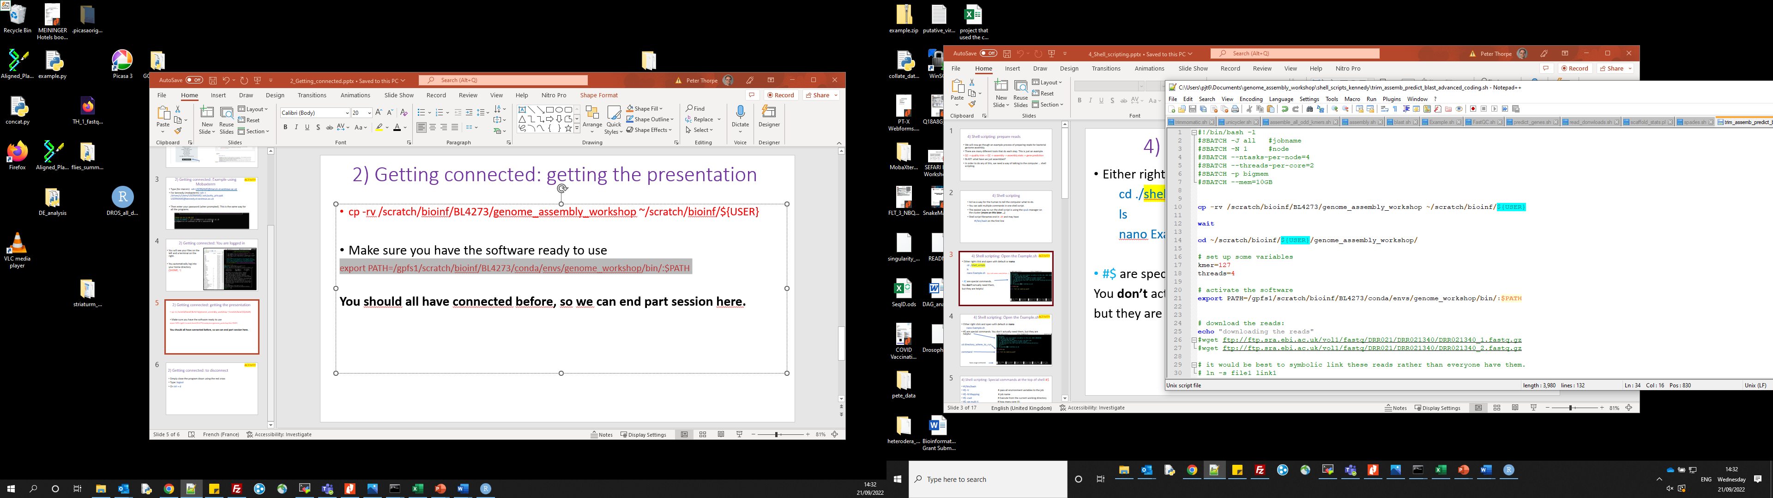
4) Shell scripting
Act as a way for the human to tell the computer what to do.
You can add multiple commands in one shell script.
The easiest way to run the shell script is using the qsub manager (or sbatch if slrum) on the cluster (more on this later …)
Shell script filenames end in .sh and may have
#!/bin/bash on the first line

Slide 3
4) Shell scripting: Open the Example.sh
ACTIVITY
Either right click and open with default or nano
cd ./shell_scripts
ls
nano Example.sh (tip: tab name completion…)
#sbatch are special commands.
You don’t actually need them,
but they are helpful

Slide 4
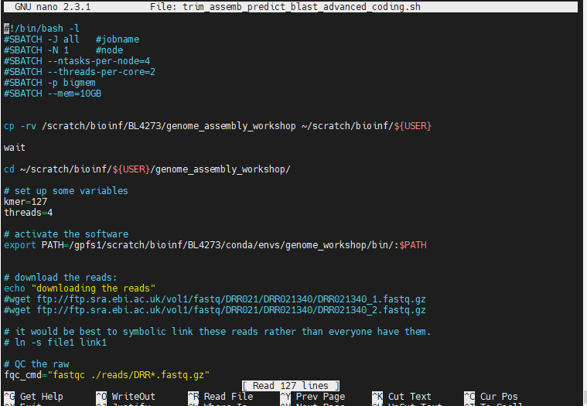
4) Shell scripting: Open the Example.sh
ACTIVITY
Either right click and open with default or nano
nano Example.sh
#sbatch are special commands. You don’t actually need them, but they are helpful
cd directory_where_to_run
Nano usage commands

Slide 5
1 thread job and email me!
#!/bin/bash -l
#SBATCH -J conda_test #jobname
#SBATCH -N 1 #node
#SBATCH --tasks-per-node=1
#SBATCH -p bigmem
#SBATCH --mail-type=ALL
#SBATCH --mail-user=$USER@st-andrews.ac.uk
Note: this line is essential for shell scripts now!!

Slide 6
High memory
#!/bin/bash -l
#SBATCH -J SPADES_cb #jobname
#SBATCH -N 1 #node
#SBATCH --tasks-per-node=48
#SBATCH -p bigmem
#SBATCH --nodelist=kennedy150
#SBATCH --mem=1450GB

Slide 7
submit a job
sbatch spades.sh
Show information on the queues:
smap
squeue (show the queue)
squeue -p bigmem (show the queue for big mem)
sview
Interactive mode (like qrsh):
srun -p bigmem --pty bash (Bioinf user : use the bigmem q)
srun -p bigmem --tasks-per-node=20 --pty bash
srun -p bigmem --tasks-per-node=20 --mem=100GB --pty bash

Slide 8
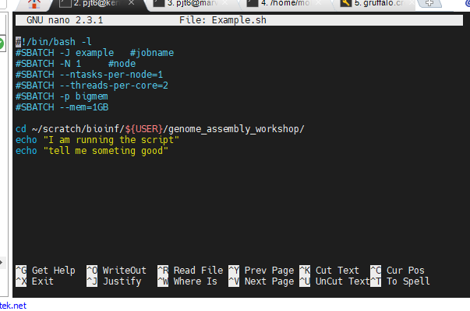
4) Shell scripting: Help - what command
The get info on what command you need to run from your tool and parameter.
Type: tool_name -h or (--help, --h) - some permutation of that
Or look up the usage on their website.
Any command entered here will be run
e.g. python myscript.py
perl myscript.pl
Etc …

Slide 9
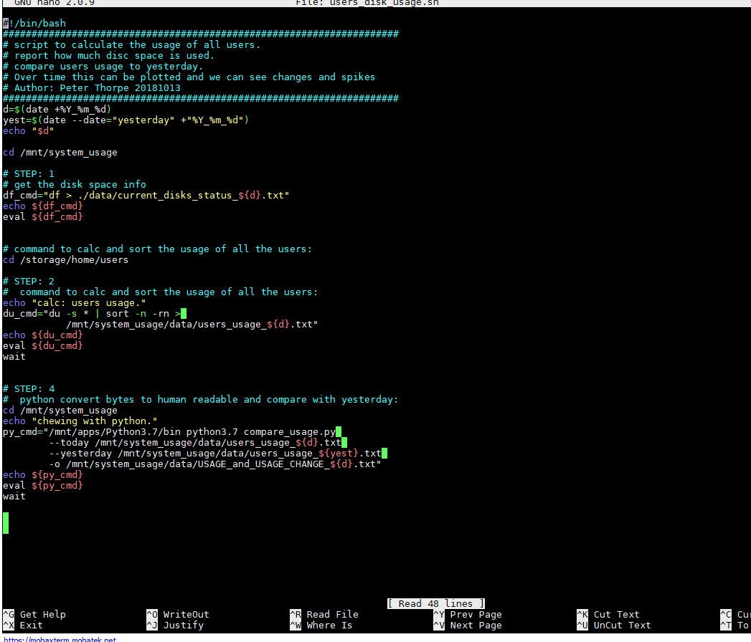
4) Shell scripting: nano command line editor
ACTIVITY
nano by default is black and white. However if you want colours, which I do, copy the .nanorc file from with the ./ngs folder to your home directory:
cp ./.nanorc ~/
(Copy, from here, a file called, to my home)

Slide 10
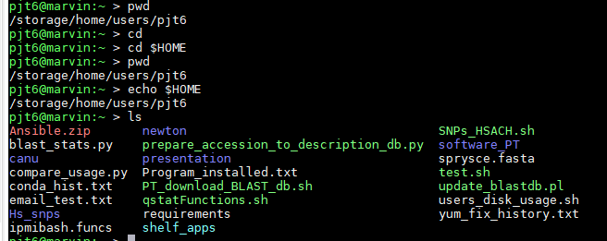
4) Shell scripting: The .sh script has to be “executable”
ACTIVITY
Type:
chmod a+x Example.sh (if it is not executable it will not run!!!)
Type
ls (executable files are green. Compressed = red. Files = white, Folders = blue)

Slide 11
4) Shell scripting: Colours of files - may differ between programs.
executable
Compressed
Just a file
folder
Symbolic link

Slide 12
4) Shell scripting: The .sh script has to be “executable”
ACTIVITY
Now you can run this:
./Example.sh (this dot slash, just means “here”)
This should just print “something” to the screen using the echo command.
Change this and try again. (to save in nano: type ctrl x, then y for yes, enter)
echo “something in quotes - boom”

Slide 13
4) Shell scripting/ qsub: Run something useful
ACTIVITY
Fastqc on real Illumina data. Open the FastQC.sh file
cd /storage/home/users/${USER}/ngs/shell_scripts
(tip: tab name completion…)
nano FastQC.sh

Slide 14
4) Shell scripting: basic for loop
loop and variables. To set up a variable:
filenames=*.fasta (all the fasta files in a directory -> variable)
Now we can loop over all these files and do something
See next slide
Example:
https://github.com/peterthorpe5/public_scripts/blob/master/metapy_tools/shell_scripts/Interogate_controls_all_folders.sh

Slide 15
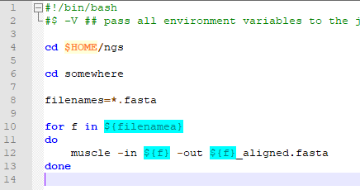
4) Shell scripting: basic for loop (easy)
For loop and variables
This aligns and refines all
Fasta files in a directory
For loop set between the
do and done
https://www.cyberciti.biz/faq/linux-unix-bash-for-loop-one-line-command/
In one line:
for f in ${filenames}; do muscle -in ${f} -o {f}.aln; done

Slide 16
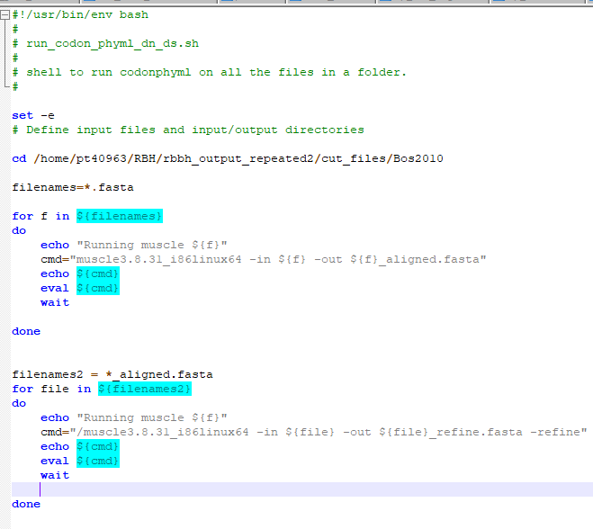
4) Shell scripting: basic for loop (more complex)
For loop and variables
Aligns and refines all fasta files in a directory
* is a wild card
All *.fasta files are assigned to a variable called filenames.
We then loop through all fasta files, each loop we assign “that” fasta file to the variable f
To call the variable in bash you need ${variable}

Slide 17

4) Shell scripting: basic for loop (more complex)
For loop and variables
Aligns and refines all Fasta files in a directory
set -e break the script at the First error (useful in pipelines)
echo put useful info to .o file for future debugging
The command assigned to a variable called cmd, which is echoed to a file and set to eval (evaluate) to be run
wait is a Linux command to wait until all other Linux commands are completed.
do and done set the boundaries of the for loop.

Slide 18
Earlier example: More fancy and reboust way of counting the reads in all files in a directory
In the previous example we “grepped for a specific string”. This changes between data sets, so will not always work. This example will make sense as we go through the material
files=*R1.fastq.gz
for f in ${files}
do
echo ${f} >> read_pairs.counts
zcat ${f} | echo $((`wc -l`/4)) >> read_pairs.counts
done

Slide 19
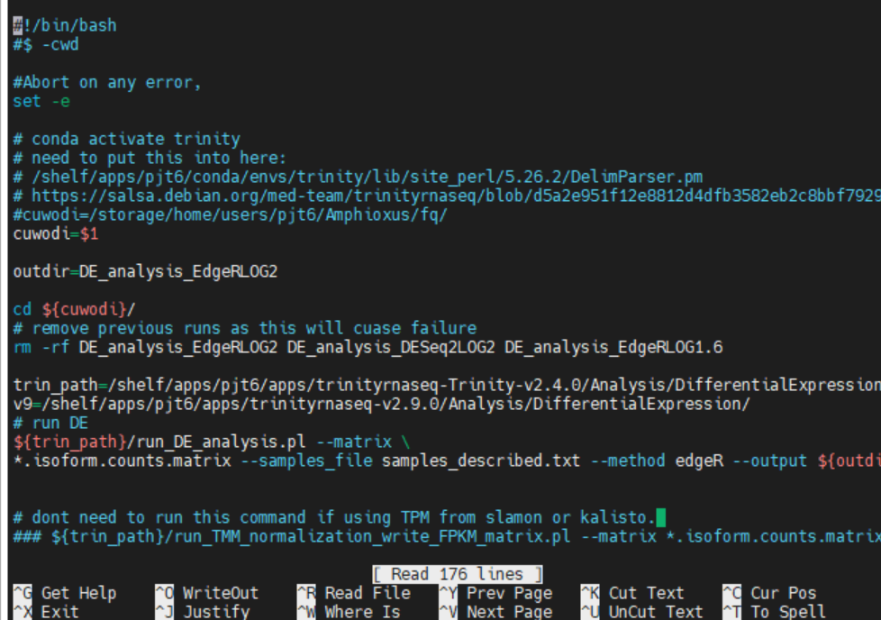
4) Shell scripting: command line arguments
https://www.linuxtechi.com/command-line-arguments-in-linux-shell-scripting/
$1 is the first string after the script name at the command line
$2 is the seconds string after the script name at the command line
$3 is the third string after the script name at the command line
Etc …….

Slide 20
4) Shell scripting: command line arguments
https://www.linuxtechi.com/command-line-arguments-in-linux-shell-scripting/

