Slide 1
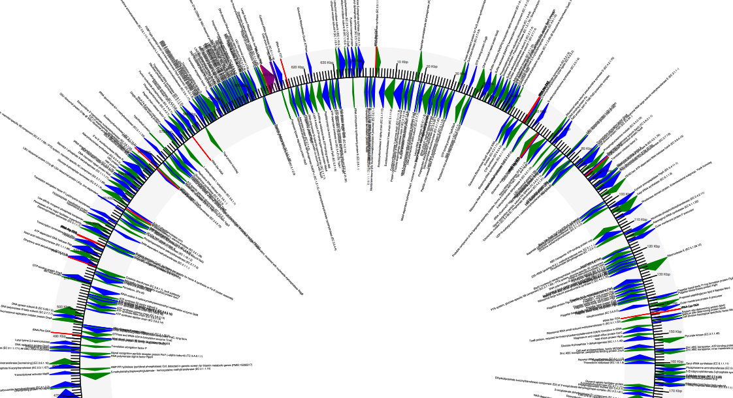
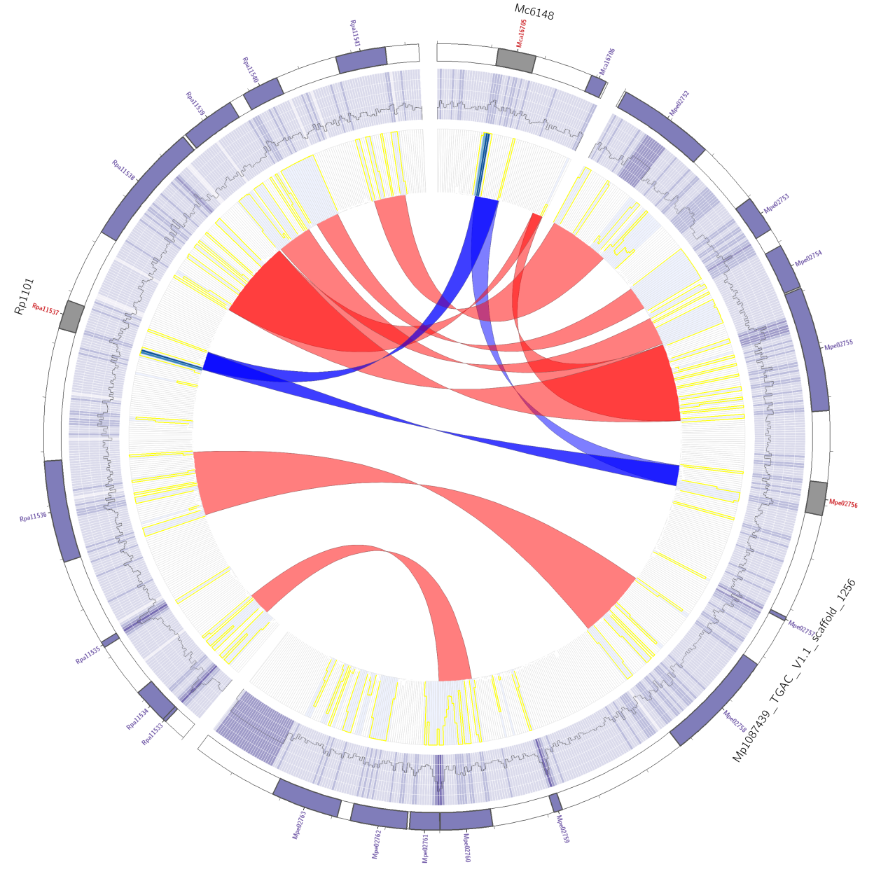
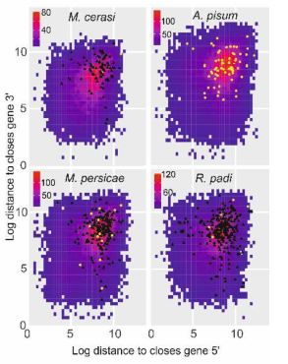
Kmers and graphs
Unknown Illumina bacterial assembly.

Slide 2
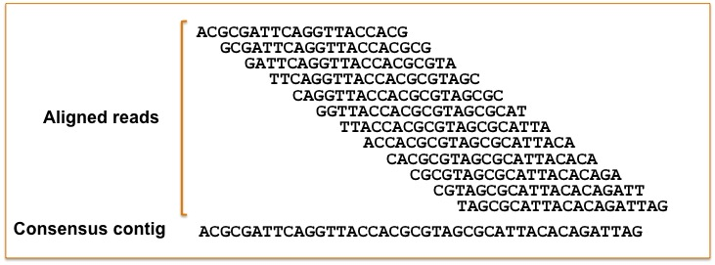
Why not just do overlap assembly
Old methods was just to simply overlap the data, where it matches you can just keep extending ….
Well, that worked with Sanger sequencing. For Illumina, it is estimated this would take a good cluster 100 years!!
Illustration of overlap consensus assembly
https://contig.wordpress.com/2010/02/09/how-newbler-works/

Slide 3
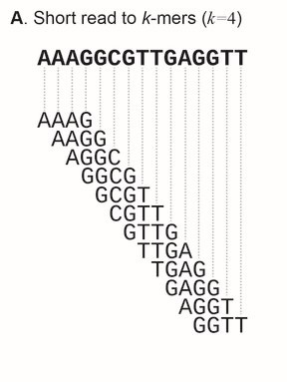
Kmers and De Bruijn graph
In this example, the read is split into 4-mers.
Errors, heterozygosity, contamination, repeats (semi-repeats) can then cause this to be difficult to “untangle”. Untangle: pick the longest path through the graph.
Sohn, J.I. and Nam, J.W., 2018. The present and future of de novo whole-genome assembly. Briefings in bioinformatics, 19(1), pp.23-40.

Slide 4
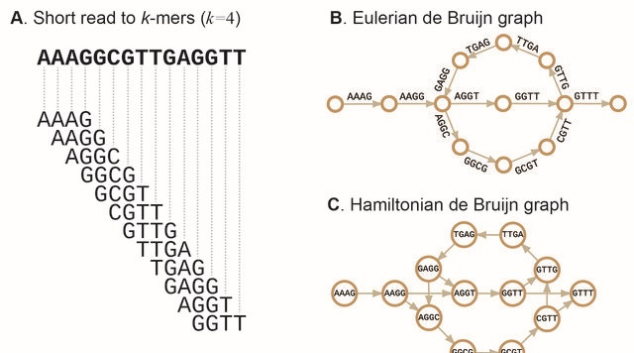
Kmers and De Bruijn graph
In this example, the read is split into 4-mers.
Errors, heterozygosity, contamination, repeats (semi-repeats) can then cause this to be difficult to “untangle”.
Bubbles are formed when there is a conflict in the sequence. Can become impossible, thus a fragmented assembly.
This part could have 100X coverage
Sohn, J.I. and Nam, J.W., 2018. The present and future of de novo whole-genome assembly. Briefings in bioinformatics, 19(1), pp.23-40.

Slide 5
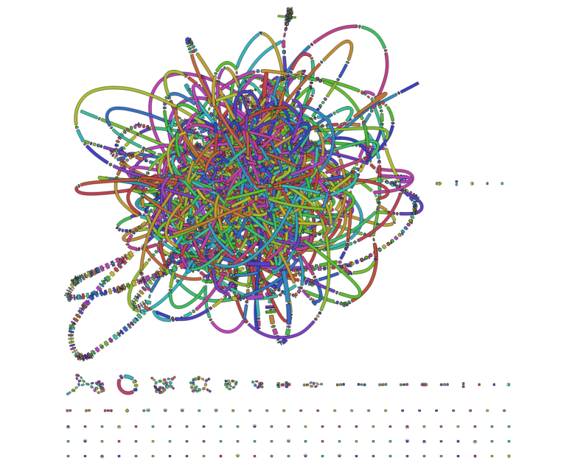
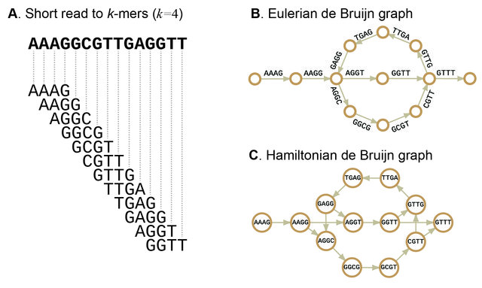
Kmers and De Bruijn graph
Real example of a graph
https://holtlab.net/2015/02/25/bandage-view-and-navigate-assembly-graphs/
Sohn, J.I. and Nam, J.W., 2018. The present and future of de novo whole-genome assembly. Briefings in bioinformatics, 19(1), pp.23-40.

Slide 6
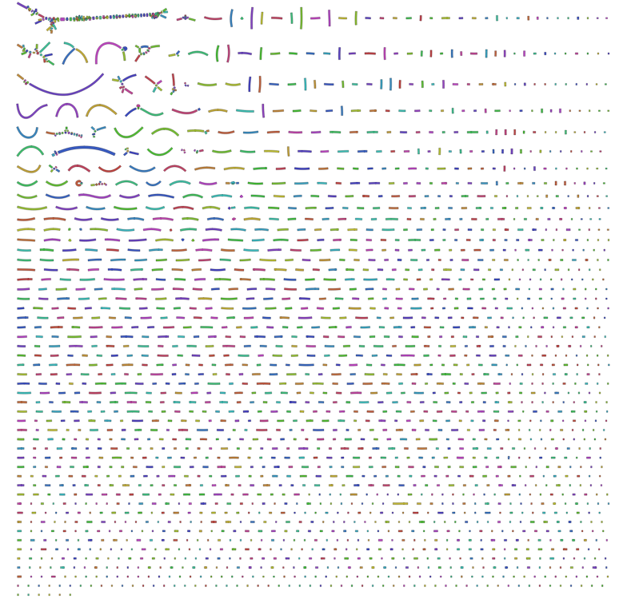
Kmers and De Bruijn graph
A kmer too small results in too many nodes and edges are there are not enough unique kmers for the assembler.
In contrast a kmer too high can lead to not enough coverage and too many unique kmer to join the sequences together leading to a very fragmented assembly
Pick the best: depends on coverage and genome size, read length, quality. Kmergenie!
https://github.com/rrwick/Bandage/wiki/Effect-of-kmer-size

Slide 7
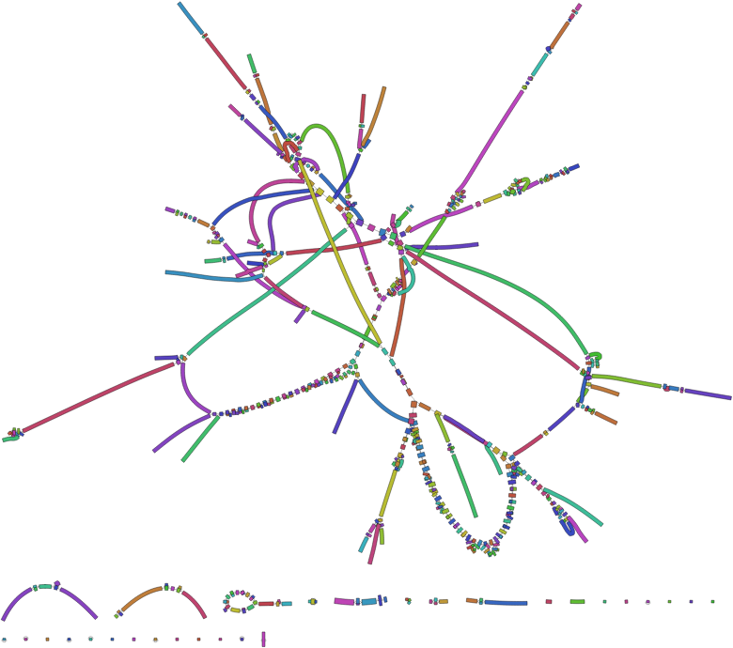
Kmers and De Bruijn graph
kmer too small
kmer too big
~optimal
https://github.com/rrwick/Bandage/wiki/Effect-of-kmer-size

Slide 8
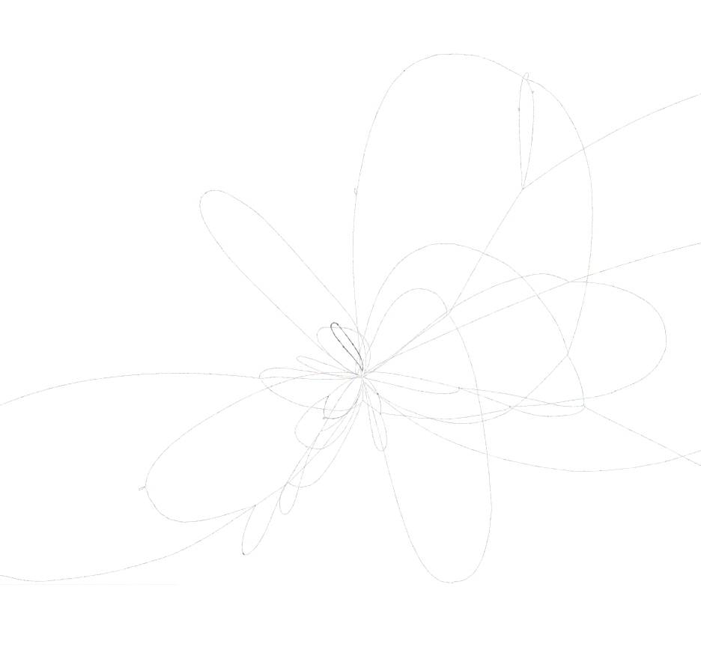
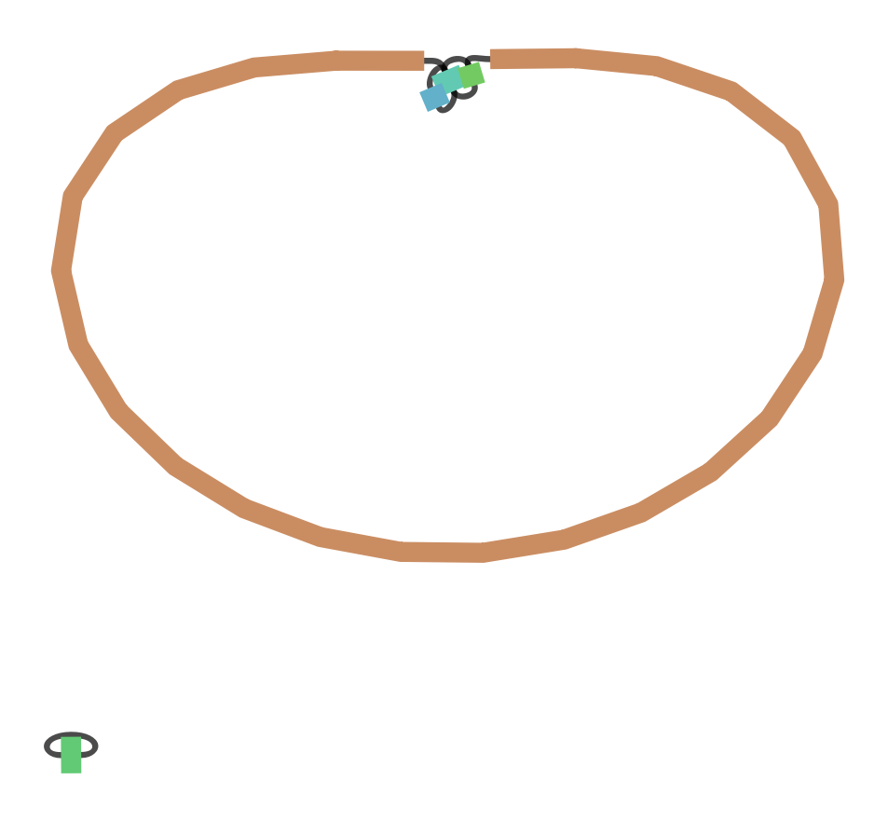
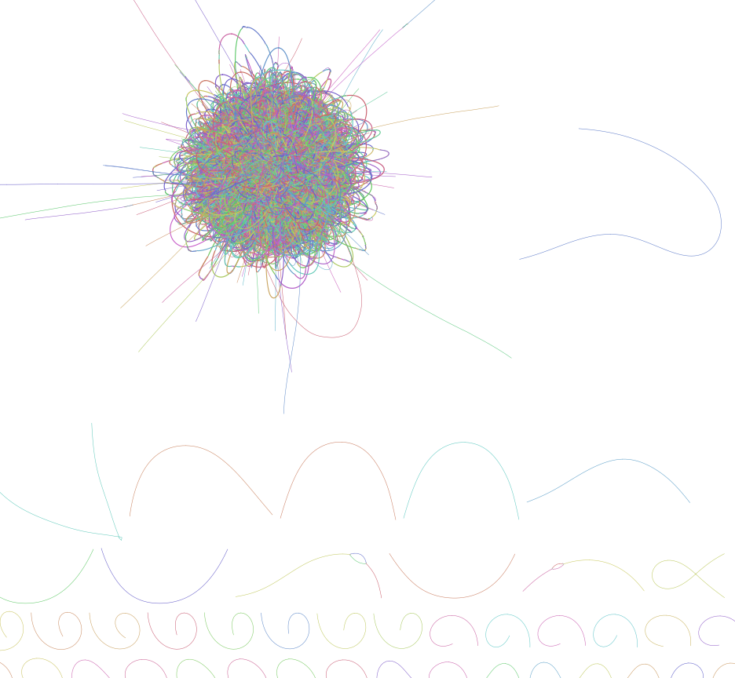
Draw your own graphs (bonus activity)
http://rrwick.github.io/Bandage/
How: https://github.com/rrwick/Bandage/wiki/Getting-started
Use the graphs in the graphs folder (.gfa file) (our dataset!)
K=18 K=53 Unicycler

