Slide 1
4) Shell scripting: prepare reads
We will now go though an example process of preparing reads for bacterial genome assembly.
There are many different tools that do each step. This is just an example.
QC -> quality trim -> QC -> assembly -> assembly stats -> gene prediction
BLAST: what have we just assembled? (an alternative here would be MetaPhlAn)
In order to do any of this, we need a way of “talking to the computer” … shell scripting.

Slide 2
4) Shell scripting
Act as a way for the human to tell the computer what to do.
You can add multiple commands in one shell script.
The easiest way to run the shell script is using the qsub manager on the cluster (more on this later …)
Shell script filenames end in .sh and may have
#!/bin/bash on the first line
#!/bin/bash this tell the computer that program to execute is is bash and this program is found in /bin/

Slide 3
4) Shell scripting – python versions as an example
#!/bin/bash this tell the computer that program to execute is is bash and this program is found in /bin/
Another example would be at the top of your python scripts (python scripting, not shell – but the same principle):
#!/usr/bin/env python3
You can mix python versions within the same software (if you have dependencies that will only work with python 2, for example) by doing this
#!/usr/bin/env python2

Slide 4
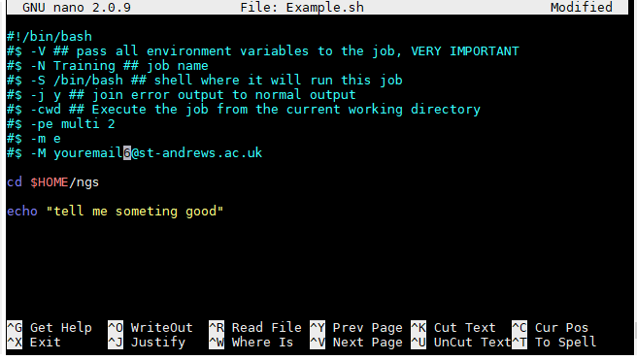
4) Shell scripting: Open the Example.sh
ACTIVITY
Either right click and open with default or nano
cd ./shell_scripts
ls
nano Example.sh (tip: tab name completion…)
#$ are special commands.
You don’t actually need them,
but they are helpful

Slide 5
4) Shell scripting: Open the Example.sh
ACTIVITY
Either right click and open with default or nano
nano Example.sh
#$ are special commands. You don’t actually need them, but they are helpful
cd directory_where_to_run
command
Nano usage commands

Slide 6
4) Shell scripting: Special commands at the top of shell #$
#!/bin/bash
#$ -V # pass all environment variables to the job
#$ -N Mapping # job name
#$ -cwd # Execute from the current working directory
#$ -pe multi 4 # how many core (4)

Slide 7
4) Shell scripting: Help - what command
The get info on what command you need to run from your tool and parameter.
Type: tool_name -h or (--help, --h) - some permutation of that
Or look up the usage on their website.
Email when the job is done
Any command entered here will be run
e.g. python myscript.py
perl myscript.pl
Etc …

Slide 8
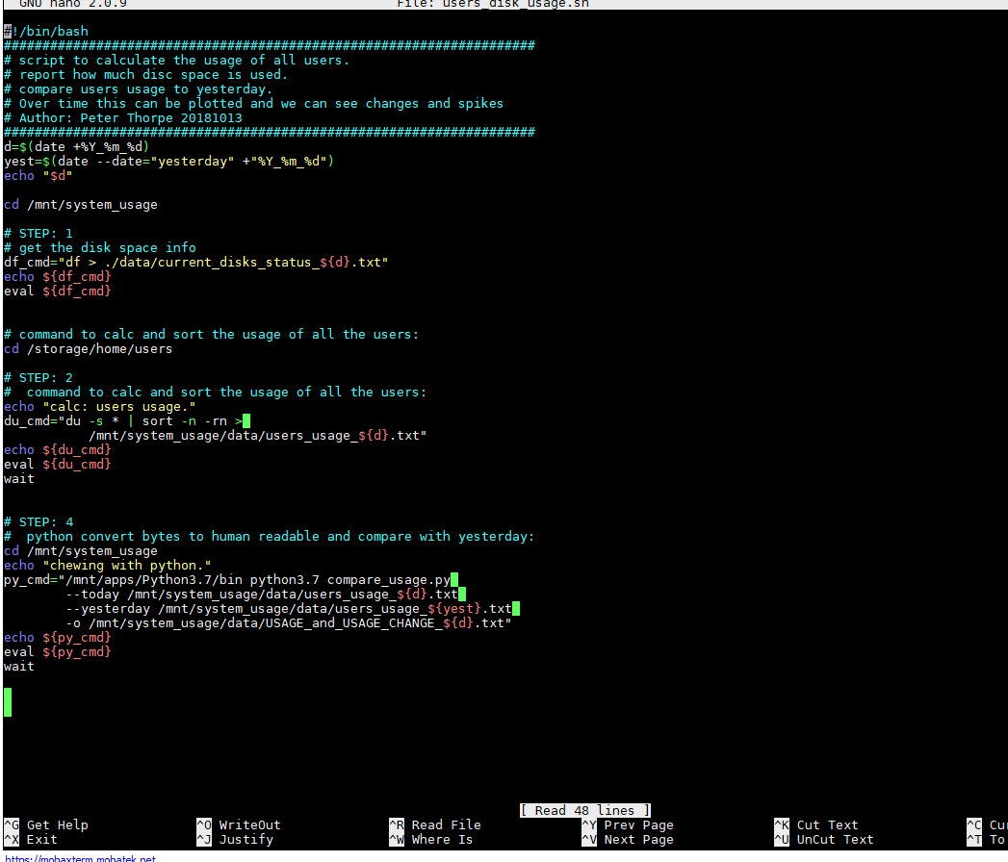
4) Shell scripting: nano command line editor
ACTIVITY
nano by default is black and white. However if you want colours, which I do, copy the .nanorc file from with the ./Msc_Digital_Health folder to your home directory:
cp ./.nanorc ~/
(Copy, from here, a file called, to my home)

Slide 9
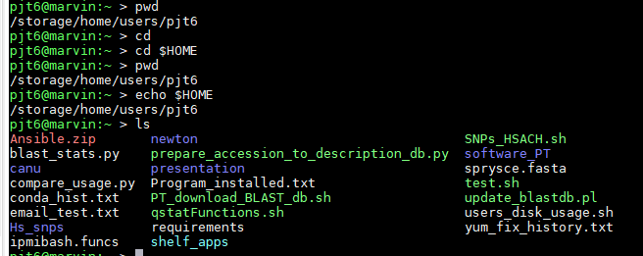
4) Shell scripting: The .sh script has to be “executable”
ACTIVITY
Type:
chmod u+x Example.sh (if it is not executable it will not run!!!)
u = “the users, i.e. you!
+x mean executable.
+rw means read/ write.
Type
ls (executable files are green. Compressed = red. Files = white, Folders = blue)

Slide 10
4) Shell scripting: Colours of files - may differ between programs/ command lines used.
executable
Compressed
Just a file
folder
Symbolic link

Slide 11
4) Shell scripting: The .sh script has to be “executable”
ACTIVITY
Now you can run this:
./Example.sh (this dot slash, just means “here”)
This should just print “something” to the screen using the echo command.
Change this and try again. (to save in nano: type ctrl x, then y for yes, enter)
echo “something in quotes - boom”

Slide 12
4) Shell scripting/ qsub: Run something useful
ACTIVITY
Fastqc on real Illumina data. Open the FastQC.sh file
cd /storage/home/users/${USER}/Msc_Digital_Health/shell_scripts
(tip: tab name completion…)
nano FastQC.sh
This script loads a module called fastqc

Slide 13
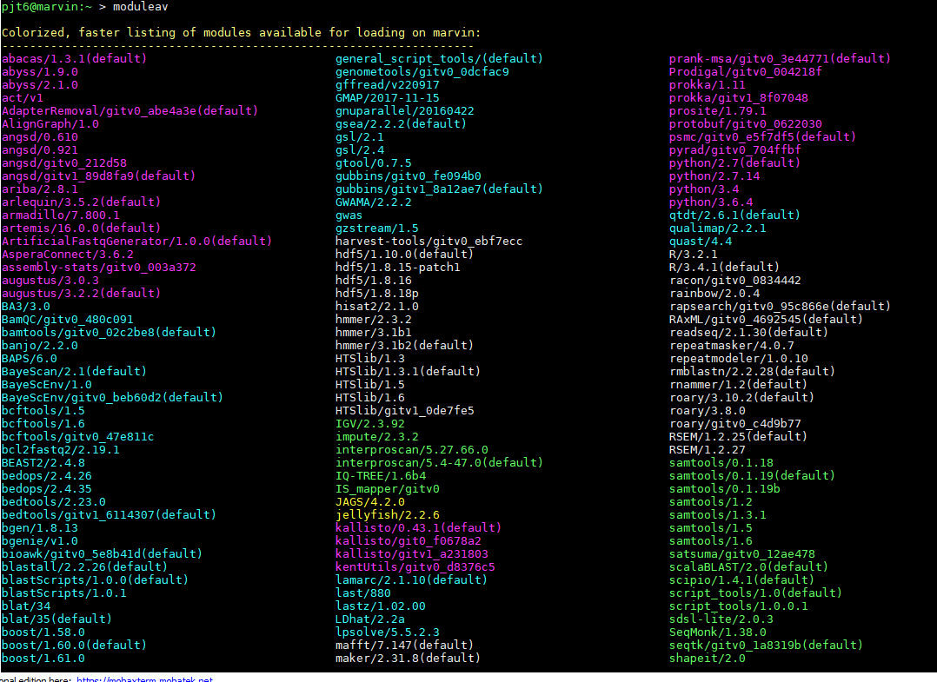
4) Shell scripting/ qsub: Run something useful
ACTIVITY
Fastqc on real Illumina data. Open the FastQC.sh file
moduleav (see a list of pre installed programs/ modules).
To load any of these programs from the list, e.g.
module load name_of_package
module load name/version
module load MUMmer/3.23

Slide 14
4) Shell scripting: basic for loop.
loop and variables. To set up a variable:
filenames=*.fasta (all the fasta files in a directory -> variable)
Now we can loop over all these files and do something
See next slide
Example:
https://github.com/peterthorpe5/public_scripts/blob/master/metapy_tools/shell_scripts/Interogate_controls_all_folders.sh

Slide 15
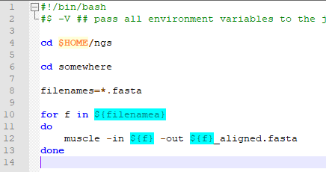
4) Shell scripting: basic for loop (easy)
For loop and variables
This aligns and refines all
Fasta files in a directory
For loop set between the
do and done
https://www.cyberciti.biz/faq/linux-unix-bash-for-loop-one-line-command/
In one line:
for f in ${filenames}; do muscle -in ${f} -o {f}.aln; done

Slide 16
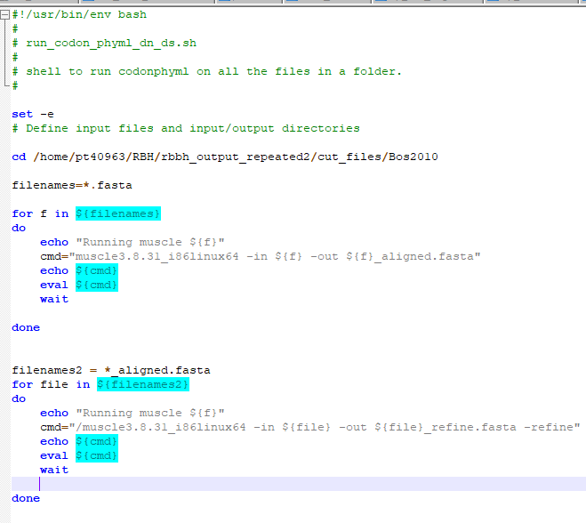
4) Shell scripting: basic for loop (more complex)
For loop and variables
Aligns and refines all fasta files in a directory
* is a wild card
All *.fasta files are assigned to a variable called filenames.
We then loop through all fasta files, each loop we assign “that” fasta file to the variable f
To call the variable in bash you need ${variable}

Slide 17

4) Shell scripting: basic for loop (more complex)
For loop and variables
Aligns and refines all Fasta files in a directory
set -e break the script at the First error (useful in pipelines)
echo put useful info to .o file for future debugging
The command assigned to a variable called cmd, which is echoed to a file and set to eval (evaluate) to be run
wait is a Linux command to wait until all other Linux commands are completed.
do and done set the boundaries of the for loop.

Slide 18
Earlier example: More fancy and reboust way of counting the reads in all files in a directory
In the previous example we “grepped for a specific string. This changes between data sets, so will not always work. This example will make sense as we go through the material
files=*R1.fastq.gz
for f in ${files}
do
echo ${f} >> read_pairs.counts
zcat ${f} | echo $((`wc -l`/4)) >> read_pairs.counts
done

Slide 19
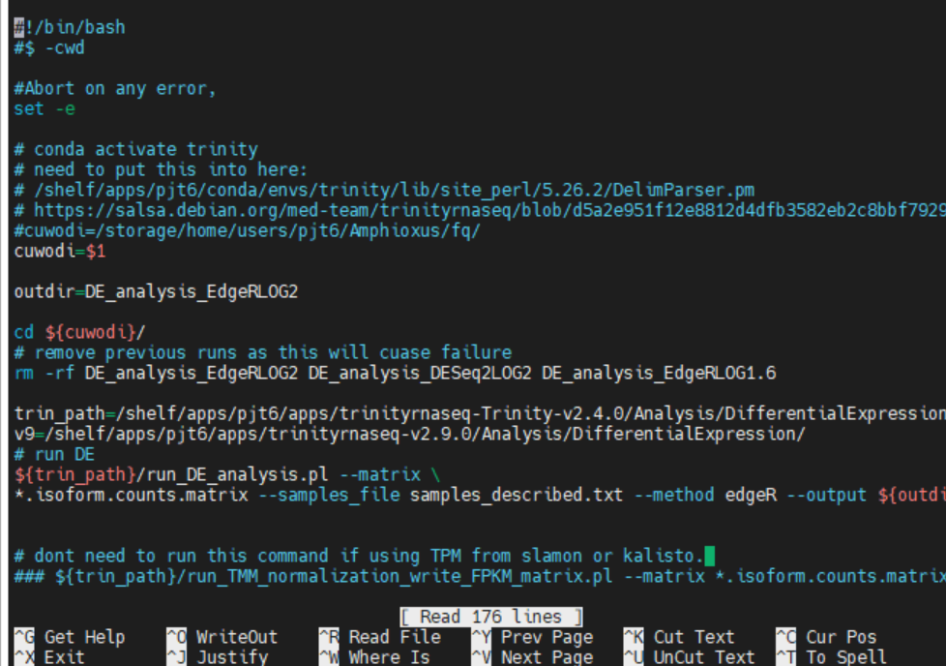
4) Shell scripting: command line arguments
https://www.linuxtechi.com/command-line-arguments-in-linux-shell-scripting/
$1 is the first string after the script name at the command line
$2 is the seconds string after the script name at the command line
$3 is the third string after the script name at the command line
Etc …….

