Slide 1
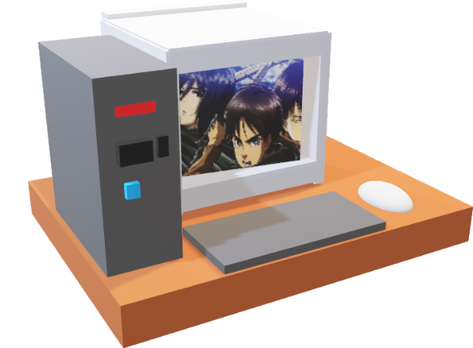
2) Getting connected
Windows:
Putty https://www.putty.org/
WinSCP https://winscp.net/eng/download.php,
Mobaxterm https://mobaxterm.mobatek.net/,
Mac/ Linux:
Cyberduck https://cyberduck.io/
command line
Other programs recommended to have: Filezilla, (Windows: Notepad++, Linux gedit)
COURSEWORK READS: /scratch/bioinf/digital_health/coursework_reads

Slide 2
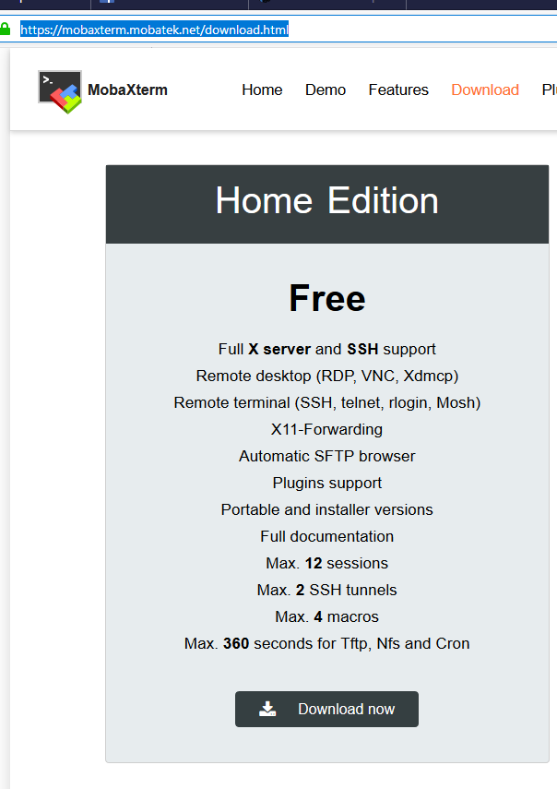
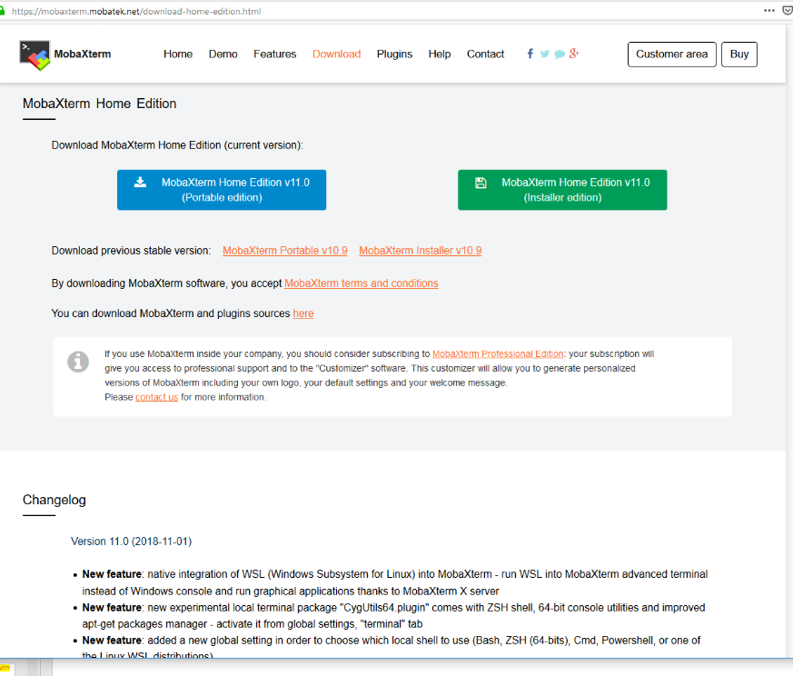
2) Getting connected: Mobaxterm
1
(Without admin access)
3
2

Slide 3
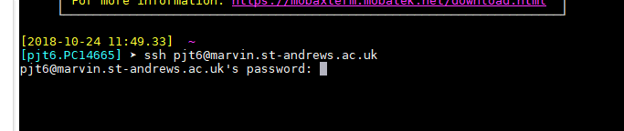
2) Getting connected: Example using Mobaxterm
ACTIVITY
Type (for marvin): ssh USERNAME@marvin.st-andrews.ac.uk
For kennedy (mobaxterm): ssh -i /drives/c/Users/USERNAME/.ssh/putty_priv.ppk USERNAME@kennedy.st-andrews.ac.uk
Then enter your password (when prompted). This is the same way for all the programs.

Slide 4
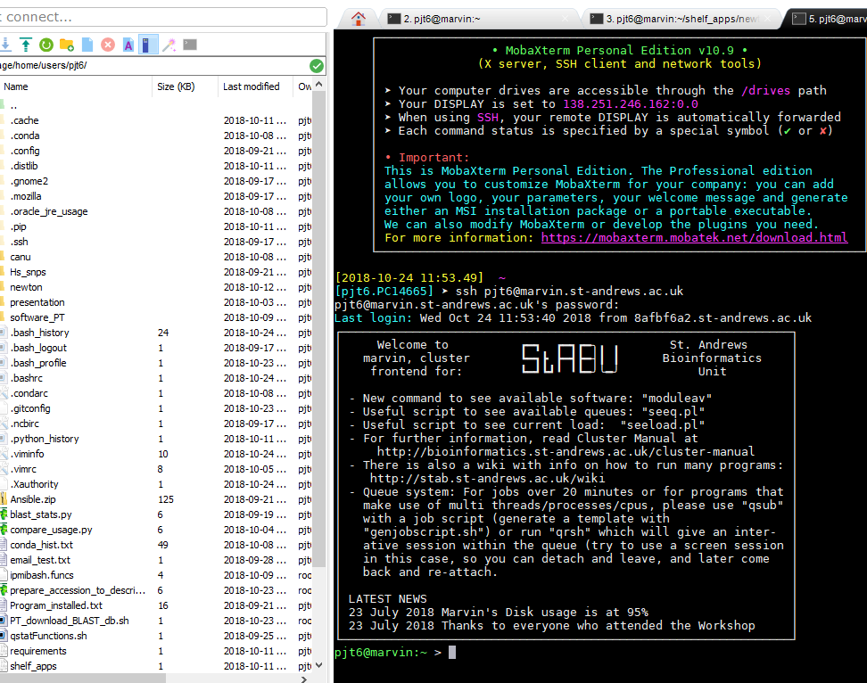
2) Getting connected: You are logged in
You will see your files on the left and a terminal on the right.
You automatically log into your home directory ($HOME, ~)

Slide 5
2) Getting connected: getting the presentation
Need to set up a syn link first???
cp -rv /scratch/bioinf/digital_health/ ~/scratch/bioinf/${USER}
Make sure you have the software ready to use
export PATH=/gpfs1/scratch/bioinf/BL4273/conda/envs/genome_workshop/bin/:$PATH
You should all have connected before, so we can end part session here.

Slide 6
2) Getting connected: to disconnect
ACTIVITY
Simply close the program down using the red cross
Type: logout
Or ctrl + d

