Slide 1
6) assembly: Bacterial genome assembly
BLAST: identify
Quality control
Quality trim
Quality control
Assemble (different kmers, different tools)
Predict genes
Draw a genome diagram with the genes marked

Slide 2
Get some long jobs running
Paste the following into the terminal to copy all the data to your home directory.
cp -rv /scratch/bioinf/digital_health ~/scratch/$USER/
Make sure you have the software ready to use (or use conda):
export PATH=/gpfs1/scratch/bioinf/BL4273/conda/envs/genome_workshop/bin/:$PATH
cd into the shell_scripts folder (tab auto complete!!)
cd $HOME/scratch/$USER/digital_Health/shell_scripts
conda activate unicyclerENV
sbatch unicycler.sh
sbatch spades.sh

Slide 3
6) assembly: Bacterial genome assembly
As an example we will assembly a bacterial data set.
You will tell me what it is after. (this is what your assessment is based on)
This is not the best approach, but a fast and resource savvy approach for training purposes.

Slide 4
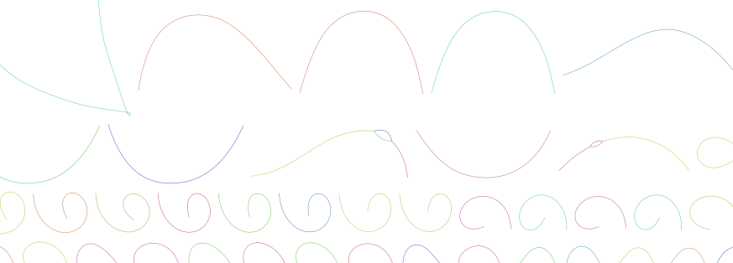
6) assembly: Bacterial genome assembly
Bacterial genome is circular (with unknown number of separate plasmids).
The circular genome (plus plasmids) is sequenced resulting in ~million(s) of 150 - 300bp fragments called reads (in the fastq file). (even more if you ask for more reads, length depends on what you ask for too).
Original genome million of fragments - Illumina complex jigsaw puzzle
The likely result is a fragmented mess ☺

Slide 5
6) assembly: fastqc
ACTIVITY
Lets look at the Illumina data (fragments) and get some metrics on the “quality”
Fastqc is a program to “look” at the predicted quality scores per base (probability of being called correctly). As this is a probability, we want to know if the data is good or poor quality.
Fastqc: Open the FastQC.sh file
Read more: https://www.bioinformatics.babraham.ac.uk/projects/fastqc/
Usage: fastqc infile.fq.gz
BLAST: identify
Quality control
Quality trim
Quality control
Assemble (different kmers, different tools)
Predict genes
Draw a genome diagram with the genes marked

Slide 6
4) Shell scripting/ qsub: Run something useful
ACTIVITY
Submit this by typing:
sbatch FastQC.sh (Don’t forget tab competition!)
Fastqc output files are in ./reads/
Download these and view them in Firefox/ or other (double click on the html file):
Or drag and drop from Mobaxterm or filezilla

Slide 7
4) Fastq (fq) format (Illumina output) as input to Fastqc. (.gz just means they are compressed)
ACTIVITY
The input to most of the following steps, are the fastq (or compressed fastq.gz) files.
@ERR861370.21 M00596:40:000000000-A712Y:1:1101:11010:1548/1 (unique read name)/1 (mean left read
GTCCAGAACTGTCTTCTGTAAATCTTTCTTGTACCTCCTGCAGTAT (sequence)
+ (+)
-B@C<8<@CF9FEFFFGAF9<<EEFGGEFF9E9CCC,CF<,,C,,< (ascii quality score encoding)
Each base is “quality scored” based on a probability score of it being correct.
Q15: p = 0.03
Q30: p = 0.001
Read more: https://en.wikipedia.org/wiki/FASTQ_format

Slide 8
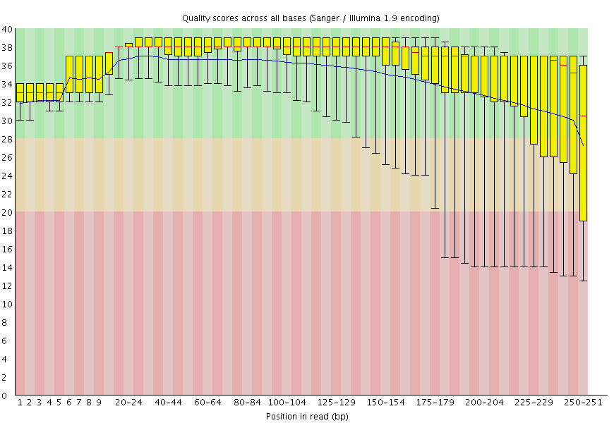
4) Fastqc output
ACTIVITY
https://en.wikipedia.org/wiki/FASTQ_format
Per base quality
As we move along the read the quality decreases

Slide 9
4) Fastqc output
ACTIVITY
https://en.wikipedia.org/wiki/FASTQ_format
Q15 line: p = 0.03 of the base being correctly called. When you have 1 billion bases, there are still many by chance that will be incorrect.

Slide 10

6) assembly: Trim reads for quality
ACTIVITY
The avoid assembling errors, or low quality bases (base calling is based on the probability of that base being called correctly)- we need to trim the raw reads before using them, using tools such as:
trimmomatic: http://www.usadellab.org/cms/?page=trimmomatic
BLAST: identify
Quality control
Quality trim
Quality control
Assemble (different kmers, different tools)
Predict genes
Draw a genome diagram with the genes marked

Slide 11
6) assembly: Trim reads for quality
ACTIVITY
Remove low quality bases
http://www.usadellab.org/cms/?page=trimmomatic
Trim command: qsub trimmomatic.sh
java -jar /shelf/training/Trimmomatic-0.38/trimmomatic-0.38.jar PE -summary trim_summary.txt -threads 2 -phred33 ./reads/subsampled_R1.fastq.gz ./reads/subsampled_R2.fastq.gz subsampled_R1_paired.fastq.gz subsampled_R1_unpaired.fastq.gz subsampled_R2_paired.fastq.gz subsampled_R2_unpaired.fastq.gz ILLUMINACLIP:/shelf/training/Trimmomatic-0.38/adapters/TruSeq3-PE.fa:2:30:10 LEADING:3 TRAILING:3 SLIDINGWINDOW:4:15 MINLEN:45
Min Q value: for example is 30 was here, it is 1 in 1000 chance of being correct. Q15 P = 0.03.
*Note in the shell script line lines are split up with \ character

Slide 12
6) assembly: Fastqc Trim reads
ACTIVITY
First look at the trim summary file.
Run fastqc on the trimmed reads
Input Read Pairs: 500000
Both Surviving Reads: 487861
Both Surviving Read Percent: 97.57
Forward Only Surviving Reads: 10907
Forward Only Surviving Read Percent: 2.18
Reverse Only Surviving Reads: 692
Reverse Only Surviving Read Percent: 0.14
Dropped Reads: 540
Dropped Read Percent: 0.11
BLAST: identify
Quality control
Quality trim
Quality control
Assemble (different kmers, different tools)
Predict genes
Draw a genome diagram with the genes marked

Slide 13
4) Fastqc output – after trimming
ACTIVITY
https://en.wikipedia.org/wiki/FASTQ_format
Q15 line: p = 0.03 of the base being correctly called. When you have 1 billion bases, there are still many by chance that will be incorrect.
You should see that this is far fewer errors now. Less errors will be less confusing to the assembler
* note: some modern assemblers like all the data and they deal with the error themselves.
Quality control
Quality trim
Quality control
Assemble
Predict genes

Slide 14

6) Put the “jigsaw together” - Velvet
Original genome million of fragments (error removed at Q15) complex jigsaw puzzle
Quality control
Quality trim
Quality control
Assemble (different kmers, different tools)

Slide 15
6) assembly: Assemble these reads with Velvet
ACTIVITY
This takes a while, so get it going!!!!
sbatch assembly.sh
BLAST: identify
Quality control
Quality trim
Quality control
Assemble (different kmers, different tools)
Predict genes
Draw a genome diagram with the genes marked

Slide 16
6) assembly: Assemble these reads with Velvet
ACTIVITY
This takes a while, so get it going!!!!
sbatch assembly.sh
Velvet is the only purely De Bruijn graph assembler. (which is fast but does not use other methods - hence the result is not good)
If you wish to change the kmer value in the assembly, look at the shell script
See what happened if you run k at 17, 127, 53
BLAST: identify
Quality control
Quality trim
Quality control
Assemble (different kmers, different tools)
Predict genes
Draw a genome diagram with the genes marked

Slide 17
6) assembly: Velvet assembly.
ACTIVITY
https://en.wikipedia.org/wiki/Velvet_assembler
Edit this: assembly.sh
velveth -h
velveth directory kmer_length -shortPaired -fastq R1.fastq.gz R2.fastq.gz
velvetg directory
Do this with :
1) the raw reads
2) the quality trimmed reads … does this impact the assembly?
Alter the kmer value if you wish. (must be odd)

Slide 18
6) assembly: Assemble these reads with Velvet
ACTIVITY
This takes a while, so get it going!!!!
sbatch assembly.sh
BONUS question: can you write a script (for loop) that will run Velvet for every odd kmer value between 55 and 127?
BLAST: identify
Quality control
Quality trim
Quality control
Assemble (different kmers, different tools)
Predict genes
Draw a genome diagram with the genes marked

Slide 19
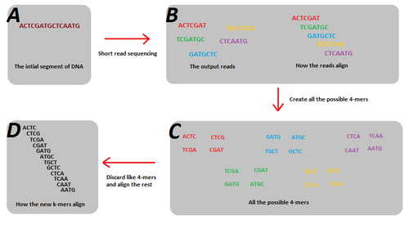
6) assembly: Velvet assembly.
ACTIVITY
What is a kmer (“split the sequence” into “kmer_length” chunks):
There is an extra presentation here explaining this more and lots of resources online. We will not dwell on this due to time limitations.

Slide 20
6) assembly: Kmer length
Kmer length too low: not enough unique kmers, fragmented incomplete assembly. Too many connections.
Kmer length too high: Not enough coverage. Kmers too many unique, not enough connections.
Open: Kmers_and_graphs.pptx

Slide 21
6) assembly: Velvet assembly, N50?
ACTIVITY
N50 is a way of giving a “number” to represent how contiguous (how connected together) your assembly is
The N50 is defined as the sum of the lengths of all contigs of size N50 or longer contain at least 50 percent of the total genome sequence.
https://en.wikipedia.org/wiki/N50,_L50,_and_related_statistics#:~:text=Given%20a%20set%20of%20contigs,of%20the%20total%20genome%20length.&text=N50%20can%20be%20described%20as,or%20larger%20than%20this%20value.

Slide 22
6) assembly: Velvet assembly, N50?
ACTIVITY
Lets get some N50 scores and other stats too:
perl $HOME/scratch/digital_Health/shell_scripts/scaffold_stats.pl -f $HOME/scratch/digital_Health/*/contigs.fa
Look at the precomputed results excel sheet if you wish.
Save the results to a file (anything printed to screen.. > ):
perl $HOME/scratch/Msc_Digital_Health/shell_scripts/scaffold_stats.pl -f $HOME/Msc_Digital_Health/*/contigs.fa $HOME/Msc_Digital_Health/*/assembly.fasta $HOME/Msc_Digital_Health/*/scaffolds.fasta > OUTPUT.txt
The N50 is defined as the sum of the lengths of all contigs of size N50 or longer contain at least 50 percent of the total genome sequence.
Scaffold stats script: https://github.com/blaxterlab/scripts/tree/master/tools

Slide 23
6) assembly: output format (fasta, fa)
ACTIVITY
The main file you will work with is called assembly.fa or some programs will output a XYZ.fasta . This is like so:
>NAME_OF_CONTIG_1
ATTAGGGGGGGCGGA … etc seq
>NAME_OF_CONTIG_2
ATTACCCCCCCCCCCGGA … etc seq
>NAME_OF_CONTIG_3
ATTTTTTTTTTTTTGA … etc seq
Each > is a new contig (assembled fragment). There can be many many thousands of these. How many should a bacteria have??
A contig is an assembled part of the genome containing zero NNNs (N is an unknown base, which cannot be resolved).
Scaffolds are collections of 2 or more contigs separated by NNNs, but the congis can only be put together when there is evidence.

Slide 24
Pause the assembly training for something cool
Conda
Open the conda PowerPoint (7_Conda.pptx) ( we wont do this, but feel free to read at a later point!!)

Slide 25
6) assembly: Predict the genes from our assembly.
ACTIVITY
There is no point in having a genome assembly without predicting the genes!!
What are genes?
To do this we are going to use prokka. https://angus.readthedocs.io/en/2017/prokka_genome_annotation.html
BLAST: identify
Quality control
Quality trim
Quality control
Assemble (different kmers, different tools)
Predict genes
Draw a genome diagram with the genes marked

Slide 26
6) assembly: Predict the genes from our assembly.
ACTIVITY
Lets install Prokka to predict the bacterial genes:
Create an env with prokka installed
conda create -n prokkaENV prokka
conda activate prokkaENV
qsub predict_genes.sh
BLAST: identify
Quality control
Quality trim
Quality control
Assemble (different kmers, different tools)
Predict genes
Draw a genome diagram with the genes marked

Slide 27
Prokka output: Many files.
PROKKA_11122018.err PROKKA_11122018.ffn PROKKA_11122018.fsa PROKKA_11122018.gff PROKKA_11122018.sqn PROKKA_11122018.tsv
PROKKA_11122018.faa PROKKA_11122018.fna PROKKA_11122018.gbk PROKKA_11122018.log PROKKA_11122018.tbl PROKKA_11122018.txt
…….
gff is a genome feature file.
faa is the amino acid sequences of the gene. fna is the nucleotide sequence of the genes.
gbk is the data in a genbank format - which genbank dont accept as a submission file ☺

Slide 28
Prokka output: Draw it!! (Genome diagram)
Why draw the genes on the genome? – well, you can get a visual representation of where you genes of interest are. The direction of coding. Any clusters? Operons?
Plus it is fun!
BLAST: identify
Quality control
Quality trim
Quality control
Assemble (different kmers, different tools)
Predict genes
Draw a genome diagram with the genes marked

Slide 29
Prokka output: Draw it!!
cd $HOME/genome_assembly_workshop/unicycler_prerun
conda activate python36
/shelf/apps/pjt6/conda/envs/python36/bin/python Genome_diagram.py
conda deactivate
Download and look at the pdf files. Lovely right ☺
BLAST: identify
Quality control
Quality trim
Quality control
Assemble (different kmers, different tools)
Predict genes
Draw a genome diagram with the genes marked

Slide 30
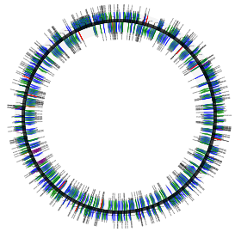
Circular version

Slide 31
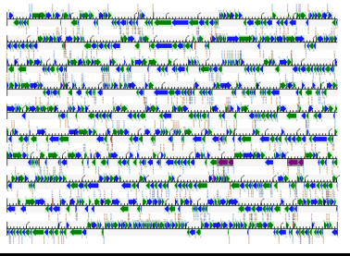
Linear
version

Slide 32
6) assembly: BLAST a seq against GenBank nt
ACTIVITY
We have an unknown sample. Which we have assembled .. to varying levels of contiguity.
We will take a snippet (to save time) of this assembly and compare this to a public database of all known nucleotide sequences (GenBank nt – just like when you do BLAST over the internet).
(Nucleotide BLAST vs nt database (blastn))
BLAST: identify
Quality control
Quality trim
Quality control
Assemble (different kmers, different tools)
Predict genes
Draw a genome diagram with the genes marked

Slide 33
6) assembly: BLAST a seq against GenBank nt
ACTIVITY
Blastn - nucleotide versus genbank nt (everything that was known and in the database at the time of download)
https://blast.ncbi.nlm.nih.gov/Blast.cgi
Look at this website for different BLAST tools. And output formats
blastn -help
BLAST: identify
Quality control
Quality trim
Quality control
Assemble (different kmers, different tools)
Predict genes
Draw a genome diagram with the genes marked

Slide 34
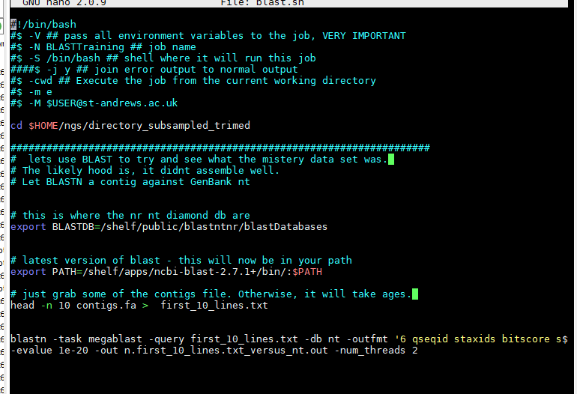
6) assembly: BLAST a seq against GenBank nt
ACTIVITY
Blast is not fast.
Blastn - nucleotide versus nt
https://blast.ncbi.nlm.nih.gov/Blast.cgi
nano ./shell_scripts/blast.sh
Blast database location
GeneBank: nr, nt, swissprot, human and these as Diamond databases

Slide 35
6) assembly: BLAST a seq against GenBank nt
ACTIVITY
Blast is not fast.
Blastn - nucleotide versus nt
https://blast.ncbi.nlm.nih.gov/Blast.cgi
Blast database location
Blast software
Get a snippet from the assembly
Blastn command

Slide 36
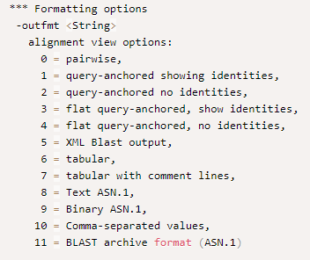
6) assembly: BLAST a seq against GenBank nt
ACTIVITY
Change the output format:
blastn -query seq.fa -db nt -outfmt 1 -evalue 1e-40 -out file.out -num_threads 4
outfmt 6 is the most useful: http://www.metagenomics.wiki/tools/blast/blastn-output-format-6

Slide 37
6) assembly: BLAST a seq against GenBank nt
ACTIVITY
Change the output format:
blastn -task megablast -query first_10_lines.txt -db nt -outfmt '6 qseqid staxids bitscore std scomnames sscinames sblastnames sskingdoms stitle' -evalue 1e-20 -out n.first_10_lines.txt_versus_ntOutfmt6.out -num_threads 4
Outfmt 6 is the
most useful: http://www.metagenomics.wiki/tools/blast/blastn-output-format-6
Have a look at the results …. What did you assemble?

Slide 38
BLAST?
In most cases you wouldn’t use BLAST for this you would use: The Genome Taxonomy Database (GTDB) (https://gtdb.ecogenomic.org/) is an initiative to establish a standardised microbial taxonomy based on genome phylogeny.
GTDB-Tk (https://github.com/Ecogenomics/GtdbTk) .
However, BLAST does work for what we want

Slide 39
Further reading
Assembly introduction: http://data-science-sequencing.github.io/Win2018/lectures/lecture5/
Greedy algorithm: http://data-science-sequencing.github.io/Win2018/lectures/lecture6/
De bruijn graph: http://data-science-sequencing.github.io/Win2018/lectures/lecture7/
Spades: https://www.liebertpub.com/doi/full/10.1089/cmb.2012.0021
BLAST: https://blast.ncbi.nlm.nih.gov/Blast.cgi?CMD=Web&PAGE_TYPE=BlastDocs
Intro to UNIX: http://www.ee.surrey.ac.uk/Teaching/Unix/unixintro.html
Genome assembly basics (or you can google anything genome assembly based): https://www.ncbi.nlm.nih.gov/assembly/basics/
The majority of the workshop will be based on this: https://github.com/peterthorpe5/genome_assembly_workshop
How to use the cluster https://github.com/peterthorpe5/Sys_admin (although this may not be the cluster we will be using during the workshop).
Sohn, J.I. and Nam, J.W., 2018. The present and future of de novo whole-genome assembly. Briefings in bioinformatics, 19(1), pp.23-40.
BLAST: ftp://ftp.ncbi.nlm.nih.gov/pub/factsheets/HowTo_BLASTGuide.pdf
Essential reading: https://github.com/rrwick/Unicycler
http://sepsis-omics.github.io/tutorials/modules/velvet/

