Slide 1
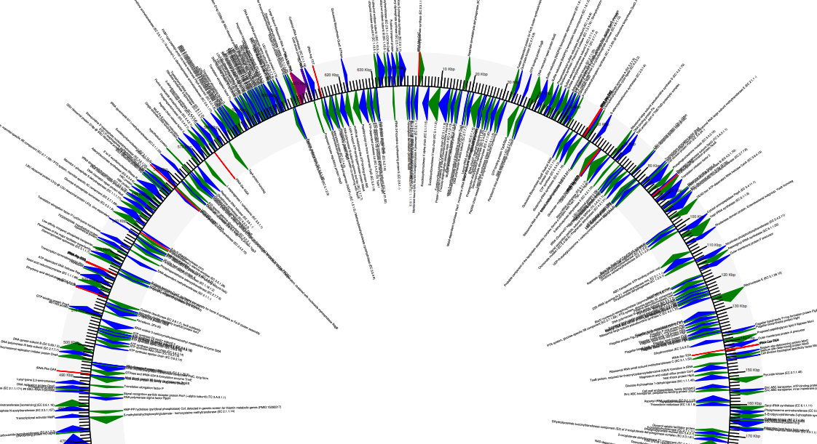
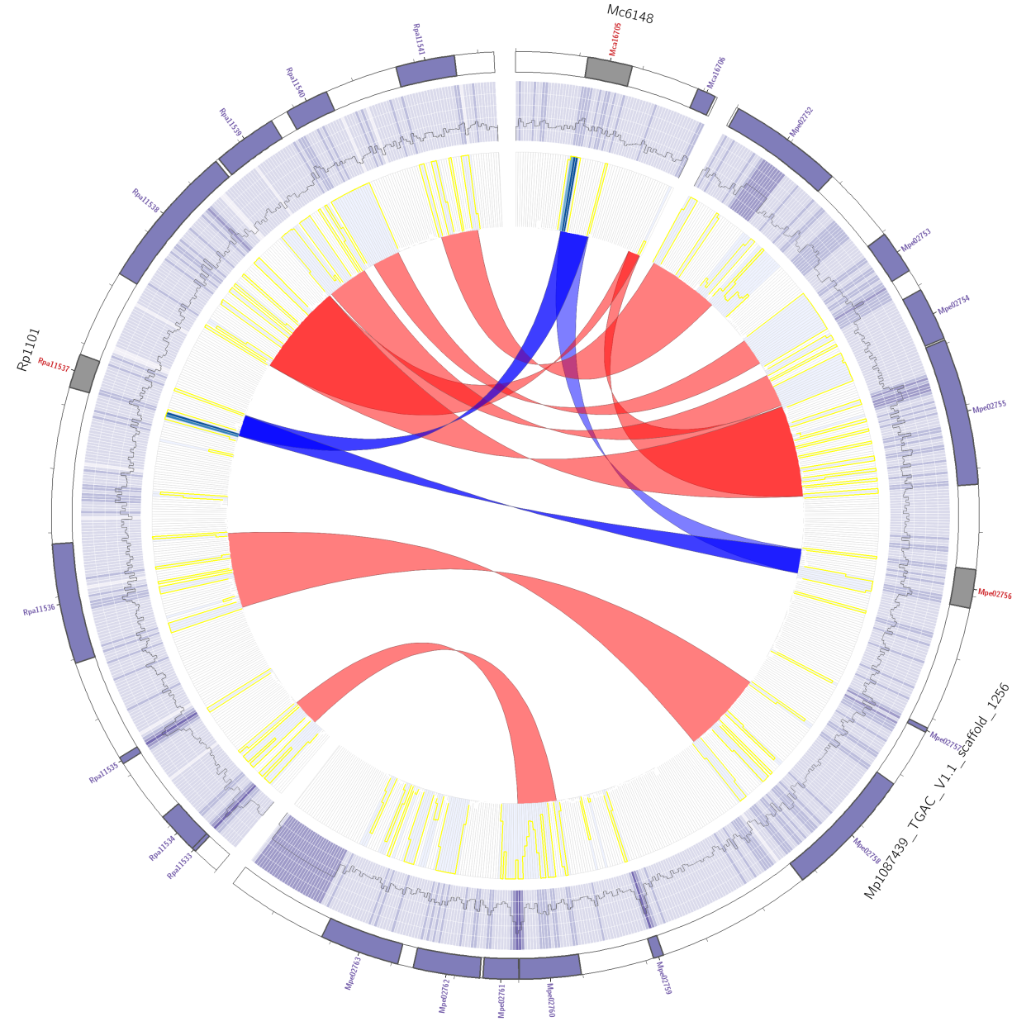
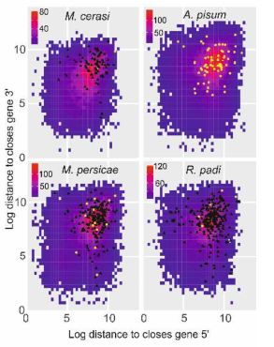
Bacterial Genome Assembly
Unknown Illumina bacterial assembly.

Slide 2
Intro
There is going to be too much here for you to remember!
This is an extensive resource with a lot of extra info for you to look back at. You wont remember it all … don’t try, just know you can look back at it!!
This is HARD. Some of you will struggle. I know genetics may not be your background, so I will not focus on this.
Therefore, we will all go through it together. All commands for the example are in the scripts for you.

Slide 3

1) Bioinformatics is the future
If you google search “lab” based jobs versus “Bioinformatics” ….
This workshop is going to be tough. Don’t be scared. Pleeeeease shout out if you don’t understand … too fast … if you are thinking it, someone else is too!!!

Slide 4
1) Cluster overview: Getting help
There is going to be too much in here for you to remember. So you can:
Look back at this presentation
Website: http://stab.st-andrews.ac.uk/wiki/index.php/Main_Page
Google is amazing! - I have to look up stuff ALL the time

Slide 5
2) Getting connected
Open this power point (you wont be able to yet!). Learn how to connect to Marvin (2_Getting_connected.pptx)

Slide 6
3) Basic UNIX: open the PowerPoint
Short practical, basic UNIX commands (3_basic_UNIX.pptx)

Slide 7
4) Shell scripting: open the PowerPoint
Here we learn how to “talk to the computer” (4_Shell_scripting.pptx)

Slide 8
5) qsub: submitting jobs to the server.
Now we have learnt how to write shell scripts, we can now submit jobs to the cluster via qsub
Open 5_qsub.pptx

Slide 9
Moving on to an actual example
I know there was a lot of background … but…
Now we know how to write shell script.
Lets do a bacterial genome assembly as an example
We have already looked at fastqc to qc our read files.
BLAST: identify
Quality control
Quality trim
Quality control
Assemble (different kmers, different tools)
Predict genes
Draw a genome diagram with the genes marked

Slide 10
THE ACTUAL PROBLEM
We will assemble the sequencing output from a patient with an unknown infection … A swab was taken, plated and a single colony was sent for Illumina Miseq sequencing. Can we identify what it was?
(your coursework is an extension to this where we have data from multiple patients)
Open 6_assembly.pptx
BLAST: identify
Quality control
Quality trim
Quality control
Assemble (different kmers, different tools)
Predict genes
Draw a genome diagram with the genes marked

Slide 11
6) Pull it all together: A full pipeline?
Downloads some reads
QC, trim.
Assemble reads with different kmers. You choose.
Produce assembly stats using the perl script,
Predict genes
Blast a bit of it to find out what it was
Assemble with more modern software.
Polish with Unicycler.

Slide 12
8) Downloading: scp - transfer files
scp <filename> <username>@marvin.st-andrews.ac.uk:~
To copy an entire directory, you need to add the -r to the scp command above-
Copy something FROM marvin TO your machine. For this, the reverse
enter marvin and type:
scp -rp <directoryname> <username_on_your_computer>@<IP_number_of_your_computer>:/</desired/path_on_your_computer>

Slide 13
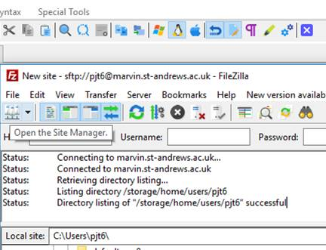
8) Downloading: transfer files Filezilla https://filezilla-project.org/download.php
Step 1. Open host

Slide 14
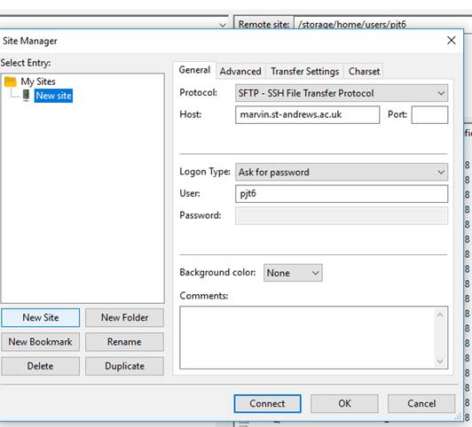
8) Downloading: transfer files Filezilla
2) When the next dialogue page comes up, click on “new site” (button , not the folder). Change the Protocol to SFTP. This is essential. Fill out the rest, use this host and port: 22.
Once connected, you can drag and drop files from one window to the next.
sfpt

Slide 15
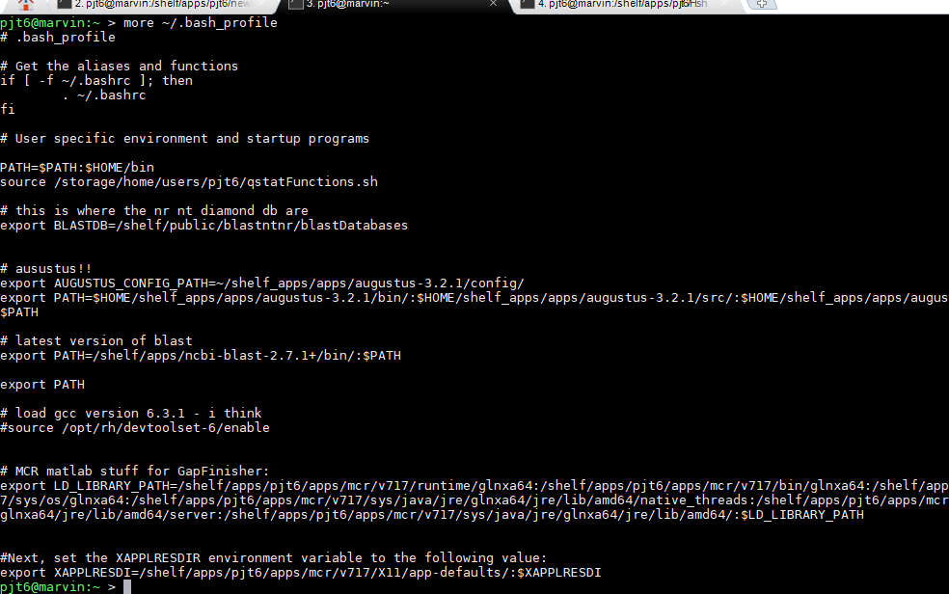
9) Advanced: .bash_profile
ACTIVITY
This is beyond a beginners course, but just to make you aware of it…
Type: more ~/.bash_profile
This is where you can tell the server to
“look for programs”, set environmental
variables, and other magic!!
I put the latest BLAST in, with db:
export PATH=/shelf/apps/ncbi-blast-2.7.1+/bin/:$PATH
# this is where the nr, nt, diamond db are
export BLASTDB=/shelf/public/blastntnr/blastDatabases

Slide 16
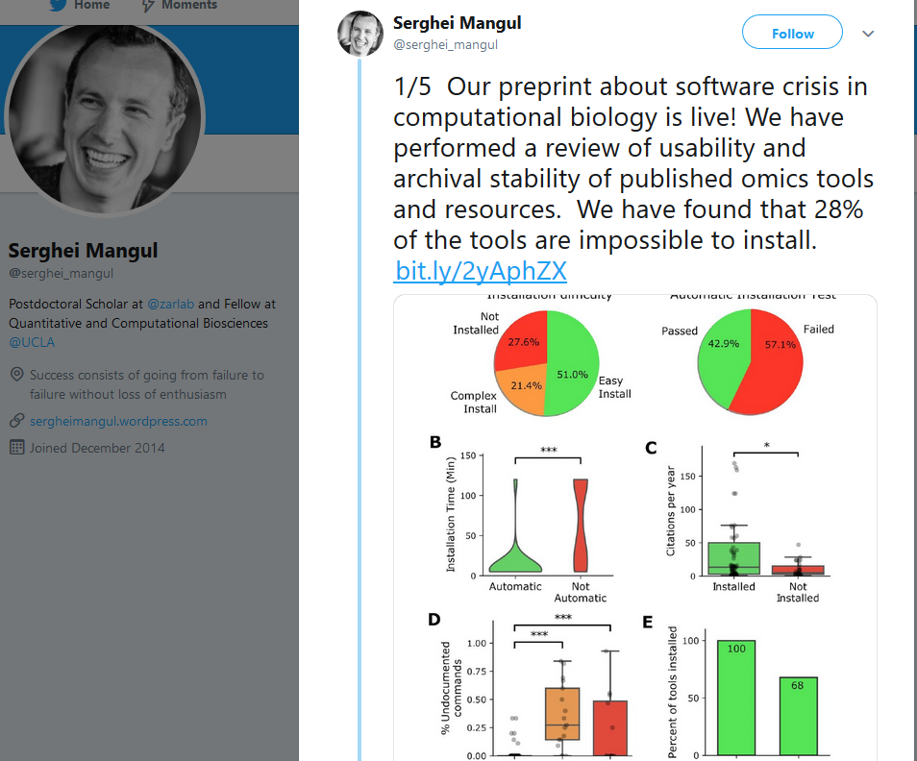
9) Advanced: Installing software:
Please try yourself. This is good for you.
Try conda first (see earlier slides).
If not on conda: read their README
and follow their instructions.. But …
If you need a newer GCC:
Type:
source /opt/rh/devtoolset-6/enable
gcc -v
gcc version 6.3.1 (GCC)

Slide 17
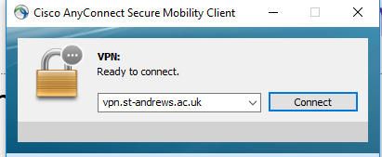
Connecting off site
Use the University VPN connection.
It will ask you for your user name and password. Then you can work as if you are on site.
Students may need to request access from central IT

Slide 18
Coursework
Can you apply all you have learnt (also looking back at the resources) and identify the unknown infections for our patients?
Reads are in : $HOME/Msc_Digital_Health/coursework_reads/
https://github.com/peterthorpe5/Msc_Digital_Health/blob/main/GD5302_Genetics_practical.pdf
Patient | reads | disease_cause
Patient_007 | patient_007_1.fastq.gz | ?
Patient_007 | patient_007_2.fastq.gz | ?
Patient_A | patient_A_1.fastq.gz | ?
Patient_A | patient_A_2.fastq.gz | ?
Patient_B | patient_B_1.fastq.gz | ?
Patient_B | patient_B_2.fastq.gz | ?
Patient_WD40 | patient_WD40_1.fastq.gz | ?
Patient_WD40 | patient_WD40_2.fastq.gz

Slide 19
Once the workshop is over – special extra ☺
Open the folder …

Slide 20

The end
Remember all bioinformatics is, it repeatedly pressing the red button and everything just happens

Slide 21
Appendix: E. coli reads - how I prepared the data
wget ftp://ftp.sra.ebi.ac.uk/vol1/fastq/DRR021/DRR021340/DRR021340_1.fastq.gz
wget ftp://ftp.sra.ebi.ac.uk/vol1/fastq/DRR021/DRR021340/DRR021340_2.fastq.gz
pigz -d *.gzconda activate python27 python Filter_fastq_for_every_nth_sequence.py -i DRR021340_1.fastq -n 50 -o subsampled_R1.fastqpython Filter_fastq_for_every_nth_sequence.py -i DRR021340_2.fastq -n 50 -o subsampled_R2.fastq
python ../scripts/Filter_fastq_for_every_nth_sequence.py -i illumina_R1.fq -n 5 -o subsampled_R1.fastqpython ../scripts/Filter_fastq_for_every_nth_sequence.py -i illumina_R2.fq -n 5 -o subsampled_R2.fastq
pigz *

Slide 22
Vim - command line editor
Command line editing is horrible. Sorry!
Type
vim name_of_file
Press the i key to insert. Now you can delete, type or whatever.
To save: ESC (Key), : then wq

