Slide 1
5) qsub: This is the official way to submit jobs
This is the Sungrid engines approach. https://docs.oracle.com/cd/E19957-01/820-0699/
You may see in other places “sbatch”. This is for queue managing software called Slurm. Slurm is a more modern replacement.
https://slurm.schedmd.com/quickstart.html

Slide 2
5) qsub: lets qsub it so we don’t break the head node.
qsub is basically a queue manager for jobs.
You must qsub your jobs!!! (please don’t run jobs directly at the login node, unless you know they are quick and not demanding)
Full help man qsub
Or https://www.uibk.ac.at/zid/systeme/hpc-systeme/common/tutorials/sge-howto.html
Easiest method is to just:
qsub script.sh (this only asks for a single core!) you need to check how many cores your tools wants to use, or tell it how many to use.

Slide 3
5) qsub: lets qsub it so we don’t break the head node.
In short you can look back at this later.
All you need for now is:
qsub name_of_script.sh

Slide 4

5) qsub: What is qsub doing?
X
Node 1: Full
X
Node 2: NOT enough RAM
Head node: Receives qsub job command from you
X
Node 3: Not enough cores
Node 4: empty
… job runs on here
Node …..
qsub will run jobs depending on the load: Waiting jobs = qw jobs in error state = Eqw dead jobs = d (these error will make sense in a few slides time)

Slide 5
5) qsub: qsub multi cores
ACTIVITY
To ask for multicore job, e.g. 4 cores:
qsub -V -pe multi 4 script.sh
To see the available queues for the cluster type seeq.pl
High memory q
qsub -q highmemory.q -V -pe multi 4 script.sh
Centos7 q
qsub -q centos7.q -V -pe multi 4 script.sh
Is it running? – type:
qstat

Slide 6
5) qsub: Special commands at the top of shell #$
#!/bin/bash
#$ -V # pass all environment variables to the job
#$ -N Mapping # job name
#$ -cwd # Execute from the current working directory
#$ -pe multi 4 # how many core (4)

Slide 7
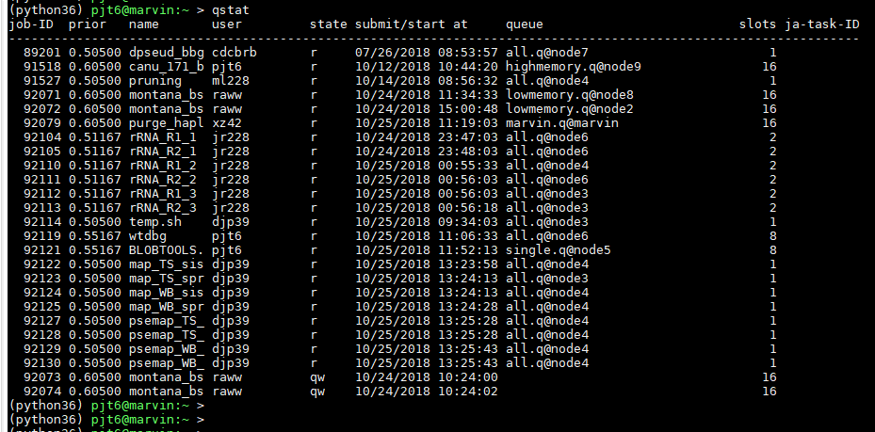
5) qsub: qstat
ACTIVITY
Job ID
Num cores
In queue waiting
waiting: Waiting jobs = qw jobs which are in error state = Eqw dead jobs = d

Slide 8
5) qsub: qsub output files .o and .e files
Each time you run a job you get 2 output file.
.o files have normal output from whatever tool is being used.
.e are errors or warnings. This is useful to track errors and find out why your tool is not working.
TRUST me this will be useful

