Slide 1
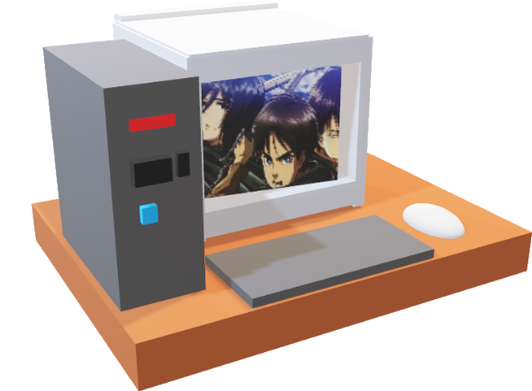
2) Getting connected
Windows:
Putty https://www.putty.org/
WinSCP https://winscp.net/eng/download.php,
Mobaxterm https://mobaxterm.mobatek.net/,
Mac/ Linux:
Cyberduck https://cyberduck.io/
command line
Other programs recommended to have: Filezilla, (Windows: Notepad++, Linux gedit)

Slide 2
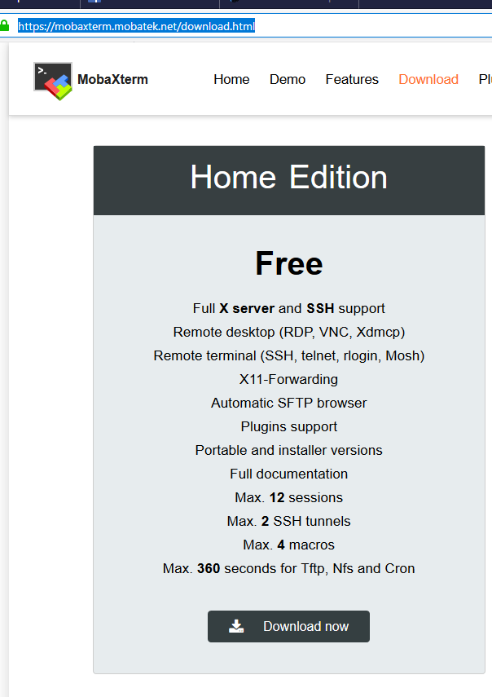
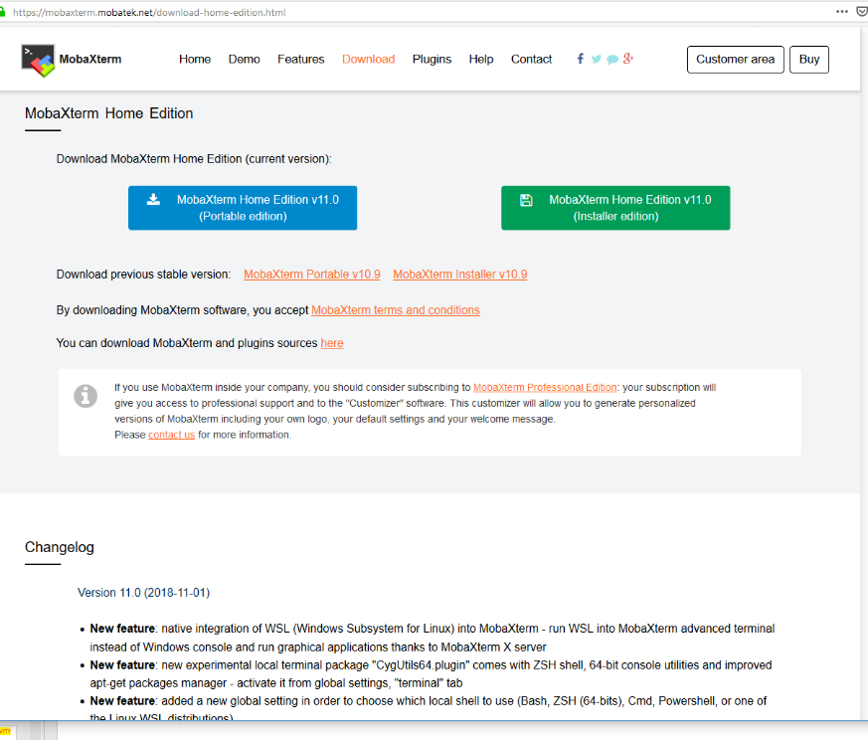
2) Getting connected: Mobaxterm
1
(Without admin access)
3
2

Slide 3
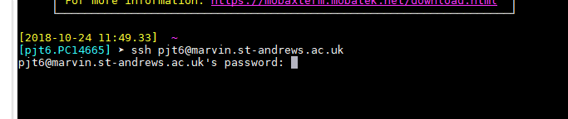
2) Getting connected: Example using Mobaxterm
ACTIVITY
Type: ssh USERNAME@marvin.st-andrews.ac.uk
Then enter your password (when prompted). This is the same way for all the programs.

Slide 4
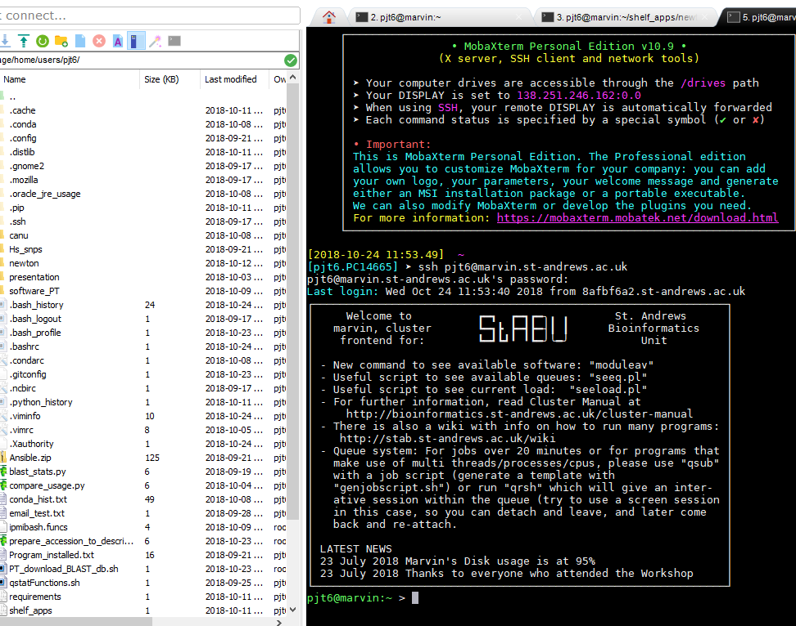
2) Getting connected: You are logged in
You will see your files on the left and a terminal on the right.
You automatically log into your home directory ($HOME, ~)

Slide 5
2) Getting connected: getting the presentation
cp -rv /storage/home/users/Msc_Digital_Health/ ~/
(note it would be better to use sym links for the data, rather than copying it).
Make sure you have the software ready to use (note dot space):
. /shelf/apps/pjt6/conda/etc/profile.d/conda.sh

Slide 6
2) Getting connected: to disconnect
ACTIVITY
Simply close the program down using the red cross
Type: logout
Or ctrl + d

