Slide 1
Genome assembly Workshop
AIM: The main aim of this practical is to identify an unknown sample using DNA sequencing. You
will assemble this DNA sequencing data to generate a genome assembly (a representation of
the genetic code of this organism) and identify what organism it was.

Slide 2
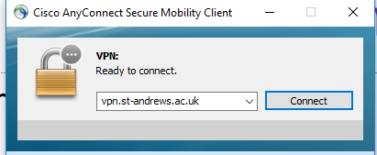
Connecting off site
Use the University VPN connection.
It will ask you for your user name and password. Then you can work as if you are on site.
Students may need to request access from central IT
https://www.st-andrews.ac.uk/it-support/services/internet/vpn/
This requires up to data OS, or the Uni will reject access.

Slide 3
Software that will help you …
All users: Filezilla https://filezilla-project.org/download.php please install this. You can always remove it later.
Windows: Notepad++ (this is the King of Editors). https://notepad-plus-plus.org/downloads/ (This software understand Linux line ending)
Windows (optional): Mobaxterm Home edition (free) https://mobaxterm.mobatek.net/download.html

Slide 4
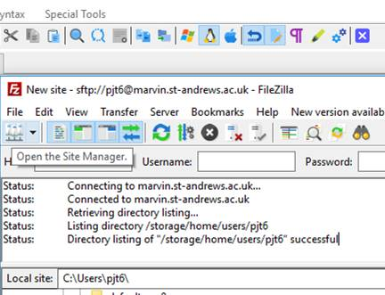
Downloading: transfer files Filezilla https://filezilla-project.org/download.php
Step 1. Open host

Slide 5
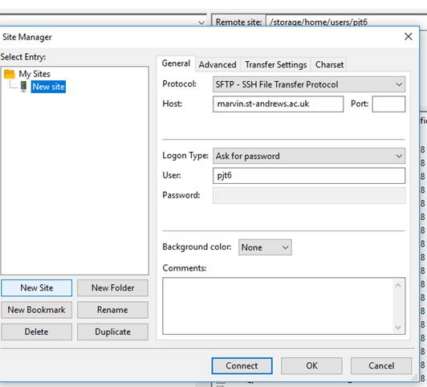
Downloading: transfer files Filezilla
2) When the next dialogue page comes up, click on “new site” (button , not the folder). Change the Protocol to SFTP. This is essential. Fill out the rest, use this host and port: 22.
Once connected, you can drag and drop files from one window to the next.
sfpt

Slide 6
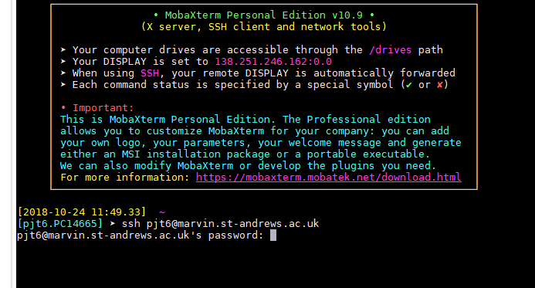
QUICK start - Getting connected:
ACTIVITY
Type: ssh USERNAME@marvin.st-andrews.ac.uk (whatever your username is)
Then enter your password (when prompted). This is the same way for all the terminal programs (Windows/ MAC/ Linux).

Slide 7
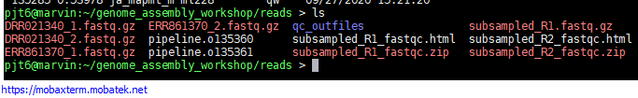
QUICK start: copy paste
Copy: If you highlight (drag over, or double click) something in a terminal – this is now copied to your clipboard.
Paste: this is different for different programs. But Right click, or the middle button on a mouse…

Slide 8
2) Getting connected: getting the files
Paste the following into the terminal to copy all the data to your home directory.
cp -rv /storage/home/users/Msc_Digital_Health/ ~/
Make sure you have the software ready to use (note dot space):
. /shelf/apps/pjt6/conda/etc/profile.d/conda.sh

Slide 9
Get some long jobs running
Submit some jobs to the cluster.
cd into the shell_scripts folder (tab auto complete!!)
cd $HOME/Msc_Digital_Health/shell_scripts
conda activate unicyclerENV
qsub -V unicycler.sh
qsub -V spades.sh

